Slide 1
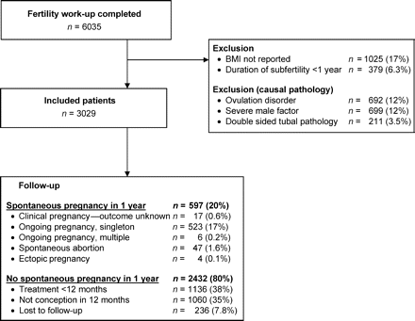
Figure 1: Flow chart
Notes:
Figure 1: Flow chart
Unless provided in the caption above, the following copyright applies to the content of this slide: © The Author 2007. Published by Oxford University Press on behalf of the European Society of Human Reproduction and Embryology. All rights reserved. For Permissions, please email: journals.permissions@oxfordjournals.org

Slide 2
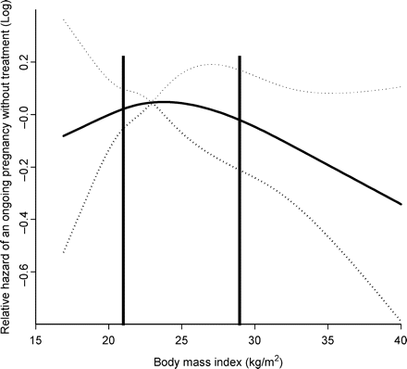
Figure 2: Spline function of the BMI in relation to time to spontaneous ongoing pregnancy. Relative hazard∼HR. Dotted ...
Notes:
Figure 2: Spline function of the BMI in relation to time to spontaneous ongoing pregnancy. Relative hazard∼HR. Dotted lines represent 95% confidence intervals. Vertical lines show the thresholds of 21 and 29 kg/m2. BMIs above 29 kg/m2 were significantly associated with a decreased fecundity, whereas there was a trend below 21 kg/m2
Unless provided in the caption above, the following copyright applies to the content of this slide: © The Author 2007. Published by Oxford University Press on behalf of the European Society of Human Reproduction and Embryology. All rights reserved. For Permissions, please email: journals.permissions@oxfordjournals.org

