Slide 1
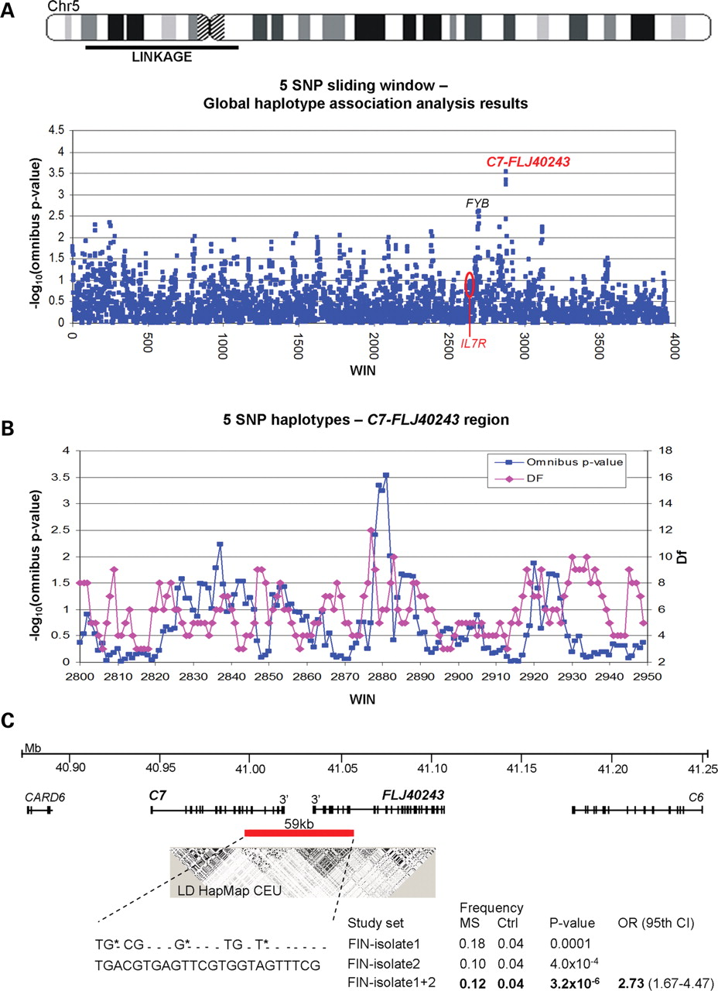
Figure 1. Screen of the linked region on 5p15-q11 utilizing the SNP data of the Finnish MS GWA study and validation of ...
Notes:
Figure 1. Screen of the linked region on 5p15-q11 utilizing the SNP data of the Finnish MS GWA study and validation of the finding. ( A ) A 45 Mb region showing linkage in Finnish MS families was screened with a five SNP haplotype association analysis from the Illumina HumanHap 300 chip genotypes using the sliding window option of the PLINK program. The –log( P -values) for the haplotypes are shown as blue dots. The analysis revealed only one region with omnibus P -values 10 −4 . These haplotype windows map to the C7 and FLJ40243 genes. ( B ) Five SNP sliding window results zoomed to the C7-FLJ40243 region. Number of degrees of freedom (df) is given to illustrate the recombination spots, which flank the four associated consecutive five SNP windows. The haplotype showing strongest evidence for association was extended with PLINK to both orientations until reaching sites with increased df, resulting to an eight SNP haplotype covering one haplotype block in the Finnish isolate. ( C ) The critical region, extending from 3′ end of C7 to 3′ end of FLJ40243 , was further covered with 24 HapMap tagging SNPs, which were genotyped in an independent case–control set from the high-risk region. The original finding was validated. To estimate the effect size of the 59 kb risk haplotype identified, an OR was calculated for the combined study set from the high-risk region. Alleles of the original eight SNP haplotype (rs324058, rs8264 and rs10512754), which correspond ( r2 = 1) to the tagging SNPs (rs324061, rs7732104 and rs3817324), are marked with asterisks. LD between the SNPs flanking the C7 and FLJ40243 genes was measured using Haploview and publicly available genotype data of CEPH individuals of European origin (CEU). Positions are obtained from the UCSC Genome Browser, hg18 assembly, March 2006.
Unless provided in the caption above, the following copyright applies to the content of this slide: © The Author 2009. Published by Oxford University Press. All rights reserved. For Permissions, please email: journals.permissions@oxfordjournals.org

Slide 2
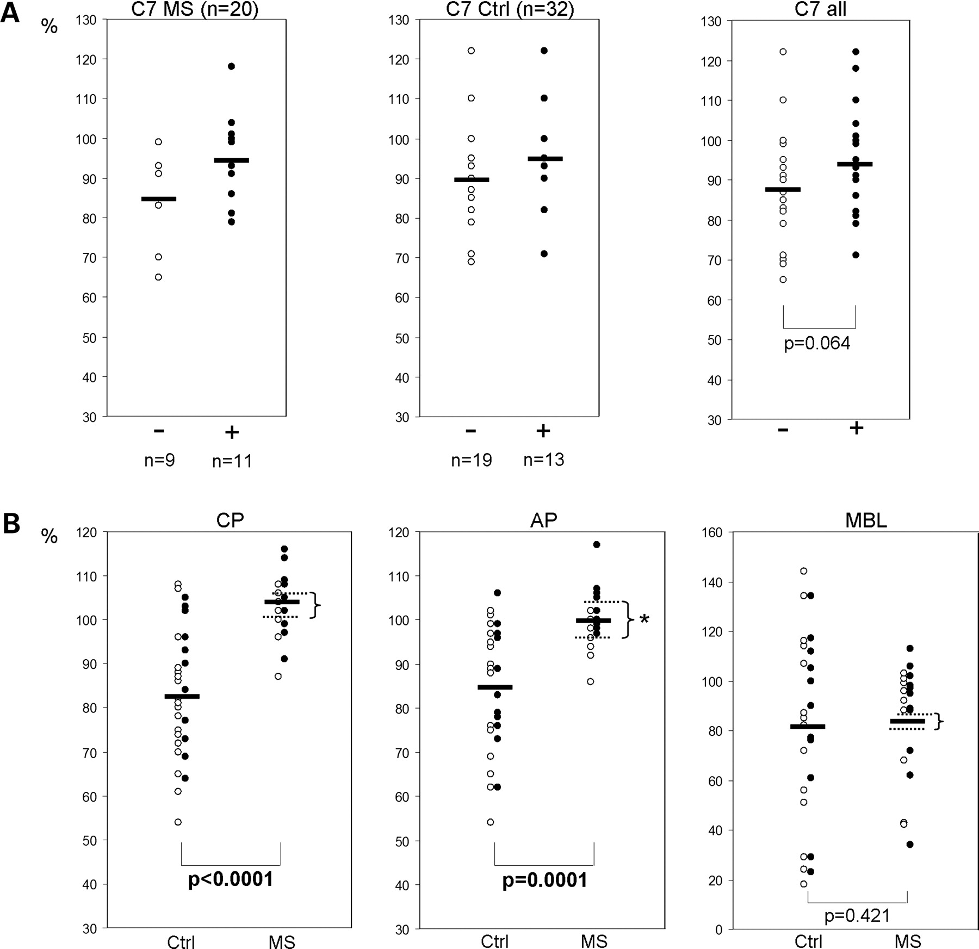
Figure 2. C7 protein levels and the amount of formed TCC following complement activation C7 protein levels and total ...
Notes:
Figure 2. C7 protein levels and the amount of formed TCC following complement activation C7 protein levels and total complement activity were measured in 20 Finnish MS cases (MS) and in 32 unaffected Finnish controls (Ctrl). Eleven of the cases and 13 of the controls were known to carry the C7-FLJ40243 risk haplotype, whereas 9 of the MS cases and 19 of the controls did not carry the risk allele. The dots indicate individual values, whereas the horizontal lines indicate the mean value of each group. P -values were calculated with the non-parametric Mann–Whitney U test. ( A ) Plasma complement component 7 protein levels (C7, measured with radial immunodiffusion) were noticed to be consistently higher in carriers of the risk haplotype (+, black dots) compared with non-carriers (−, open dots). However, the difference was not statistically significant in this relatively small study sample. Reference range: 80–120%. ( B ) Amount of serum terminal complement complexes (TCC, C5b–C9, measures with ELISA), formed as a consequence of the activation of each (classical = CP, alternative = AP, lectin = MBL) pathway, was observed to be higher in MS patients compared with controls. Reference values: CP > 60%, AP > 40%, MBL > 10%. Carriers of the risk allele are indicated with black dots and the non-carriers with open dots. The complement system was most active in MS cases carrying the identified C7-FLJ40243 risk allele. The star (*) indicates the statistically significant difference between the mean values of the carriers (upper dashed line) and non-carriers (lower dashed line) of the risk haplotype identified to be enriched in the MS high-risk region.
Unless provided in the caption above, the following copyright applies to the content of this slide: © The Author 2009. Published by Oxford University Press. All rights reserved. For Permissions, please email: journals.permissions@oxfordjournals.org

Slide 3
Figure 3. Effect of the C7-FLJ40243 and IL7R risk alleles on MS predisposition. Y -axis refers to the proportion (%) ...
Notes:
Figure 3. Effect of the C7-FLJ40243 and IL7R risk alleles on MS predisposition. Y -axis refers to the proportion (%) of the MS cases among all the individuals of the study set (cases and controls) carrying a certain number of the IL7R (0, 1 or 2 copies) and C7-FLJ40243 (0 or 1 copies) risk alleles. The population-specific C7-FLJ40243 risk allele was selected according to the association results in Table 3 . The absolute number of the MS cases in each risk group is shown within the bars in parenthesis. Groups with two copies of the C7-FLJ40243 risk alleles were excluded from the analysis due to the small number of individuals. IL7R genotypes were not available for the study sets from Norway and USA, thus, these samples were not included in the analysis. ( A ) Southern Ostrobothnia high-risk region. ( B ) Two study sets from more heterogeneous population, Finland outside the high-risk region and Sweden, combined.
Unless provided in the caption above, the following copyright applies to the content of this slide: © The Author 2009. Published by Oxford University Press. All rights reserved. For Permissions, please email: journals.permissions@oxfordjournals.org

