Slide 1
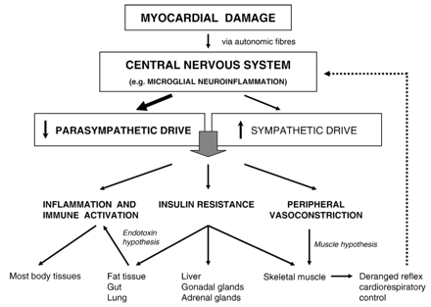
Fig. 1 Depiction of hypothetical mechanisms linking centrally depleted parasympathetic drive due to myocardial ...
Notes:
Fig. 1 Depiction of hypothetical mechanisms linking centrally depleted parasympathetic drive due to myocardial damage with the progression of chronic heart failure.
Unless provided in the caption above, the following copyright applies to the content of this slide: Copyright © 2006, European Society of Cardiology

