Slide 1
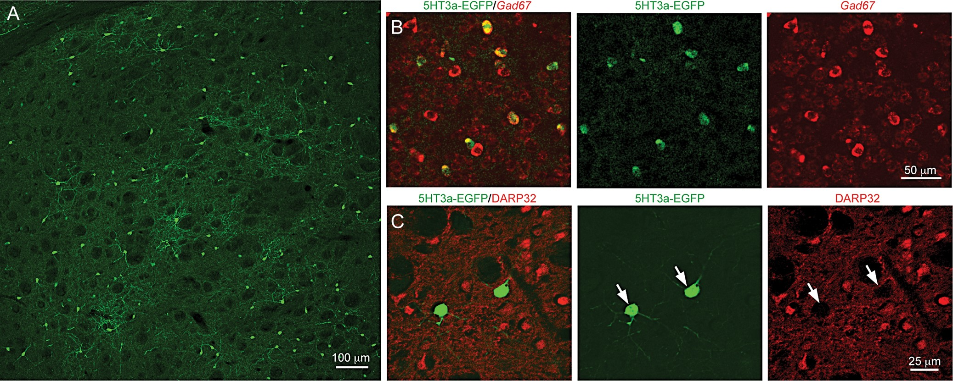
Figure 1. 5HT3a^{EGFP} mouse labels a population of striatal GABAergic interneurons. (A) Immunofluorescence for ...
Notes:
Figure 1. 5HT3aEGFP mouse labels a population of striatal GABAergic interneurons. (A) Immunofluorescence for EGFP shows the dorsolateral striatal 5HT3aEGFP-expressing population. (B) Double immunohistochemistry for EGFP and in situ hybridization for Gad67, respectively. Note that all 5HT3aEGFP cells are also Gad67 positive. (C) Double immunohistochemical staining for medium-sized spiny neuron (MSN) marker DARPP32 and EGFP show that cells labeled in the 5HT3aEGFP mouse are not MSN cells.
Unless provided in the caption above, the following copyright applies to the content of this slide: © The Author 2014. Published by Oxford University Press. All rights reserved. For Permissions, please e-mail: journals.permissions@oup.com

Slide 2
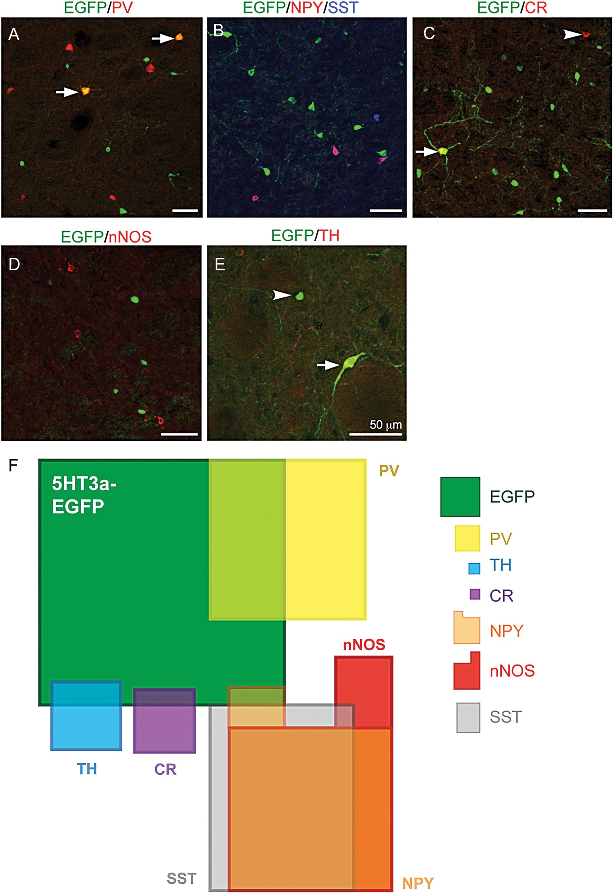
Figure 2. A majority of striatal 5HT3a^{EGFP} cells do not overlap with known interneuron markers. (A–E) Double ...
Notes:
Figure 2. A majority of striatal 5HT3aEGFP cells do not overlap with known interneuron markers. (A–E) Double and triple immunohistochemical staining of the dorsolateral striatal 5HT3aEGFP population for EGFP and (A) PV, (B) NPY and SST (NPY/SST), (C) CR, (D) nNOS, and (E) TH (in a 6-OHDA-lesioned striatum). Arrows and arrowheads mark double-positive neurons and single-positive neurons, respectively. (F) A schematic of the populations expressing known striatal interneuron markers including those labeled in the 5HT3aEGFP mouse. The area of each box, including all overlaps, is proportional to the relative contributions found in our study (see Table 1 for detailed description). On the right side is the legend showing the relative size, color and shape of the described cell populations in the map.
Unless provided in the caption above, the following copyright applies to the content of this slide: © The Author 2014. Published by Oxford University Press. All rights reserved. For Permissions, please e-mail: journals.permissions@oup.com

Slide 3
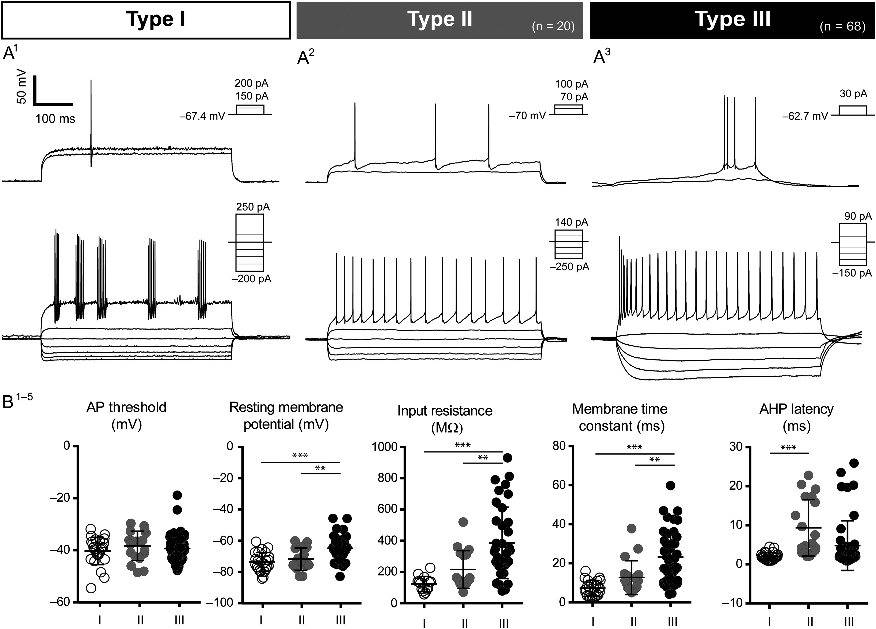
Figure 3. Electrophysiological profiles of 5HT3a^{EGFP} cells. Three distinct subtypes were discovered within ...
Notes:
Figure 3. Electrophysiological profiles of 5HT3aEGFP cells. Three distinct subtypes were discovered within the 5HT3aEGFP population. Type 1 cells exhibited properties typical of FS cells, with short AP half-widths and fast and deep AHPs (A1). Type II cells were very similar to the previously described NGF cells, both in terms of physiology and morphology (A2). Type III cells (A3) formed the largest subgroup and was also the most heterogeneous, exhibiting a range of specific features not seen in the other 2 groups. Multivariate ANOVAs and post hoc multiple comparisons demonstrated that a number of measured parameters were able to differentiate the 3 subgroups successfully. While the threshold for AP activation did not differ between groups (B1), Type III cells had significantly different RMP s, membrane time constants, and input resistances, compared with both Type I and II cells (B2–4). The features that best distinguished Type I and Type II cells were related to temporal properties of AP discharge, for example, Type II cells exhibited longer AHP latencies than did Type I cells (B5).
Unless provided in the caption above, the following copyright applies to the content of this slide: © The Author 2014. Published by Oxford University Press. All rights reserved. For Permissions, please e-mail: journals.permissions@oup.com

Slide 4
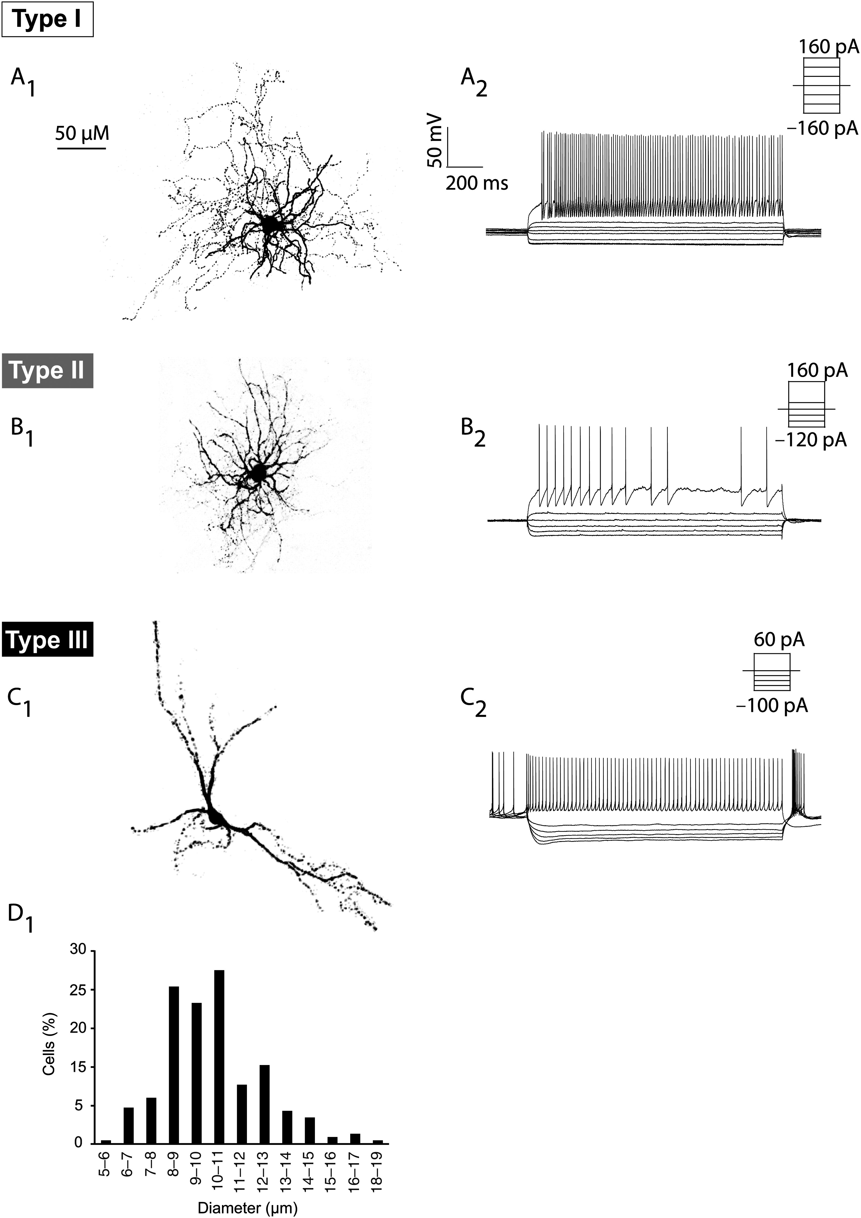
Figure 4. Morphology of the 5HT3a^{EGFP} interneuron subtypes. Examples of different morphologies of ...
Notes:
Figure 4. Morphology of the 5HT3aEGFP interneuron subtypes. Examples of different morphologies of 5HT3aEGFP gINs (A1–C1) and their corresponding electrophysiological recordings (A2–C2). (A) Type I interneurons had medium-sized somas and compact dendritic and axonal branching (A1) and exhibited typical FS properties (A2). (B) A LS-NGF cell (Type II) exhibiting a typical NGF morphology with dense and extensive dendritic branching close to the soma (B1). These cells exhibited some characteristics similar to FS cells, but had a larger input resistance and pronounced intraspike interval adaptation (B2). (C) An example of a Type III cell with spontaneous activity and a pronounced sag, which exhibited morphology with 2–3 main dendrites and a longitudinally stretched out dendritic tree. (D) The soma size of EGFP+ cells was quantified to demonstrate their medium-size and diversity.
Unless provided in the caption above, the following copyright applies to the content of this slide: © The Author 2014. Published by Oxford University Press. All rights reserved. For Permissions, please e-mail: journals.permissions@oup.com

Slide 5
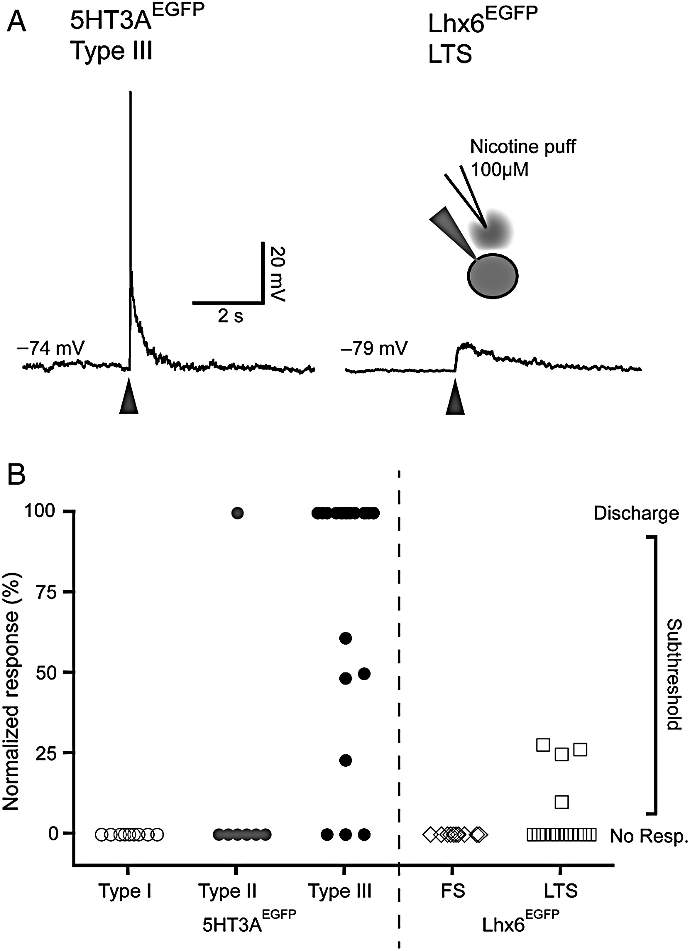
Figure 5. Type III 5HT3a^{EGFP} interneurons are robustly activated by nicotine. (A) Representative traces of ...
Notes:
Figure 5. Type III 5HT3aEGFP interneurons are robustly activated by nicotine. (A) Representative traces of responses to puffing with 100 μM nicotine ditartate on a Type I 5HT3aEGFP cell (left) and a Lhx6EGFP LTS cell (right). (B) Graph representing the normalized response to nicotine puffing in the different cell types labeled in 5HT3aEGFP and Lhx6EGFP mice. Peak of responses were scaled between RMP (0%) and threshold (100%), meaning that any cell that fired in response to puffing was 100%. Note that a majority of 5HT3aEGFP Type III cells responded strongly, while only scattered responses was seen in some other cell types.
Unless provided in the caption above, the following copyright applies to the content of this slide: © The Author 2014. Published by Oxford University Press. All rights reserved. For Permissions, please e-mail: journals.permissions@oup.com

