Slide 1
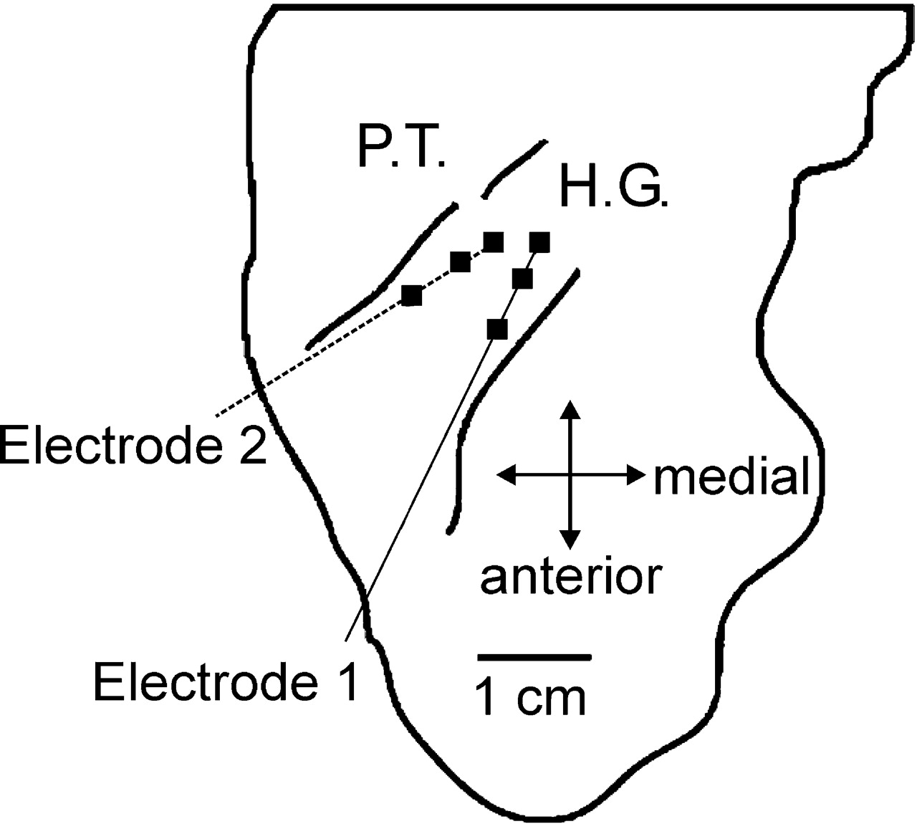
Figure 1. Schematic diagram of the superior surface of the superior temporal gyrus illustrating the locations of the ...
Notes:
Figure 1. Schematic diagram of the superior surface of the superior temporal gyrus illustrating the locations of the two intracortical electrodes used in the study. Electrode locations were reconstructed from magnetic resonance images. Electrode 1 was located in the anterior portion of Heschl's gyrus and within primary auditory cortex. Electrode 2 was located in the posterior portion of Heschl's gyrus at the border with the planum temporale. Recordings were made from three sites on each electrode. The most medial recording sites on each electrode were low-impedance contacts, while the other sites were higher impedance contacts embedded into the shafts of the electrodes.
Unless provided in the caption above, the following copyright applies to the content of this slide: Cerebral Cortex V 15 N 2 © Oxford University Press 2005; all rights reserved

Slide 2
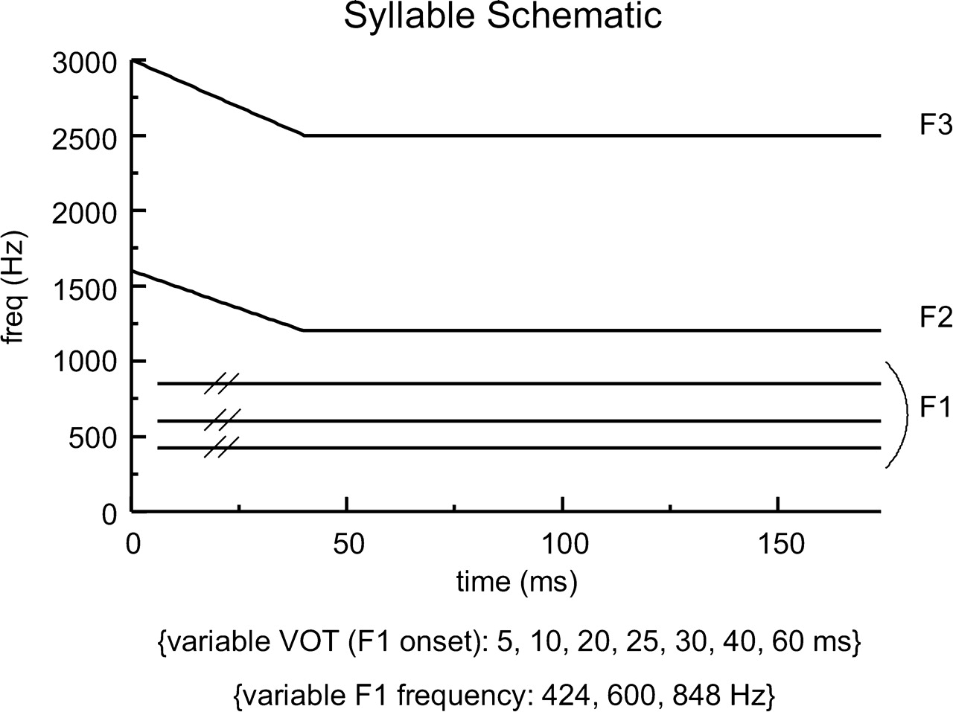
Figure 2. Schematic diagram of the synthetic syllables presented to the subject. Syllables consisted of three formants ...
Notes:
Figure 2. Schematic diagram of the synthetic syllables presented to the subject. Syllables consisted of three formants and contained identical second (F2) and third (F3) formants. Three first (F1) formants without formant transitions were co-varied with seven VOT values, producing a total of 21 stimuli presented to the patient. See text for details.
Unless provided in the caption above, the following copyright applies to the content of this slide: Cerebral Cortex V 15 N 2 © Oxford University Press 2005; all rights reserved

Slide 3
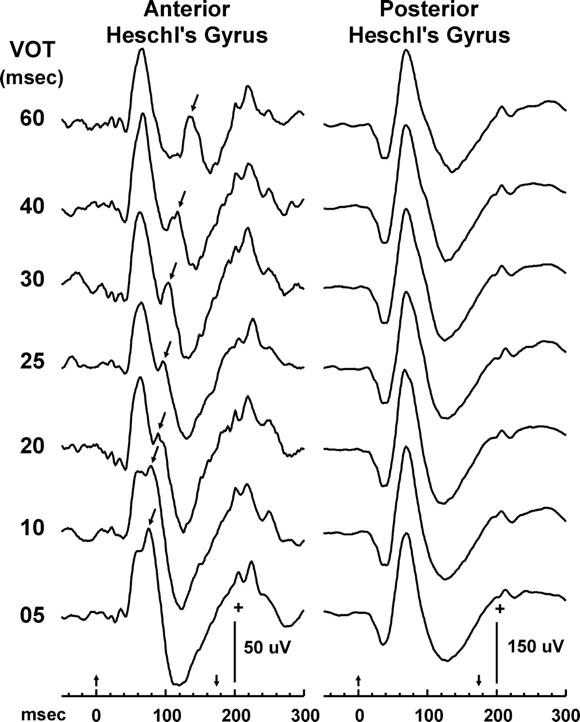
Figure 3. AEP response patterns evoked by the syllables differ between the two recording electrodes located in the ...
Notes:
Figure 3. AEP response patterns evoked by the syllables differ between the two recording electrodes located in the anterior and posterior portions of Heschl's gyrus. Responses evoked at the three recording sites on each electrode and for each of the three F1 conditions have been averaged together to illustrate the effect of electrode location on the temporal activity patterns. Activity patterns are segregated according to the VOT of the syllables. AEPs recorded from the anterior electrode contain responses evoked by both consonant release and by voicing onset (arrows). Responses evoked by voicing markedly decrease in amplitude at VOT values of <30 ms and merge with the initial response component evoked by consonant release. In contrast, AEPs recorded from the more posterior electrode fail to exhibit a response component elicited by voicing onset at any VOT value. This absence occurs despite a threefold increase in overall amplitude of the AEPs relative to those recorded from the more anterior electrode.
Unless provided in the caption above, the following copyright applies to the content of this slide: Cerebral Cortex V 15 N 2 © Oxford University Press 2005; all rights reserved

Slide 4
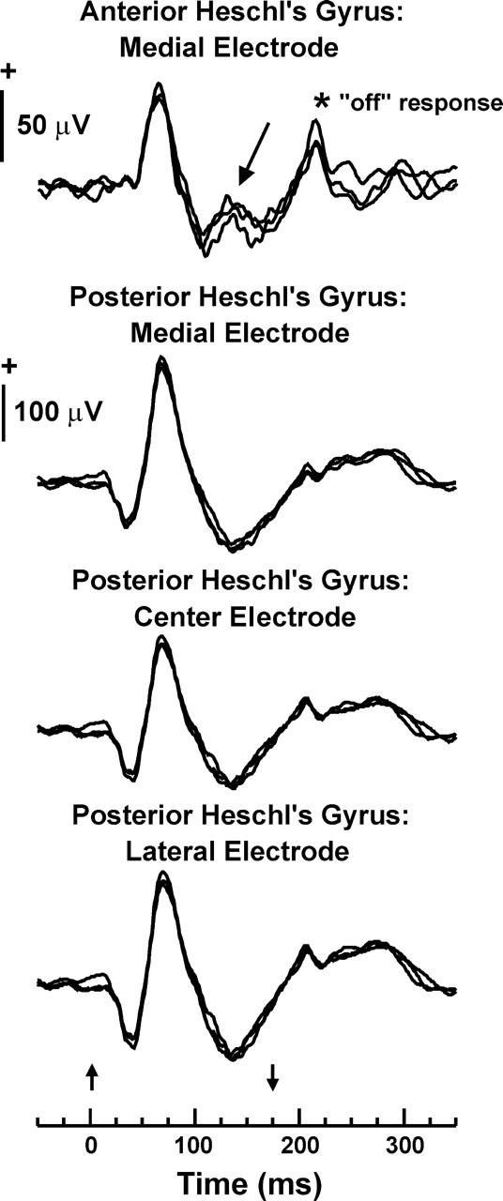
Figure 4. AEP response patterns evoked by the syllables with a 60 ms VOT. Responses at the medial electrode site on the ...
Notes:
Figure 4. AEP response patterns evoked by the syllables with a 60 ms VOT. Responses at the medial electrode site on the anterior Heschl's gyrus electrode and all three sites on the posterior Heschl's gyrus electrode are shown. AEPs evoked by the syllables with the three F1 conditions are shown as overlapping waveforms. See text for details.
Unless provided in the caption above, the following copyright applies to the content of this slide: Cerebral Cortex V 15 N 2 © Oxford University Press 2005; all rights reserved

Slide 5
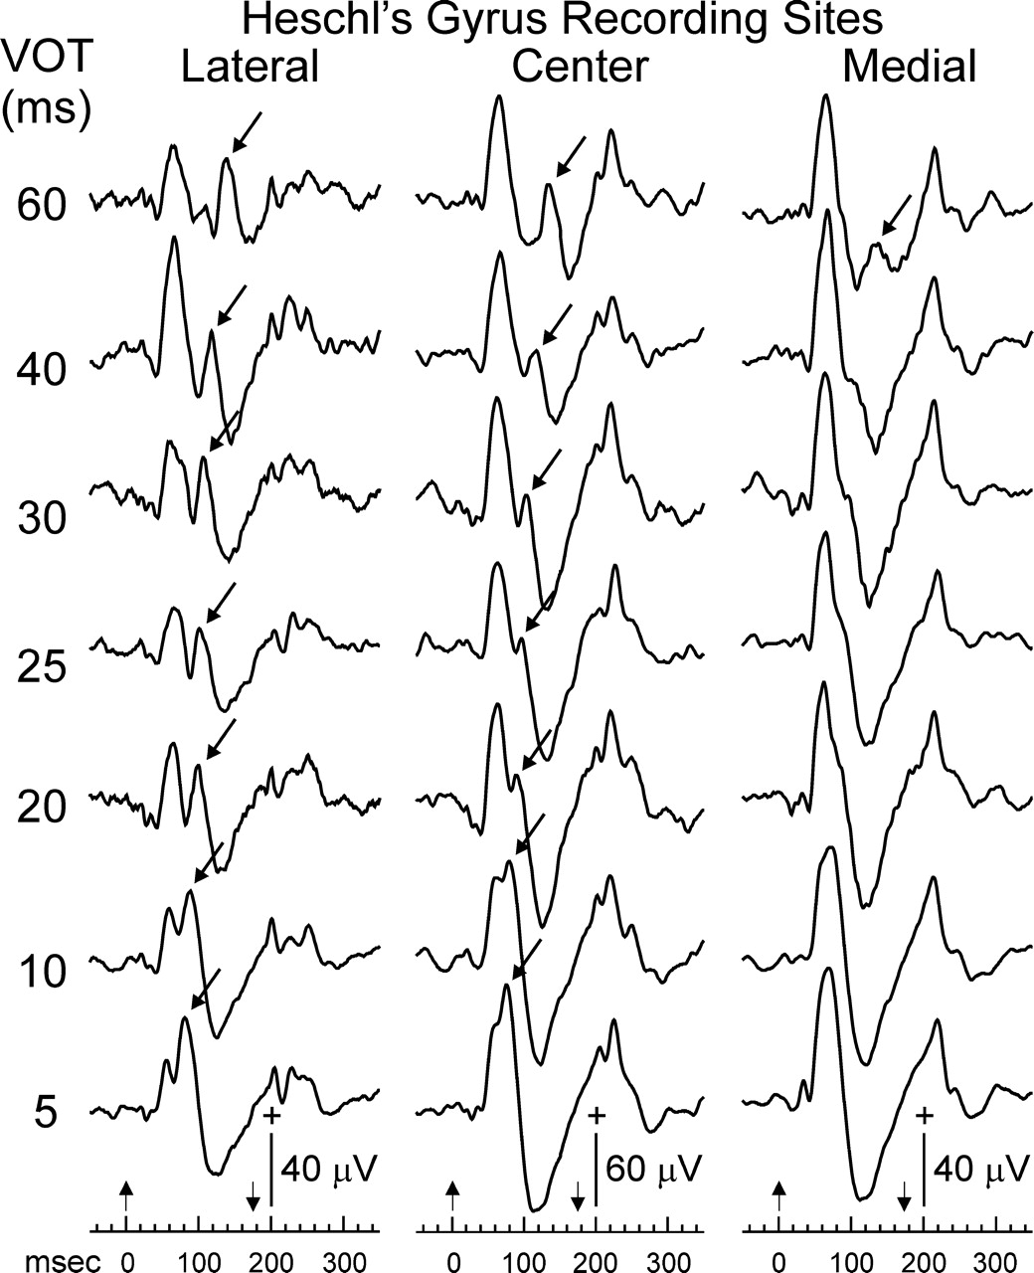
Figure 5. AEP response patterns evoked by the syllables systematically vary with recording site along the anterior ...
Notes:
Figure 5. AEP response patterns evoked by the syllables systematically vary with recording site along the anterior Heschl's gyrus electrode. Responses evoked by the three F1 conditions have been averaged together to illustrate the effect of electrode location on the temporal activity patterns. AEPs recorded from the lateral electrode site contain responses time-locked to voicing onset for all VOT values (arrows), while responses at the medial site contain a time-locked burst evoked by voicing onset for only the syllables with a VOT of 60 ms. Responses recorded from the center electrode display an intermediate capacity to respond to voicing onset.
Unless provided in the caption above, the following copyright applies to the content of this slide: Cerebral Cortex V 15 N 2 © Oxford University Press 2005; all rights reserved

Slide 6
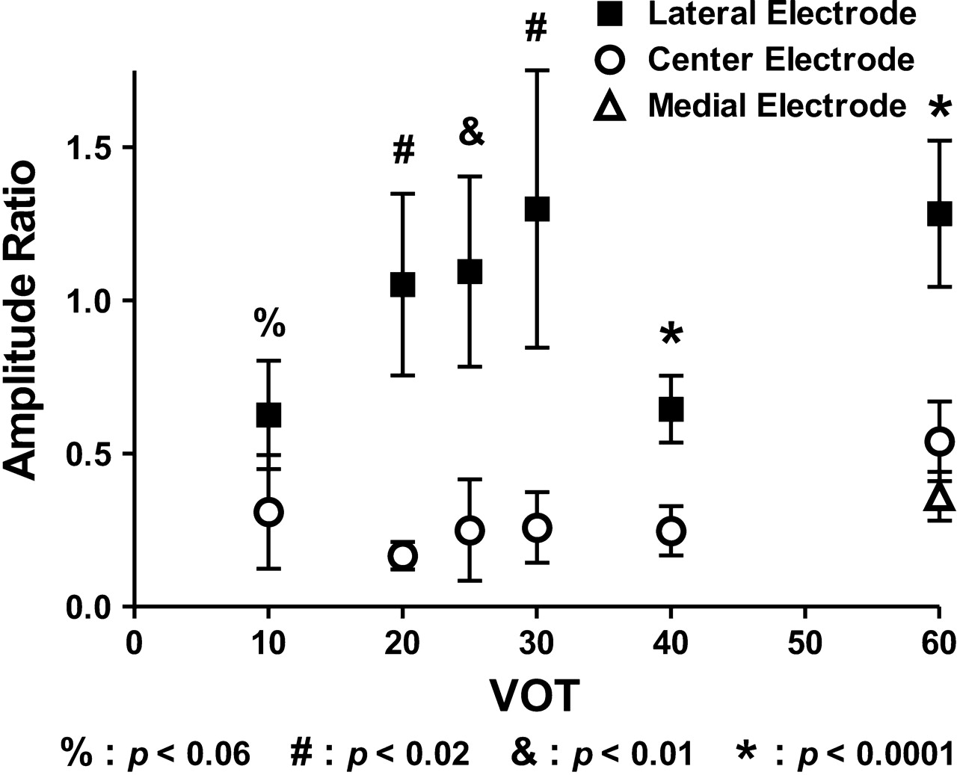
Figure 6. Amplitude ratios of the responses evoked by voicing onset relative to that of consonant release for VOTs of ...
Notes:
Figure 6. Amplitude ratios of the responses evoked by voicing onset relative to that of consonant release for VOTs of 10–60 ms. Comparisons are between the lateral and center recording sites on the anterior electrode for VOTs of 10–40 ms, and between all recording sites for the VOT of 60 ms. P values are derived from a series of t-tests for the former comparisons, and a one-way ANOVA for the latter comparison. See text for details. The apparent decrease in the response ratio at the lateral site when VOT was 40 ms reflects an exceptionally large initial positivity that occurred for unclear, and probably spurious, reasons.
Unless provided in the caption above, the following copyright applies to the content of this slide: Cerebral Cortex V 15 N 2 © Oxford University Press 2005; all rights reserved

Slide 7
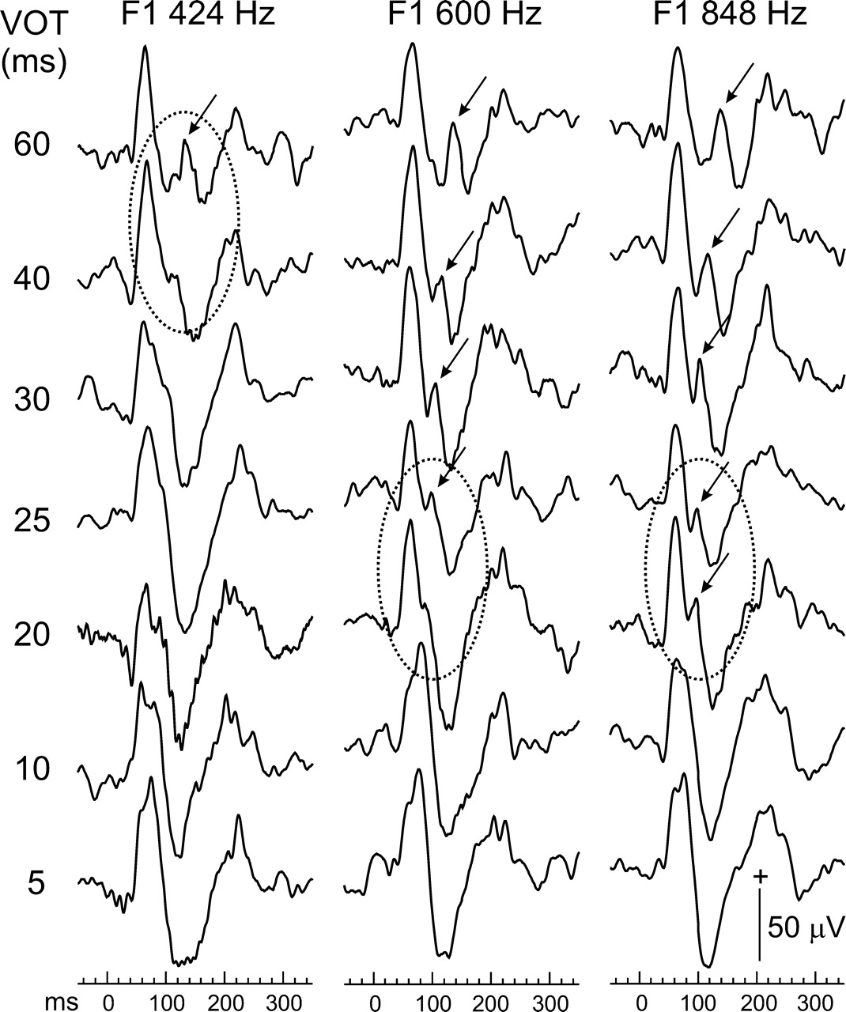
Figure 7. Responses recorded from the anterior Heschl's gyrus electrode are modulated by F1 frequency in a manner that ...
Notes:
Figure 7. Responses recorded from the anterior Heschl's gyrus electrode are modulated by F1 frequency in a manner that parallels the patient's perceptual boundaries between /d/ and /t/. AEPs recorded from the three electrode sites have been averaged together to illustrate the effect of F1 frequency on the temporal response patterns. Ovals superimposed on the waveforms indicate the perceptual boundaries. See text for details.
Unless provided in the caption above, the following copyright applies to the content of this slide: Cerebral Cortex V 15 N 2 © Oxford University Press 2005; all rights reserved

Slide 8
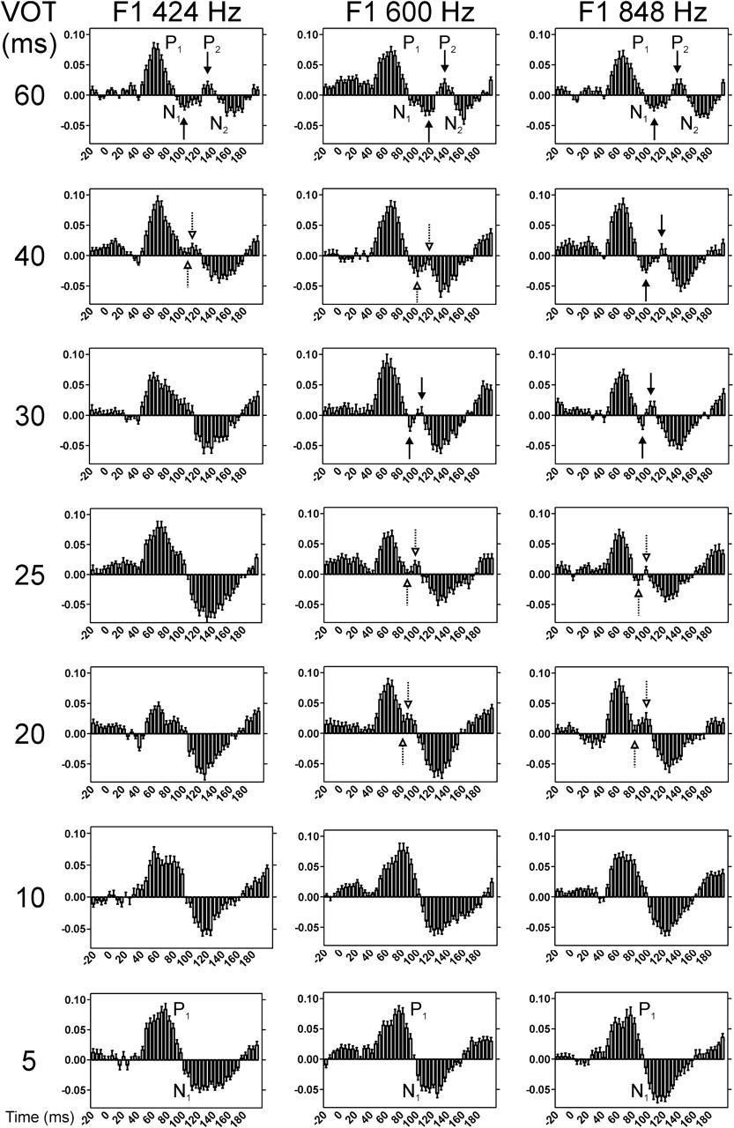
Figure 8. Responses recorded from the anterior electrode binned in 5 ms increments according to maximum values within ...
Notes:
Figure 8. Responses recorded from the anterior electrode binned in 5 ms increments according to maximum values within the bins. Means and standard errors are shown for the responses from 20 ms prior to stimulus onset to 200 ms post-stimulus onset. AEPs from the three recording sites are averaged together for each F1 condition and at each VOT. See text for details.
Unless provided in the caption above, the following copyright applies to the content of this slide: Cerebral Cortex V 15 N 2 © Oxford University Press 2005; all rights reserved

Slide 9
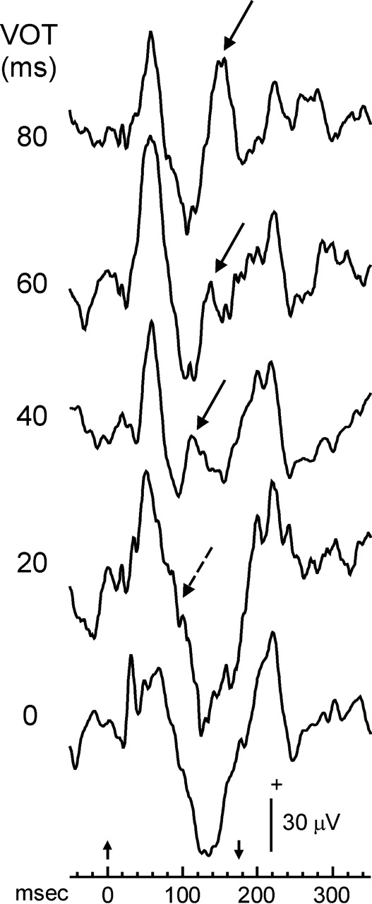
Figure 9. AEPs averaged across the three recording sites on the anterior Heschl's gyrus electrode and elicited by the ...
Notes:
Figure 9. AEPs averaged across the three recording sites on the anterior Heschl's gyrus electrode and elicited by the /da/-/ta/ series previously reported for speech-evoked Heschl's gyrus activity (Steinschneider et al., 1999). The patient heard the syllables with a VOT of 0 and 20 ms as /da/, and those with higher VOTs as /ta/. Responses evoked by voicing onset are only observed for the /ta/ stimuli (solid arrows). The dotted arrow overlying the waveform evoked by /da/ with the 20 ms VOT indicates the predicted time for the absent response to voicing onset.
Unless provided in the caption above, the following copyright applies to the content of this slide: Cerebral Cortex V 15 N 2 © Oxford University Press 2005; all rights reserved

Slide 10
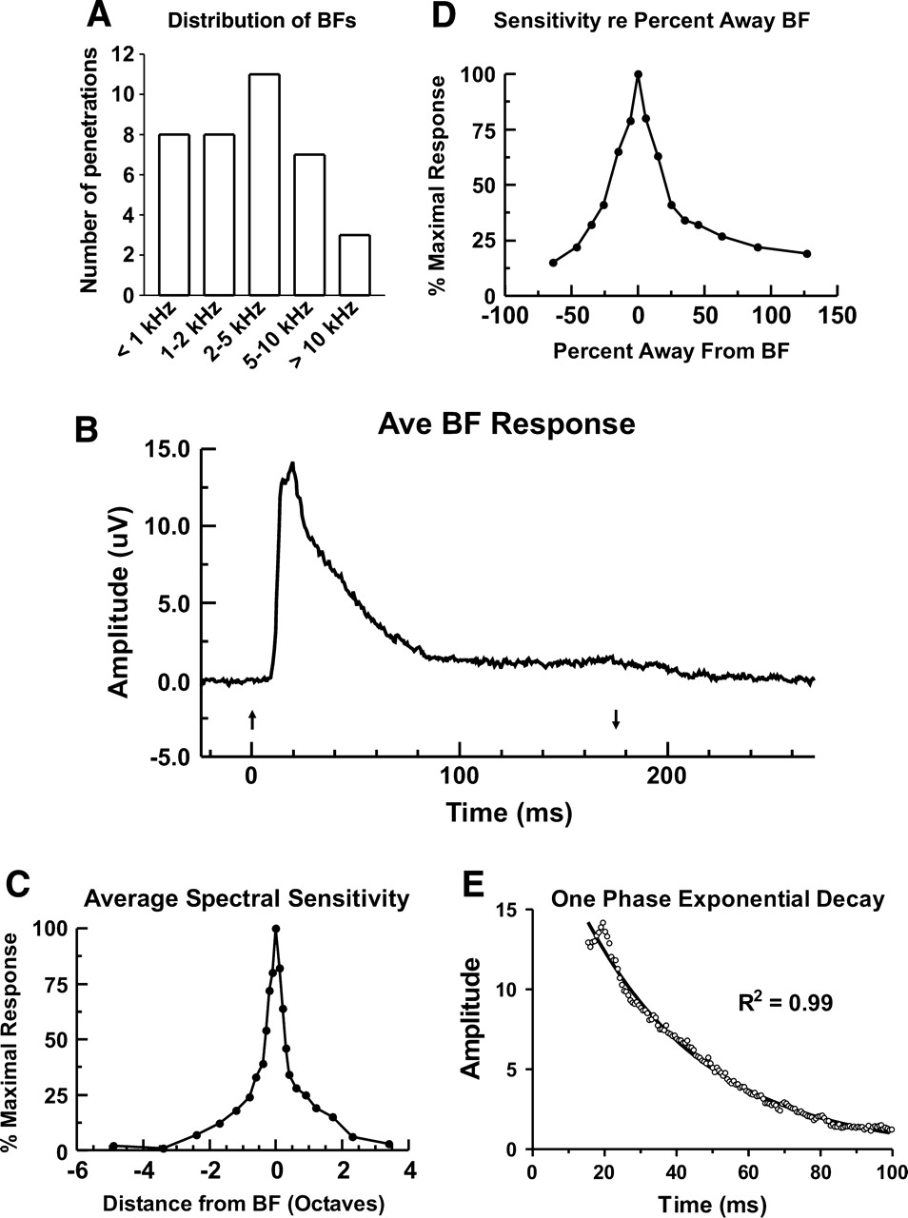
Figure 10. Sample characteristics of MUA in monkey A1. (A) Distribution of BFs for the 37 electrode penetrations. (B) ...
Notes:
Figure 10. Sample characteristics of MUA in monkey A1. (A) Distribution of BFs for the 37 electrode penetrations. (B) Average MUA evoked by BF tones at the 37 recording sites. Onset of activity is ∼10 ms, and is followed by a rapid rise in activity peaking at 15–20 ms and a subsequent decay. (C) Average spectral sensitivity of MUA onset responses to the 60 dB tones, plotted as a function of distance away from the BF in octaves. (D) Average spectral sensitivity of the same responses plotted as a function of percent distance from the BF. (E) Curve fitting for the decay in the MUA BF response using a one phase exponential decay function. Goodness-of-fit has an R2 = 0.99.
Unless provided in the caption above, the following copyright applies to the content of this slide: Cerebral Cortex V 15 N 2 © Oxford University Press 2005; all rights reserved

Slide 11
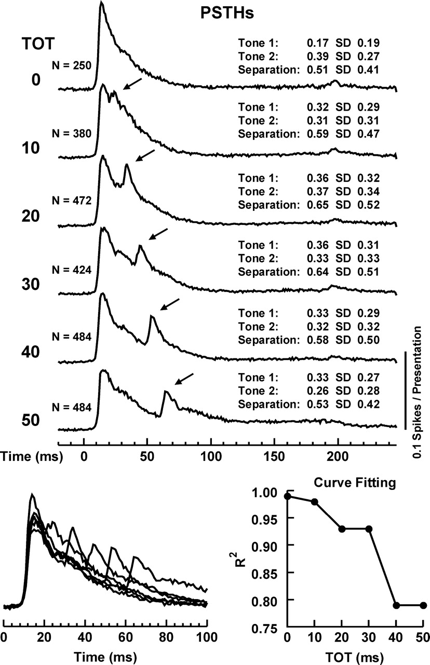
Figure 11. Top: total sample PSTHs evoked by two-tone complexes with variable tone onset times (TOT). Mean and standard ...
Notes:
Figure 11. Top: total sample PSTHs evoked by two-tone complexes with variable tone onset times (TOT). Mean and standard deviations of tone frequencies in terms of octave distance away from the BF of the recording sites, and values for their separation in octaves, are shown for each TOT. Arrows denote responses evoked by the onset of the second tones. Bottom left: superimposed waveforms of the first 100 ms of the PSTHs illustrating the progressively more prolonged responses to the second tone at longer TOTs. Bottom right: graph of goodness-of-fit (R2) values for curve fitting of the first 100 ms of the PSTHs evoked by two-tone complexes using a one phase exponential decay function. See text for details.
Unless provided in the caption above, the following copyright applies to the content of this slide: Cerebral Cortex V 15 N 2 © Oxford University Press 2005; all rights reserved

Slide 12
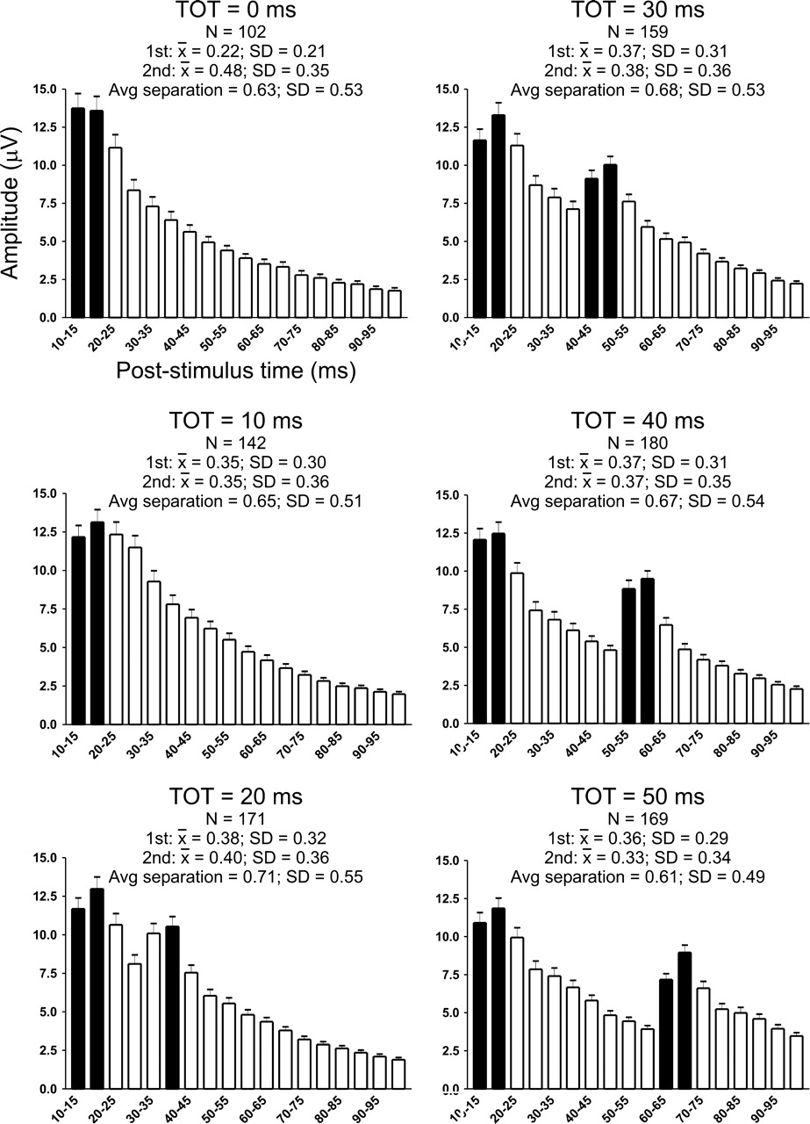
Figure 12. Averaged MUA evoked by the two-tone complexes. Mean and standard deviations of tone frequencies re octave ...
Notes:
Figure 12. Averaged MUA evoked by the two-tone complexes. Mean and standard deviations of tone frequencies re octave distance away from the BF of the recording sites, and values for their separation in octaves, are shown for each TOT. Peak MUA values binned together in 5 ms intervals are shown with the standard error in each time bin. Solid black bars denote responses that are significantly larger than responses occurring 10 ms earlier. The 20 ms TOT is the shortest interval that a response evoked by the second tone is larger than preceding activity. For clarity, activity occurring in the pre-stimulus baseline and during the first 10 ms after stimulus onset is not shown. The average peak activity during this time is ∼1 μV.
Unless provided in the caption above, the following copyright applies to the content of this slide: Cerebral Cortex V 15 N 2 © Oxford University Press 2005; all rights reserved

Slide 13
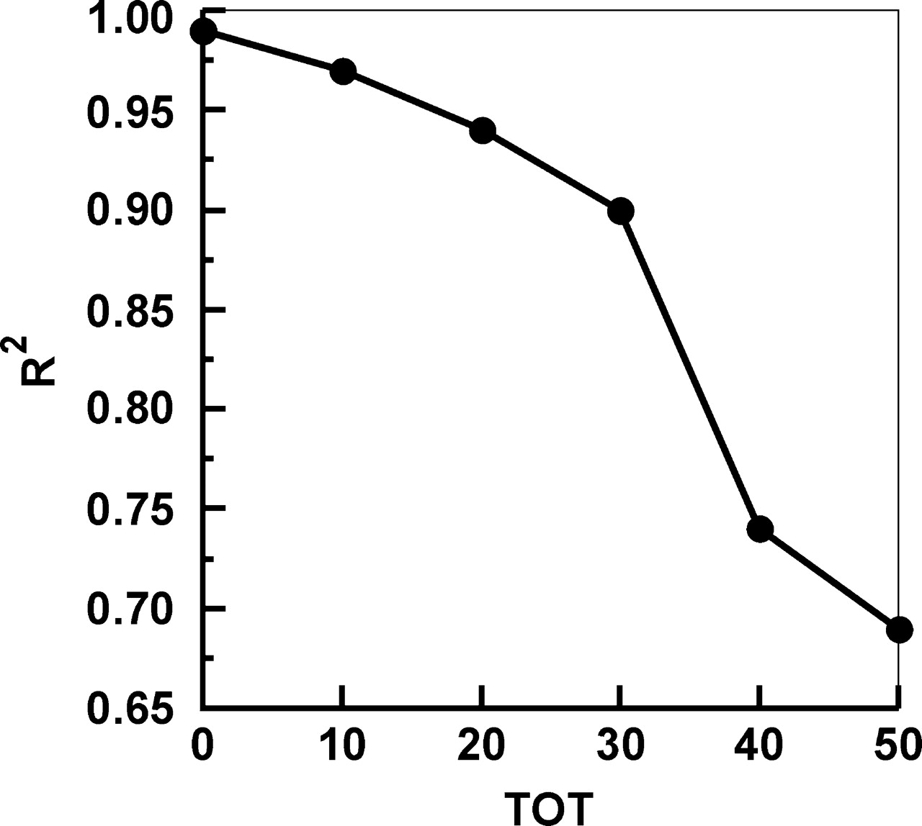
Figure 13. Goodness-of-fit values for curve fitting of the peak MUA responses to a one phase exponential decay ...
Notes:
Figure 13. Goodness-of-fit values for curve fitting of the peak MUA responses to a one phase exponential decay function.
Unless provided in the caption above, the following copyright applies to the content of this slide: Cerebral Cortex V 15 N 2 © Oxford University Press 2005; all rights reserved

Slide 14
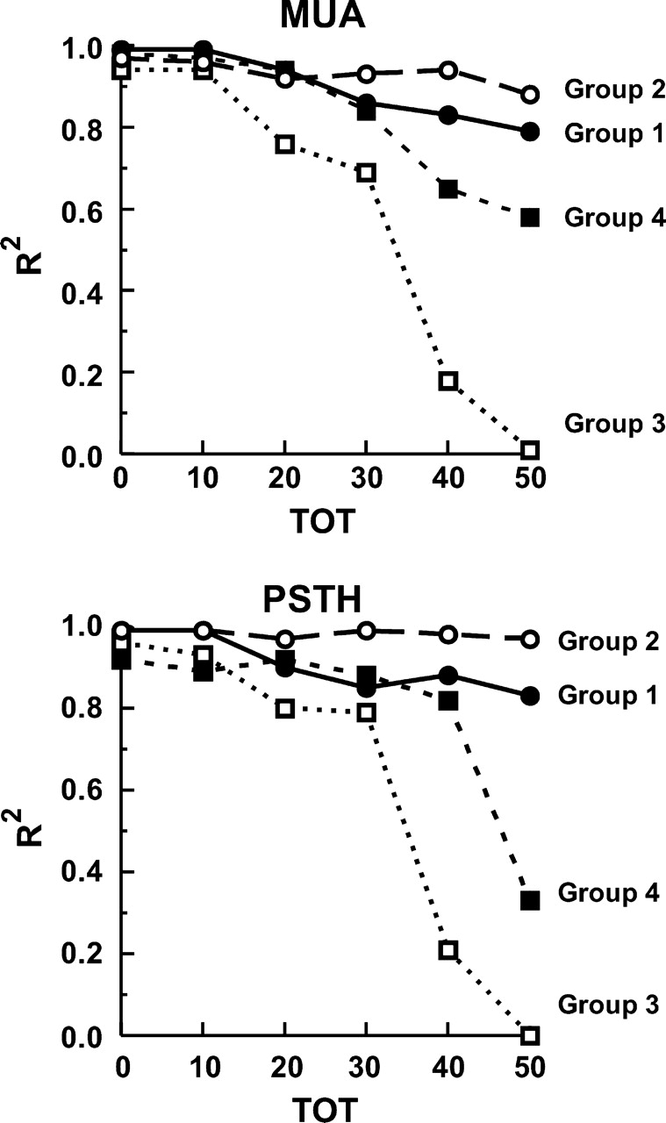
Figure 14. Goodness-of-fit values for curve fitting of the peak MUA responses (top graph) and peak PSTH responses ...
Notes:
Figure 14. Goodness-of-fit values for curve fitting of the peak MUA responses (top graph) and peak PSTH responses (bottom graph) to a one phase exponential decay function. See text for details.
Unless provided in the caption above, the following copyright applies to the content of this slide: Cerebral Cortex V 15 N 2 © Oxford University Press 2005; all rights reserved

