Slide 1
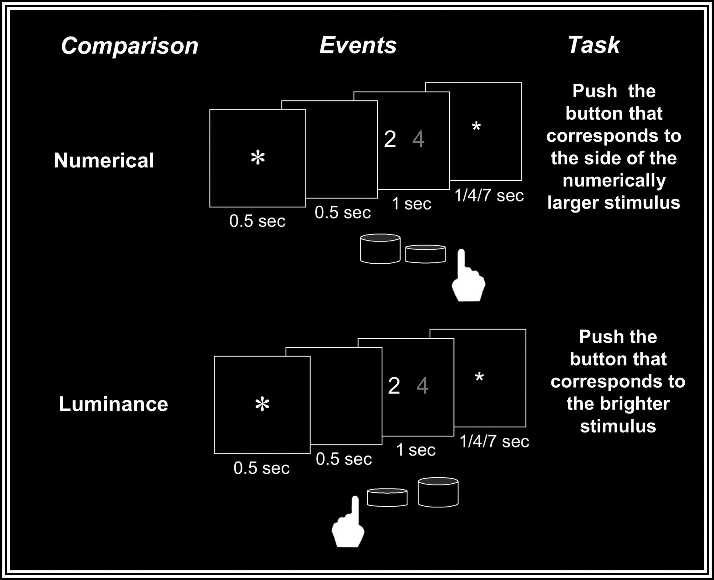
Figure 1. Paradigm design for 2 different tasks containing numerical and luminance comparisons. Each pair of stimuli ...
Notes:
Figure 1. Paradigm design for 2 different tasks containing numerical and luminance comparisons. Each pair of stimuli was preceded by a fixation point and a blank screen (500 ms each) and remained visible for 1 s. After 1, 4, or 7 s (ITI) a new trial began with the presentation of a larger fixation point that indicated the beginning of a new trial. The participants had to decide which stimulus was numerically larger or brighter while ignoring the irrelevant dimension. The correct response was indicated by a button press on the side that corresponded to the larger numerical value (numerical comparison) or brighter stimulus (luminance comparison).
Unless provided in the caption above, the following copyright applies to the content of this slide: © The Author 2007. Published by Oxford University Press. All rights reserved. For permissions, please e-mail: journals.permissions@oxfordjournals.org

Slide 2
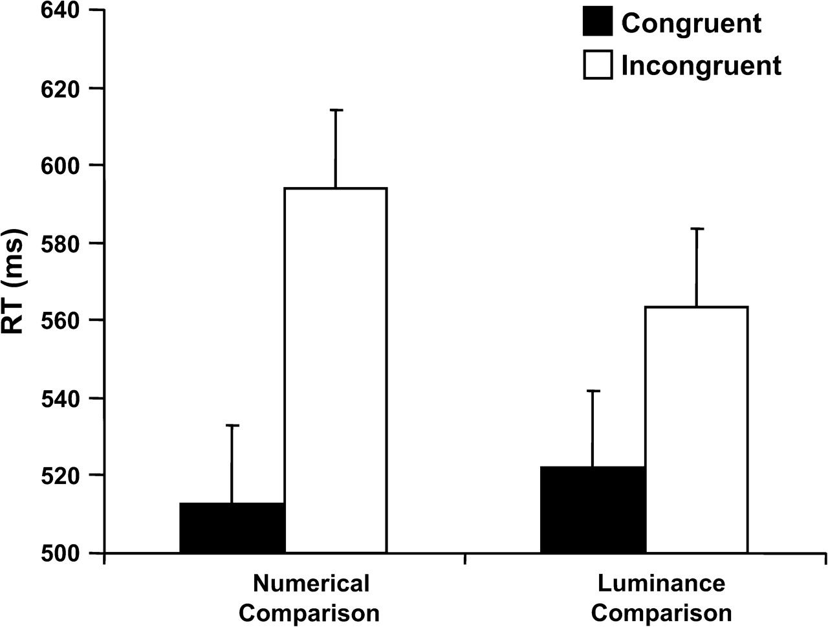
Figure 2. Mean RT as a function of congruity and comparison. Error bars depict one standard error of mean.
Notes:
Figure 2. Mean RT as a function of congruity and comparison. Error bars depict one standard error of mean.
Unless provided in the caption above, the following copyright applies to the content of this slide: © The Author 2007. Published by Oxford University Press. All rights reserved. For permissions, please e-mail: journals.permissions@oxfordjournals.org

Slide 3
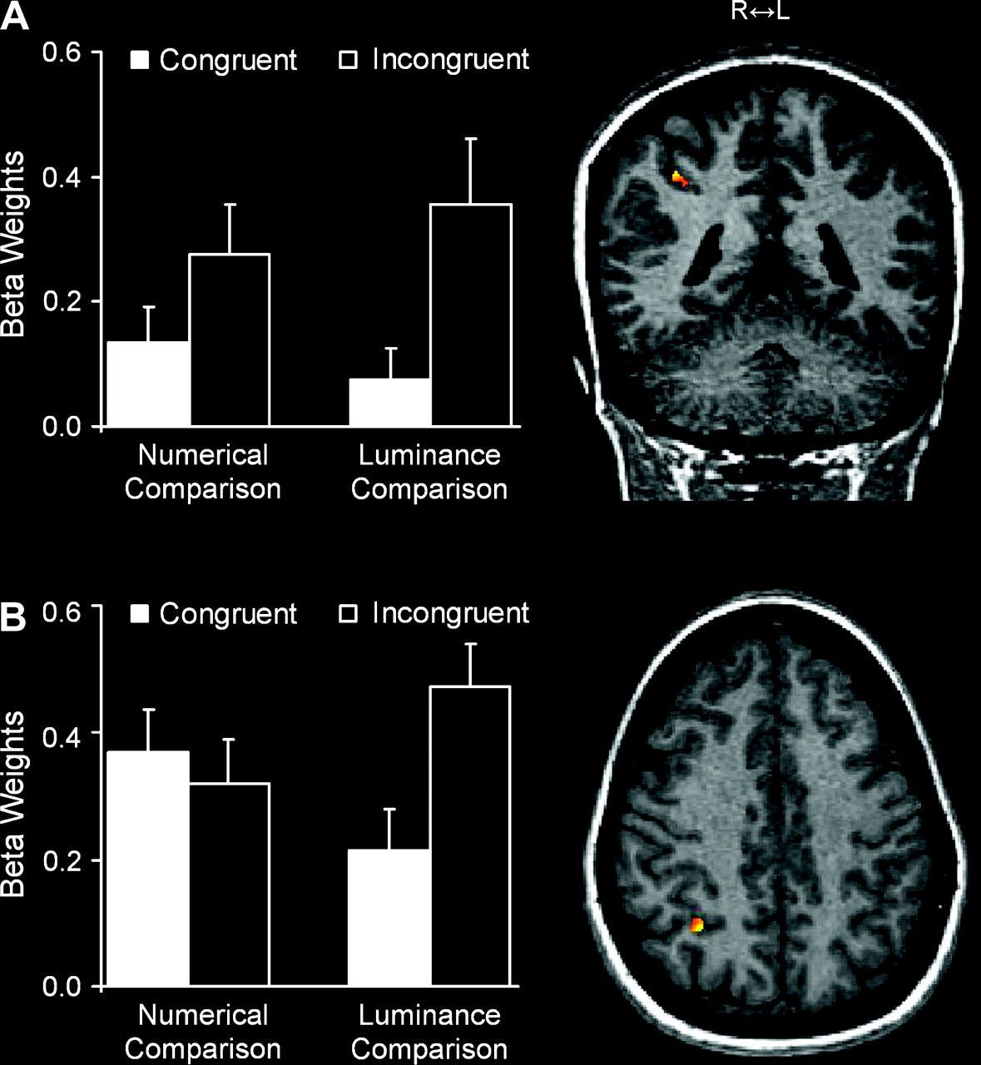
Figure 3. (A) Main congruity effect in the right IPS (x = 35, y = −43, z = 35) from a sagittal point of view and a plot ...
Notes:
Figure 3. (A) Main congruity effect in the right IPS (x = 35, y = −43, z = 35) from a sagittal point of view and a plot of the congruent and incongruent beta weights for each comparison task. (B) Interaction between congruity and comparison in the right IPS (x = 32, y = −53, z = 39) from a transverse point of view and a plot of the congruent and incongruent beta weights for each comparison task. L = left; R = right. Error bars depict one standard error of mean.
Unless provided in the caption above, the following copyright applies to the content of this slide: © The Author 2007. Published by Oxford University Press. All rights reserved. For permissions, please e-mail: journals.permissions@oxfordjournals.org

