Slide 1
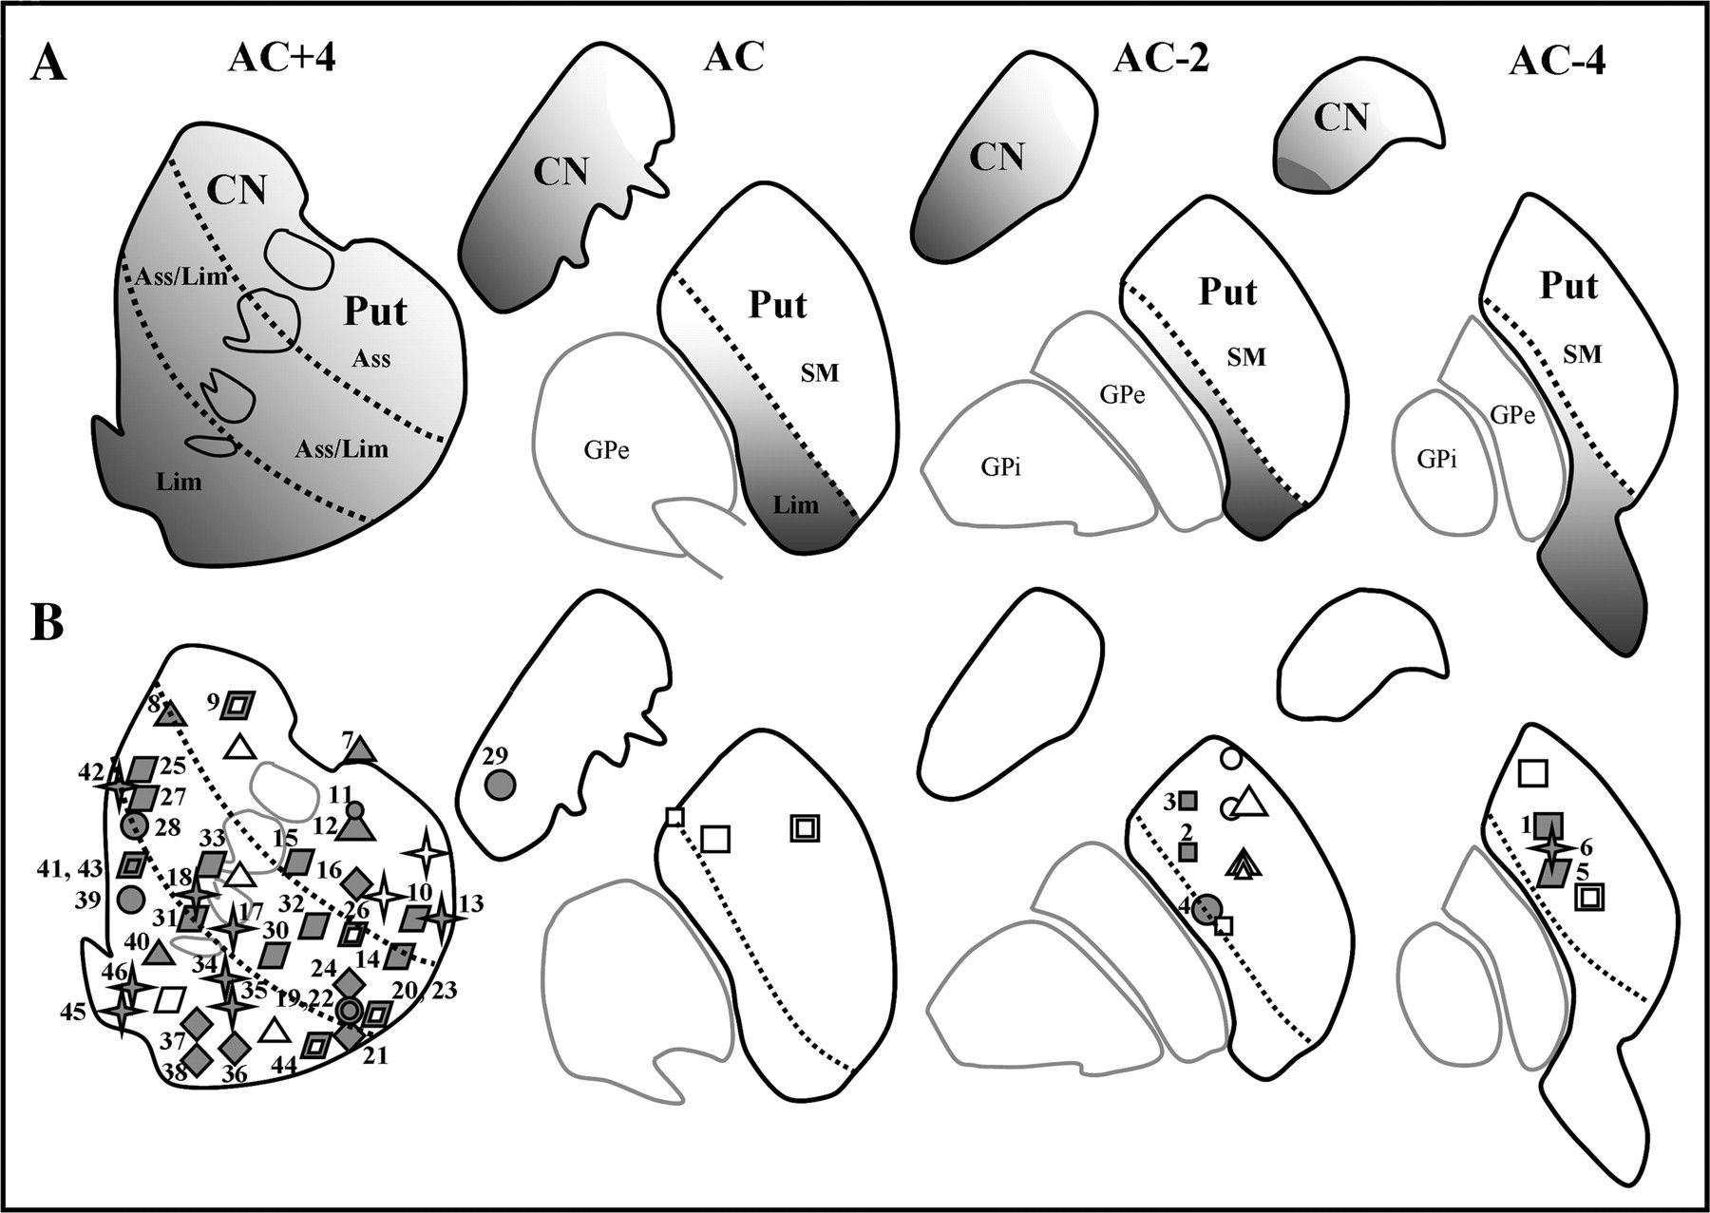
Figure 1. Representation of the functional territories and localization of the microinjection sites within the ...
Notes:
Figure 1. Representation of the functional territories and localization of the microinjection sites within the striatum. (A) Delineation of functional territories according to the topography of corticostriatal projections. (B) An overview of the localization of microinjection sites throughout the striatal functional territories performed on 6 monkeys at 4 levels relative to the AC. SM, sensorimotor functional territory; Ass, associative functional territory; Lim, limbic functional territory; CN, caudate nucleus; Put, putamen; GPe, external segment of the globus pallidus; GPi, internal segment of the globus pallidus. Monkeys: A (□), B (), C (△), H (○), N (⋄), and S (). “Filled” symbols represent the microinjections that induced an effect; open symbols correspond to microinjections without an effect. The smaller symbols correspond to the smaller microinjection volume: 1.5–2.0 μL; the larger symbols correspond to a microinjection volume of 2.5–3.0 μL.
Unless provided in the caption above, the following copyright applies to the content of this slide: © The Author 2008. Published by Oxford University Press. All rights reserved. For permissions, please e-mail: journals.permissions@oxfordjournals.org

Slide 2
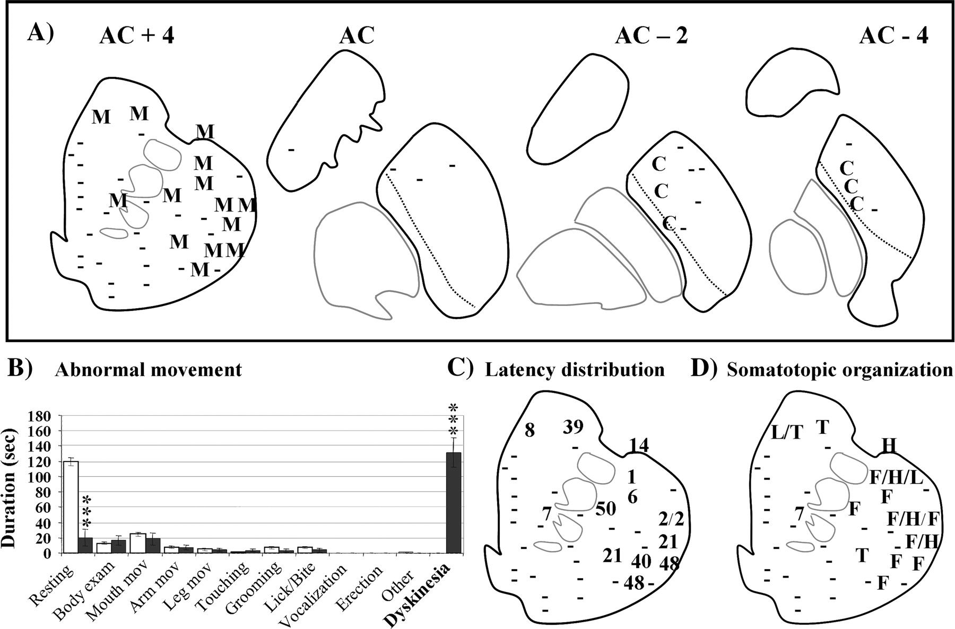
Figure 2. (A) Distribution of sites in the striatum that induced different types of dyskinesia. (B) Histogram showing ...
Notes:
Figure 2. (A) Distribution of sites in the striatum that induced different types of dyskinesia. (B) Histogram showing an example of a microinjection with dyskinetic effect without behavioral modification. (C) Distribution of latencies. (D) Somatotopic organization of the myoclonic jerks produced by the anterior part of the striatum (AC +4): M, myoclonic jerks; C, chorea; F, face; H, hand; T, tail; L, leg. The dashes (-) indicate the sites where dyskinesias were not induced. Error bars show the standard error of the mean. ***P < 0.001.
Unless provided in the caption above, the following copyright applies to the content of this slide: © The Author 2008. Published by Oxford University Press. All rights reserved. For permissions, please e-mail: journals.permissions@oxfordjournals.org

Slide 3
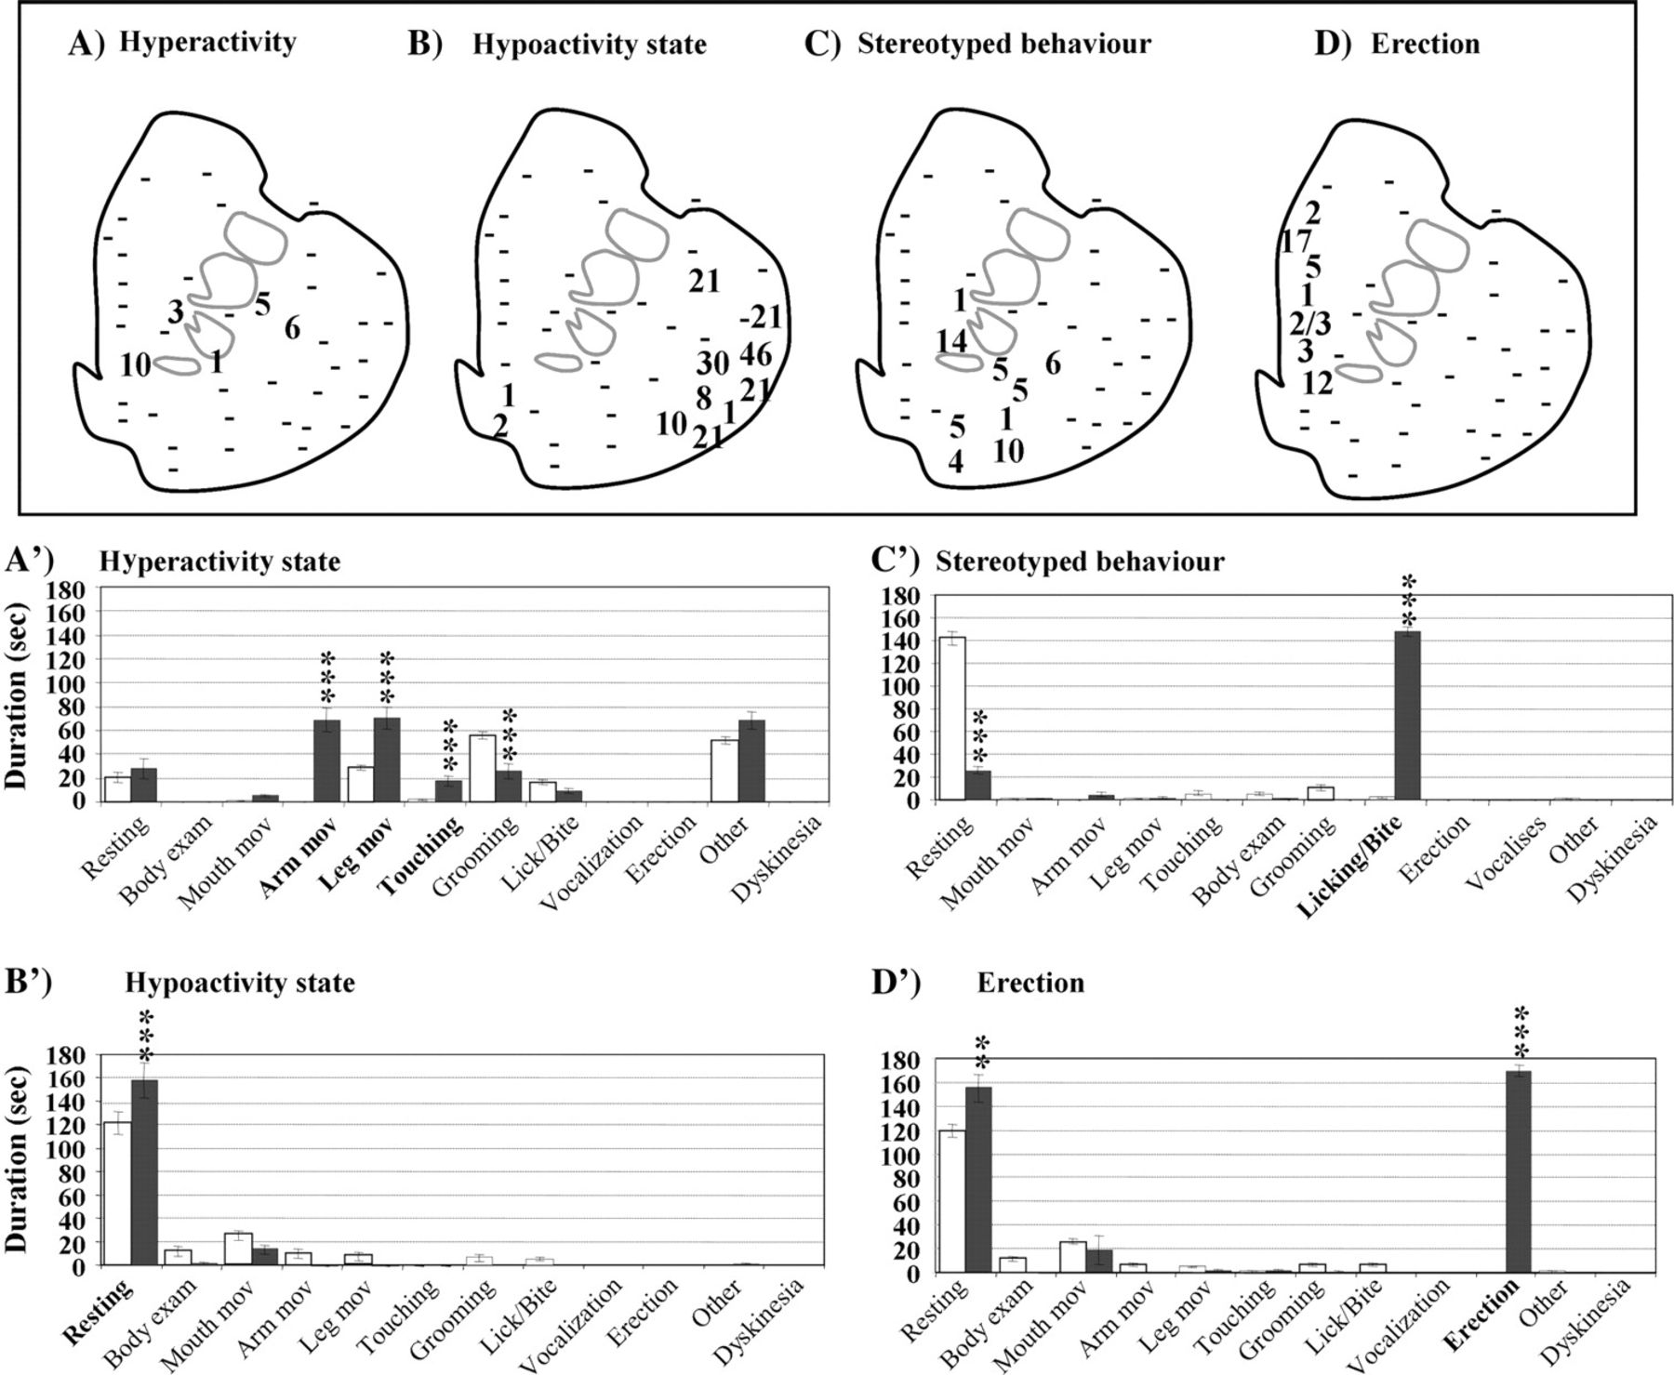
Figure 3. Latencies and examples of different behavioral manifestations observed after microinjections into the ...
Notes:
Figure 3. Latencies and examples of different behavioral manifestations observed after microinjections into the anterior level (AC +4) of the striatum: (A, A′) hypoactivity; (B, B′) hyperactivity; (C, C′) stereotyped behavior; and (D, D′) erection with ejaculation. The numbers represent the latency of the effect of each injection and the dashes (-) indicate the sites where the same effect was not observed. Error bars show the standard error of the mean. ***P < 0.001.
Unless provided in the caption above, the following copyright applies to the content of this slide: © The Author 2008. Published by Oxford University Press. All rights reserved. For permissions, please e-mail: journals.permissions@oxfordjournals.org

Slide 4
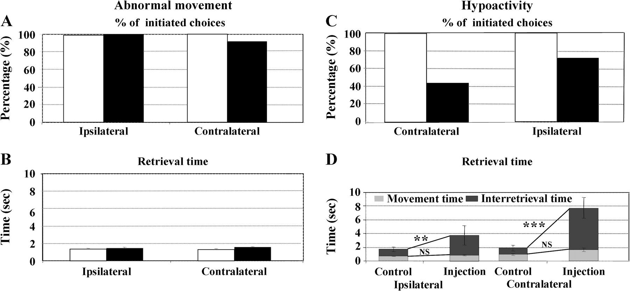
Figure 4. Two examples of task performance after bicuculline microinjections that induced dyskinesia (A, B) or ...
Notes:
Figure 4. Two examples of task performance after bicuculline microinjections that induced dyskinesia (A, B) or hypoactivity (C, D). The white bars show the control condition and the black bars the performance after bicuculline injection. Dyskinesia did not produce any effect on the percentage of initiated choices (A) or on retrieval times (B) for either side of the board (ipsilateral or contralateral to the injection site). However, during the hypoactivity effect, the percentage of initiated choices decreased (C) and retrieval times increased (D) for both sides of the board (ipsilateral or contralateral to the injection site). Further analysis of retrieval times showed that the increase in retrieval times during the hypoactivity effect (D) was mainly due to a significant increase in the duration of the interretrieval period between choices and not to a change in the duration of the movement. Error bars show the standard error of the mean. **P < 0.01, ***P < 0.001, NS, no significant effect.
Unless provided in the caption above, the following copyright applies to the content of this slide: © The Author 2008. Published by Oxford University Press. All rights reserved. For permissions, please e-mail: journals.permissions@oxfordjournals.org

Slide 5
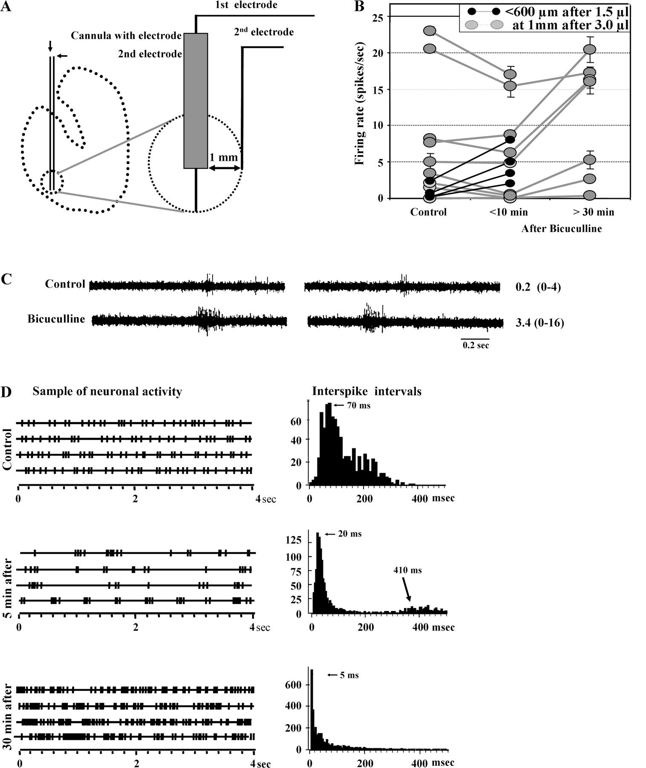
Figure 5. Setup for unit recordings and neuronal modifications observed following injections of bicuculline. (A) Unit ...
Notes:
Figure 5. Setup for unit recordings and neuronal modifications observed following injections of bicuculline. (A) Unit recording was obtained from a microelectrode inside the injection cannula or from a second electrode lateral to the injection cannula. Unit recording was done at different distances from the orifice of the injection cannula, depending on the injection volume: 600–700 μm for 1.5 μL of bicuculline (via the first electrode) and 1000 μm for 3.0 μL of bicuculline (via the first or second electrode). (B) Modifications of firing rate for each unit recording were compared between the control period (before injection) and 10 and 30 min after the injection. Error bars show the standard error of the mean. (C) An example of the local effect (<600 μm) observed after 1.5 μL of bicuculline; the numbers represent the mean and the range of the spikes. (D) An example of the distance effect (at 1 mm) after 3.0 μL of bicuculline.
Unless provided in the caption above, the following copyright applies to the content of this slide: © The Author 2008. Published by Oxford University Press. All rights reserved. For permissions, please e-mail: journals.permissions@oxfordjournals.org

Slide 6
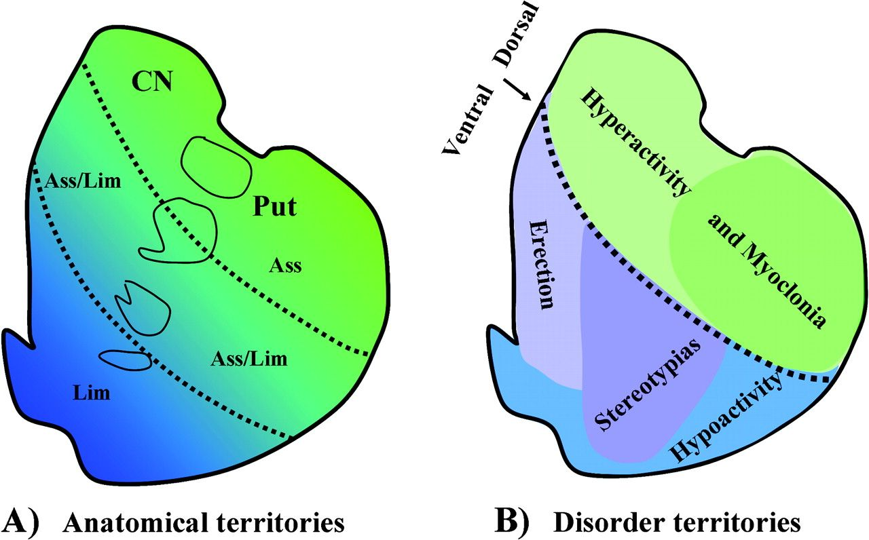
Figure 6. (A, B) Summary of the presentation of different behavioral and movement disorders induced through the ...
Notes:
Figure 6. (A, B) Summary of the presentation of different behavioral and movement disorders induced through the anterior striatum in the study. CN, caudate nucleus; Put, putamen; Acc, nucleus accumbens; Lim, limbic territory; Ass, associative territory.
Unless provided in the caption above, the following copyright applies to the content of this slide: © The Author 2008. Published by Oxford University Press. All rights reserved. For permissions, please e-mail: journals.permissions@oxfordjournals.org

