Slide 1
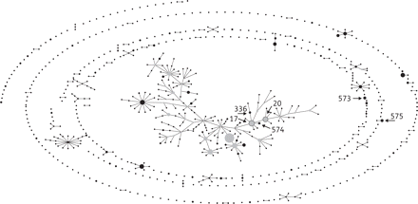
Figure 1. eBURST population of different STs in Calgary among ESBL-producing K. pneumoniae.
Notes:
Figure 1. eBURST population of different STs in Calgary among ESBL-producing K. pneumoniae.
Unless provided in the caption above, the following copyright applies to the content of this slide: © The Author 2012. Published by Oxford University Press on behalf of the British Society for Antimicrobial Chemotherapy. All rights reserved. For Permissions, please e-mail: journals.permissions@oup.com

