Slide 1
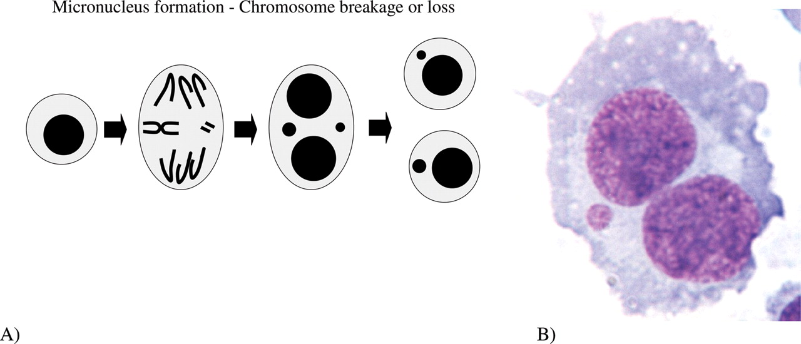
Fig. 1 ( A ) Schematic diagram showing the origin of MN from either a lagging chromosome fragment or a whole ...
Notes:
Fig. 1 ( A ) Schematic diagram showing the origin of MN from either a lagging chromosome fragment or a whole chromosome. ( B ) A photomicrograph of a mitogen-stimulated, cytokinesis-blocked lymphocyte containing one MN.
Unless provided in the caption above, the following copyright applies to the content of this slide: © 2006 The AuthorThis is an Open Access article distributed under the terms of the Creative Commons Attribution Non-Commercial License (http://creativecommons.org/licenses/by-nc/2.0/uk/) which permits unrestricted non-commercial use, distribution, and reproduction in any medium, provided the original work is properly cited.

Slide 2
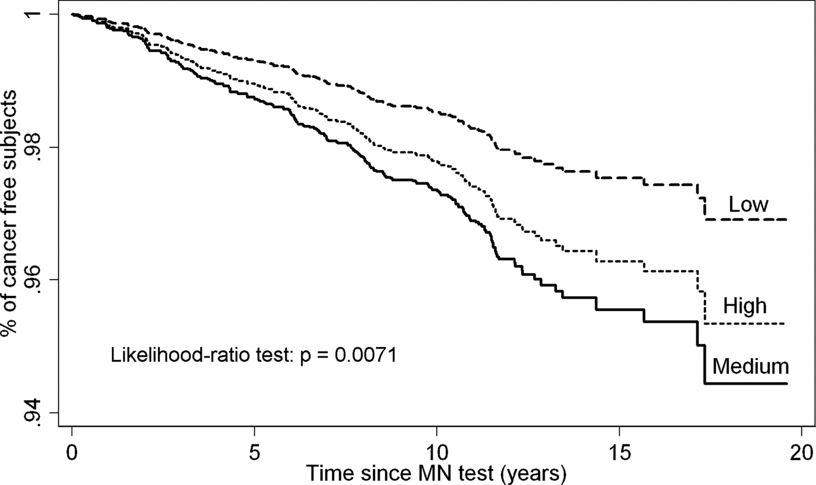
Fig. 2 Probability curves of cancer free survival by tertile of MN frequency (pooled data from the HUMN cohort). ...
Notes:
Fig. 2 Probability curves of cancer free survival by tertile of MN frequency (pooled data from the HUMN cohort). Cancer free survival refers to time from MN test to the first cancer diagnosis. The association between MN and survival was estimated using the multivariate Cox proportional hazard model. (all cancer incidence ICD IX 140–208).
Unless provided in the caption above, the following copyright applies to the content of this slide: © 2006 The AuthorThis is an Open Access article distributed under the terms of the Creative Commons Attribution Non-Commercial License (http://creativecommons.org/licenses/by-nc/2.0/uk/) which permits unrestricted non-commercial use, distribution, and reproduction in any medium, provided the original work is properly cited.

