Slide 1
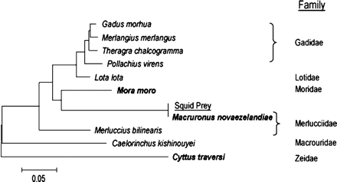
Figure 1. Neighbor-joining tree based on the 252 bp mtDNA sequence obtained from the Architeuthis gut sample aligned ...
Notes:
Figure 1. Neighbor-joining tree based on the 252 bp mtDNA sequence obtained from the Architeuthis gut sample aligned with sequences of the five closest Blast matches (Gadus morhua, Merlangius merlangus, Theragra chalcogramma, Pollachius virens, and Lota lota), GenBank sequence of a related fish belonging to a genus previously identified as Architeuthis prey (Caelorinchus kishinouyei), sequences of fish species obtained during the present study (bold), and an additional GenBank sequence from the family Merlucciidae (Merluccius bilinearis). All of the species belong to the order Gadiformes, with the exception of C. traversi, which belongs to the sister order Zeiformes.
Unless provided in the caption above, the following copyright applies to the content of this slide: © The American Genetic Association. 2005. All rights reserved. For Permissions, please email: journals.permissions@oupjournals.org.

Slide 2
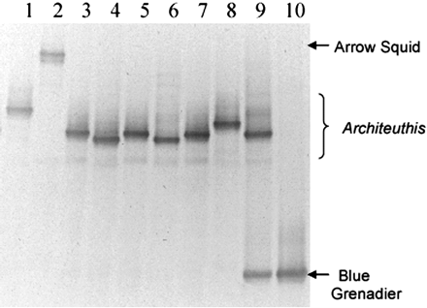
Figure 2. Denaturing gradient gel electrophoresis separation of mtDNA 16S PCR products. Lanes 2 and 10 are amplified ...
Notes:
Figure 2. Denaturing gradient gel electrophoresis separation of mtDNA 16S PCR products. Lanes 2 and 10 are amplified from genomic DNA of arrow squid (Nototodarus sp.) and blue grenadier (M. novaezelandiae), respectively. Lane 9 is an amplification of DNA extracted from the amorphous slurry component of the Architeuthis gut contents. Remaining lanes are amplified from clones derived from the same source. Sequences of the clones shown either match the Architeuthis consensus (lanes 3, 5, and 7) or are closely related (lane 1, variant H; lane 4, variant B; lane 6, variant D; lane 8, variant F). See Table 2 for sequences.
Unless provided in the caption above, the following copyright applies to the content of this slide: © The American Genetic Association. 2005. All rights reserved. For Permissions, please email: journals.permissions@oupjournals.org.

