Slide 1
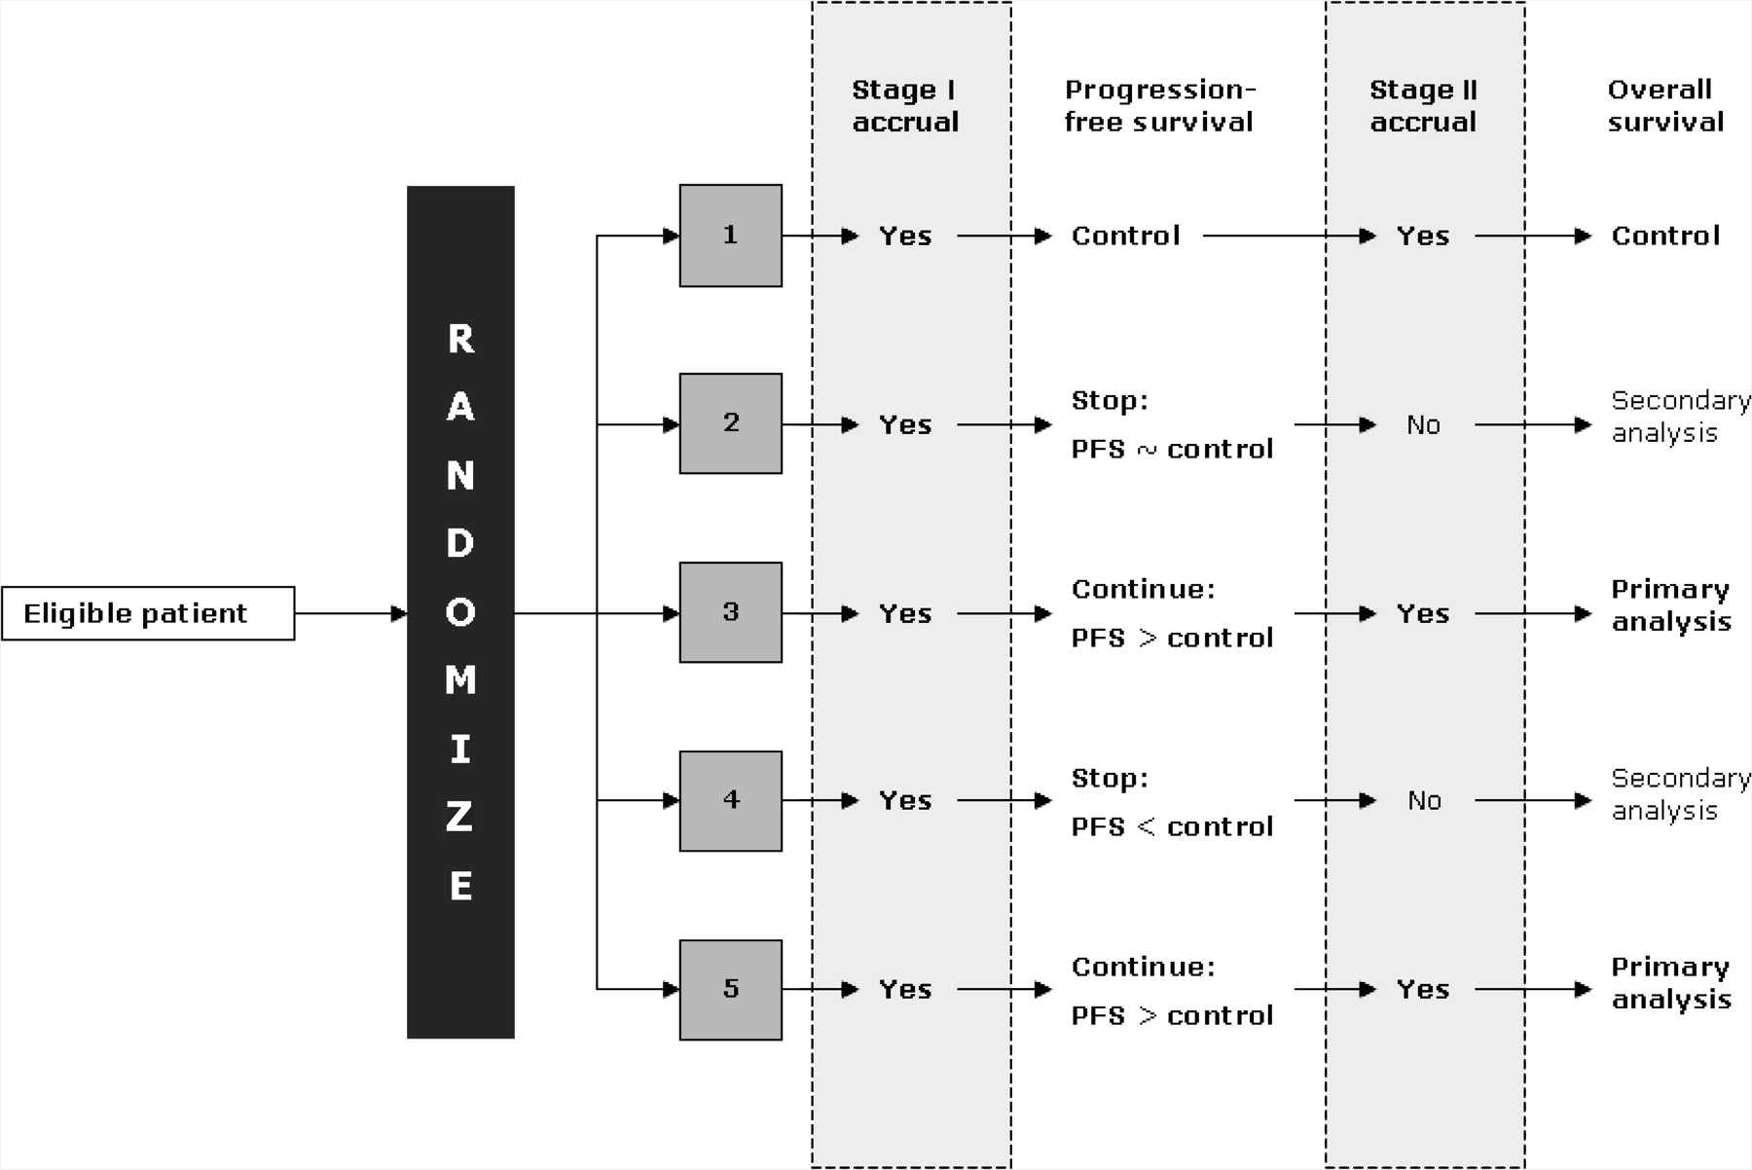
Figure 1 Hypothetical randomized trial showing a multi-arm, two-stage design. Arm 1 is the control arm and arms 2–5 ...
Notes:
Figure 1 Hypothetical randomized trial showing a multi-arm, two-stage design. Arm 1 is the control arm and arms 2–5 are the experimental arms. At the end of stage I, each experimental arm is compared against the control arm in a pairwise manner using the intermediate outcome measure (in this case, progression-free survival). At the end of stage II, each experimental arm that has passed stage I is compared with the control arm on the primary outcome measure for the trial (primary comparison; in this case overall survival). However, secondary comparisons of experimental versus control for each arm that did not pass stage I are also performed (these comparisons will, of course, have fewer patients and events).
Unless provided in the caption above, the following copyright applies to the content of this slide: © 2008 The Author(s).This is an Open Access article distributed under the terms of the Creative Commons Attribution Non-Commercial License (http://creativecommons.org/licenses/by-nc/2.0/uk/), which permits unrestricted non-commercial use, distribution, and reproduction in any medium, provided the original work is properly cited.

Slide 2
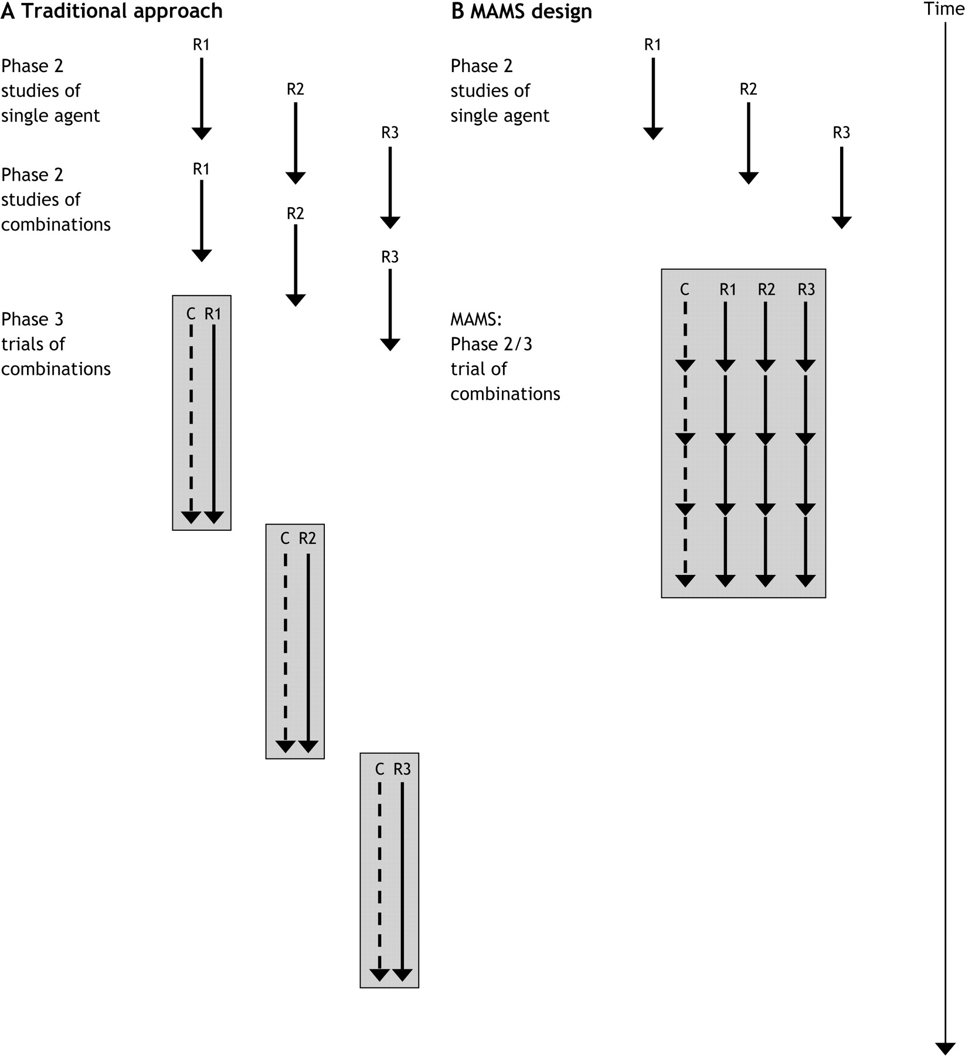
Figure 2 Where do multi-arm multi-stage (MAMS) trials fit into the phase 1, 2, and 3 setup? A ) The traditional ...
Notes:
Figure 2 Where do multi-arm multi-stage (MAMS) trials fit into the phase 1, 2, and 3 setup? A ) The traditional approach. Three new agents, R1, R2, and R3, enter and pass three single-agent single-arm phase 2 trials and also three separate single-arm combination phase 2 trials. The three combination therapies are finally compared with the control therapy in three separate randomized phase 3 trials. In this model, a total of 2100 patients are required. B ) In the MAMS design, the single-agent single-arm phase 2 trials are followed by a single MAMS trial of all combination therapies. The MAMS model required 1300 patients in total, a saving of 800 patients. C = control arm; R1 = experimental arm R1; R2 = experimental arm R2; R3 = experimental arm R3. In these models, we assume that single-agent studies would be carried out before combination therapy studies and that phase 2 studies require only a small number of centers. Consequently, phase 2 studies of different agents may be carried out concurrently. We also assume that phase 3 trials require larger numbers of patients and a network of centers that can run only one trial in a particular group of patients at a time, and, therefore, phase 3 trials of different agents must be carried out sequentially. The MAMS design rolls the phase 2 assessment of the activity of combination therapy into the same trial as the phase 3 assessment of effectiveness.
Unless provided in the caption above, the following copyright applies to the content of this slide: © 2008 The Author(s).This is an Open Access article distributed under the terms of the Creative Commons Attribution Non-Commercial License (http://creativecommons.org/licenses/by-nc/2.0/uk/), which permits unrestricted non-commercial use, distribution, and reproduction in any medium, provided the original work is properly cited.

Slide 3
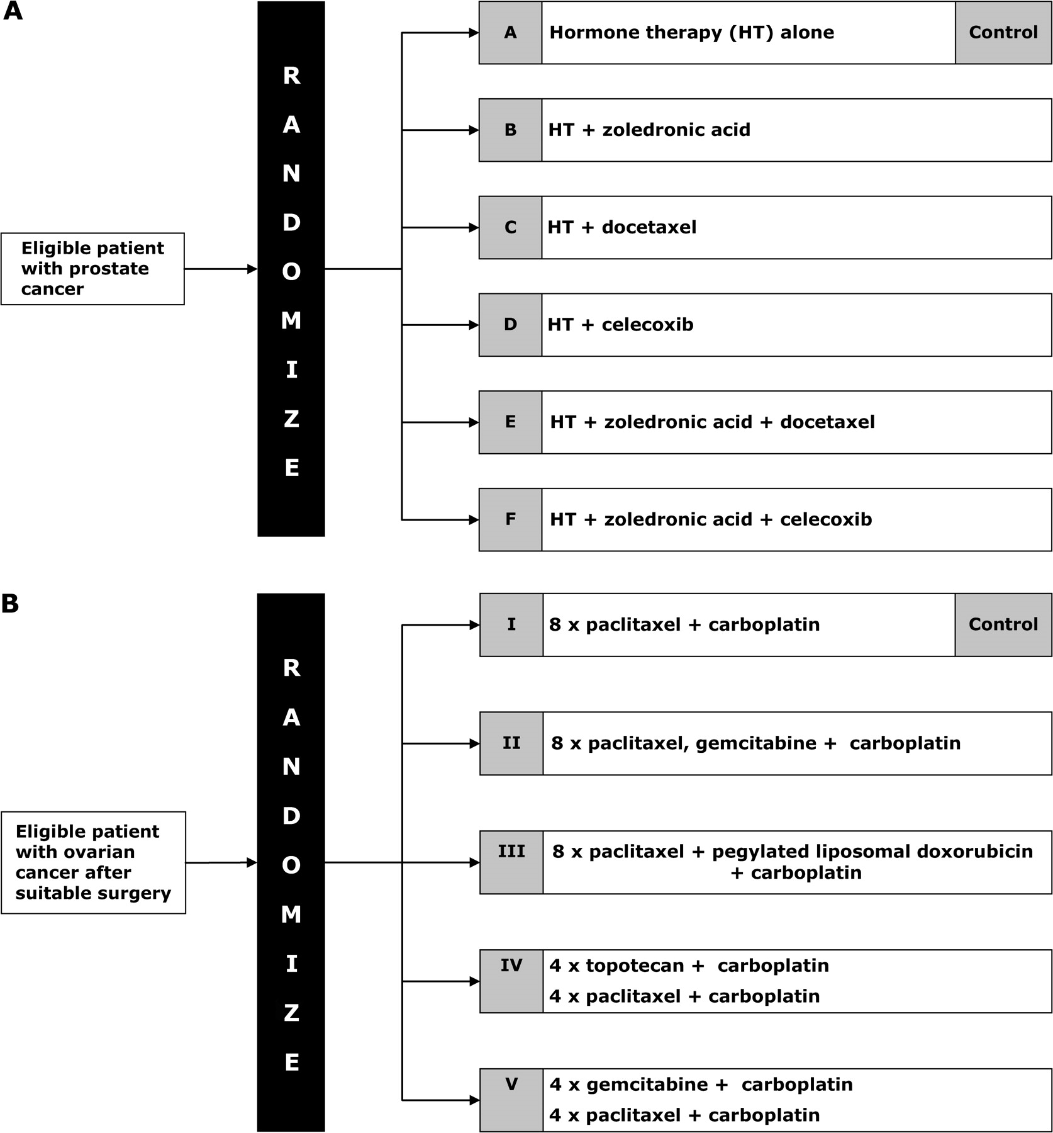
Figure 3 Two multi-arm multi-stage trials. A ) Systemic Therapy in Advancing or Metastatic Prostate Cancer: ...
Notes:
Figure 3 Two multi-arm multi-stage trials. A ) Systemic Therapy in Advancing or Metastatic Prostate Cancer: Evaluation of Drug Efficacy (STAMPEDE) trial with six arms (A–F). B ) Gynecologic Oncology Group/International Collaborative Ovarian Neoplasm Studies (GOG-182/ICON5) trial with five arms (I–V).
Unless provided in the caption above, the following copyright applies to the content of this slide: © 2008 The Author(s).This is an Open Access article distributed under the terms of the Creative Commons Attribution Non-Commercial License (http://creativecommons.org/licenses/by-nc/2.0/uk/), which permits unrestricted non-commercial use, distribution, and reproduction in any medium, provided the original work is properly cited.

Slide 4
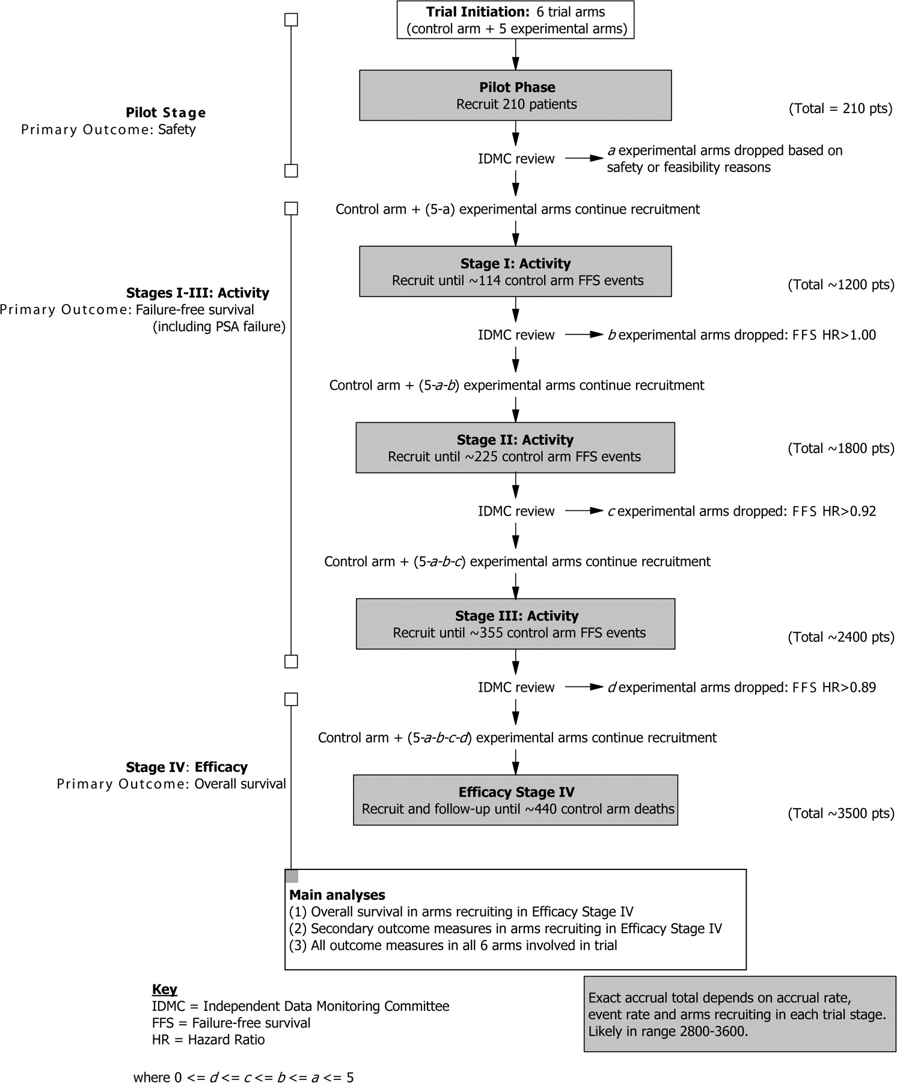
Figure 4 Five Stages of the Systemic Therapy in Advancing or Metastatic Prostate Cancer: Evaluation of Drug Efficacy ...
Notes:
Figure 4 Five Stages of the Systemic Therapy in Advancing or Metastatic Prostate Cancer: Evaluation of Drug Efficacy (STAMPEDE) trial. IDMC = Independent Data Monitoring Committee; FFS = failure-free survival; HR = hazard ratio, where 0 ≤ d ≤ c ≤ b ≤ a ≤ 5.
Unless provided in the caption above, the following copyright applies to the content of this slide: © 2008 The Author(s).This is an Open Access article distributed under the terms of the Creative Commons Attribution Non-Commercial License (http://creativecommons.org/licenses/by-nc/2.0/uk/), which permits unrestricted non-commercial use, distribution, and reproduction in any medium, provided the original work is properly cited.

Slide 5
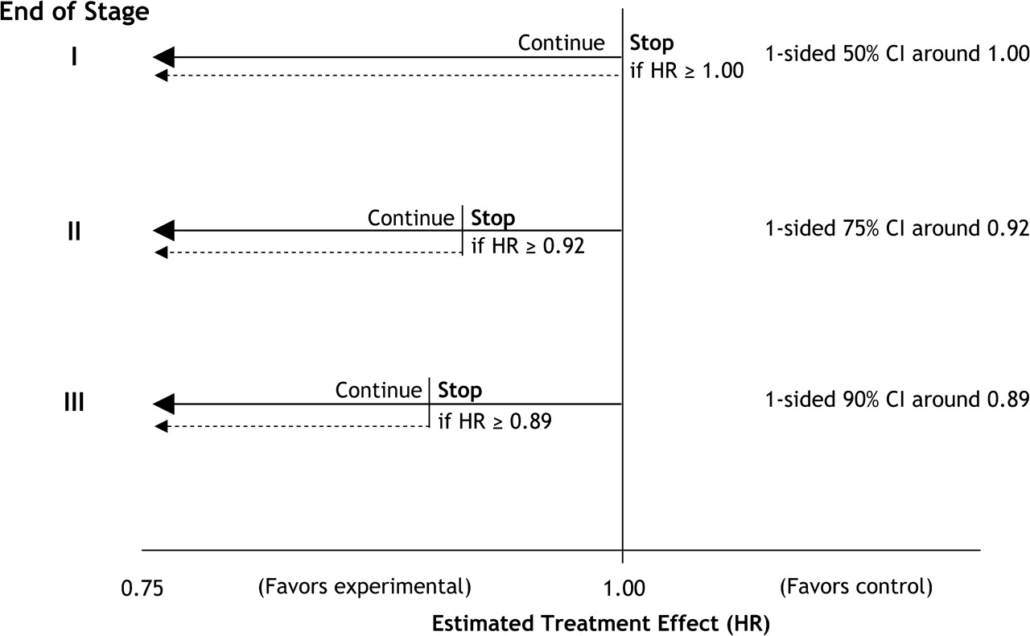
Figure 5 Stopping guidelines on the hazard ratio scale for the Systemic Therapy in Advancing or Metastatic Prostate ...
Notes:
Figure 5 Stopping guidelines on the hazard ratio scale for the Systemic Therapy in Advancing or Metastatic Prostate Cancer: Evaluation of Drug Efficacy (STAMPEDE) trial. CI = confidence interval; HR = hazard ratio; Stop = stopping of accrual (rather than termination of follow up).
Unless provided in the caption above, the following copyright applies to the content of this slide: © 2008 The Author(s).This is an Open Access article distributed under the terms of the Creative Commons Attribution Non-Commercial License (http://creativecommons.org/licenses/by-nc/2.0/uk/), which permits unrestricted non-commercial use, distribution, and reproduction in any medium, provided the original work is properly cited.

