Slide 1
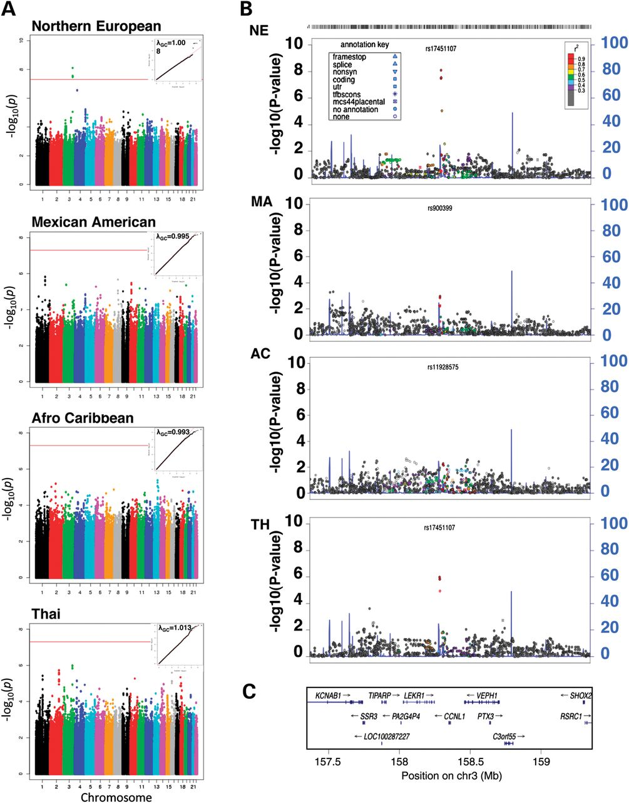
Figure. 1. (A) Genome-wide associations with the sum of skinfolds in HAPO newborns. Shown are the Manhattan plots for ...
Notes:
Figure. 1. (A) Genome-wide associations with the sum of skinfolds in HAPO newborns. Shown are the Manhattan plots for Model 2 for each of the four populations along with the corresponding QQ plot in the upper right corner. The redline indicates genome-wide significance (−log10P = 7.3). (B) Locus zoom plot of chromosome 3q25.32 locus for the sum of skinfolds for each cohort under Model 2. Each of the panels contains the population-specific association results and estimates of LD (r2) from the SNP with the strongest evidence for association in the meta-analysis. The LD estimates are color coded as a heat map from purple to red (0.9 ≥ r2 > 1.0), while grey indicates r2 < 0.3. These coincide with the recombination hotspots shown by the blue lines (recombination rate in cM/Mb from HapMap). (C) Map of the genes and their orientation (5′–3′) in this region of chromosome 3q25.31.
Unless provided in the caption above, the following copyright applies to the content of this slide: © The Author 2013. Published by Oxford University Press. All rights reserved. For Permissions, please email: journals.permissions@oup.com

Slide 2
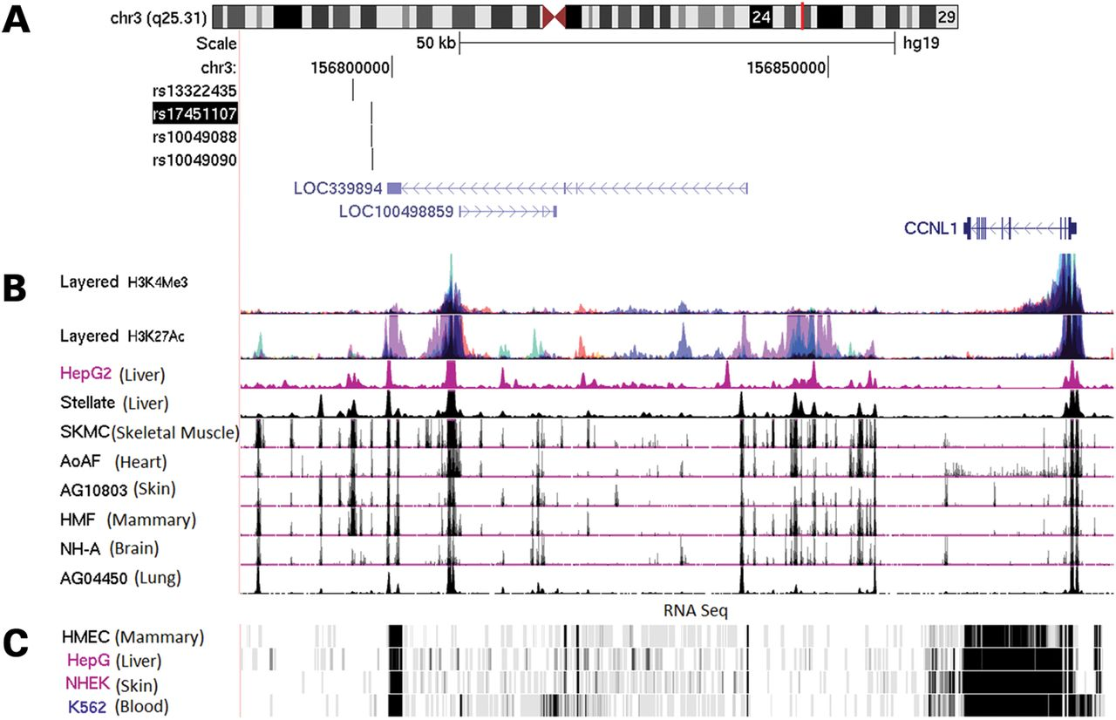
Figure 2. Schematic of the region of chromosome 3q25.31 adiposity associated region showing aligned SNPs, noncoding ...
Notes:
Figure 2. Schematic of the region of chromosome 3q25.31 adiposity associated region showing aligned SNPs, noncoding RNAs and genes, active enhancer marks, open chromatin regions and expression profiles of RNAs mapping to this region. (http://genome.ucsc.edu Build 37)
Unless provided in the caption above, the following copyright applies to the content of this slide: © The Author 2013. Published by Oxford University Press. All rights reserved. For Permissions, please email: journals.permissions@oup.com

