Slide 1
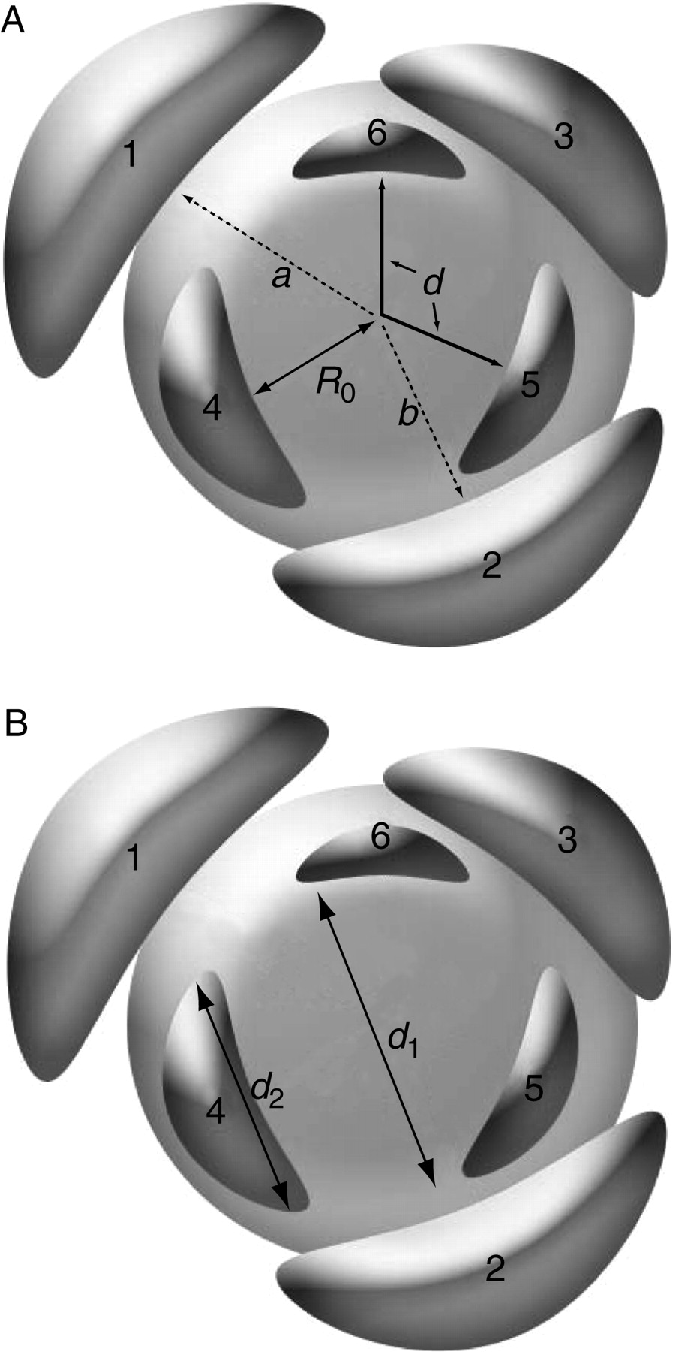
F ig . 1. Diagrams of SAM highlighting specific phyllotactic parameters. Primordia are numbered in order of ...
Notes:
F ig . 1. Diagrams of SAM highlighting specific phyllotactic parameters. Primordia are numbered in order of appearance. (A) d , Divergence angle; a , b , distances from the centre of the SAM ( a / b = R ); R0 , radius of the SAM. (B) d1 , Diameter of the SAM; d2 , diameter of the leaf primordium ( d2 / d1 = Γ ).
Unless provided in the caption above, the following copyright applies to the content of this slide: © The Author 2007. Published by Oxford University Press on behalf of the Annals of Botany Company. All rights reserved. For Permissions, please email: journals.permissions@oxfordjournals.org

Slide 2
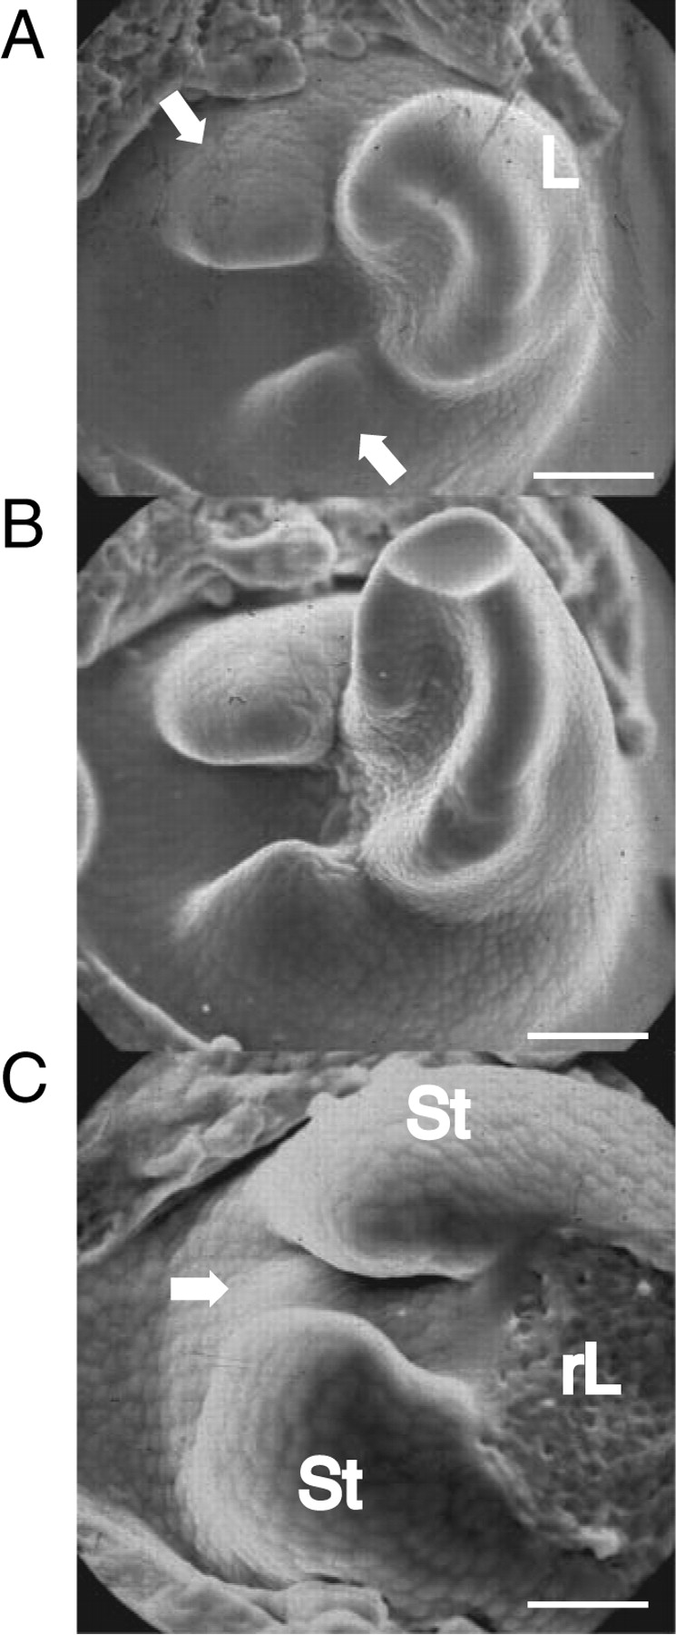
F ig . 2. General features of the shoot apical meristem. (A) Top view of leaf primordium (L) flanked by two stipule ...
Notes:
F ig . 2. General features of the shoot apical meristem. (A) Top view of leaf primordium (L) flanked by two stipule primordia (arrows). (B) Later stage of leaf development showing accentuated asymmetry of the developing leaf blade. This photograph represents the same shoot apex as (A) but 5 d later. (C) Top view of a shoot apex to where the blade of the leaf primordium was removed (rL). Initiation of new leaf primordium (arrow) is visible between stipules (St) of the previous leaf. Scale bars: A, B = 54 µm; C = 42 µm.
Unless provided in the caption above, the following copyright applies to the content of this slide: © The Author 2007. Published by Oxford University Press on behalf of the Annals of Botany Company. All rights reserved. For Permissions, please email: journals.permissions@oxfordjournals.org

Slide 3
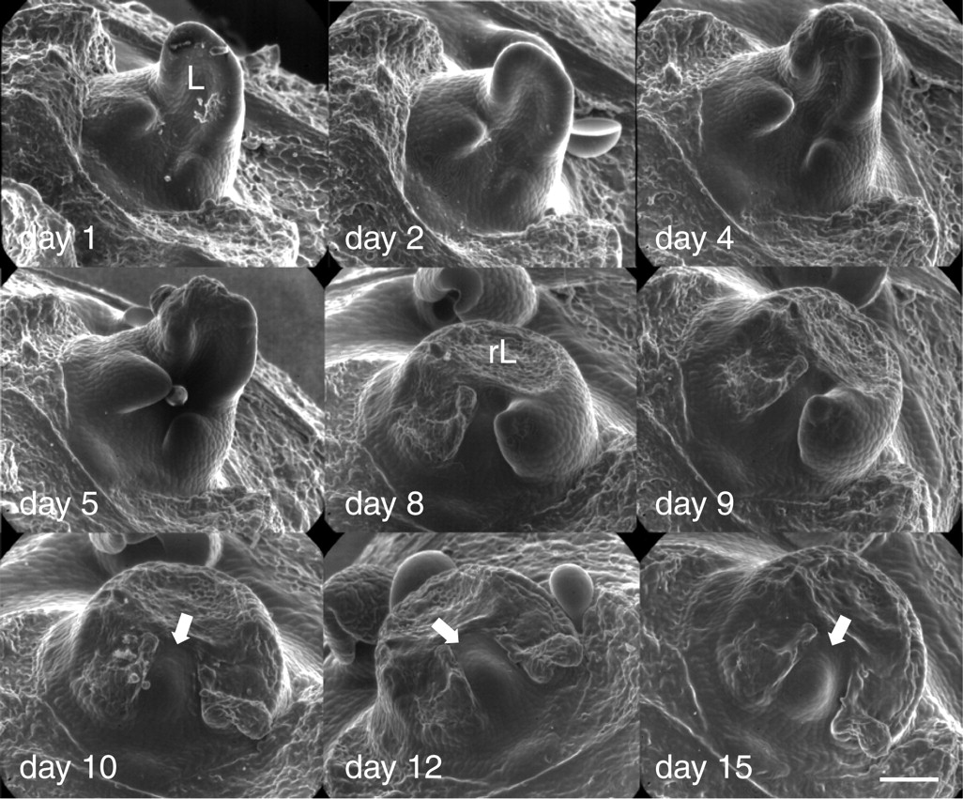
F ig . 3. Developmental sequence of a single shoot apical meristem using the impression mould technique and showing the ...
Notes:
F ig . 3. Developmental sequence of a single shoot apical meristem using the impression mould technique and showing the development of a leaf primordium (L) followed by the initation of a new leaf primordium (arrows). The date the impression mould was taken is represented on each photograph. Scale bar = 54 µm.
Unless provided in the caption above, the following copyright applies to the content of this slide: © The Author 2007. Published by Oxford University Press on behalf of the Annals of Botany Company. All rights reserved. For Permissions, please email: journals.permissions@oxfordjournals.org

Slide 4
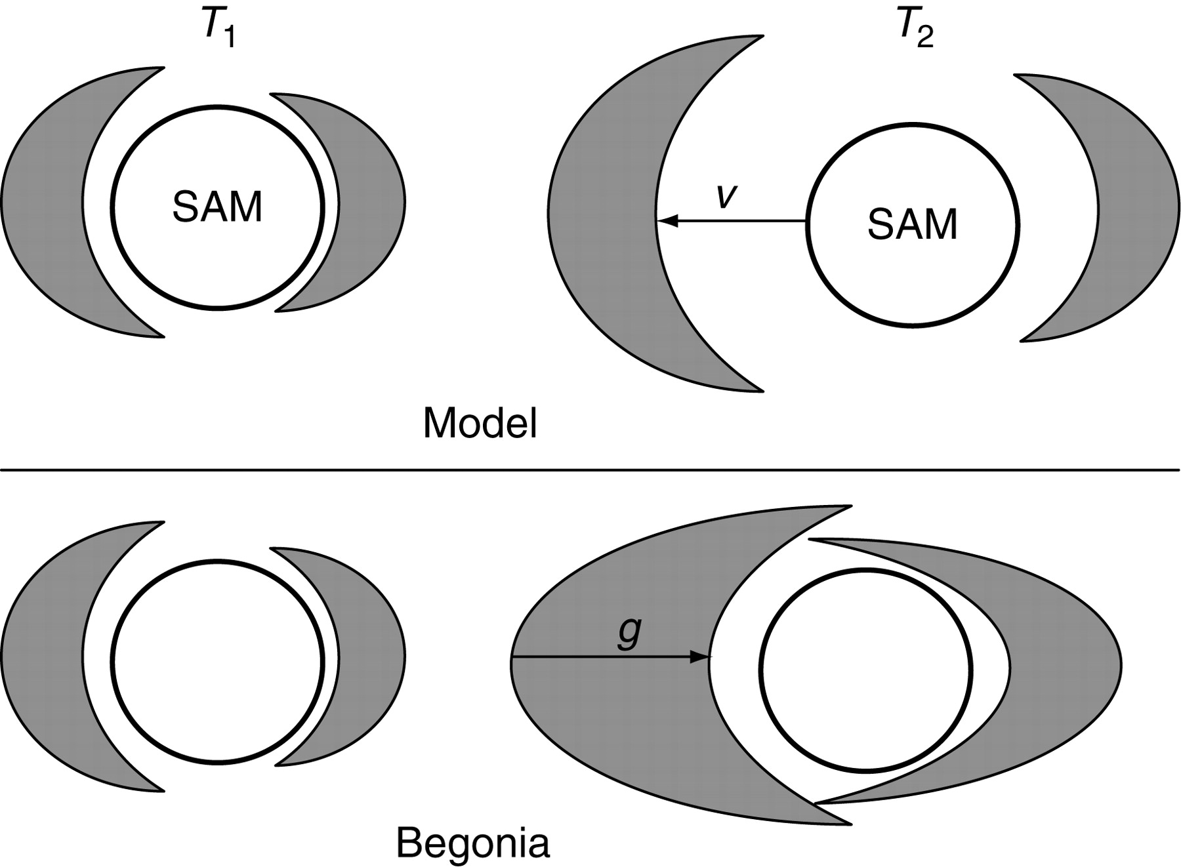
F ig . 4. Comparison of theoretical model ( Douady and Couder, 1992 ) and Begonia in terms of speed of advection ( V ) ...
Notes:
F ig . 4. Comparison of theoretical model ( Douady and Couder, 1992 ) and Begonia in terms of speed of advection ( V ) and growth of leaf ( g ) around SAM at different times ( T1 and T2 ).
Unless provided in the caption above, the following copyright applies to the content of this slide: © The Author 2007. Published by Oxford University Press on behalf of the Annals of Botany Company. All rights reserved. For Permissions, please email: journals.permissions@oxfordjournals.org

