Slide 1
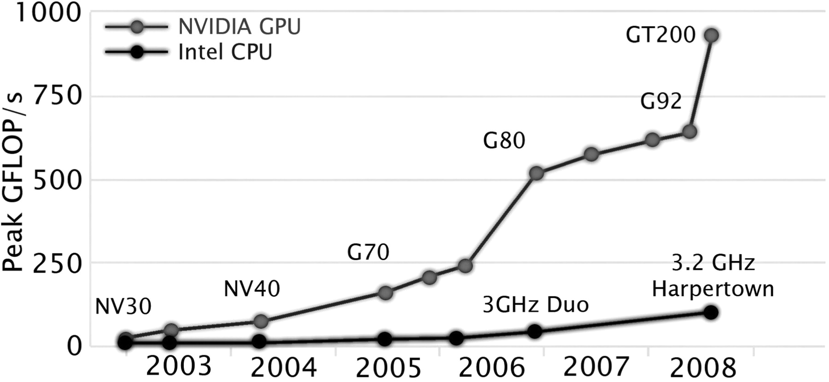
Figure 1: Peak Performance of NVIDIA GPU Hardware (grey) versus Intel CPU Hardware (black).
Notes:
Figure 1: Peak Performance of NVIDIA GPU Hardware (grey) versus Intel CPU Hardware (black).
Unless provided in the caption above, the following copyright applies to the content of this slide: © The Author 2010. Published by Oxford University Press. For Permissions, please email: journals.permissions@oxfordjournals.org

Slide 2
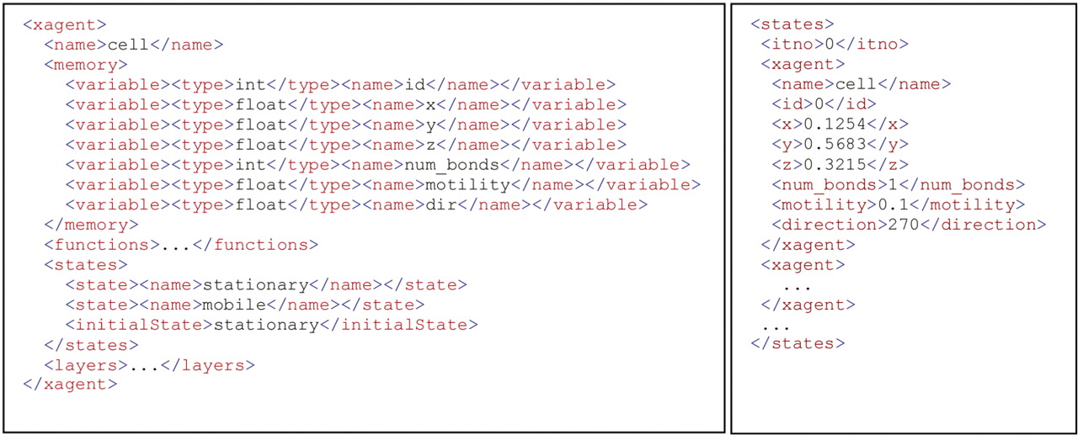
Figure 2: An example of cell expressed as an X-machine agent. Left shows the XMML model definition and right shows an ...
Notes:
Figure 2: An example of cell expressed as an X-machine agent. Left shows the XMML model definition and right shows an example of an initial memory configuration file.
Unless provided in the caption above, the following copyright applies to the content of this slide: © The Author 2010. Published by Oxford University Press. For Permissions, please email: journals.permissions@oxfordjournals.org

Slide 3
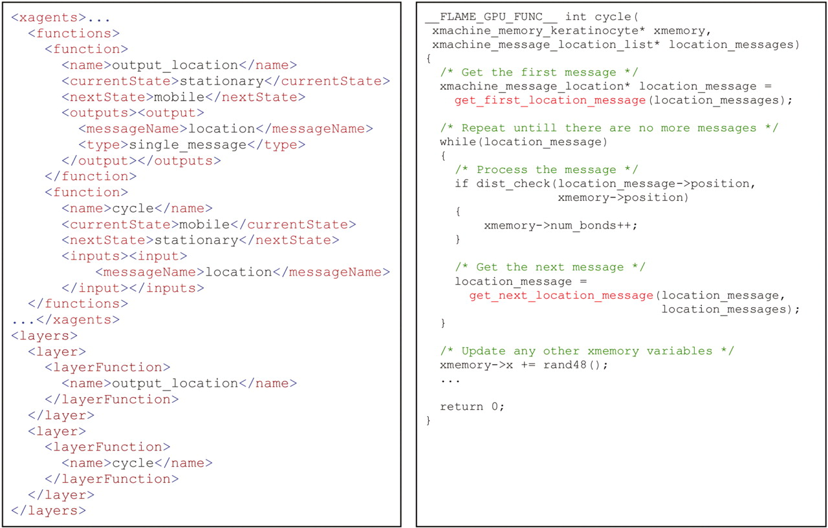
Figure 3: An example of the definition of XMML agent function definitions with corresponding function code script. Left ...
Notes:
Figure 3: An example of the definition of XMML agent function definitions with corresponding function code script. Left shows the XMML function definition including the processing order layer definition. Right shows an example of a simple function script performing message iteration using the FLAME GPU message functions.
Unless provided in the caption above, the following copyright applies to the content of this slide: © The Author 2010. Published by Oxford University Press. For Permissions, please email: journals.permissions@oxfordjournals.org

Slide 4
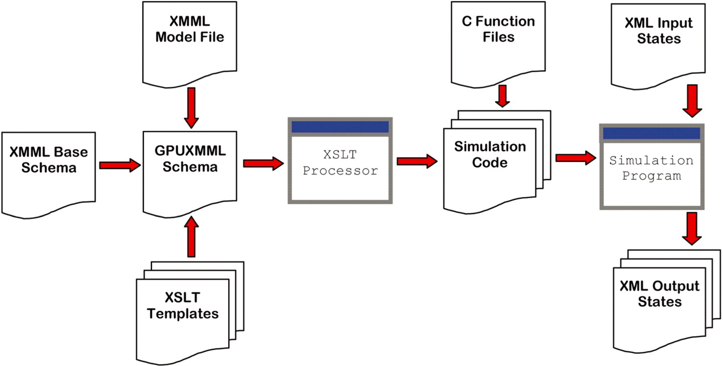
Figure 4: The FLAME GPU modelling process. Models are translated from an XMML file using a template processor which ...
Notes:
Figure 4: The FLAME GPU modelling process. Models are translated from an XMML file using a template processor which produces simulation code. The simulation program includes routines for real-time visualisation if the appropriate XSLT template is included.
Unless provided in the caption above, the following copyright applies to the content of this slide: © The Author 2010. Published by Oxford University Press. For Permissions, please email: journals.permissions@oxfordjournals.org

Slide 5
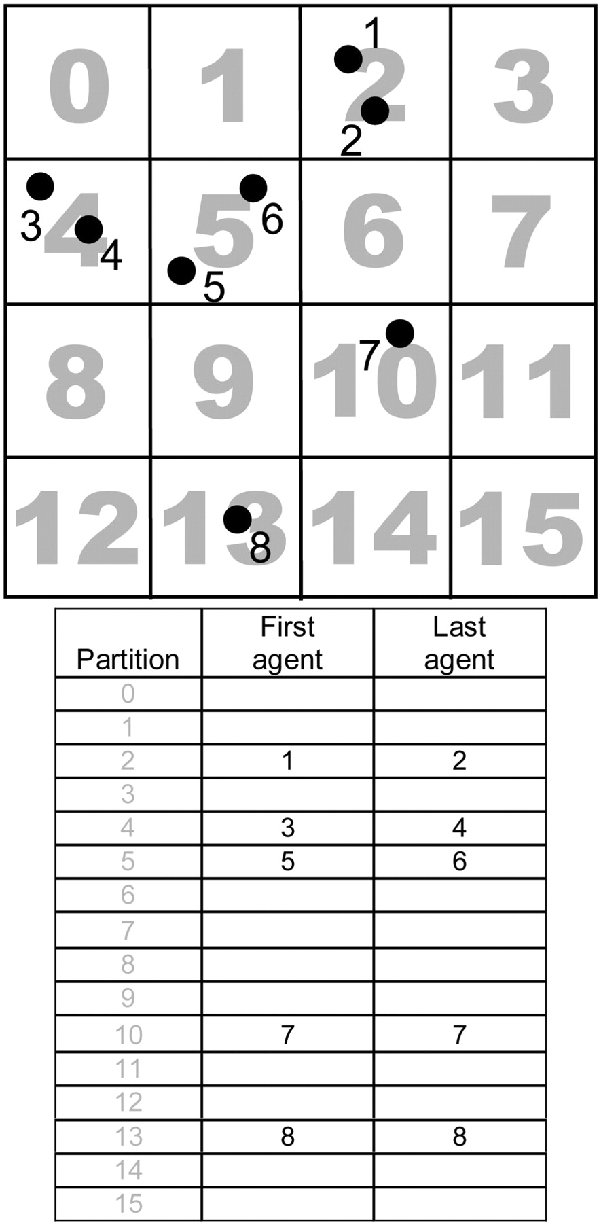
Figure 5: An example of a 2D partitioned message space containing sorted messages. The matrix below holds the first and ...
Notes:
Figure 5: An example of a 2D partitioned message space containing sorted messages. The matrix below holds the first and last message in the partition which is used to iterate messages. For example an agent in partition space 10 iterates 9 message partitions (5–7, 9–11, 13–15) to ensure all messages (5–8) within the potential message range are examined.
Unless provided in the caption above, the following copyright applies to the content of this slide: © The Author 2010. Published by Oxford University Press. For Permissions, please email: journals.permissions@oxfordjournals.org

Slide 6
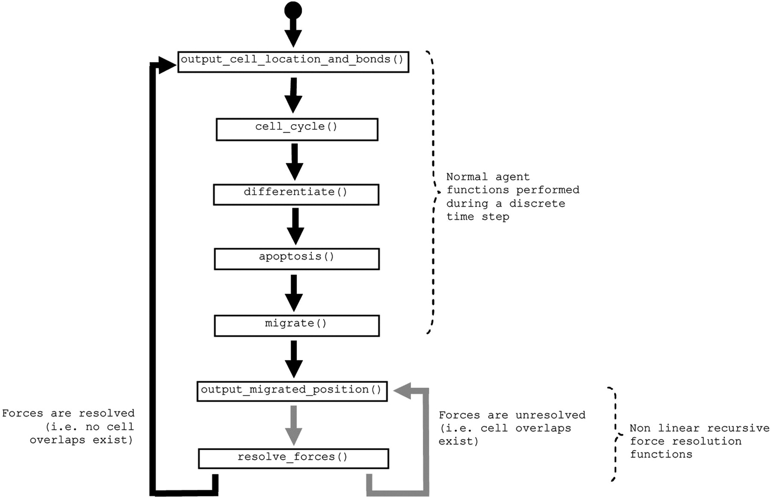
Figure 6: An example of the simulation flow of the keratinocyte modelling example. Arrows represent the resolution ...
Notes:
Figure 6: An example of the simulation flow of the keratinocyte modelling example. Arrows represent the resolution state of forces within the simulation (resolved or unresolved). After the processing of the normal cell functions, agents may perform any number of recursive force resolution steps.
Unless provided in the caption above, the following copyright applies to the content of this slide: © The Author 2010. Published by Oxford University Press. For Permissions, please email: journals.permissions@oxfordjournals.org

Slide 7
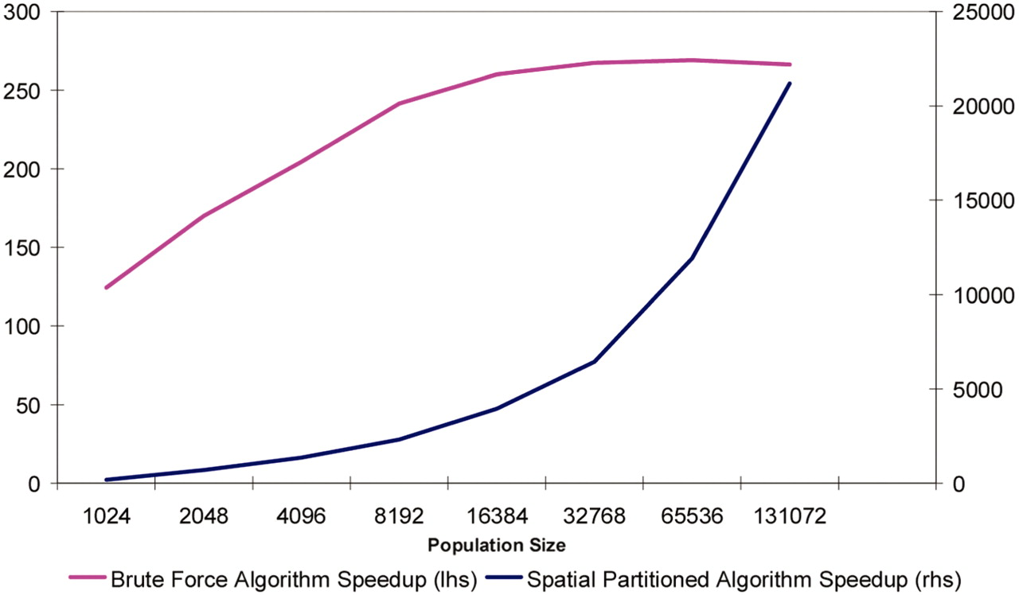
Figure 7: Relative performance of the keratinocyte model using both brute force and the spatially partitioned message ...
Notes:
Figure 7: Relative performance of the keratinocyte model using both brute force and the spatially partitioned message iteration functions within FLAME GPU.
Unless provided in the caption above, the following copyright applies to the content of this slide: © The Author 2010. Published by Oxford University Press. For Permissions, please email: journals.permissions@oxfordjournals.org

Slide 8
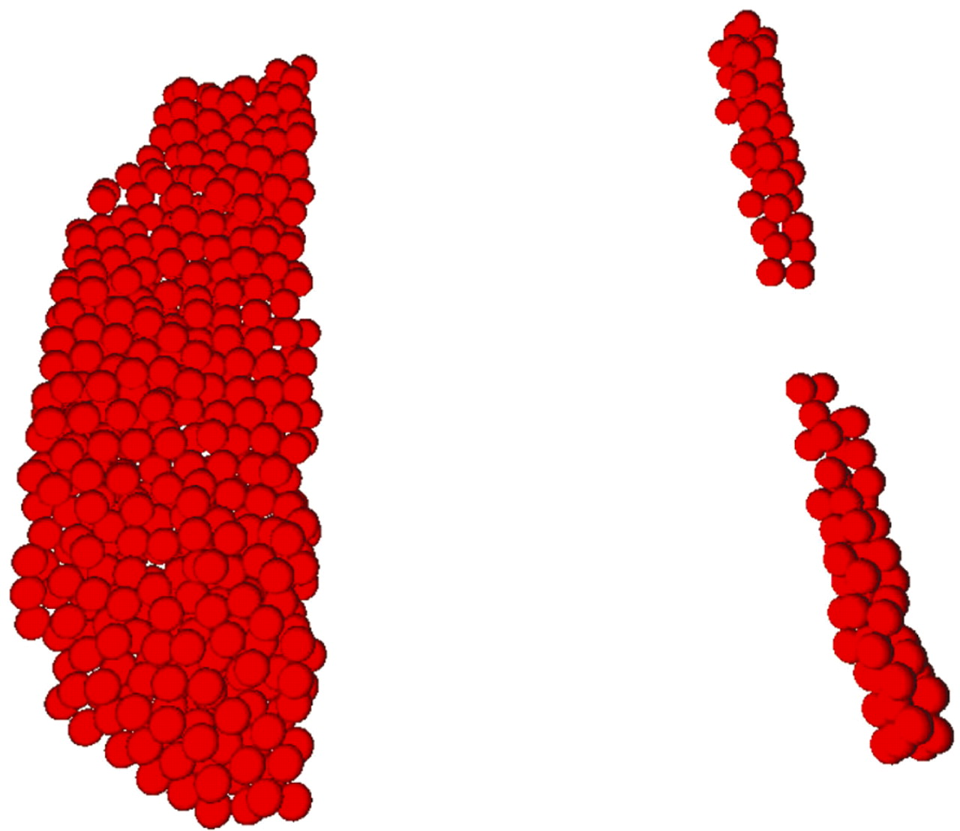
Figure 8: An example of an initial configuration of a keratinocyte scratch wound in FLAME GPU.
Notes:
Figure 8: An example of an initial configuration of a keratinocyte scratch wound in FLAME GPU.
Unless provided in the caption above, the following copyright applies to the content of this slide: © The Author 2010. Published by Oxford University Press. For Permissions, please email: journals.permissions@oxfordjournals.org

Slide 9
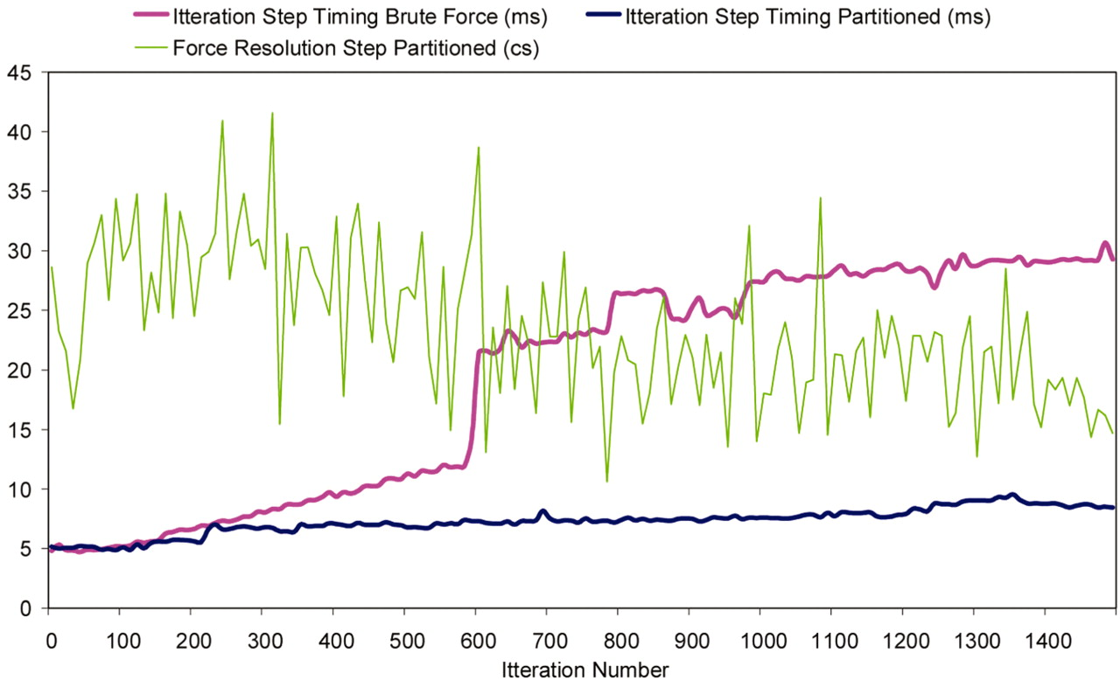
Figure 9: Progressive timing of normal agent functions and the recursive force resolution steps during a scratch would ...
Notes:
Figure 9: Progressive timing of normal agent functions and the recursive force resolution steps during a scratch would simulation of keratinocyte cells in FLAME GPU.
Unless provided in the caption above, the following copyright applies to the content of this slide: © The Author 2010. Published by Oxford University Press. For Permissions, please email: journals.permissions@oxfordjournals.org

