Slide 1
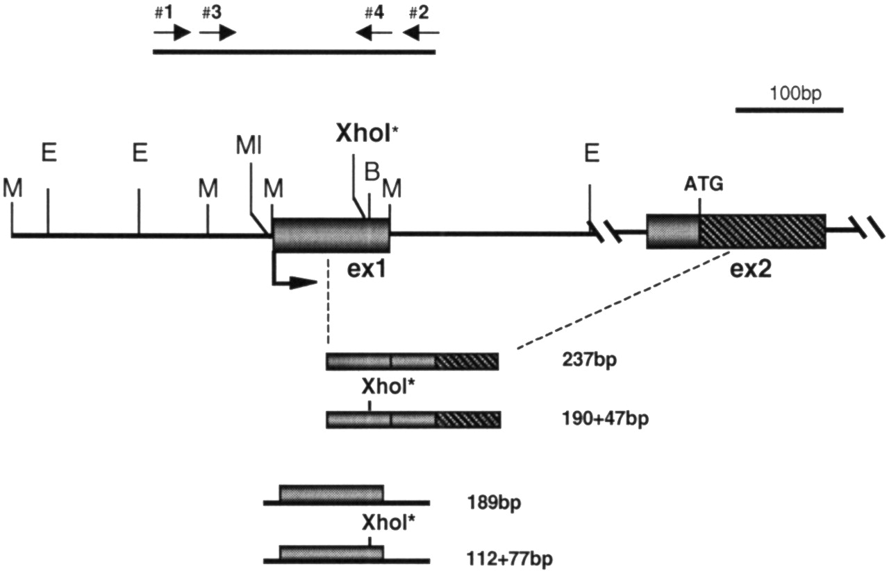
Figure 1. Schematic map of the 5′ region of SYBL1. Exons 1 and 2 are shown as boxes, with the ATG start codon ...
Notes:
Figure 1. Schematic map of the 5′ region of SYBL1. Exons 1 and 2 are shown as boxes, with the ATG start codon indicated. EcoRI (E), MspI (M), BssHII (B), MluI (MI) sites, and the polymorphic XhoI* site, are shown. The line above designates the CpG island which has been examined by bisulfite sequencing (primers used for the nested PCR are shown). PCR fragments used for expression analysis (237 bp; 190+47 bp), and for the DNaseI and ChIP experiments (189 bp; 112+77 bp), are shown below.
Unless provided in the caption above, the following copyright applies to the content of this slide:

Slide 2
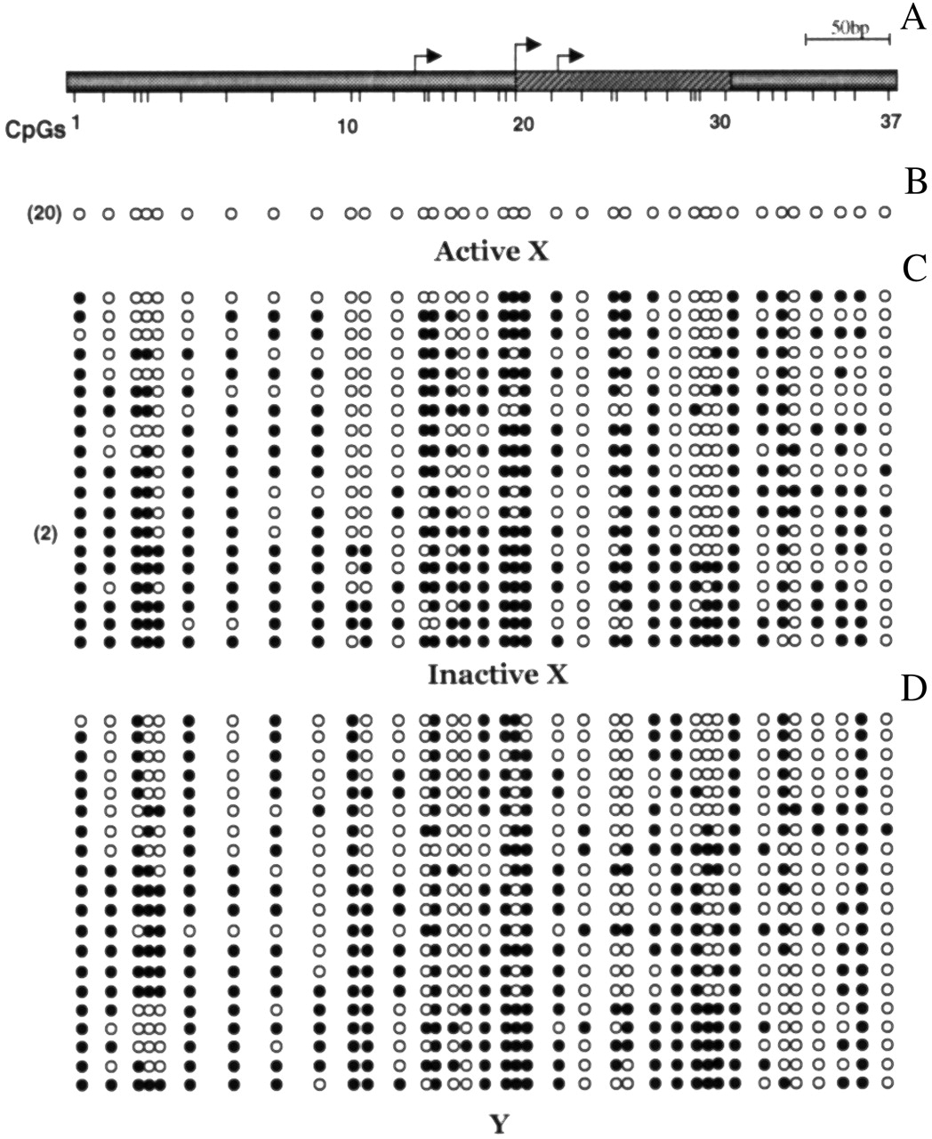
Figure 2.SYBL1 regulatory sequences are methylated on the inactive X and the Y chromosomes. (A) Schematic map ...
Notes:
Figure 2.SYBL1 regulatory sequences are methylated on the inactive X and the Y chromosomes. (A) Schematic map of the CpG island containing the 37 CpG dinucleotides examined from position −252 to +227. Transcription start sites, as defined in Huber et al. (15), are indicated. (B, C and D) Methylation profiles for the active X, inactive X and the Y chromosome from heterozygous individuals (females with highly skewed X inactivation and males) that have monoallelic SYBL1 expression. Solid and open circles represent methylated and unmethylated residues, respectively. In several experiments, SYBL1 was found to be completely unmethylated on the active X chromosome in all 20 clones analysed (the numbers on the left indicate identical clones).
Unless provided in the caption above, the following copyright applies to the content of this slide:

Slide 3
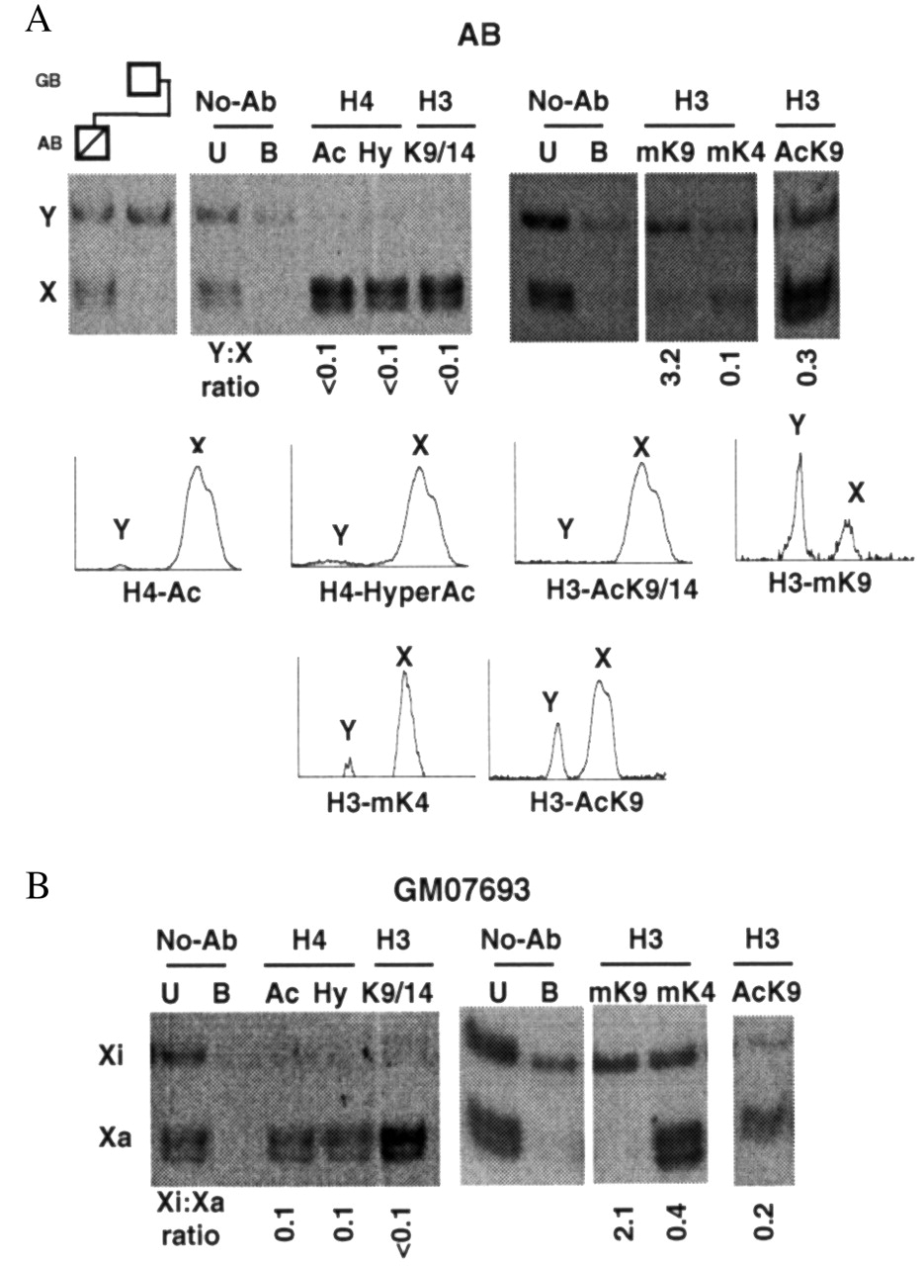
Figure 3. H4 and H3 histone modifications at the SYBL1 promoter in male (AB) (A) and female (GM07693) (B) ...
Notes:
Figure 3. H4 and H3 histone modifications at the SYBL1 promoter in male (AB) (A) and female (GM07693) (B) cell lines. (A) Far left lanes, amplifications from control DNA samples of the heterozygous male (AB) and his father (GB), respectively. From left to right, XhoI-digested PCR product from the male cells (AB) following chromatin immunoprecipitations (ChIPs). Lanes 1–2, negative control with no antibody (unbound, U, and bound, B); lane 3, acetylated histone H4 (anti-AcH4; H4 acetylated at any one of four positions in its N terminus); lane 4, hyperacetylated isoforms of histone H4 (anti-HyAcH4); lane 5, acetylated histone H3 (anti-AcK9/14H3); lanes 6–7, negative control as above; lanes 8–9, di-methylated lysine 9 (anti-mK9H3) and di-methylated lysine 4 (anti-mK4H3) of histone H3, respectively; lane 10, acetylated lysine 9 (anti-AcK9H3) of histone H3. Y/X and Xi/Xa ratios are shown beneath each lane and examples of the lane profiles used for quantification are shown. (B) The same experiment as shown in (A) was performed for female cell line GM07693. Density profiles were normalized to the no-antibody lane.
Unless provided in the caption above, the following copyright applies to the content of this slide:

Slide 4
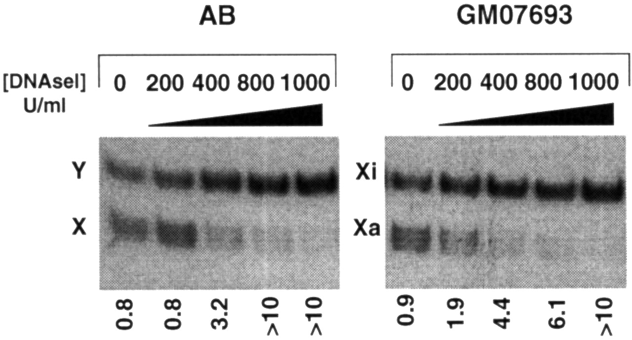
Figure 4.In vivo DNaseI accessibility at SYBL1 in male and females cells. From left to right, DNaseI ...
Notes:
Figure 4.In vivo DNaseI accessibility at SYBL1 in male and females cells. From left to right, DNaseI digestions on purified nuclei from AB (left panel) and GM07693 cells (right panel), at increasing enzyme concentrations (0, 200, 400, 800 and 1000 U/ml, respectively) in 10 min. Measured Y/X and Xi/Xa ratios are shown beneath each lane.
Unless provided in the caption above, the following copyright applies to the content of this slide:

Slide 5
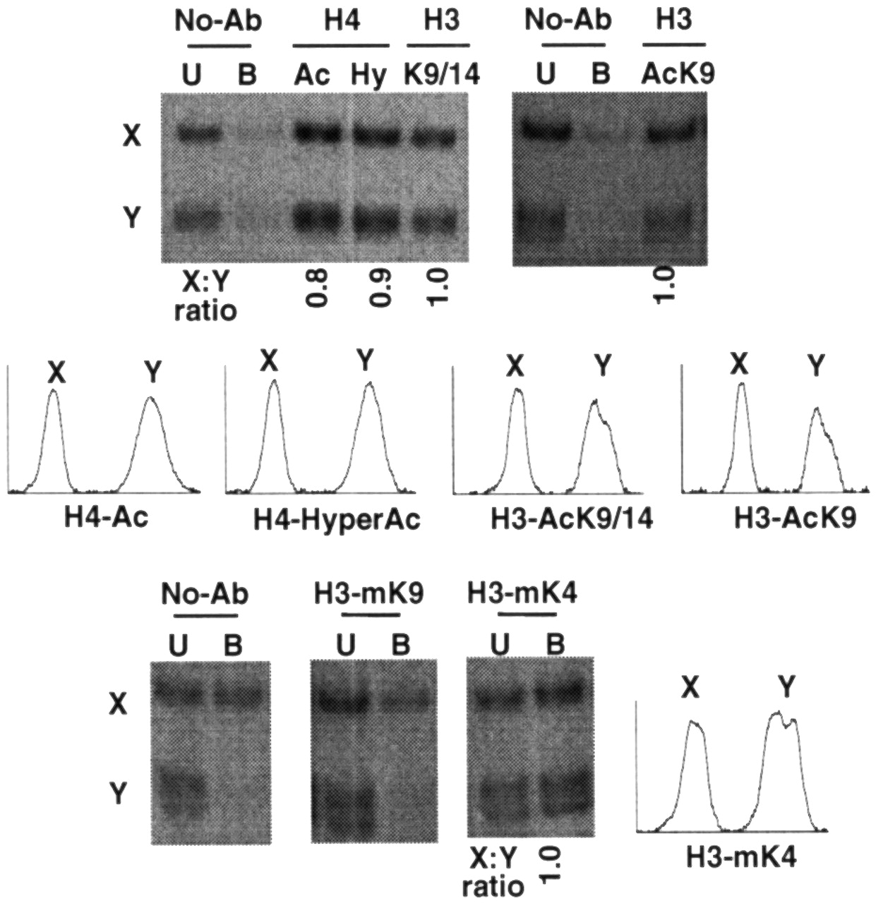
Figure 5. H4 and H3 histone modifications at SYBL1 promoter in the ICF male cell line PT5. From left to ...
Notes:
Figure 5. H4 and H3 histone modifications at SYBL1 promoter in the ICF male cell line PT5. From left to right, XhoI digested PCR product followed by chromatin immunoprecipitations. Top line: lanes 1–2, negative control with no antibody (unbound, U, and bound, B); lane 3, acetylated histone H4 (anti-AcH4; H4 acetylated at any one of four positions in its N terminus); lane 4, hyperacetylated isoforms of histone H4 (anti-HyAcH4); lane 5, acetylated histone H3 (anti-AcK9/14H3); lanes 6–8, negative control with no antibody followed by acetylated lysine 9 of histone H3 (anti-AcK9H3) antiserum. Bottom line: lanes 1–2, negative control with no antibody; lanes 3–4, di-methylated lysine 9 and di-methylated lysine 4 of histone H3 (anti-mK9H3 and anti-mK4H3, including bound, B, and unbound, U, fractions). Lane profiles used for quantification are shown. Density profiles were normalized to the no antibody lane.
Unless provided in the caption above, the following copyright applies to the content of this slide:

Slide 6
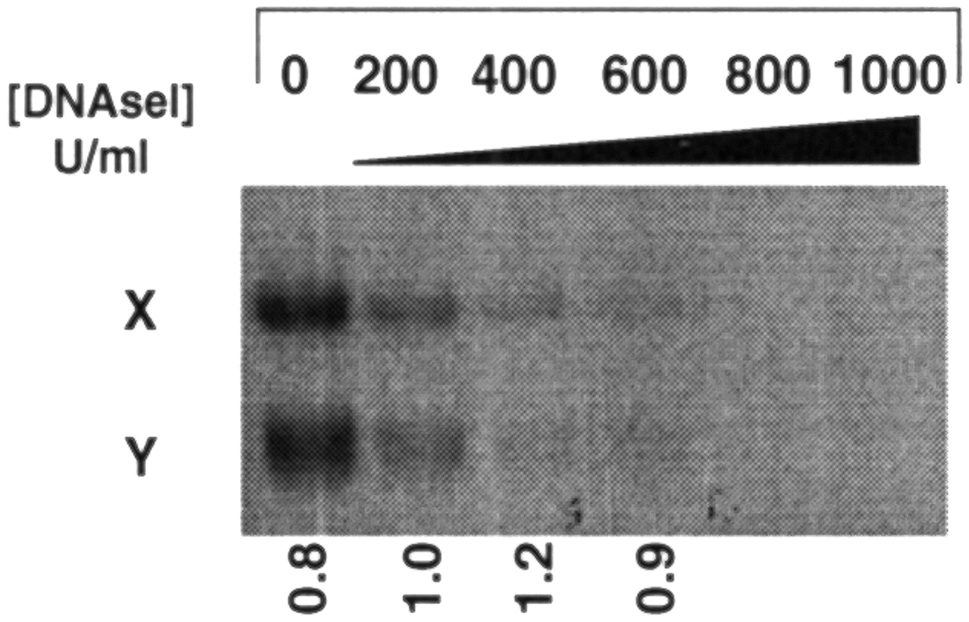
Figure 6.In vivo DNaseI accessibility at SYBL1 in the ICF male cell line PT5. From left to right: DNaseI ...
Notes:
Figure 6.In vivo DNaseI accessibility at SYBL1 in the ICF male cell line PT5. From left to right: DNaseI digestions on purified nuclei at increasing enzyme concentrations—0, 200, 400, 600, 800 and 1000 U/ml. Measured X/Y ratios are shown beneath each lane.
Unless provided in the caption above, the following copyright applies to the content of this slide:

