Slide 1
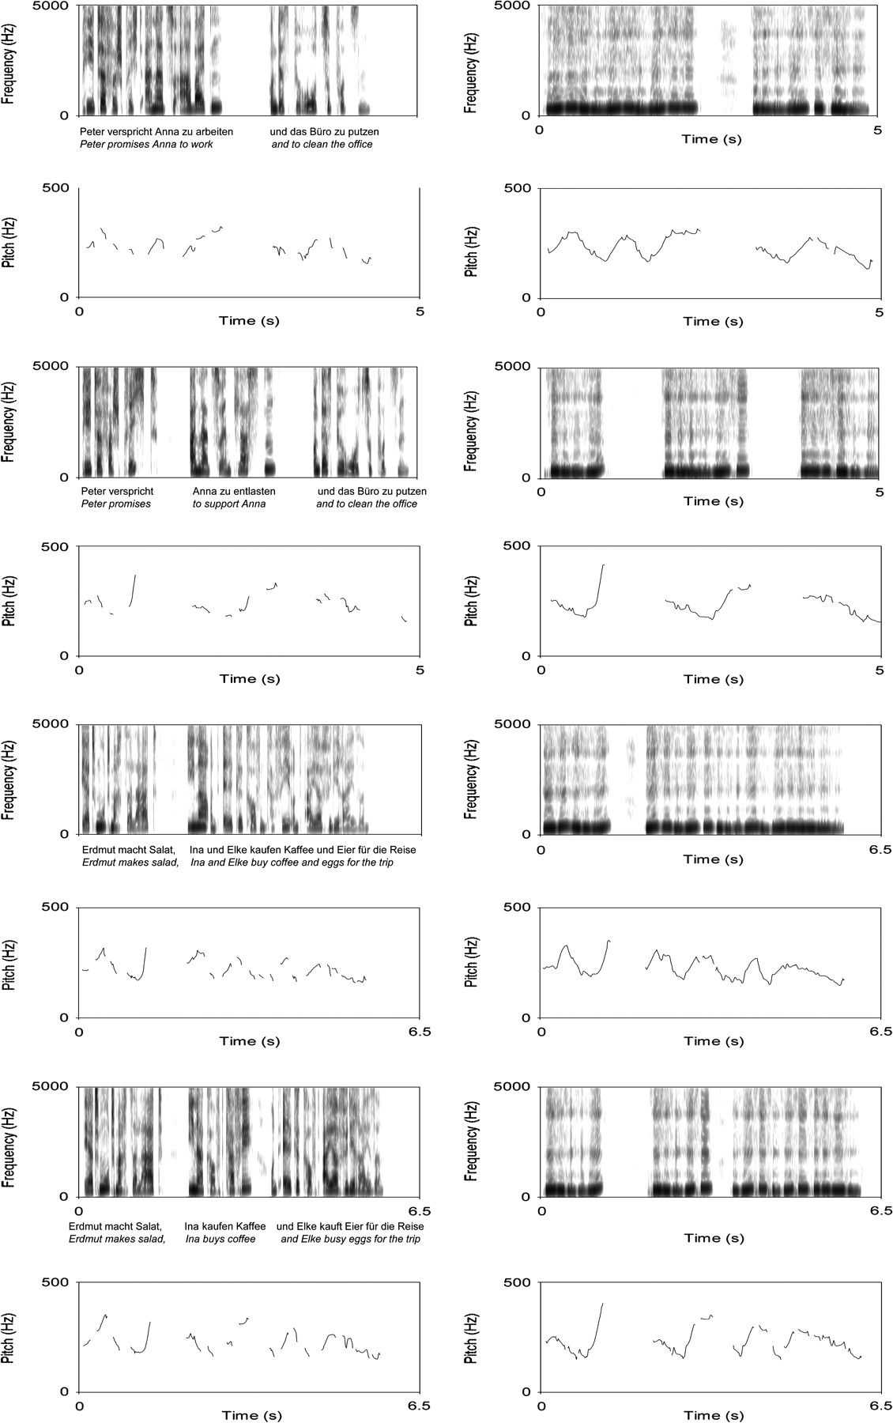
Figure 1. Spectrograms (0–5000 Hz) and fundamental frequency contours (pitch: 0–500 Hz) for sample stimuli of the ...
Notes:
Figure 1. Spectrograms (0–5000 Hz) and fundamental frequency contours (pitch: 0–500 Hz) for sample stimuli of the sentence materials used for all conditions of the experiment. Natural speech is presented on the left, the respective hummed version of the sentence on the right. Spectograms and pitch contours are given for each pair (1 and 2 IPBs) of sentence materials, for type A sentences in the top half, for type B sentences in the bottom half.
Unless provided in the caption above, the following copyright applies to the content of this slide: © The Author 2007. Published by Oxford University Press. All rights reserved. For permissions, please e-mail: journals.permissions@oxfordjournals.org

Slide 2
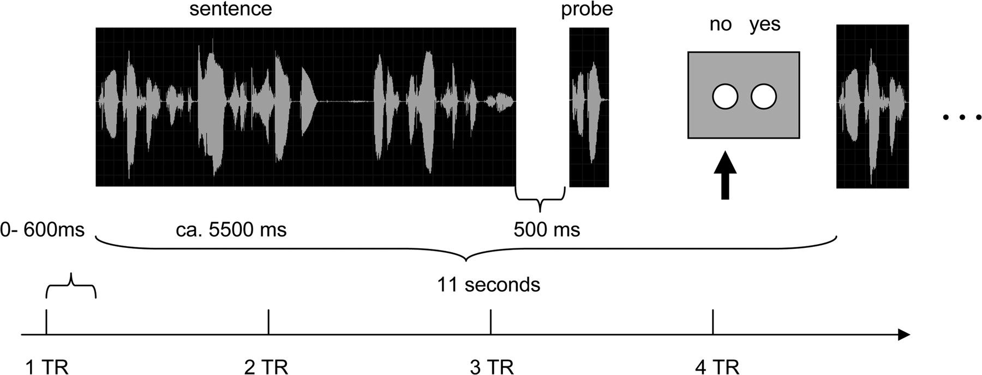
Figure 2. Trial timing scheme.
Notes:
Figure 2. Trial timing scheme.
Unless provided in the caption above, the following copyright applies to the content of this slide: © The Author 2007. Published by Oxford University Press. All rights reserved. For permissions, please e-mail: journals.permissions@oxfordjournals.org

Slide 3
Figure 3. A visualization of the 6 temporal ROIs as an ascending series of axial slices (shown only for the left ...
Notes:
Figure 3. A visualization of the 6 temporal ROIs as an ascending series of axial slices (shown only for the left hemisphere). ROIs: anterior (y > −15, light blue), middle (−15 > y > −35, yellow), and posterior (y −35, medium blue), and posterior (y < −35, orange) part of the Rolandic operculum.
Unless provided in the caption above, the following copyright applies to the content of this slide: © The Author 2007. Published by Oxford University Press. All rights reserved. For permissions, please e-mail: journals.permissions@oxfordjournals.org

Slide 4
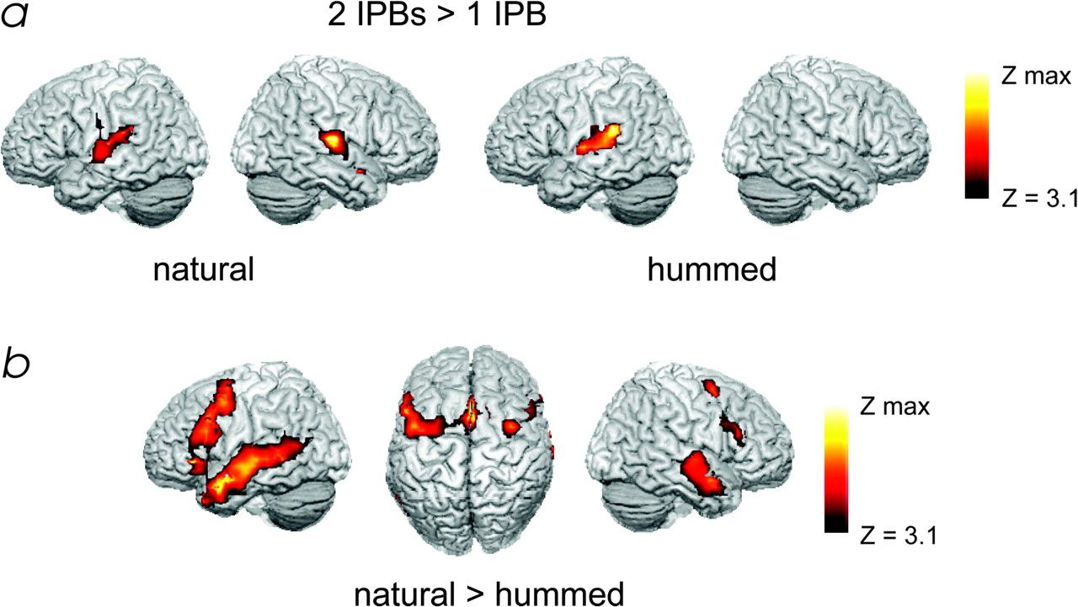
Figure 4. (a) Comparison of sentences with 2 IPBs to sentences with 1 IPB: 2 IPBs > 1 IPB. Natural speech (left) and ...
Notes:
Figure 4. (a) Comparison of sentences with 2 IPBs to sentences with 1 IPB: 2 IPBs > 1 IPB. Natural speech (left) and hummed sentences (right). (b) Comparison of speech types: natural speech > hummed sentences. Threshold: P < 0.001, uncorrected, showing only clusters with more than 40 voxels, corresponding to a P < 0.05 corrected on cluster level. Left is left in the image.
Unless provided in the caption above, the following copyright applies to the content of this slide: © The Author 2007. Published by Oxford University Press. All rights reserved. For permissions, please e-mail: journals.permissions@oxfordjournals.org

Slide 5
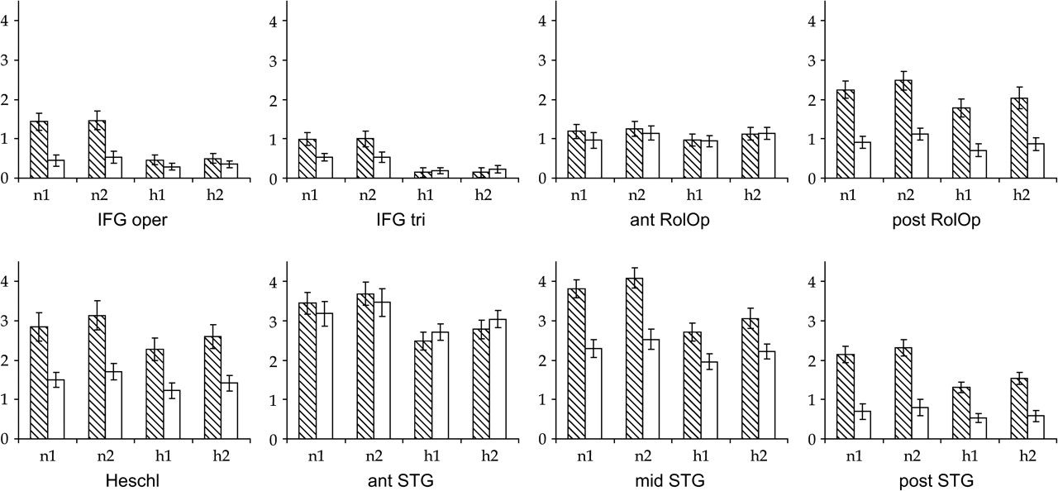
Figure 5. Results of the ROI analysis (bars with black stripes = left hemisphere, white bars = right hemisphere). ...
Notes:
Figure 5. Results of the ROI analysis (bars with black stripes = left hemisphere, white bars = right hemisphere). Effect sizes were averaged over all voxels of each ROI. Error bars represent the standard error of the mean. n1, natural speech with 2 IPBs; n2, natural speech with 2 IPBs; h1, hummed sentences with 1 IPB; h2, hummed sentences with 2 IPBs; IFG oper, inferior frontal gyrus, pars opercularis; IFG tri, inferior frontal gyrus, pars triangularis; ant/post RolOp, anterior/posterior part of the rolandic operculum; ant/mid/post STG, anterior/middle/posterior part of the STG; Heschl, gyrus of Heschl.
Unless provided in the caption above, the following copyright applies to the content of this slide: © The Author 2007. Published by Oxford University Press. All rights reserved. For permissions, please e-mail: journals.permissions@oxfordjournals.org

