Slide 1
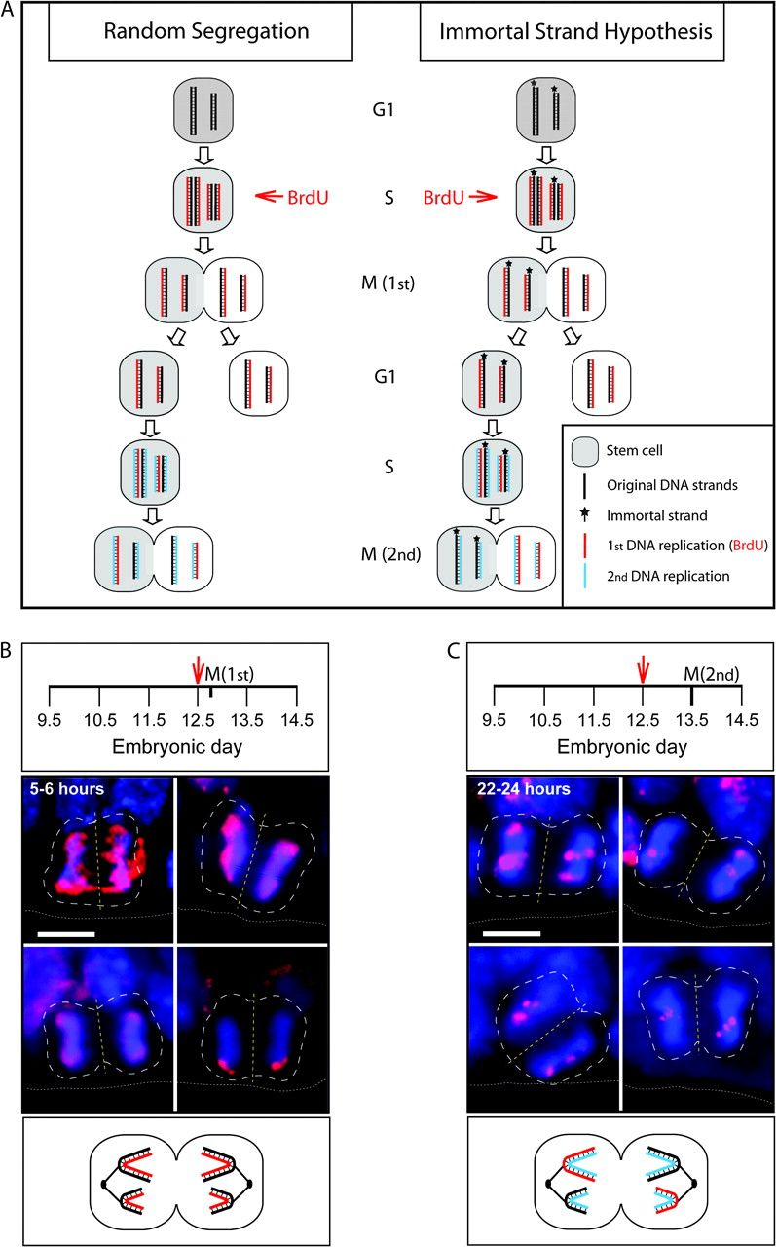
Figure 2. Lack of asymmetric distribution of BrdU-labeled DNA to the nascent daughter cells of mitotic neocortical ...
Notes:
Figure 2. Lack of asymmetric distribution of BrdU-labeled DNA to the nascent daughter cells of mitotic neocortical precursor cells. (A) Cartoon illustrating the random segregation of BrdU-labeled sister chromatids to both daughter cells during the second M-phase after BrdU labeling of a stem cell (left) and the segregation into one daughter only upon inheritance of the unlabeled immortal DNA strands by the other daughter (right). For simplicity, only 2 chromosomes (1 long and 1 short) are depicted. For details, see key. (B, C) Mouse embryos were subjected to BrdU labeling as indicated in the panels in (B, C) depicting the timescale of embryonic development; red arrows indicate single BrdU injections; “M(1st)” and “M(2nd)” indicate the time point of analysis 5–6 h after BrdU labeling (B), that is, the first M-phase after BrdU incorporation (see panel A), and 22–24 h after BrdU labeling (C), that is, the second M-phase after BrdU incorporation (see panel A), respectively. BrdU immunostaining (red) combined with DAPI staining (blue) of coronal cryosections of dorsal telencephalon is shown. White dashed lines outline the mitotic cell; yellow dashed lines indicate the cleavage plane; white dotted lines, ventricular surface. Note that irrespective of the amount of BrdU incorporation, which is different for the 4 cells in each set, the pattern of distribution of BrdU-labeled DNA to the nascent daughters is mirror symmetrical in (B) but not in (C), as also illustrated in the cartoons at the bottom (red DNA strands, see also panel A). Scale bars, 5 μm.
Unless provided in the caption above, the following copyright applies to the content of this slide: © The Author 2009. Published by Oxford University Press. All rights reserved. For permissions, please e-mail: journals.permissions@oxfordjournals.org

Slide 2
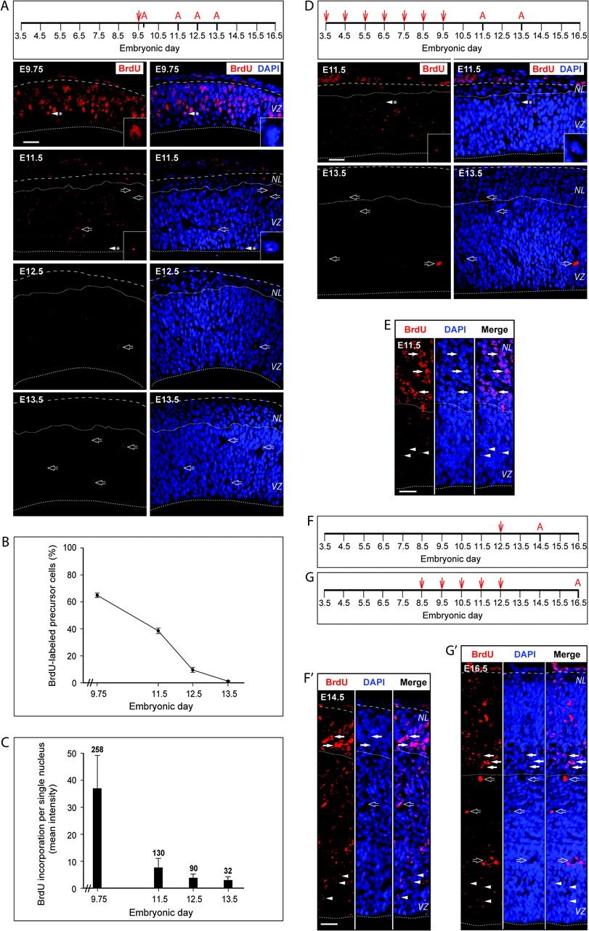
Figure 1. Lack of BrdU label–retaining precursor cells in the mouse embryonic neocortex. Mouse embryos were subjected ...
Notes:
Figure 1. Lack of BrdU label–retaining precursor cells in the mouse embryonic neocortex. Mouse embryos were subjected to BrdU labeling as indicated in the panels in (A, D, F, G) depicting the timescale of embryonic development; red arrows indicate single BrdU injections and red letters “A” time points of analyses. (A, D–G′) BrdU immunostaining (red) and DAPI staining (blue), shown alone or merged as indicated, of coronal cryosections of dorsal telencephalon (A, D, F′, G′) and hindbrain (E; BrdU labeling as in D) at the indicated stages of embryonic development. Arrowheads with asterisks, single nuclei shown at higher magnification in the insets (note that the top right inset in A is DAPI staining only); open arrows, autofluorescent blood vessels; arrowheads, precursor cell nuclei with sparse BrdU immunoreactivity; arrows, neuronal nuclei with abundant BrdU immunoreactivity; dotted lines, ventricular surface; dashed lines, basal lamina; solid lines, boundary between the germinal layers and the NL. Scale bars, 20 μm. (B) Quantitation of BrdU-immunoreactive precursor cells in the VZ and, when present, subventricular zone after BrdU labeling as in (A). Data are expressed as a percentage of total cells present in the area of quantification, as determined by DAPI staining, and are the mean of 12 (E9.75), 6 (E11.5), 4 (E12.5), and 6 (E13.5) images; bars indicate standard deviation (SD). (C) Quantitation of the BrdU incorporation per single precursor cell nucleus after BrdU labeling as in (A). Data indicate the average intensity per nuclear area and are the mean of the indicated number of nuclei; bars indicate SD.
Unless provided in the caption above, the following copyright applies to the content of this slide: © The Author 2009. Published by Oxford University Press. All rights reserved. For permissions, please e-mail: journals.permissions@oxfordjournals.org

