Slide 1
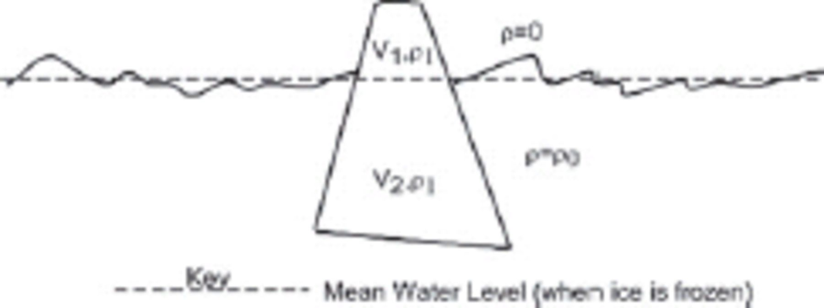
Figure 1. A schematic of floating ice, with geometry appropriate to an iceberg (for ice sheets and sea ice see next ...
Notes:
Figure 1. A schematic of floating ice, with geometry appropriate to an iceberg (for ice sheets and sea ice see next figure). The exposed part has volume V1 and the submerged part V2. The ice has density ρ1 (unimportant) while the sea water or brine has density ρ0.
Unless provided in the caption above, the following copyright applies to the content of this slide: © 2007 The Author Journal compilation © 2007 RAS

Slide 2
Figure 2. A schematic of sea ice or an ice shelf floating. The exposed part has volume V₁ and the submerged ...
Notes:
Figure 2. A schematic of sea ice or an ice shelf floating. The exposed part has volume V1 and the submerged part V2. The densities are as denoted in Fig. 1 and the dashed line again indicated sea level. The thickness T is the sum of the freeboard h1 and the draft h2. The area A is not shown, as the slab is edge-on.
Unless provided in the caption above, the following copyright applies to the content of this slide: © 2007 The Author Journal compilation © 2007 RAS

Slide 3
Table 1. Materials for the experiment.
Notes:
Table 1. Materials for the experiment.
Unless provided in the caption above, the following copyright applies to the content of this slide: © 2007 The Author Journal compilation © 2007 RAS

Slide 4
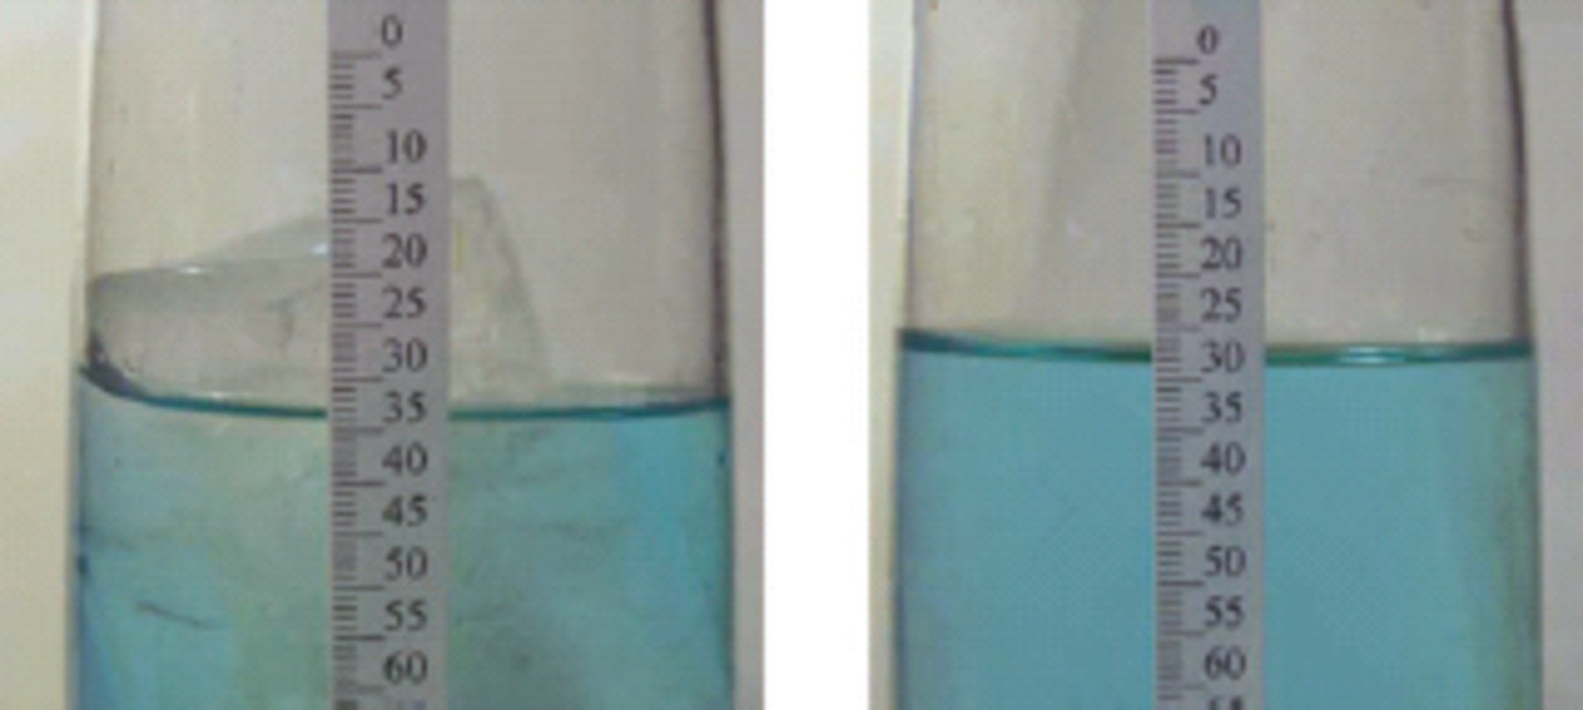
Figure 3. Composite of initial and final state photographs. (left-hand panel) pre-melting and (right-hand panel) ...
Notes:
Figure 3. Composite of initial and final state photographs. (left-hand panel) pre-melting and (right-hand panel) melted.
Unless provided in the caption above, the following copyright applies to the content of this slide: © 2007 The Author Journal compilation © 2007 RAS

