Slide 1
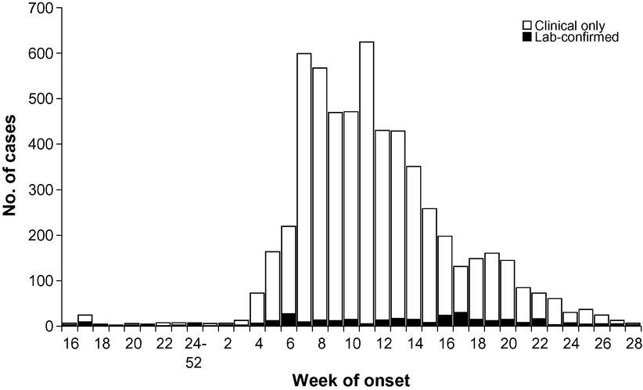
Figure 1 Notified cases of Chikungunya fever in Mayotte, April 2005–July 2006.
Notes:
Figure 1 Notified cases of Chikungunya fever in Mayotte, April 2005–July 2006.
Unless provided in the caption above, the following copyright applies to the content of this slide: © Royal Society of Tropical Medicine and Hygiene 2008

Slide 2
Table 1 Incidence of clinical or confirmed cases of Chikungunya according to the geographic region of Mayotte (1 ...
Notes:
Table 1 Incidence of clinical or confirmed cases of Chikungunya according to the geographic region of Mayotte (1 January to 7 May 2006)
Unless provided in the caption above, the following copyright applies to the content of this slide: © Royal Society of Tropical Medicine and Hygiene 2008

Slide 3
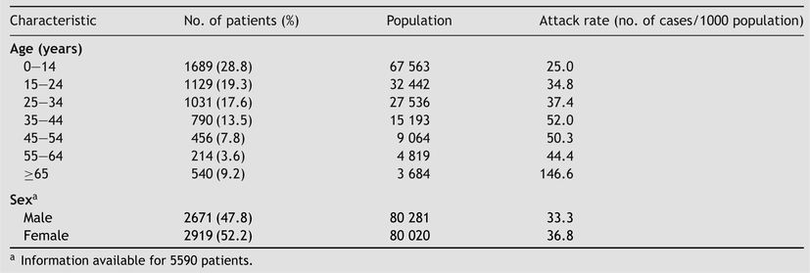
Table 2 Demographic characteristics of 5849 patients notified of Chikungunya infection and population attack rates in ...
Notes:
Table 2 Demographic characteristics of 5849 patients notified of Chikungunya infection and population attack rates in Mayotte (1 January to 7 May 2006)
Unless provided in the caption above, the following copyright applies to the content of this slide: © Royal Society of Tropical Medicine and Hygiene 2008

Slide 4
Table 3 Proportion of antibodies against Chikungunya virus in the serum of pregnant women in Mayotte (October 2005 to ...
Notes:
Table 3 Proportion of antibodies against Chikungunya virus in the serum of pregnant women in Mayotte (October 2005 to March/April 2006)
Unless provided in the caption above, the following copyright applies to the content of this slide: © Royal Society of Tropical Medicine and Hygiene 2008

