Slide 1
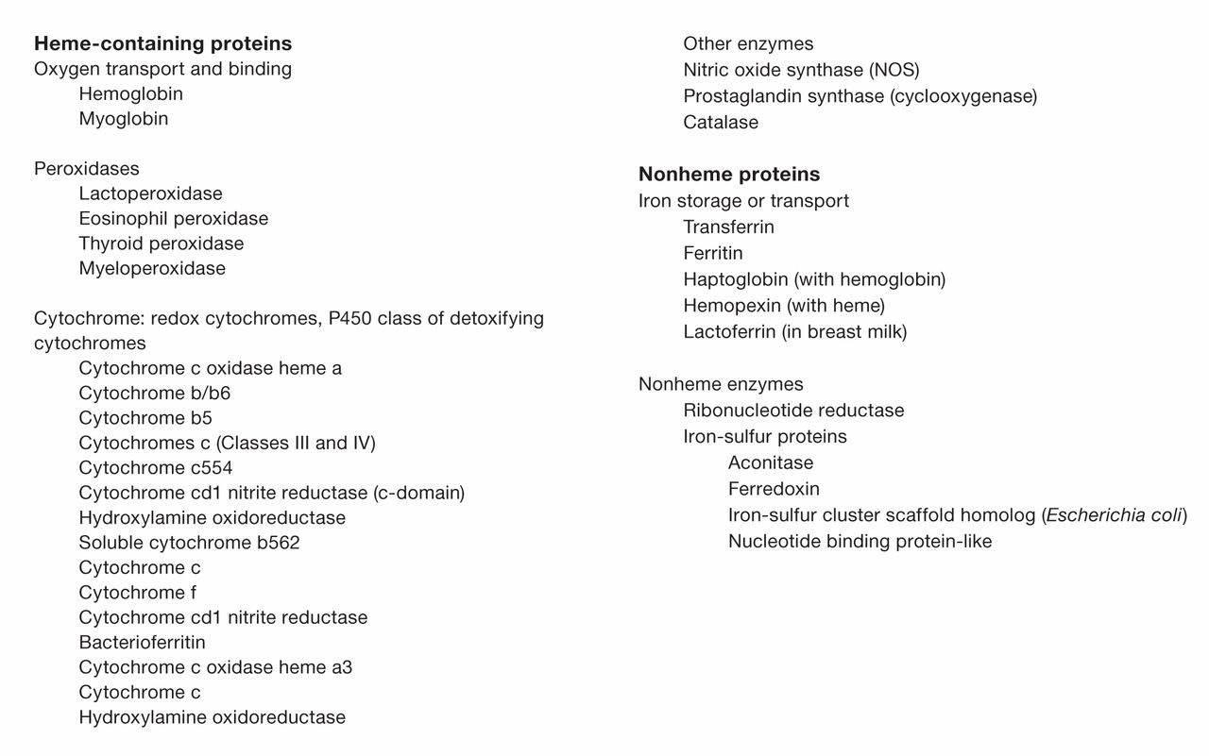
Figure 1 Heme and nonheme containing proteins.
Notes:
Figure 1 Heme and nonheme containing proteins.
Unless provided in the caption above, the following copyright applies to the content of this slide: © American Society of Clinical Pathologists

Slide 2
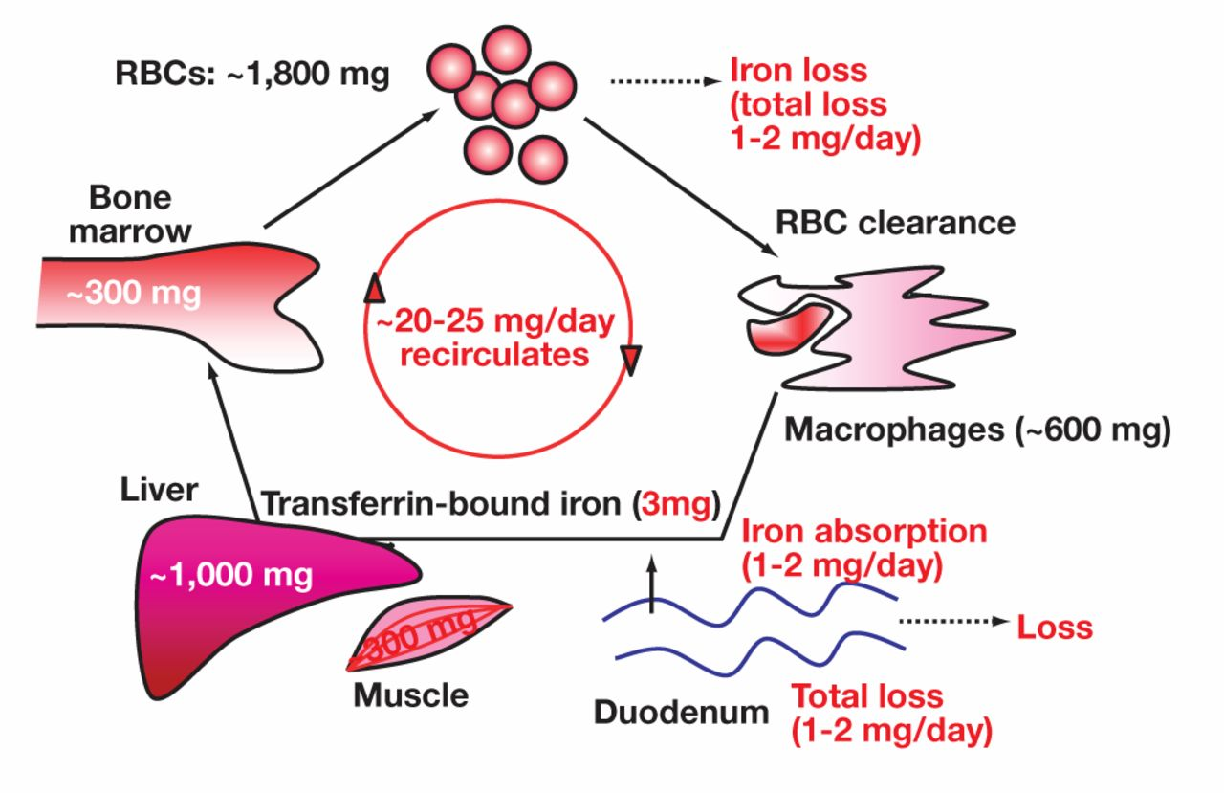
Figure 2 Normal iron biology. This process involves the transit of iron from the bone marrow as red blood cells (RBCs) ...
Notes:
Figure 2 Normal iron biology. This process involves the transit of iron from the bone marrow as red blood cells (RBCs) to the spleen for removal by macrophages with iron recycled to the bone marrow via transferrin. The intestine absorbs iron to balance the iron that is lost daily.
Unless provided in the caption above, the following copyright applies to the content of this slide: © American Society of Clinical Pathologists

Slide 3
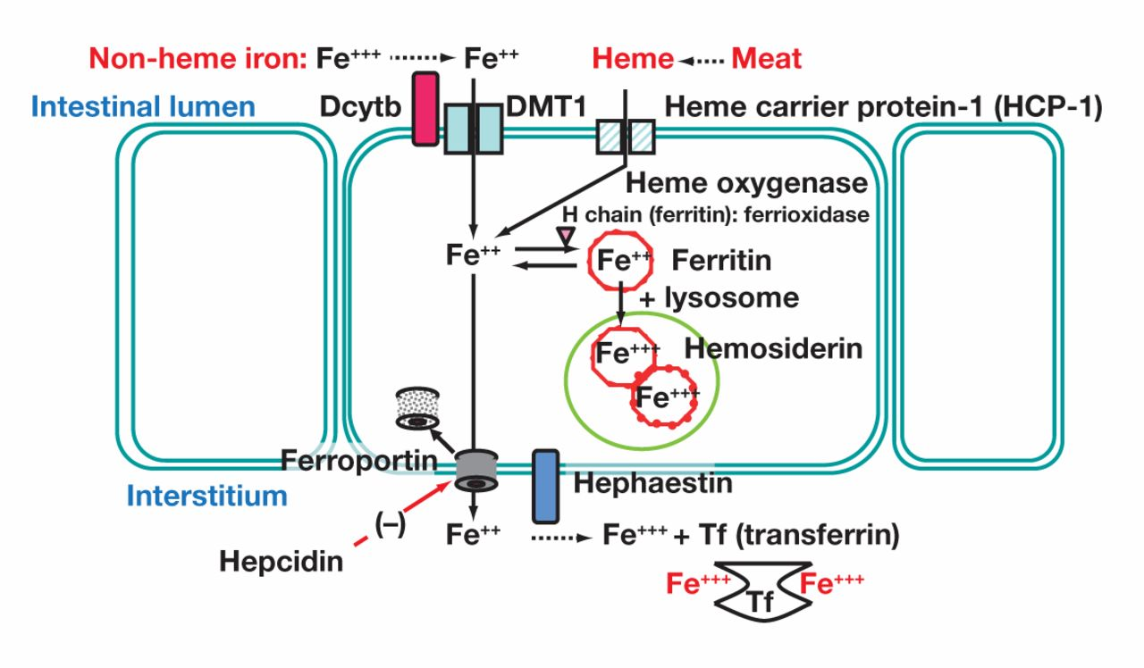
Figure 3 Depiction of the clearance of ferroportin from the cell membrane by hepcidin, the export of ferrous iron by ...
Notes:
Figure 3 Depiction of the clearance of ferroportin from the cell membrane by hepcidin, the export of ferrous iron by ferroportin, the oxidation of ferrous iron to ferric iron by hephaestin, and the subsequent loading of ferric iron onto transferrin. Enterocytes regulate total body iron through the absorption of iron. Heme iron from meat is better absorbed than elemental iron. Hepcidin is a major regulator of this process.
Unless provided in the caption above, the following copyright applies to the content of this slide: © American Society of Clinical Pathologists

Slide 4
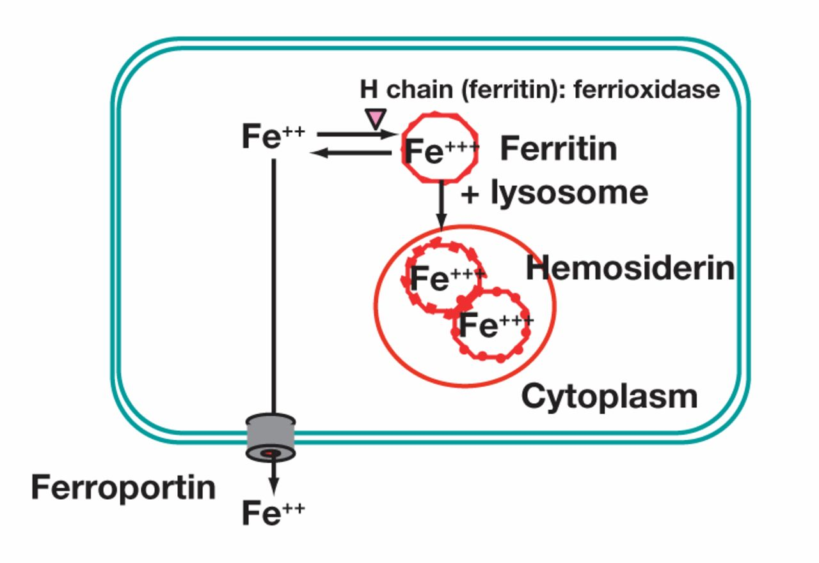
Figure 4 Depiction of the within-cell process of ferrous iron oxidized to ferric iron to be incorporated into ...
Notes:
Figure 4 Depiction of the within-cell process of ferrous iron oxidized to ferric iron to be incorporated into ferritin, or ferrous iron exported outside the cell by ferroportin.
Unless provided in the caption above, the following copyright applies to the content of this slide: © American Society of Clinical Pathologists

Slide 5
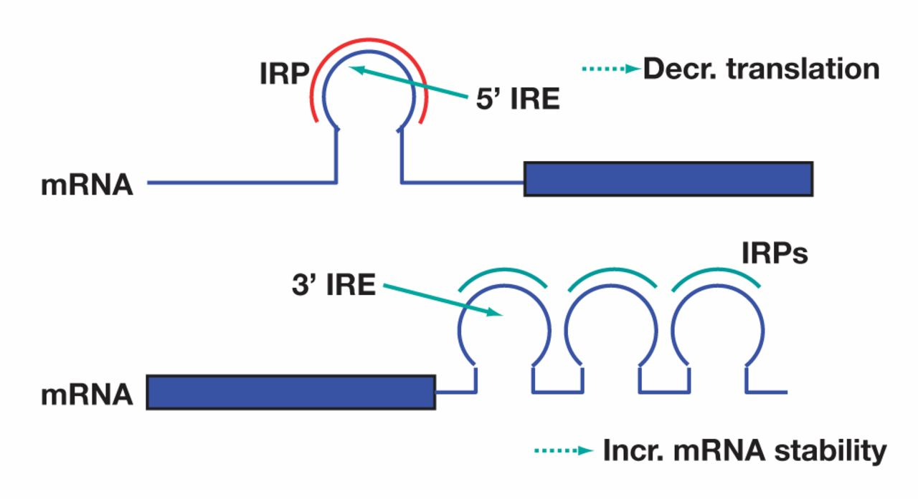
Figure 5 Iron regulatory proteins (IRPs) that bind to the 5′ iron-responsive elements (IREs) within messenger RNA ...
Notes:
Figure 5 Iron regulatory proteins (IRPs) that bind to the 5′ iron-responsive elements (IREs) within messenger RNA (mRNA) impairs the translation of such chains. IRPs that bind to the 3′ iron-responsive elements (IREs) within mRNA stabilizes the mRNA, leading to the increased translation.
Unless provided in the caption above, the following copyright applies to the content of this slide: © American Society of Clinical Pathologists

Slide 6
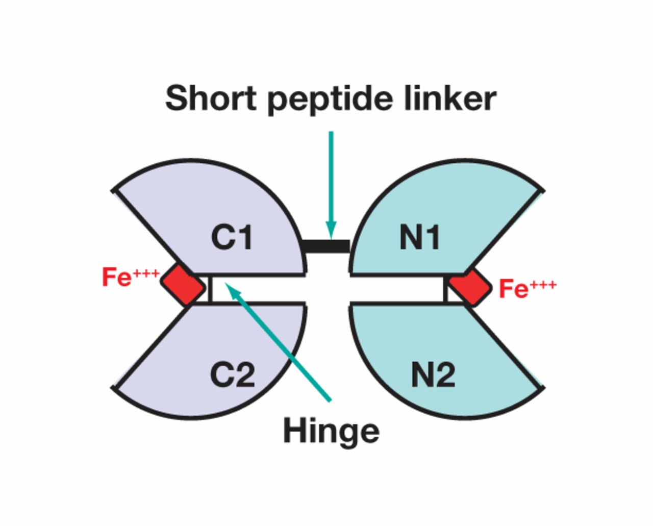
Figure 6 Depiction of the transferrin glycoprotein. Transferrin is composed of 2 lobes, namely, the C-lobe and the ...
Notes:
Figure 6 Depiction of the transferrin glycoprotein. Transferrin is composed of 2 lobes, namely, the C-lobe and the N-lobe. Each lobe binds 1 ferric atom. There is a hinge between the C1 and C2 domains of the C-lobe and also a hinge between the N1and N2 domains of the N-lobe.
Unless provided in the caption above, the following copyright applies to the content of this slide: © American Society of Clinical Pathologists

Slide 7
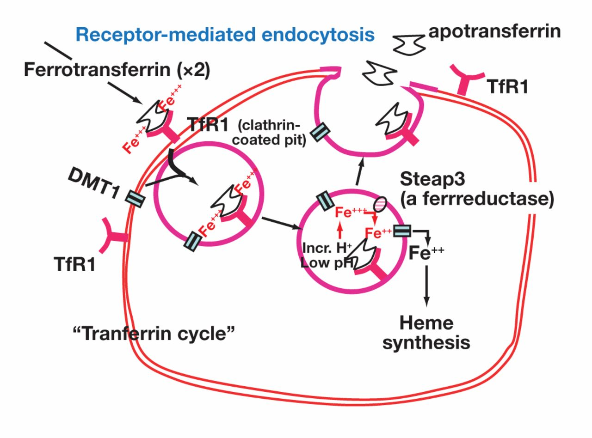
Figure 7 Depiction of the erythroblasts that take up transferrin by the binding of transferrin to the transferrin ...
Notes:
Figure 7 Depiction of the erythroblasts that take up transferrin by the binding of transferrin to the transferrin receptor 1 (TfR1). For simplicity, the drawing shows 1 transferrin molecule binding to TfR1. However, according to the correct stoichiometric information, TfR1 can bind 2 transferrin molecules. The divalent metal ion transporter 1 (DMT1) is internalized with the internalization of the transferrin-TfR1 complex. With acidification of this vesicle, transferrin releases ferric iron. By reduction to ferrous iron via the 6-transmembrane epithelial antigen of the prostate-3 (STAEP-3), iron enters the cytoplasm of the cell via DMT1. Transferrin is then released from the cell as the TfR1 recycles to the erythroblast plasma membrane. This process is termed the transferrin cycle.
Unless provided in the caption above, the following copyright applies to the content of this slide: © American Society of Clinical Pathologists

Slide 8
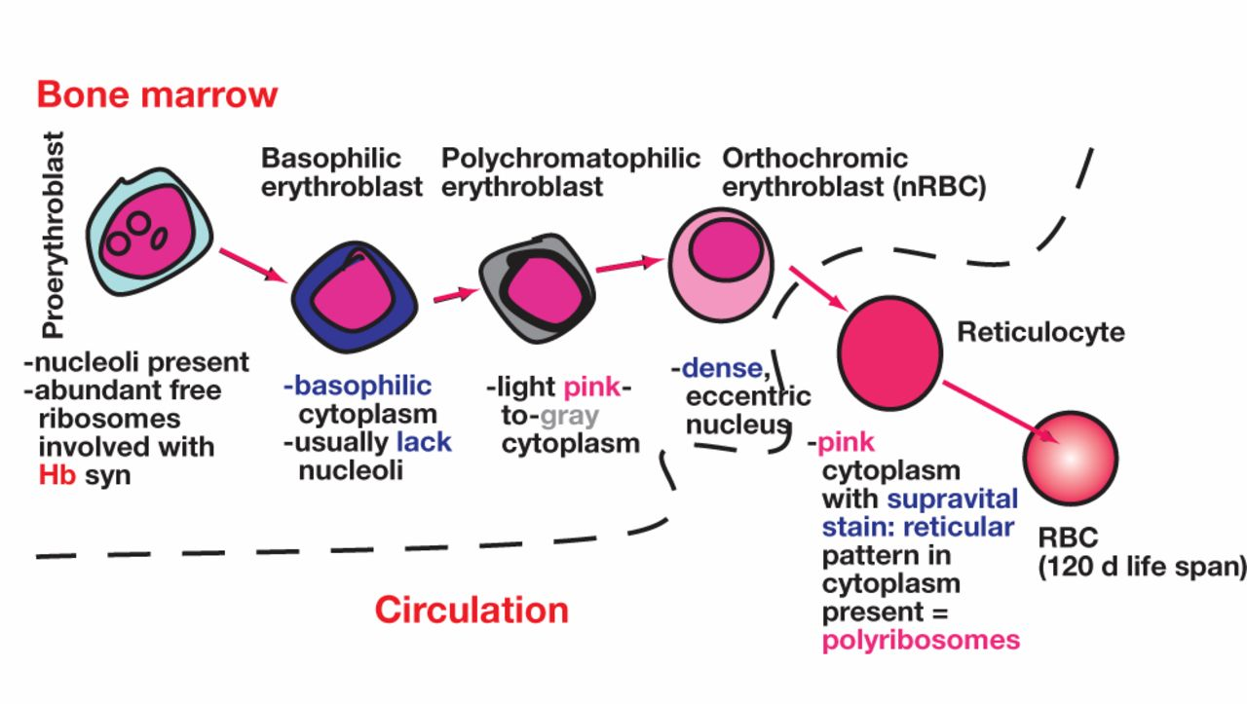
Figure 8 Outline of the stages of red blood cell (RBC) development. Hb refers to hemoglobin; nRBC, nucleated red blood ...
Notes:
Figure 8 Outline of the stages of red blood cell (RBC) development. Hb refers to hemoglobin; nRBC, nucleated red blood cell.
Unless provided in the caption above, the following copyright applies to the content of this slide: © American Society of Clinical Pathologists

Slide 9
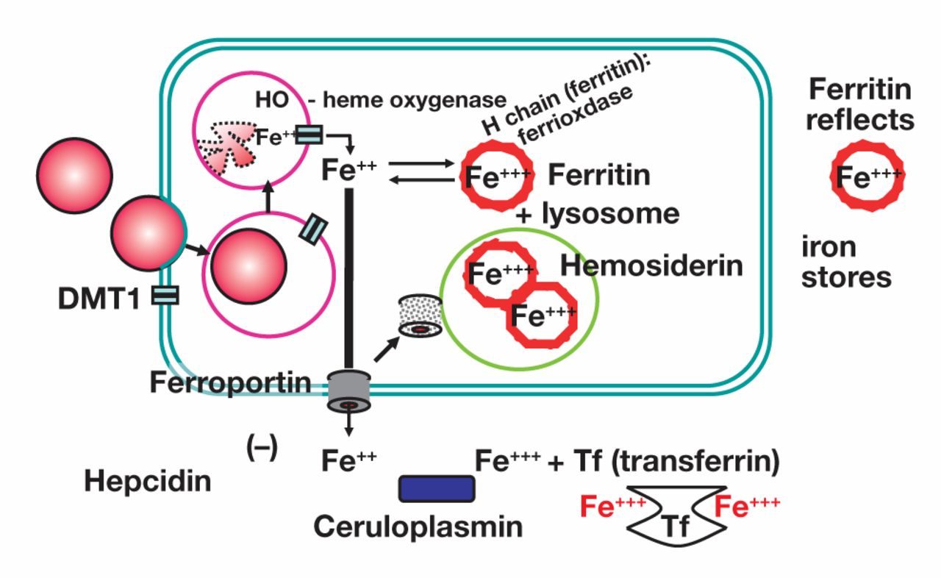
Figure 9 Illustration of splenic macrophages phagocytizing damaged red blood cells (RBCs). Similar to erythrocytes, ...
Notes:
Figure 9 Illustration of splenic macrophages phagocytizing damaged red blood cells (RBCs). Similar to erythrocytes, divalent metal ion transporter–1 (DMT1) is internalized concurrent with this process. With digestion of the RBC, heme is released. Heme oxygenase (HO) then removes ferrous iron from heme that enters the cell cytoplasm via DMT1. Ferrous iron that exits the cell via ferroportin is oxidized to ferric iron for loading onto transferrin via the action of ceruloplasmin.
Unless provided in the caption above, the following copyright applies to the content of this slide: © American Society of Clinical Pathologists

Slide 10
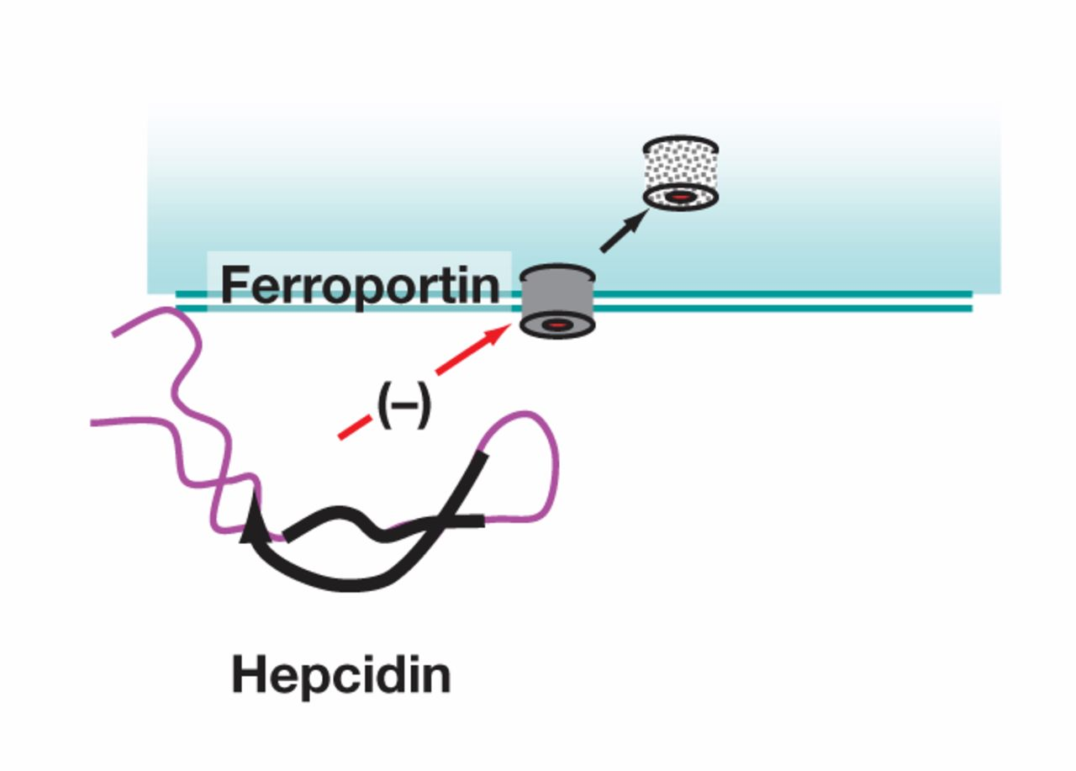
Figure 10 Line drawing of the currently understood tertiary structure of hepcidin. Hepcidin binds to ferroportin to ...
Notes:
Figure 10 Line drawing of the currently understood tertiary structure of hepcidin. Hepcidin binds to ferroportin to initiate the internalization and metabolism of ferroportin. Consequently, cellular release of iron is reduced.
Unless provided in the caption above, the following copyright applies to the content of this slide: © American Society of Clinical Pathologists

Slide 11
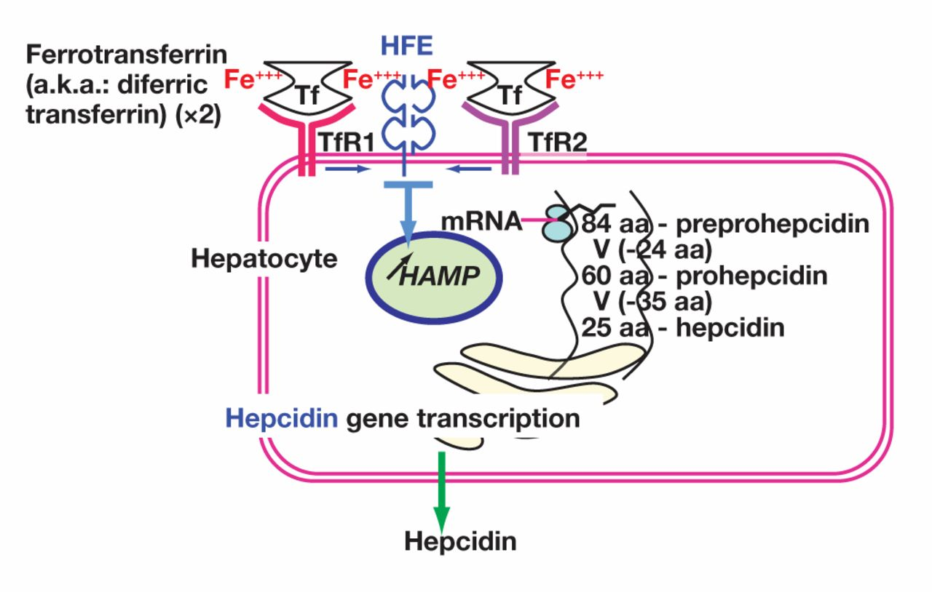
Figure 11 Depiction of how hepatocytes monitor transferrin saturation via transferrin receptor 1 (TfR1) and transferrin ...
Notes:
Figure 11 Depiction of how hepatocytes monitor transferrin saturation via transferrin receptor 1 (TfR1) and transferrin receptor 2 (TfR2). HFE is involved in this process. mRNA refers to messenger RNA; HAMP, hepcidin (hepatic) antimicrobial peptide.
Unless provided in the caption above, the following copyright applies to the content of this slide: © American Society of Clinical Pathologists

Slide 12
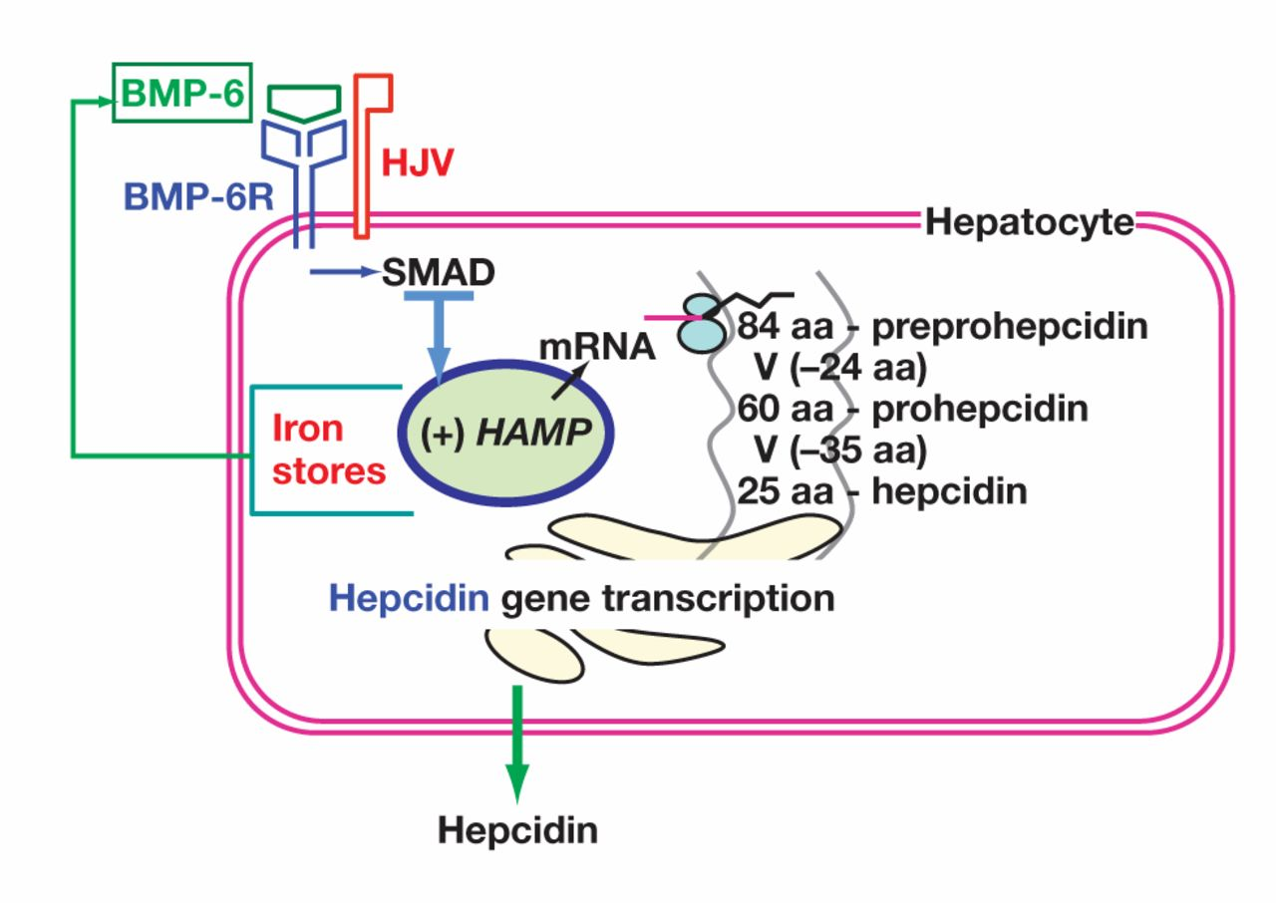
Figure 12 Depiction of hepatocyte monitoring of tissue iron content. This process is afforded by the secretion of bone ...
Notes:
Figure 12 Depiction of hepatocyte monitoring of tissue iron content. This process is afforded by the secretion of bone morphogenetic protein 6 (BMP-6). BMP-6 binds to its receptor, BMP-6R. Hemojuvelin (HJV) is involved in this signaling process.
Unless provided in the caption above, the following copyright applies to the content of this slide: © American Society of Clinical Pathologists

Slide 13
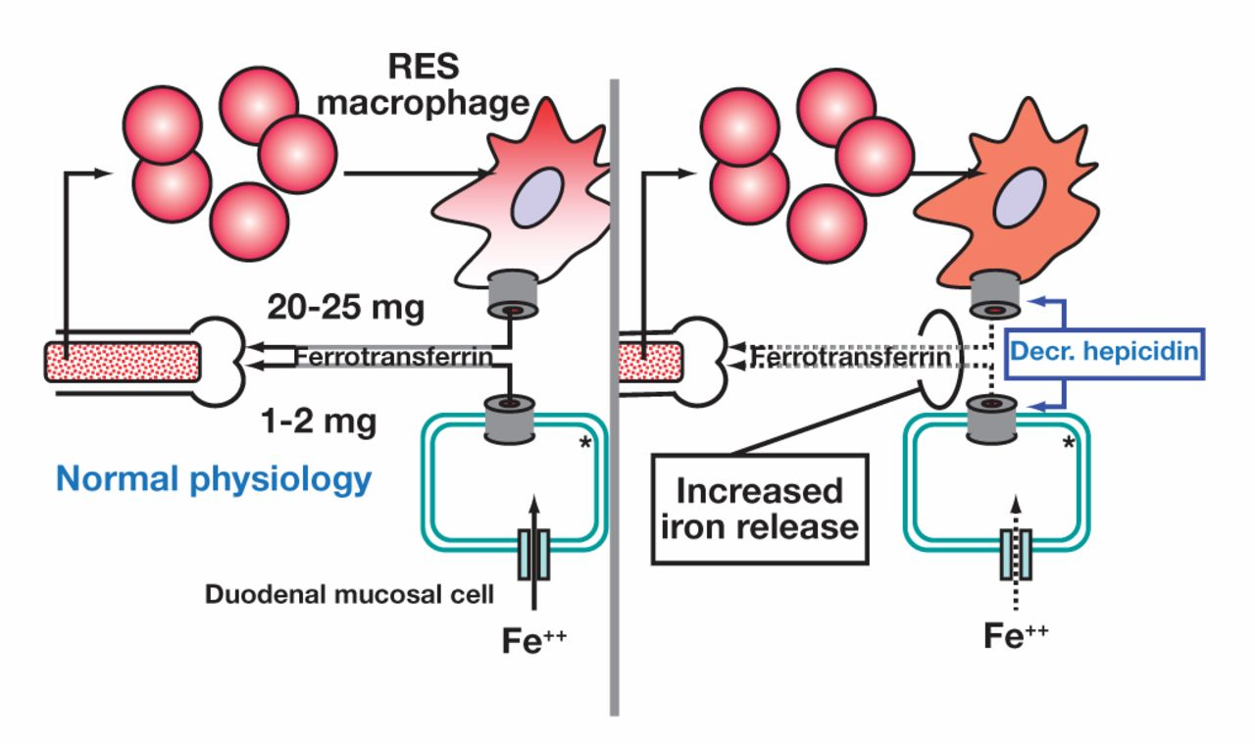
Figure 13 Depiction of iron cycling and hepcidin deficiency with decreased plasma hepcidin concentrations. A, The ...
Notes:
Figure 13 Depiction of iron cycling and hepcidin deficiency with decreased plasma hepcidin concentrations. A, The normal state of iron cycling. B, hepcidin deficiency. Decreased plasma hepcidin concentrations permit hyperabsorption of iron and iron overload.
Unless provided in the caption above, the following copyright applies to the content of this slide: © American Society of Clinical Pathologists

Slide 14
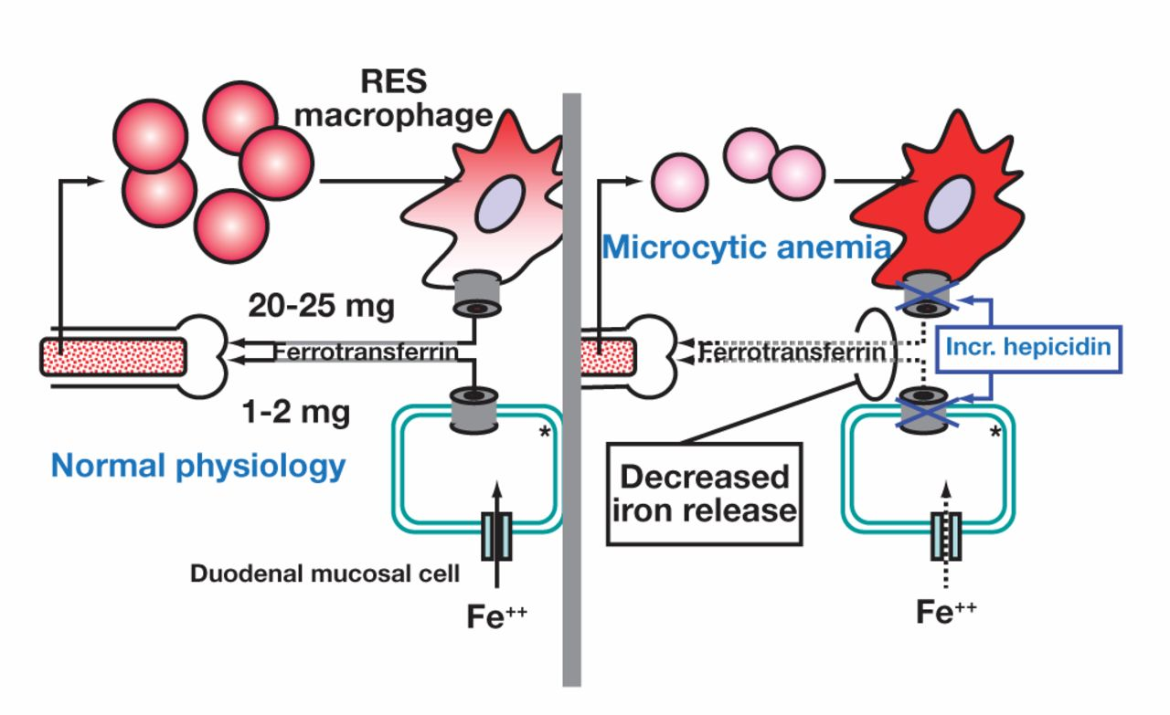
Figure 14 Depiction of iron cycling and hepcidin deficiency with increased plasma hepcidin concentrations. A, The ...
Notes:
Figure 14 Depiction of iron cycling and hepcidin deficiency with increased plasma hepcidin concentrations. A, The normal state of iron cycling. B, Hepcidin excess. Increased plasma hepcidin concentrations impair iron availability to the bone marrow, causing iron-restricted anemia.
Unless provided in the caption above, the following copyright applies to the content of this slide: © American Society of Clinical Pathologists

