Slide 1
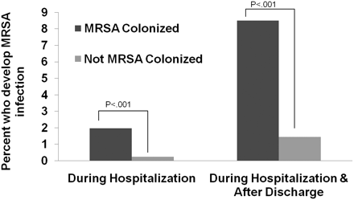
Figure 1. Impact of methicillin-resistant Staphylococcus aureus (MRSA) colonization on risk of subsequent infection in ...
Notes:
Figure 1. Impact of methicillin-resistant Staphylococcus aureus (MRSA) colonization on risk of subsequent infection in critically ill children. The risk of developing a subsequent MRSA infection was compared for children with and without MRSA colonization at time of admission to the pediatric intensive care unit. Patients were monitored for an infection during their hospitalization and after hospital discharge.
Unless provided in the caption above, the following copyright applies to the content of this slide: © The Author 2011. Published by Oxford University Press on behalf of the Infectious Diseases Society of America. All rights reserved. For Permissions, please e-mail: journals.permissions@oup.com.

