Slide 1
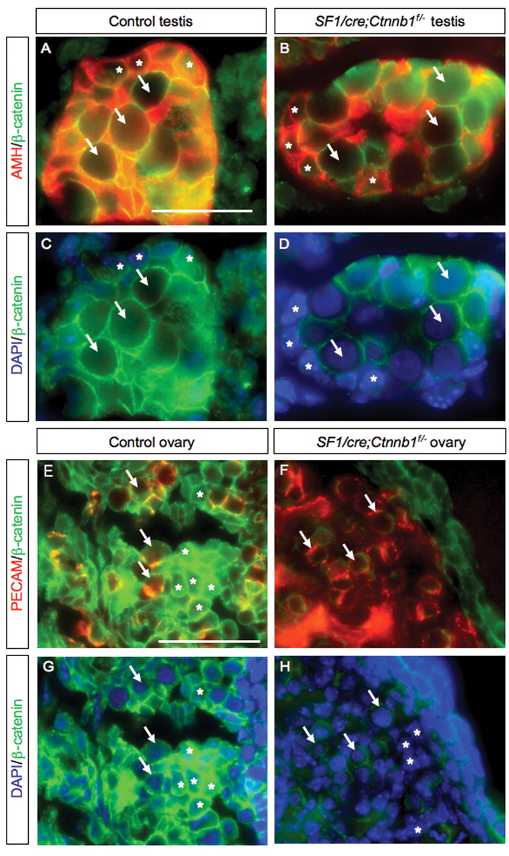
Figure 1. Immunofluorescence analysis of β-catenin, AMH, and PECAM in control and SF1 /cre;Ctnnb1^{f/−} testes ...
Notes:
Figure 1. Immunofluorescence analysis of β-catenin, AMH, and PECAM in control and SF1 /cre;Ctnnb1f/− testes and ovaries. ( A and B ) are double-staining for AMH (Sertoli cell marker in red) and β-catenin (green) in control and mutant testes at E15.5. ( C and D ) are the same sections in (A) and (B) stained with β-catenin (green) and DAPI (blue). ( E and F ) are double-staining for PECAM (germ cells and endothelial cell marker in red) and β-catenin (green) in control and mutant ovaries at E12.5. ( G and H ) are the same sections in (E) and (F) stained with β-catenin (green) and DAPI (blue). Arrows and asterisks indicate germ cells and somatic cells, respectively. Scale bars represent 25 and 50 µm in (A–D) and (E–H), respectively. All experiments were performed on at least three animals for each genotype.
Unless provided in the caption above, the following copyright applies to the content of this slide: © The Author 2008. Published by Oxford University Press. All rights reserved. For Permissions, please email: journals.permissions@oxfordjournals.org

Slide 2
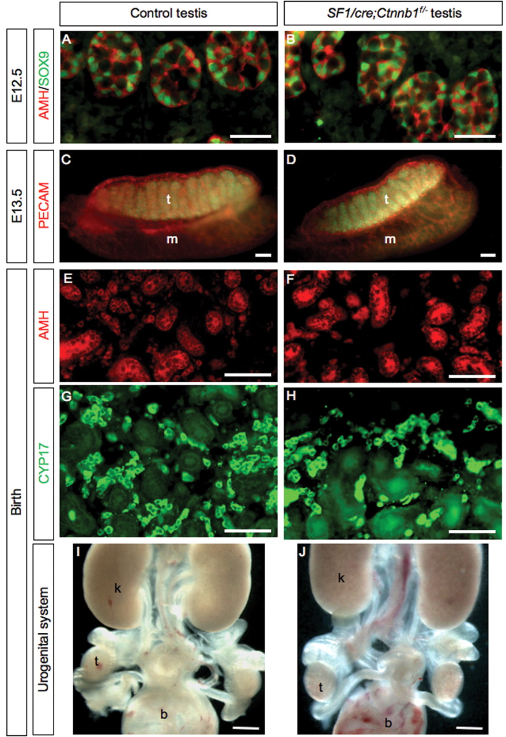
Figure 2. Development of testis and reproductive system in control and SF1/cre;Ctnnb1^{f/−} male. ( A and B ) ...
Notes:
Figure 2. Development of testis and reproductive system in control and SF1/cre;Ctnnb1f/− male. ( A and B ) are double immunohistochemistry for the Sertoli cell marker AMH (red) and SOX9 (green) at E12.5. ( C and D ) are whole-mount immunohistochemistry of E13.5 testes and mesonephroi stained with PECAM antibody, a marker for vasculature and primordial germ cells. ( E and F ) are immunohistochemistry for Sertoli cell markers AMH and ( G and H ) are immunohistochemistry for Leydig cell marker CYP17 in newborn testes. ( I and J ) are whole-mount light field microscopic image of the urogenital system at birth. Scale bars represent 20 µm (A and B), 100 µm (C–H) and 500 µm (I and J), respectively. b, bladder; k, kidney; m, mesonephros; t, testis.
Unless provided in the caption above, the following copyright applies to the content of this slide: © The Author 2008. Published by Oxford University Press. All rights reserved. For Permissions, please email: journals.permissions@oxfordjournals.org

Slide 3
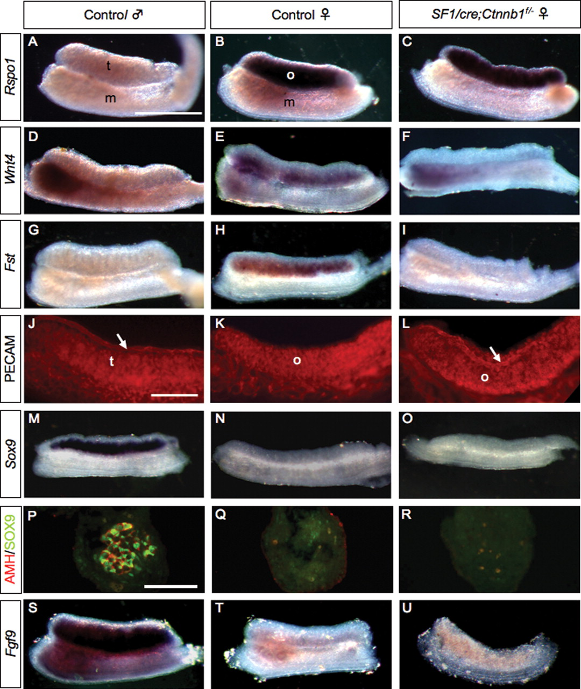
Figure 3. Expression of gonadal markers in control and SF1/cre;Ctnnb1^{f/−} ovaries and testes. ( A – C ), ( D ...
Notes:
Figure 3. Expression of gonadal markers in control and SF1/cre;Ctnnb1f/− ovaries and testes. ( A – C ), ( D – F ) and ( G – I ) are whole-mount in situ hybridization at E12.5 for Rspo1, Wnt4 and Fst , respectively. ( J – L ) are whole-mount immunohistochemistry for PECAM (red) at E12.5. ( M – O ) and ( S – U ) are whole-mount in situ hybridization for Sox9 at E11.5 and Fgf9 at E12.5, respectively. ( P – R ) are cross-sections of E11.5 gonads stained with AMH (red) and SOX9 (green) antibodies. Scale bars represent 100 µm in (P–R) and 500 µm for all the other images. M, mesonephros; o, ovary; t, testis; white arrow, coelomic vessel.
Unless provided in the caption above, the following copyright applies to the content of this slide: © The Author 2008. Published by Oxford University Press. All rights reserved. For Permissions, please email: journals.permissions@oxfordjournals.org

Slide 4
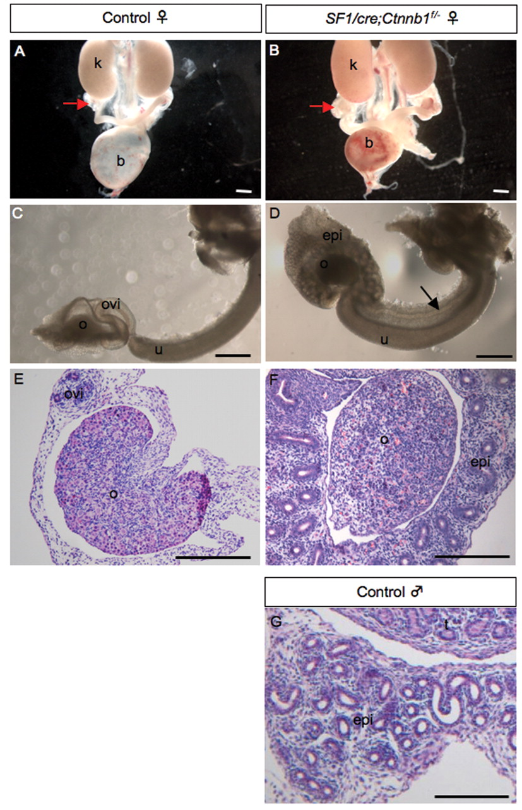
Figure 4. Development of the internal reproductive organs in control and SF1/cre;Ctnnb1^{f/−} female embryos ...
Notes:
Figure 4. Development of the internal reproductive organs in control and SF1/cre;Ctnnb1f/− female embryos at birth. ( A and B ) are whole-mount light field microscopic images of the urogenital system. ( C and D ) are close-up images of the reproductive tracts in (A) and (B), respectively. ( E and F ) are H&E stained sections that contain ovaries and associated reproductive tracts from (C) and (D), respectively. ( G ) is a H&E stained section of the epididymis of a control male. Red arrows indicate the position of the ovaries. The black arrow indicates the presence of vas deferens. Scale bars represent 500 µm. b, bladder; epi, epididymis; k, kidney; o, ovary; ovi, oviduct; u, uterus.
Unless provided in the caption above, the following copyright applies to the content of this slide: © The Author 2008. Published by Oxford University Press. All rights reserved. For Permissions, please email: journals.permissions@oxfordjournals.org

Slide 5
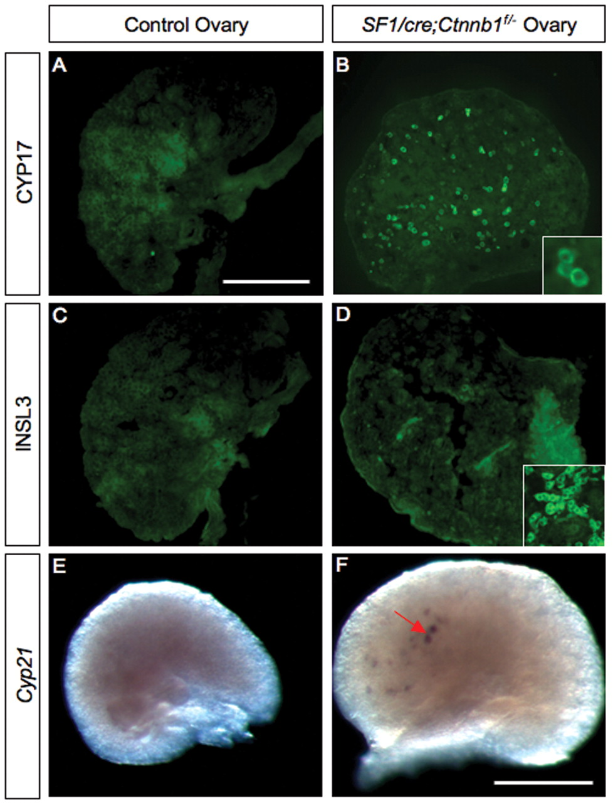
Figure 5. Detection of markers for fetal Leydig cells and adrenal cells in control and SF1/cre;Ctnnb^{f/−} ...
Notes:
Figure 5. Detection of markers for fetal Leydig cells and adrenal cells in control and SF1/cre;Ctnnbf/− ovaries at birth. ( A and B ) are immunohistochemistry for CYP17, a steroidogenic enzyme involved in androgen production. The inset in (B) represents a higher magnification of the CYP17-positive cells. ( C and D ) are immunohistochemistry for INSL3, a Leydig cell-specific marker. ( E and F ) are whole-mount in situ hybridization for Cyp21 , an adrenal marker. The inset in (C) is immunohistochemistry for INSL3 on wild-type testis as a positive control. The red arrow indicates clusters of Cyp21 -positive cells. The scale bars represent 100 µm.
Unless provided in the caption above, the following copyright applies to the content of this slide: © The Author 2008. Published by Oxford University Press. All rights reserved. For Permissions, please email: journals.permissions@oxfordjournals.org

Slide 6
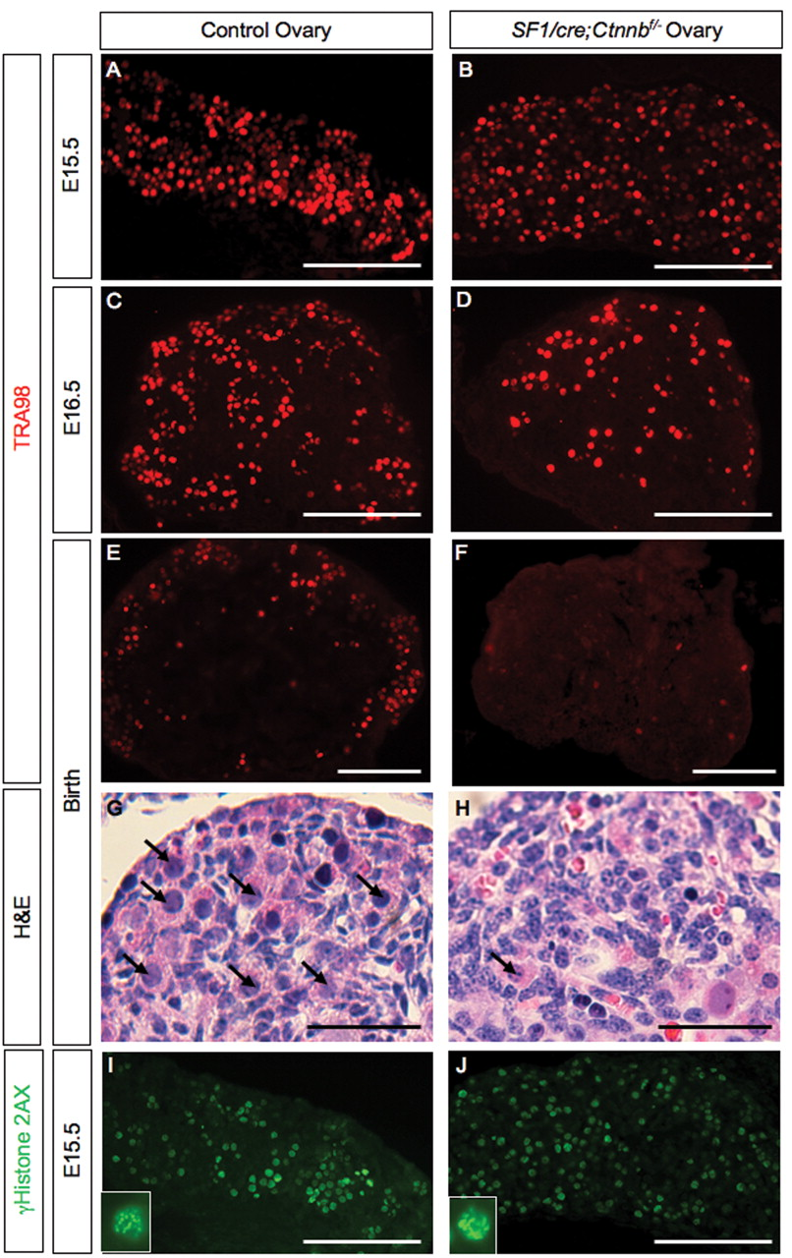
Figure 6. Development of female germ cells in the control and SF1/cre;Ctnnb1^{f/−} ovaries. ( A – F ) are ...
Notes:
Figure 6. Development of female germ cells in the control and SF1/cre;Ctnnb1f/− ovaries. ( A – F ) are immunohistochemistry for germ cell nuclear marker TRA98 on E15.5 (A and B), E16.5 (C and D) and birth (E and F). ( G and H ) are H&E-stained ovary sections at the time of birth. Black arrows indicate germ cells with large and round nuclei. Only one abnormal-looking germ cell is found in (H). ( I and J ) are immunohistochemistry for meiosis marker γHiston2AX (green). Pictures in the insets are higher magnification of individual germ cells from the sections. The scale bars are 100 µm in (A–F, I and J) and 50 µm in (G and H).
Unless provided in the caption above, the following copyright applies to the content of this slide: © The Author 2008. Published by Oxford University Press. All rights reserved. For Permissions, please email: journals.permissions@oxfordjournals.org

