Slide 1
Figure 1. The continuum of academic knowledge.
Notes:
Figure 1. The continuum of academic knowledge.
Unless provided in the caption above, the following copyright applies to the content of this slide: © The Author 2015. Published by Oxford University Press and the Society for the Advancement of Socio-Economics. All rights reserved. For Permissions, please email: journals.permissions@oup.com

Slide 2
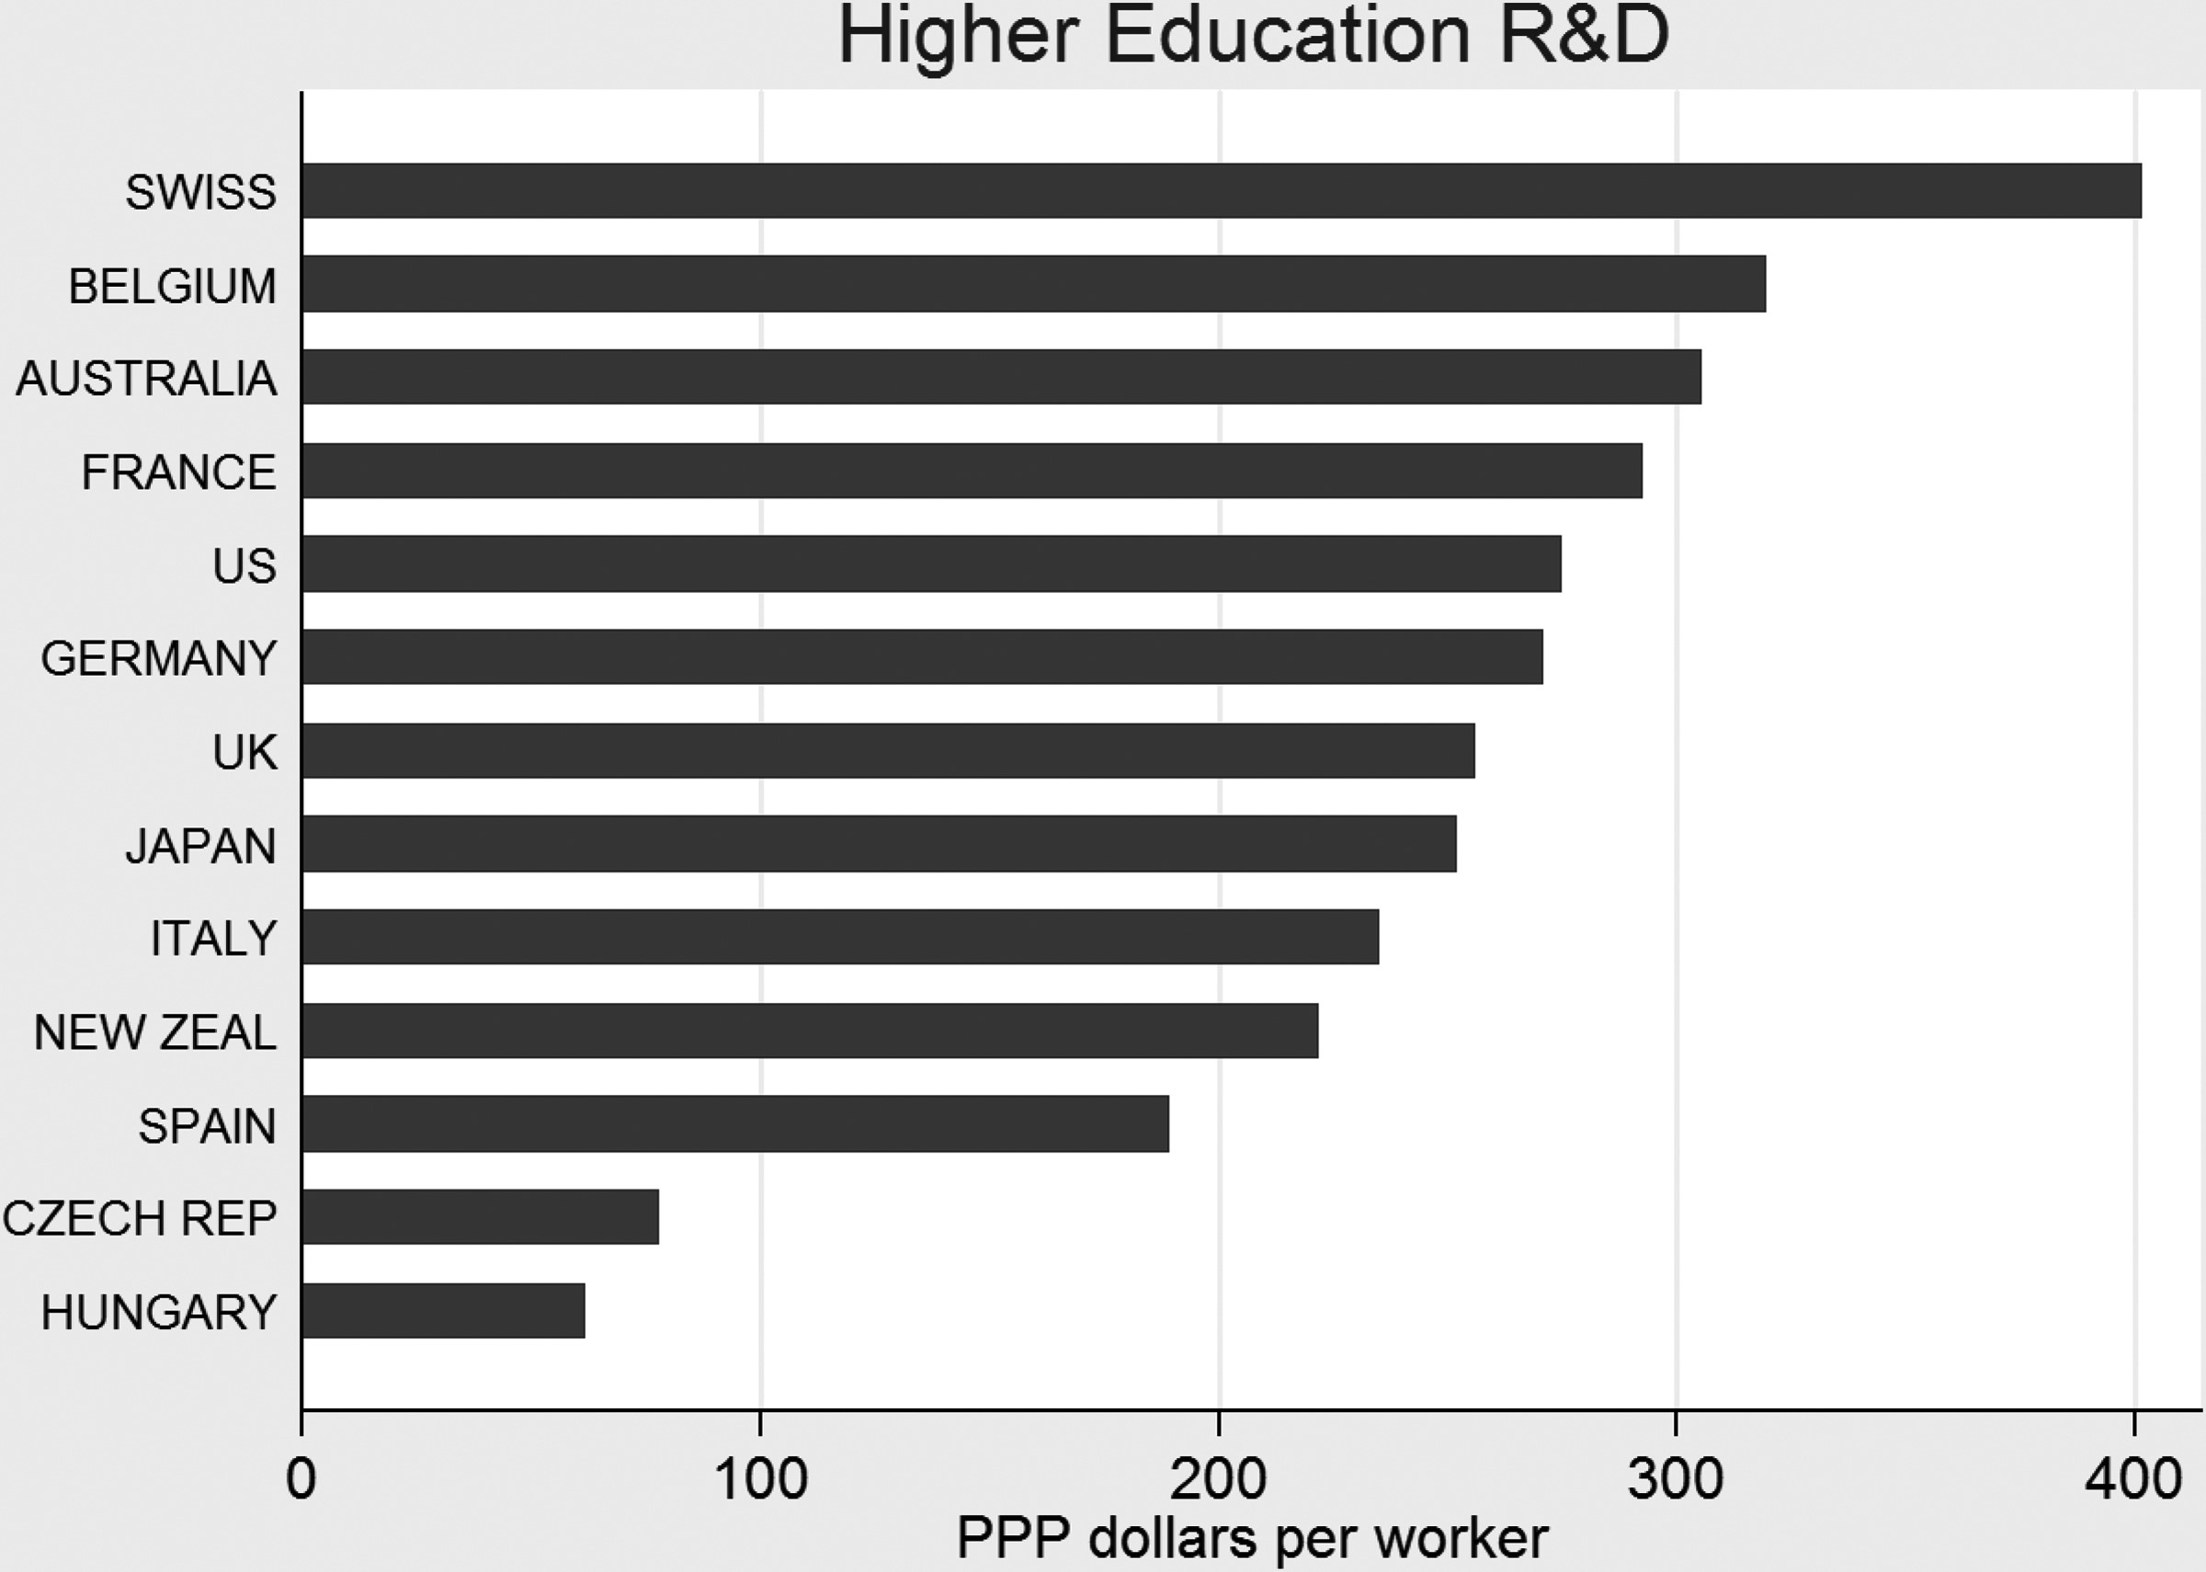
Figure 2. Average ratio of HERD per worker (1998–2008).
Notes:
Figure 2. Average ratio of HERD per worker (1998–2008).
Unless provided in the caption above, the following copyright applies to the content of this slide: © The Author 2015. Published by Oxford University Press and the Society for the Advancement of Socio-Economics. All rights reserved. For Permissions, please email: journals.permissions@oup.com

Slide 3
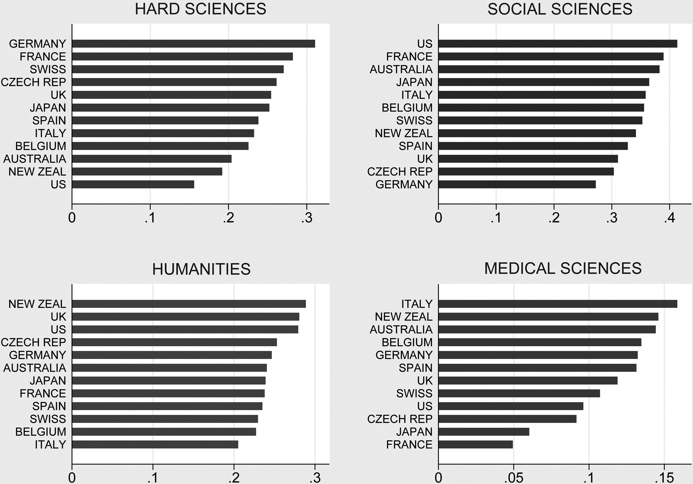
Figure 3. Average share of graduates by discipline (1998–2008).
Notes:
Figure 3. Average share of graduates by discipline (1998–2008).
Unless provided in the caption above, the following copyright applies to the content of this slide: © The Author 2015. Published by Oxford University Press and the Society for the Advancement of Socio-Economics. All rights reserved. For Permissions, please email: journals.permissions@oup.com

