Slide 1
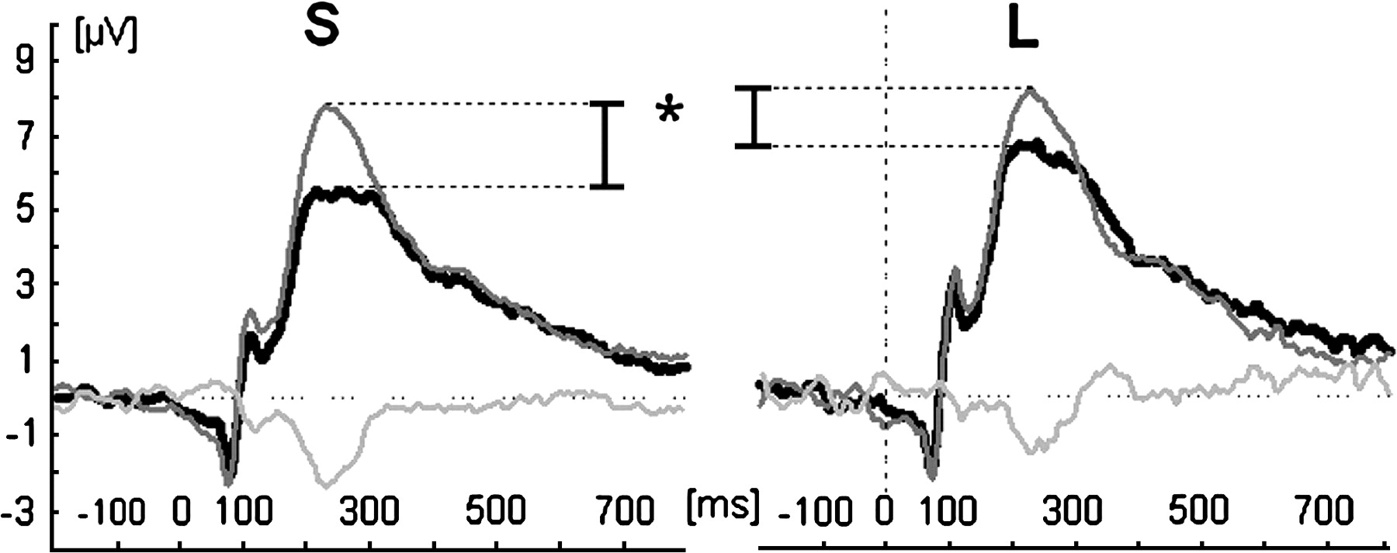
Figure 2. The ERPs to high- (black) and low-arousing (gray) emotional stimuli (and the negative difference wave (light ...
Notes:
Figure 2. The ERPs to high- (black) and low-arousing (gray) emotional stimuli (and the negative difference wave (light gray) over the occipital cortex (electrode position Oz) for the S and L groups of 5-HTT genotype.
Unless provided in the caption above, the following copyright applies to the content of this slide: © The Author 2006. Published by Oxford University Press. All rights reserved. For permissions, please e-mail: journals.permissions@oxfordjournals.org

Slide 2
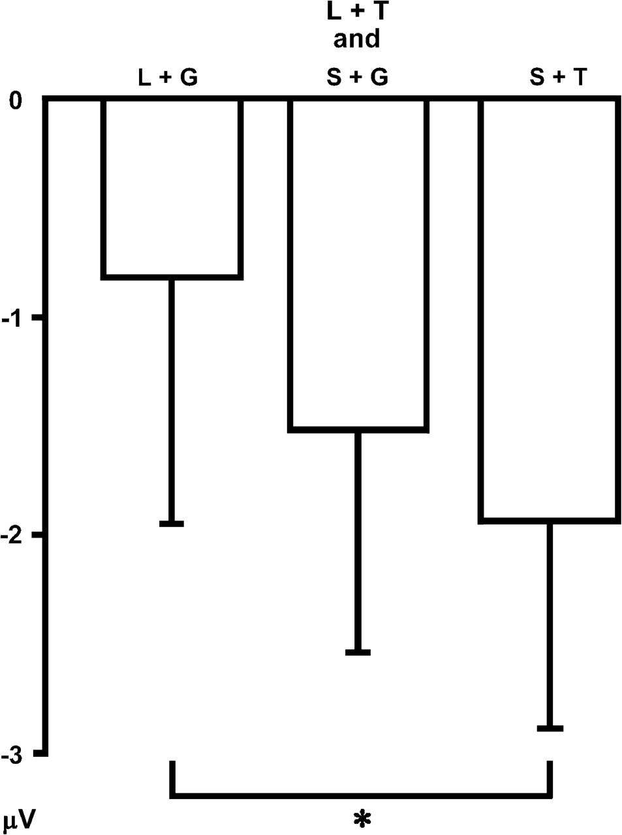
Figure 1. Mean (+SD) amplitudes of the EPN (differences between high- and low-arousing conditions) according to the ...
Notes:
Figure 1. Mean (+SD) amplitudes of the EPN (differences between high- and low-arousing conditions) according to the combination of genotypes stratified for 5-HTT (L and S groups) in combination with TPH2 (G and T groups).
Unless provided in the caption above, the following copyright applies to the content of this slide: © The Author 2006. Published by Oxford University Press. All rights reserved. For permissions, please e-mail: journals.permissions@oxfordjournals.org

