Slide 1
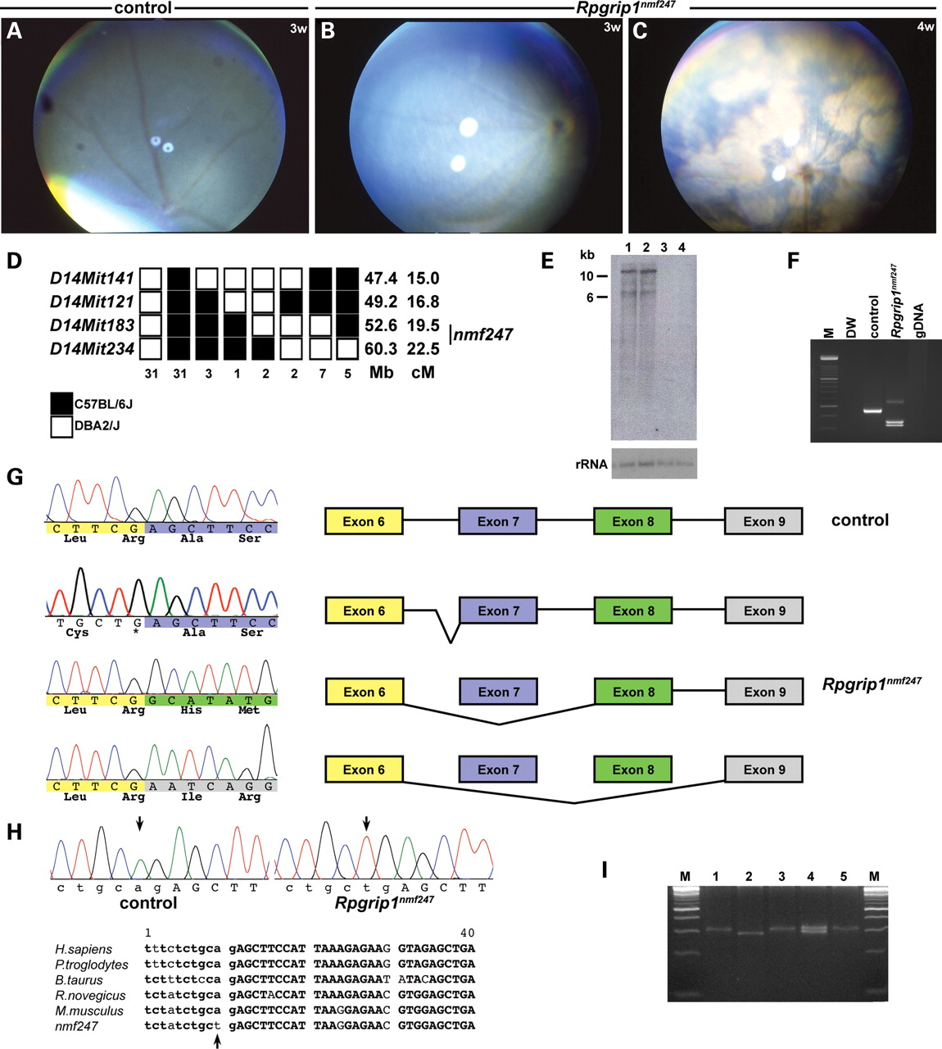
Figure 1. Fundus photographs of (A) WT control at 3 weeks, and (B, C) Rpgrip1^{nmf247} mutants at 3 weeks (B) ...
Notes:
Figure 1. Fundus photographs of (A) WT control at 3 weeks, and (B, C) Rpgrip1nmf247 mutants at 3 weeks (B) and at 4 weeks of age (C), indicating a rapid progression of the retinal degenerative phenotype. (D) Haplotype analysis. F2 mice from a (B6D2F2-nmf247/+) F1 intercross were phenotyped for the retinal spotting and genotyped for the indicated microsatellite markers. Black boxes represent the B6-derived allele, and white boxes represent the DBA/2J-derived allele. The number of chromosomes sharing the corresponding haplotype is indicated below each column of squares. The order of marker loci was determined by minimizing the numbers of crossovers. The genomic coordinates based on NCBI build 37 in mega base (Mb) and centimorgan (cM) are indicated next to each row of squares. The genotype for nmf247 was inferred from the phenotype or the results from progeny testing of non-informative recombinants. (E) Northern analysis of poly A+ RNA isolated from P14 mutant (lane 1, 3) and WT control (lane 2, 4) whole eyes (lane 1, 2) and brains (lane 3, 4). A 844 bp probe spanning nucleotides 3230–4074 was used for hybridization. The shorter band, ∼6 kb in size was not observed in both mutant and WT control in Northern analysis of total retinal RNA isolated from P15 eyes (data not shown) using the same probe, indicating either extraretinal splicing variants or non-specific cross-action of the probe. The 18S ribosomal RNA (rRNA) is shown as a loading control. (F) Amplification of cDNA synthesized from RNA isolated from eyes of mutant and wild-type mice with primers 2F in exon4 (5′GCACAGCCTCGAGTCCAC3′) and 2R in exon 9 (5′TTGGCTGAGGAAGGCATTAT3′) led to a smaller product in Rpgrip1nmf247 mutants. Distilled water (DW) and genomic DNA (gDNA) from tail were used as negative controls. (G) A deletion of exon 7 of Rpgrip1 from Rpgrip1nmf247 mice compared with WT was observed. The color-coded sequences indicate each exon; yellow, blue, green and grey indicate exon 6, 7, 8 and 9, respectively. The non-color coded sequences are from the intron. Skipping of exon 7 or both exon 7 and 8 results in frame-shift that is predicted to lead to a premature termination in exon 9 in mutant mice. Alternatively, the mutation causes an abnormal splicing into intron 6 generating a 96 bp insertion. The inserted sequences code for 32 amino acids, but the mutant protein is predicted to terminate at the mutation site, which generates a stop codon. (H) Genomic analyses of Rpgrip1 using primers 13F in intron 6 (5′GGTCTTCAGGTCTCGCTGTC3′) and 13R in exon 7 (5′ACTCGTGTCAGTTGGGCTTC3′) revealed a point mutation (A to T) that alters the splice acceptor site in intron 6 (arrows). Sequence comparison shows this nucleotide is highly conserved across species. Lower case letters indicates nucleotides in the intron, upper case letters indicate exon, and the bold face indicates conserved sequence. (I) An allele specific PCR assay (49) was designed using primers mRpgrip1-Ra1 (5′CTCCACGTTCTCCTTAATGGAAGCTTT3′), mRpgrip1-Ra2 (5′GCTTCTTAAGGCGAATCAGACCCACGTTCTCCTTAATGGAAGTTCA3′), and mRpgrip1-Fa1 (5′GCACATATTTAGTTGGGTTCTGTAAG3′). M; DNA ladder marker, lane 1, 3, 5: Rpgrip1nmf247, lane 2: WT, lane 4: het.
Unless provided in the caption above, the following copyright applies to the content of this slide: © The Author 2009. Published by Oxford University Press. All rights reserved. For Permissions, please email: journals.permissions@oxfordjournals.org

Slide 2
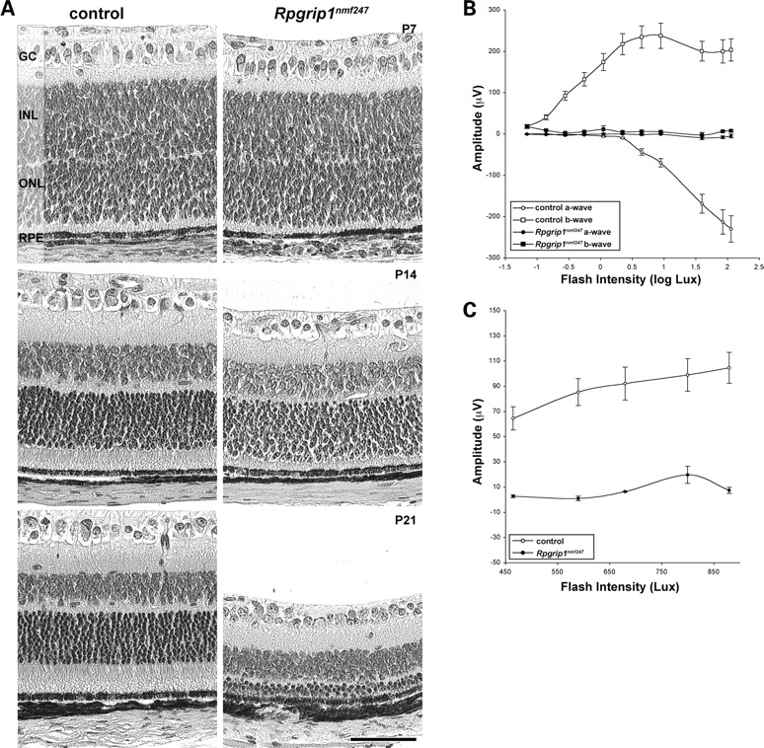
Figure 2. Early onset, progressive photoreceptor degeneration observed in Rpgrip1^{nmf247} mutants. (A) Retinal ...
Notes:
Figure 2. Early onset, progressive photoreceptor degeneration observed in Rpgrip1nmf247 mutants. (A) Retinal sections were obtained from control and Rpgrip1nmf247 at P7, P14 and P21 and stained by hematoxilin and eosin (H&E) and visualized by light microscopy. GC, ganglion cell; INL, inner nuclear layer; ONL, outer nuclear layer; RPE, retinal pigment epithelium. Bar indicates 50 µm. ERG analysis of (B) rod and (C) cone photoreceptors in 3-week-old Rpgrip1nmf247 mutants and controls.
Unless provided in the caption above, the following copyright applies to the content of this slide: © The Author 2009. Published by Oxford University Press. All rights reserved. For Permissions, please email: journals.permissions@oxfordjournals.org

Slide 3
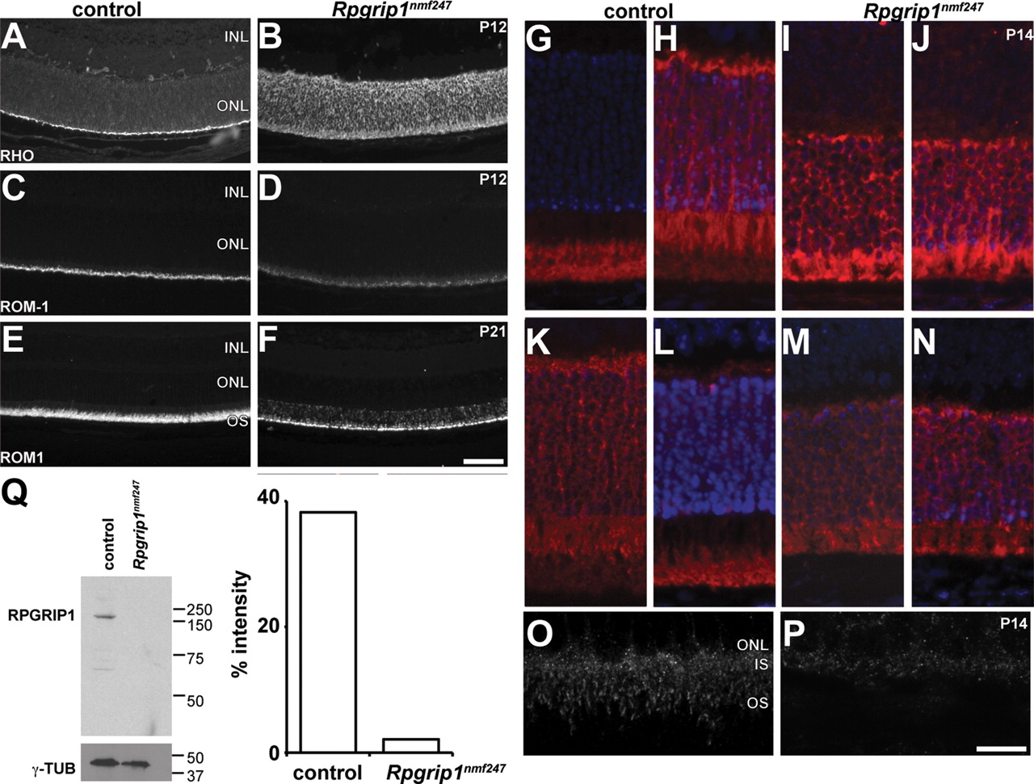
Figure 3. Mislocalization of proteins in Rpgrip1^{nmf247} mutant retinas. Retinal sections were obtained from ...
Notes:
Figure 3. Mislocalization of proteins in Rpgrip1nmf247 mutant retinas. Retinal sections were obtained from control and Rpgrip1nmf247 at P12 (A–D) and at P21 (E, F), and stained with (RHO; A, B) anti-rhodopsin, anti-ROM1 (ROM1; C–F). To examine the ability of transducin and arrestin to translocate in rod photoreceptor cells, (G–J) anti-transducin and (K–N) anti-arrestin were used to stain dark adapted (G, I, K, M) and light stimulated (H, J, L, N) retinas. RPGRIP1 localization was examined using a polyclonal anti-RPGRIP1 antibody (O, P). INL, inner nuclear layer; ONL, outer nuclear layer; OS, outer segment. Bars indicate 50 µm (A–F), 25 µm (G–N), and 10 µm (O, P). (Q) Western analysis indicates the absence of RPGRIP1 in Rpgrip1nmf247 mutants. γ-tubulin (γ-TUB) serves as a loading control (left). The ratio of the intensity of staining of RPGRIP1 to γ-tubulin was 38.2% in WT control but 2.1% in Rpgrip1nmf247 mutants.
Unless provided in the caption above, the following copyright applies to the content of this slide: © The Author 2009. Published by Oxford University Press. All rights reserved. For Permissions, please email: journals.permissions@oxfordjournals.org

Slide 4
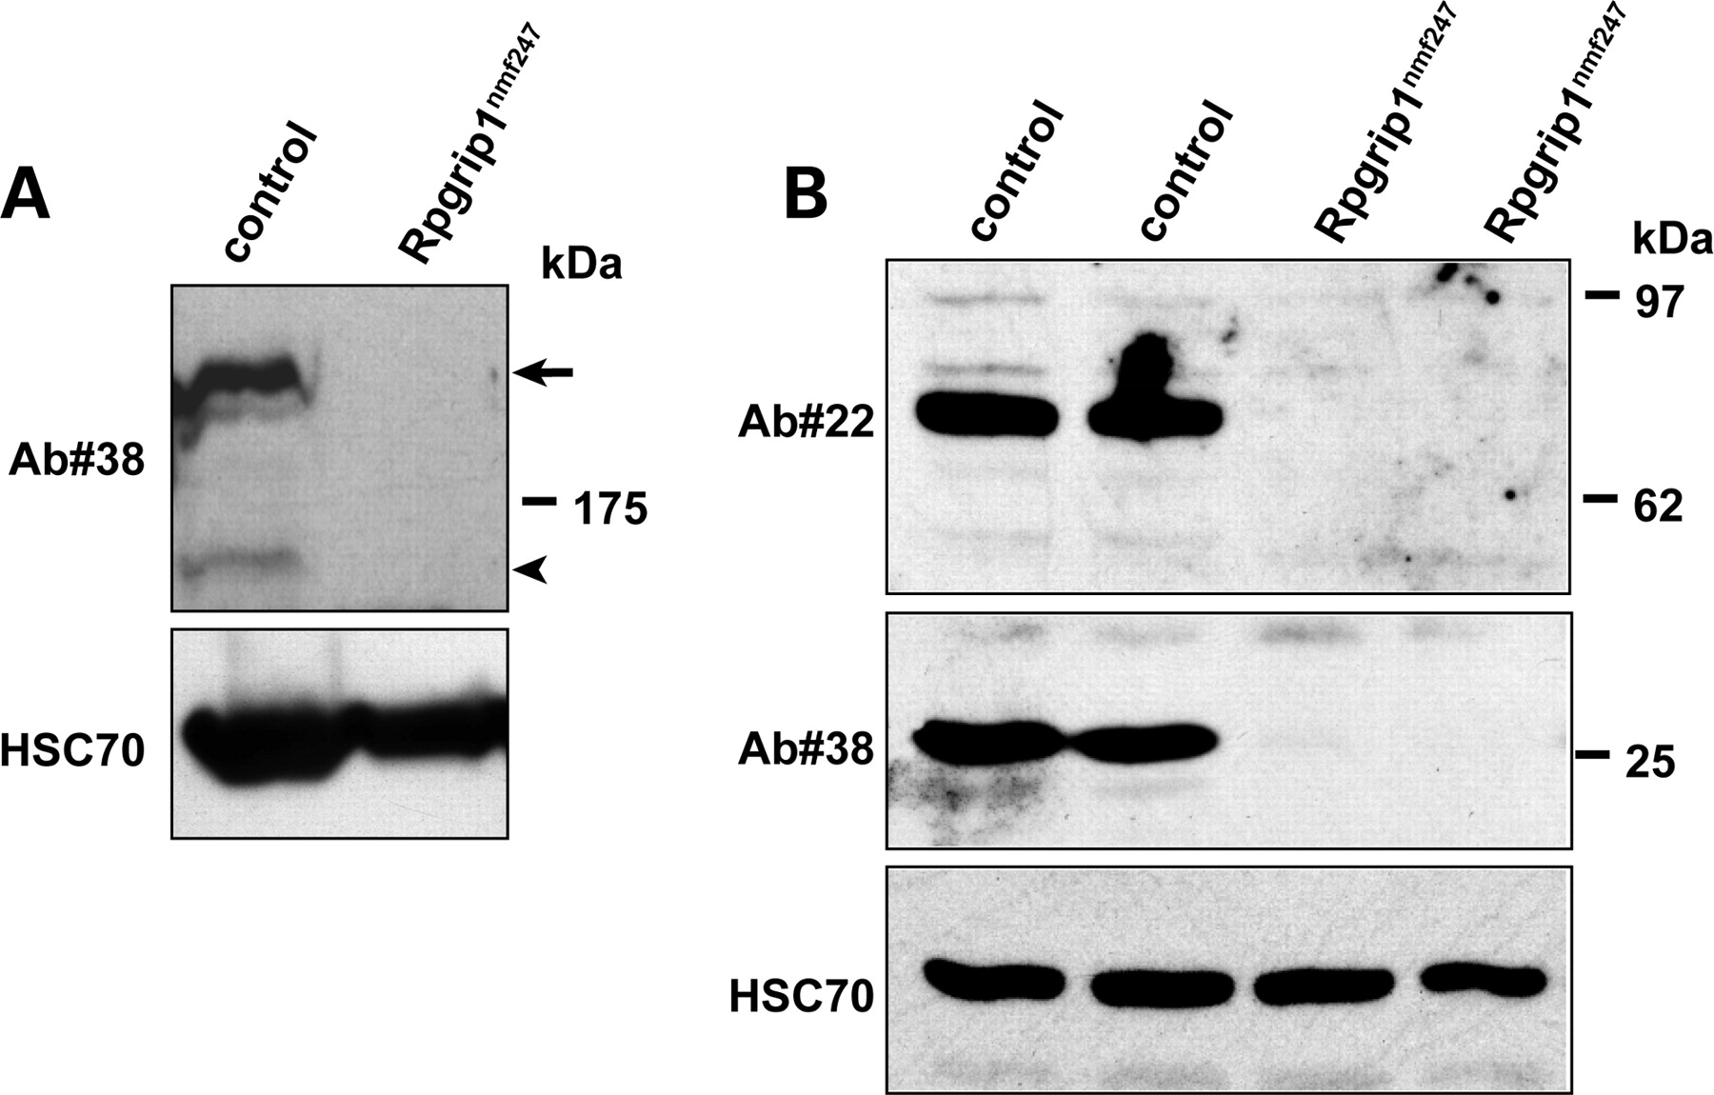
Figure 4. Immunoblot of retinal homogenates of wild-type, and Rpgrip1^{nmf247}mice (P16), with antibodies ...
Notes:
Figure 4. Immunoblot of retinal homogenates of wild-type, and Rpgrip1nmf247mice (P16), with antibodies against the N-terminal coiled-coil (Ab#22) and C-terminal RID (Ab#38) domains of RPGRIP1. The absence of the ∼200 kDa full length (arrow, A) and smaller ∼150kD (arrowhead, A) and other smaller (70 and 25 kDa, B) RPGRIP1 isoforms is observed in Rpgrip1nmf247 mice. HSC70 serves as a loading control in both panels.
Unless provided in the caption above, the following copyright applies to the content of this slide: © The Author 2009. Published by Oxford University Press. All rights reserved. For Permissions, please email: journals.permissions@oxfordjournals.org

Slide 5
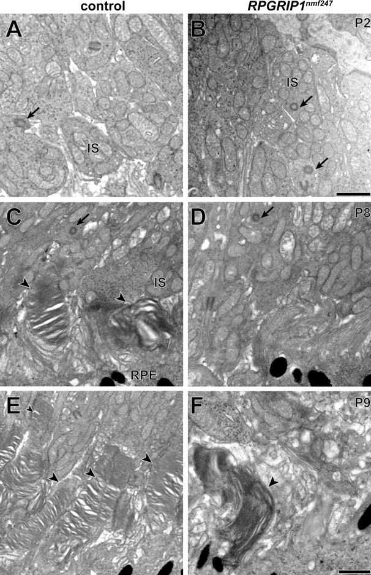
Figure 5. Ultrastructural transmission electron microscopy analysis suggests normal CC formation and aberrant OS ...
Notes:
Figure 5. Ultrastructural transmission electron microscopy analysis suggests normal CC formation and aberrant OS development. The CC (arrows) in (A) wild-type controls and (B) Rpgrip1nmf247 mutants did not differ (P2). At P8 OS discs are observed (arrow heads) in (C) wild-type controls but not in (D) Rpgrip1nmf247 mutants. At P9, OS are lengthened in (E) wild-type controls but (F) in the rare instance in which OS are observed in Rpgrip1nmf247 mutants, OS discs are enlarged and have a vertical orientation. IS, inner segment; RPE, retinal pigment epithelium. Bars = 500 nm.
Unless provided in the caption above, the following copyright applies to the content of this slide: © The Author 2009. Published by Oxford University Press. All rights reserved. For Permissions, please email: journals.permissions@oxfordjournals.org

Slide 6
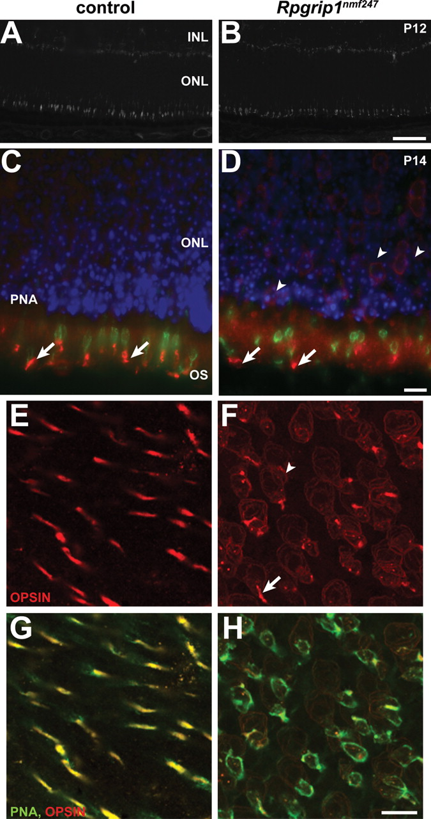
Figure 6. Defective cone OS morphogenesis in Rpgrip1^{nmf247} mutant retina. Staining of (A) wild-type control ...
Notes:
Figure 6. Defective cone OS morphogenesis in Rpgrip1nmf247 mutant retina. Staining of (A) wild-type control and (B) Rpgrip1nmf247 mutant retinas with PNA. Double staining of blue cone opsin (red) with PNA (green) in control (C) and Rpgrip1nmf247 mutant retina (D) at P12. Retinas were obtained at P14, flat mounted, and stained with red/green opsin (red, E–H) and double stained with PNA (green, G–H). Arrows indicate OS and arrowheads indicate mislocalized opsin in nuclear bodies. INL, inner nuclear layer; ONL, outer nuclear layer; OS, outer segment. Bars; 50 µm (A, B), 10 µm (C–H).
Unless provided in the caption above, the following copyright applies to the content of this slide: © The Author 2009. Published by Oxford University Press. All rights reserved. For Permissions, please email: journals.permissions@oxfordjournals.org

Slide 7
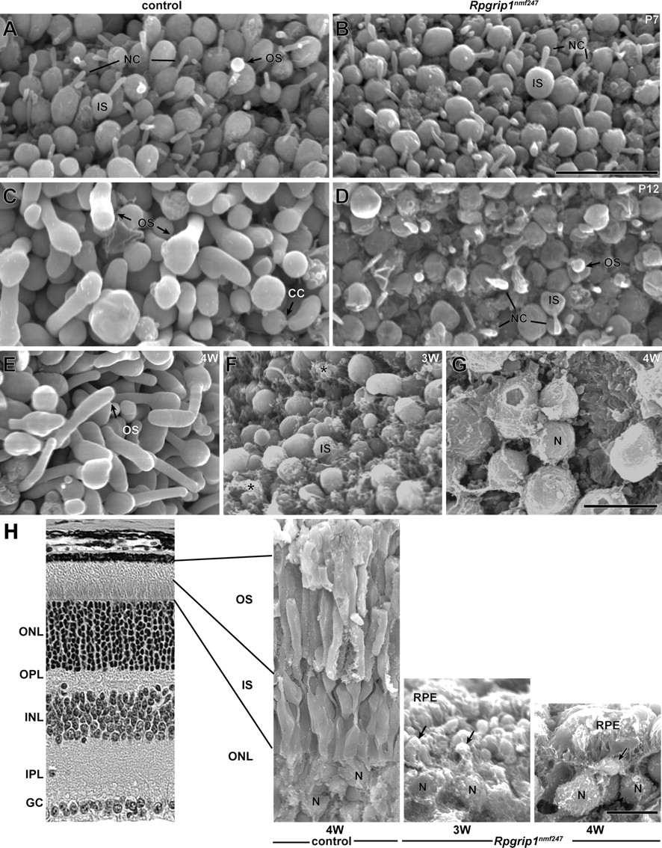
Figure 7. OS morphogenesis and degeneration were observed by scanning electron microscopy of control and ...
Notes:
Figure 7. OS morphogenesis and degeneration were observed by scanning electron microscopy of control and Rpgrip1nmf247 mutant retina at P7 (A, B), P12 (C, D), 3 weeks (F, H) and 4 weeks (E, G, H). Specimens were viewed from an RPE orientation (A–G) or fractured and viewed from a neuroretinal orientation (H). In control retinas, at P7, developing OS were observed (OS, A) and at P12, elongation of OS was observed (C). In contrast, in Rpgrip1nmf247 mutant retinas no OS were observed at P7 (B) and rare rudimentary OS budding was observed at P12 (OS, D). Asterisks indicate RPE adherence to the IS (F) in Rpgrip1nmf247 mutants. The photoreceptor nuclei (N) are noted (G, H). The degeneration is rapid and progressive with CC no longer observable on IS at 3 weeks (F and arrows, H) and with very rare IS at 4 weeks (G and arrow, H). OS, outer segment; IS, inner segment; ONL, outer nuclear layer; OPL, outer plexiform layer; INL, inner nuclear layer; IPL, inner plexiform layer; GC, ganglion cells; RPE, retinal pigment epithelium; CC, connecting cilium; NC, nascent cilia. Bars = 10 µm.
Unless provided in the caption above, the following copyright applies to the content of this slide: © The Author 2009. Published by Oxford University Press. All rights reserved. For Permissions, please email: journals.permissions@oxfordjournals.org

