Slide 1
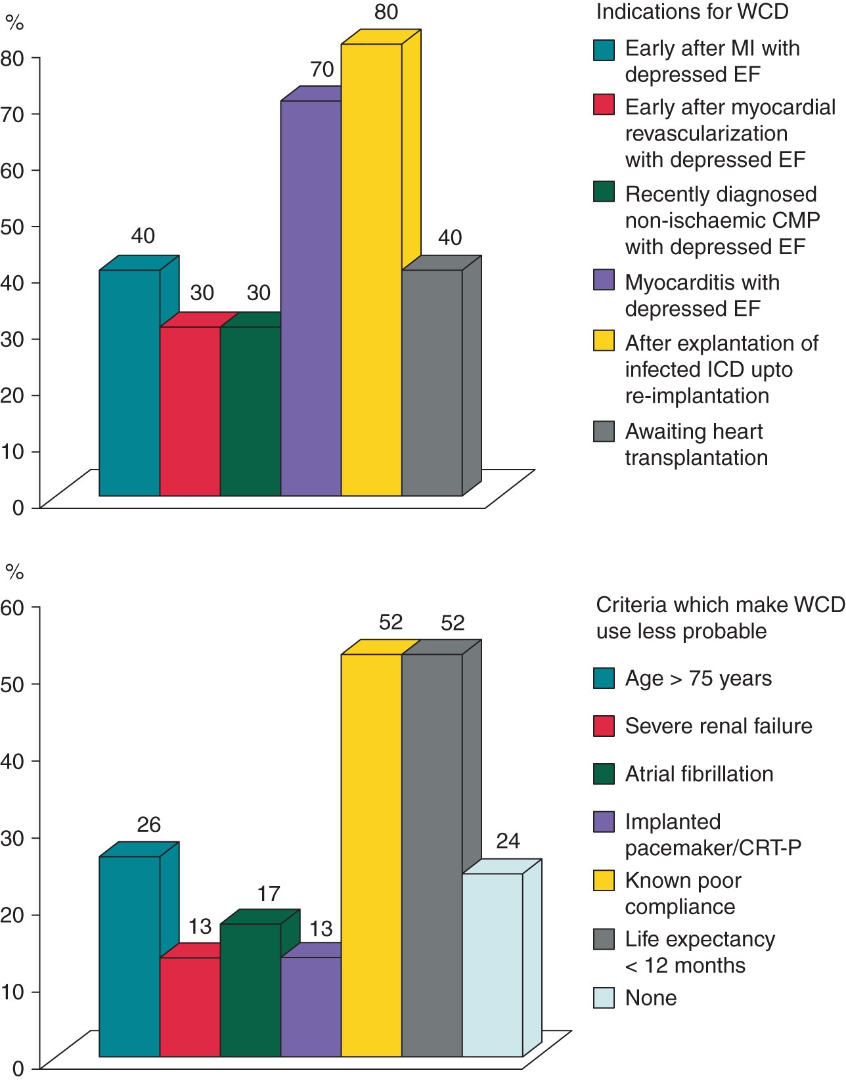
Figure 1 Indications (upper panel) and contraindications (lower panel) for WCDs. MI, myocardial infarction; EF, ...
Notes:
Figure 1 Indications (upper panel) and contraindications (lower panel) for WCDs. MI, myocardial infarction; EF, ejection fraction of the left ventricle; CMP, cardiomyopathy; ICD, implantable cardioverter-defibrillator; CRT-P, cardiac resynchronization therapy-pacing.
Unless provided in the caption above, the following copyright applies to the content of this slide: Published on behalf of the European Society of Cardiology. All rights reserved. © The Author 2016. For permissions please email: journals.permissions@oup.com

Slide 2
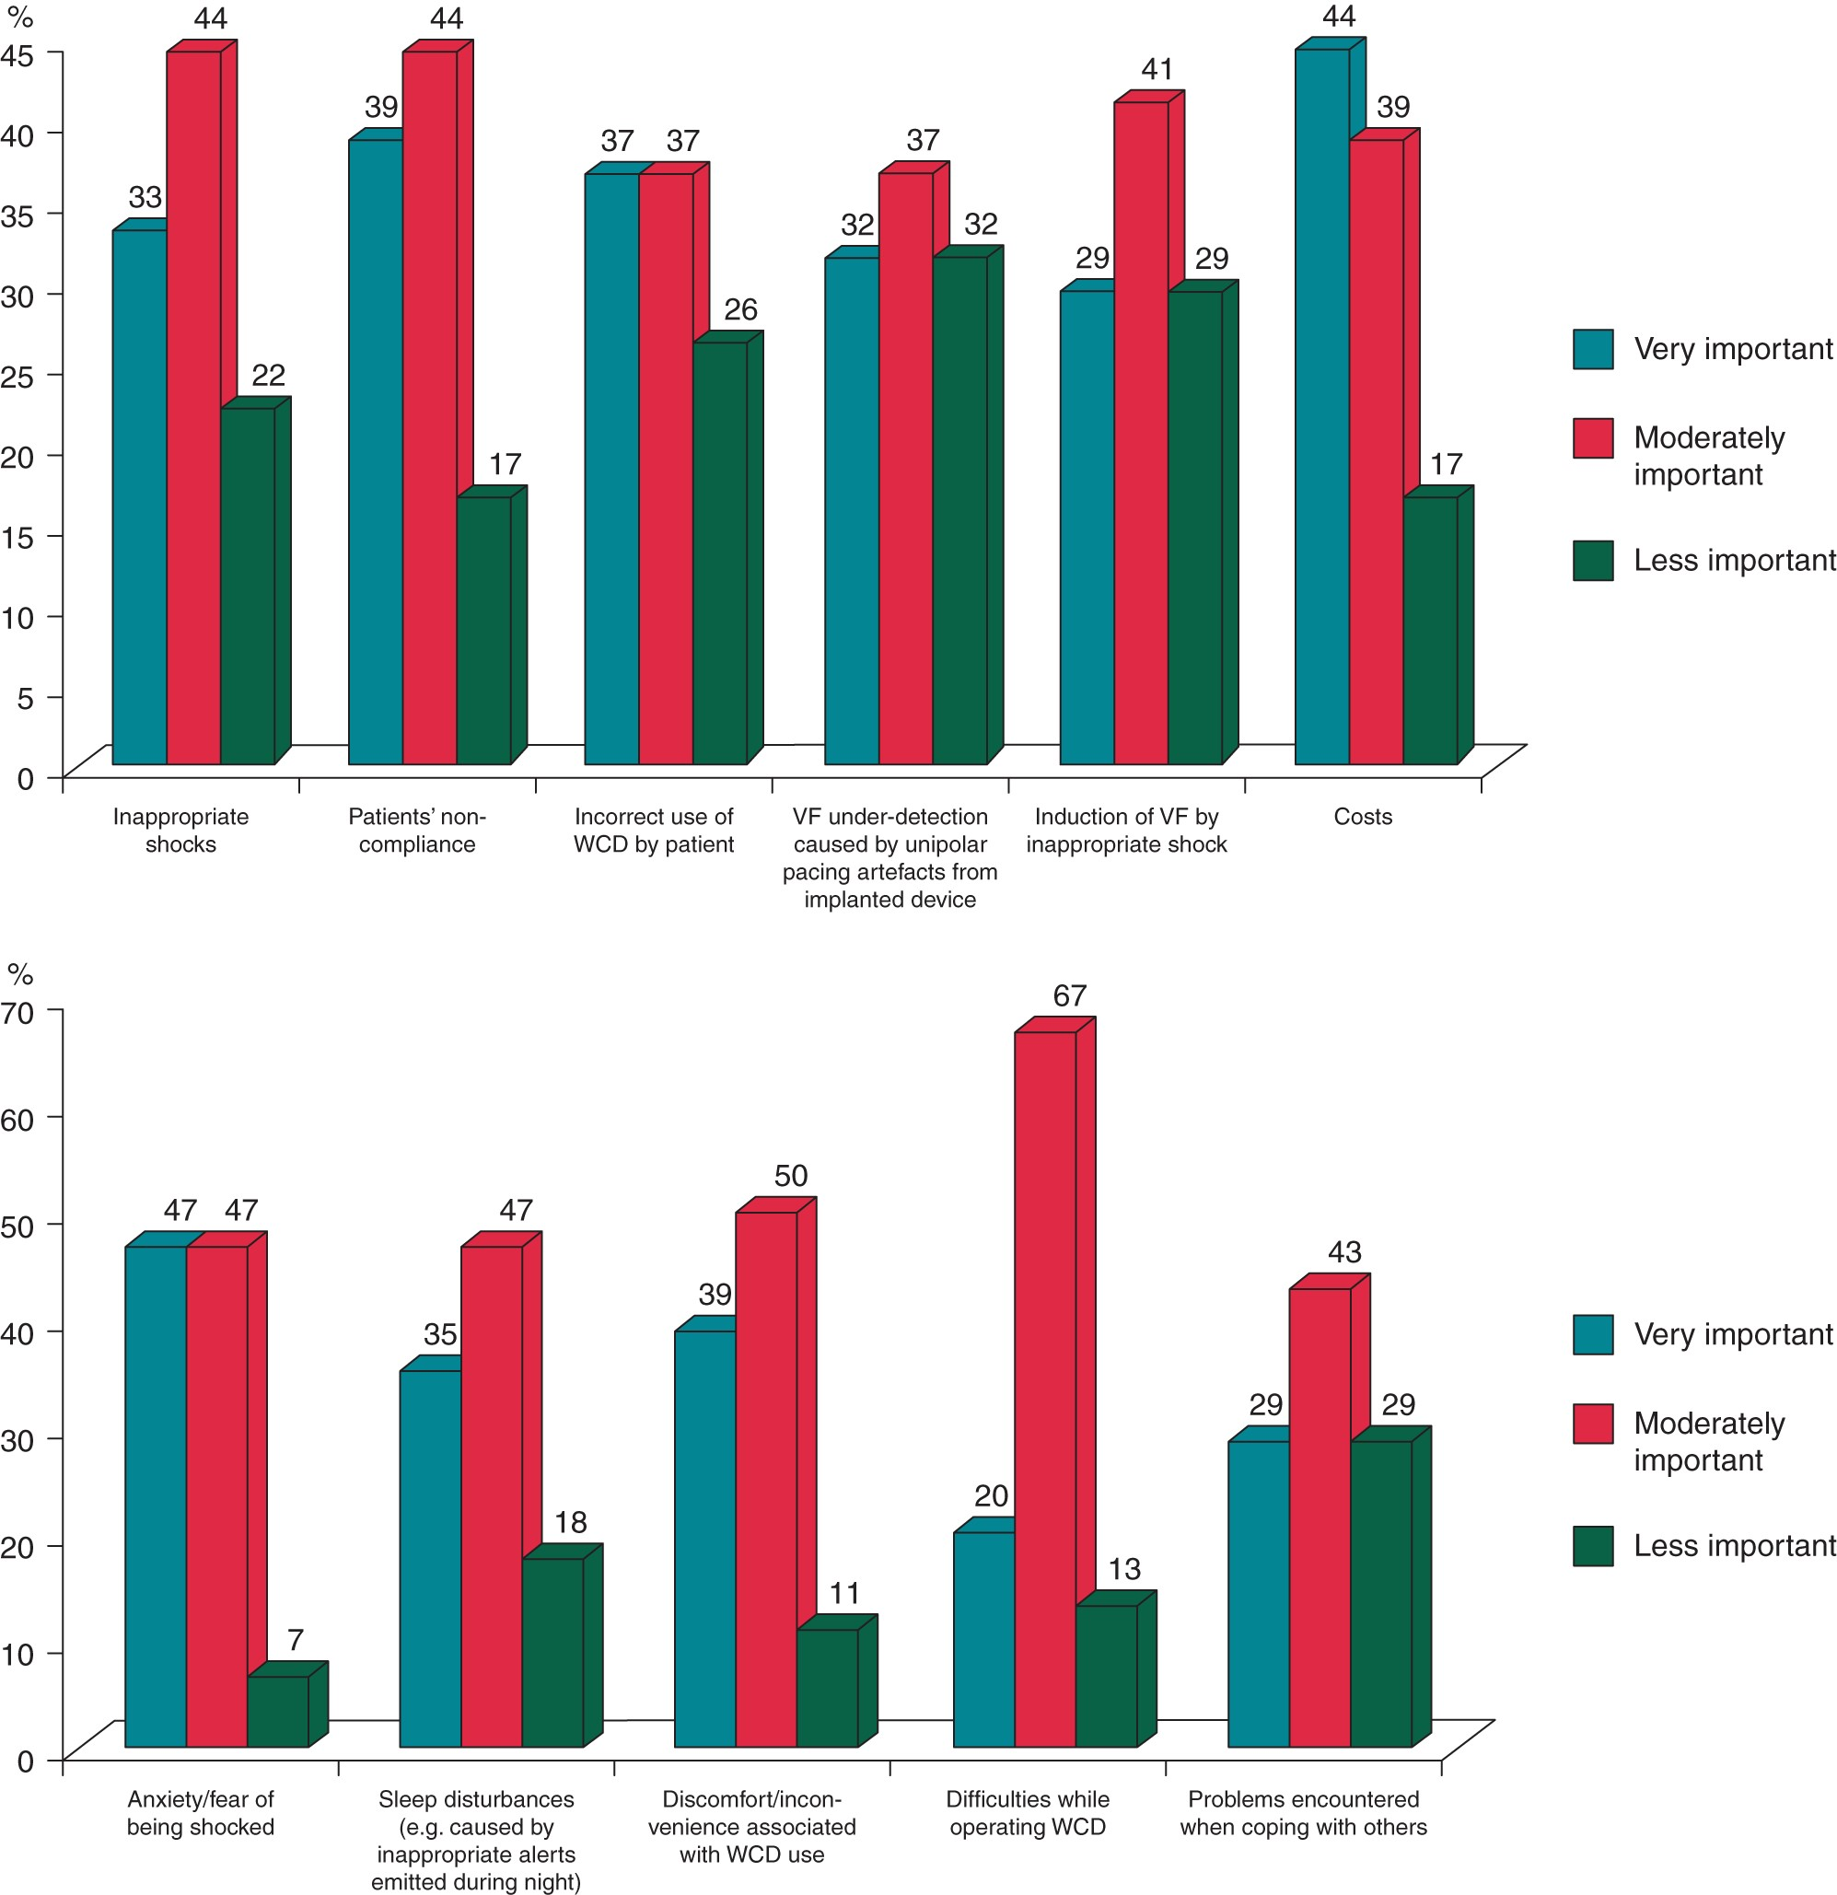
Figure 2 Major concerns associated with the use of WCDs from physicians' (upper panel) and patients' (lower panel) ...
Notes:
Figure 2 Major concerns associated with the use of WCDs from physicians' (upper panel) and patients' (lower panel) perspectives. WCD, wearable cardioverter-defibrillator; VF, ventricular fibrillation.
Unless provided in the caption above, the following copyright applies to the content of this slide: Published on behalf of the European Society of Cardiology. All rights reserved. © The Author 2016. For permissions please email: journals.permissions@oup.com

Slide 3
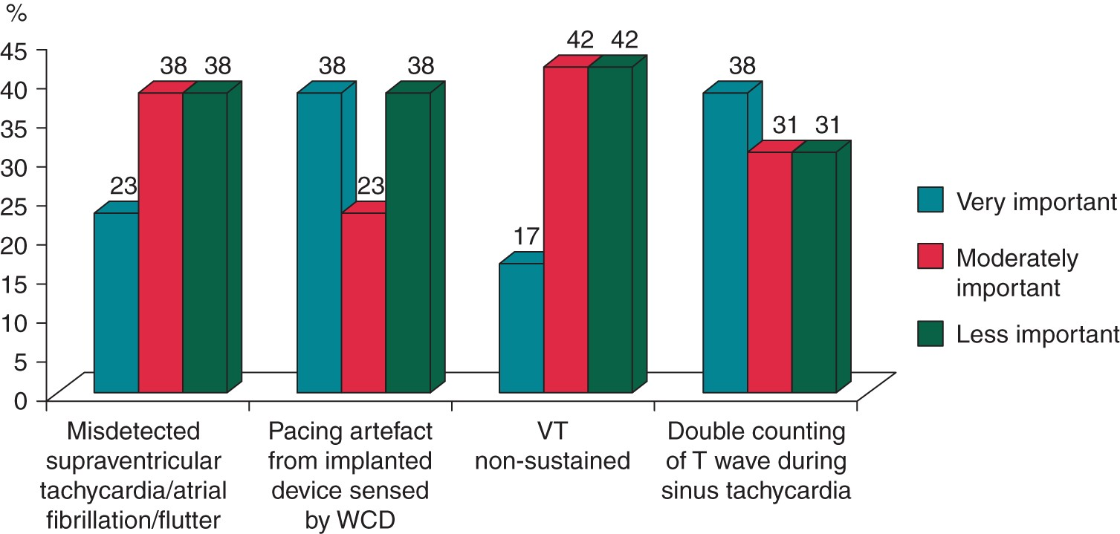
Figure 3 Causes of inappropriate therapies. WCD, wearable cardioverter-defibrillator; VT, ventricular tachycardia.
Notes:
Figure 3 Causes of inappropriate therapies. WCD, wearable cardioverter-defibrillator; VT, ventricular tachycardia.
Unless provided in the caption above, the following copyright applies to the content of this slide: Published on behalf of the European Society of Cardiology. All rights reserved. © The Author 2016. For permissions please email: journals.permissions@oup.com

