Slide 1
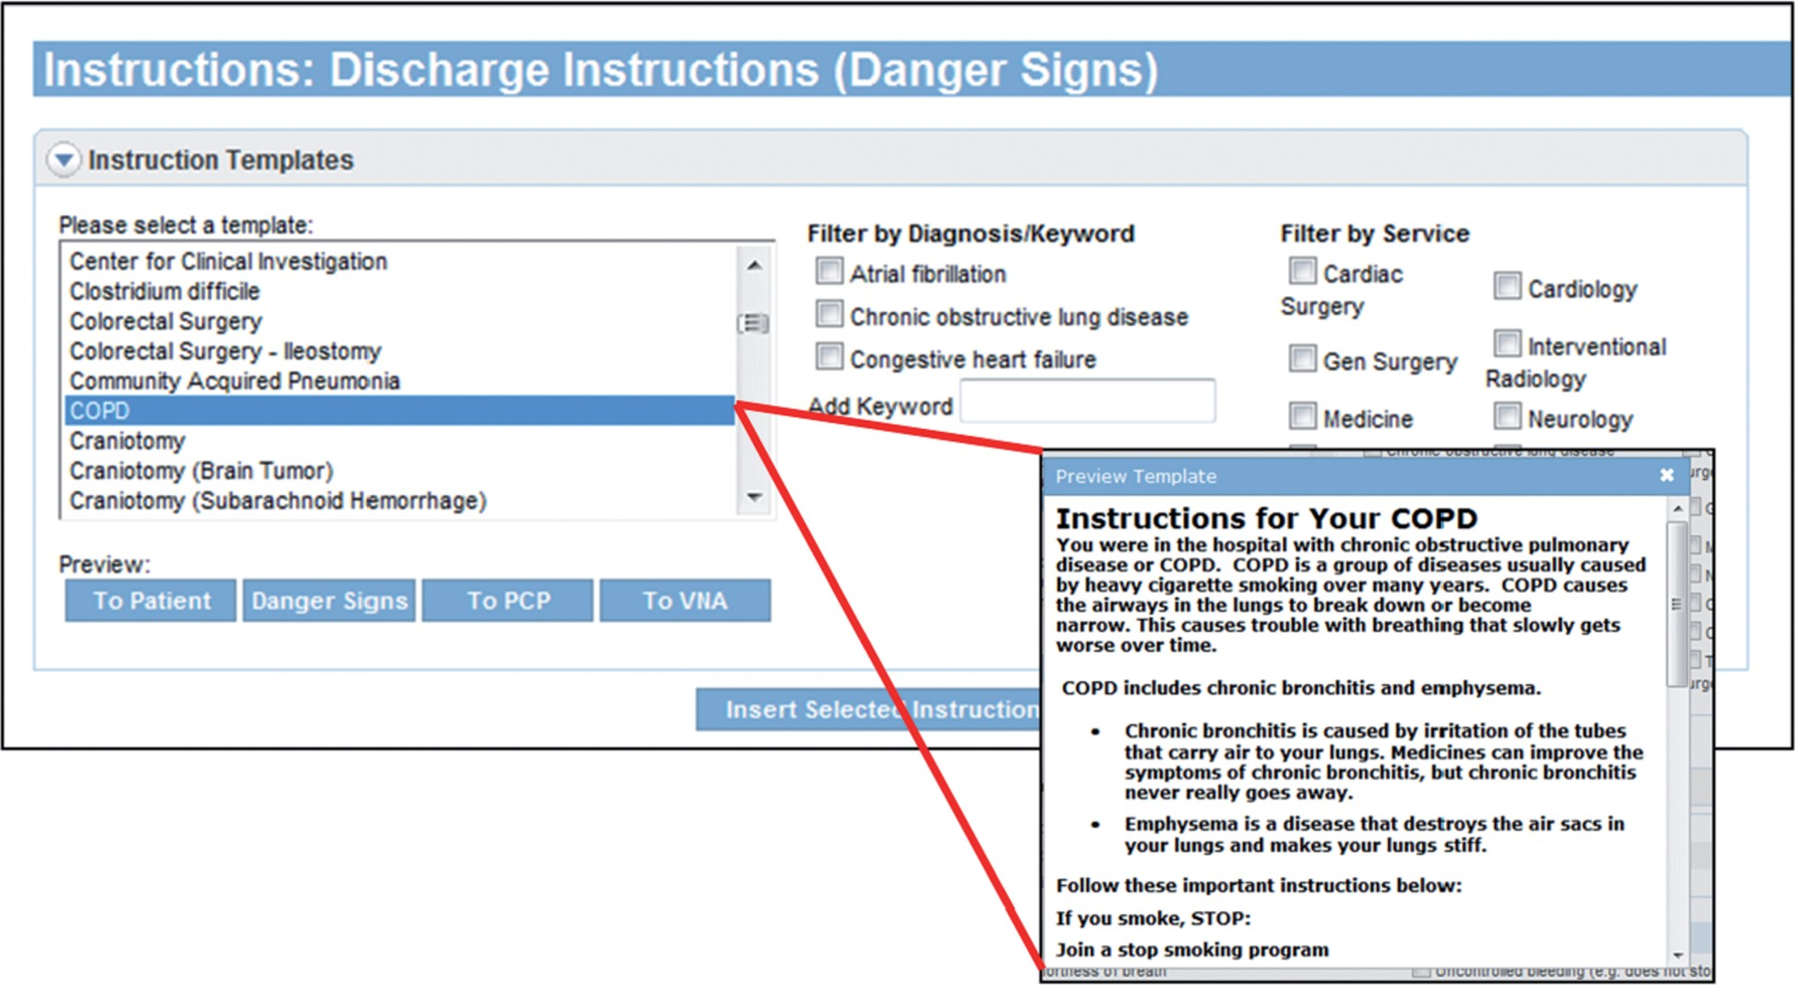
Figure 1: Screen shot of selection of electronically available templated discharge instructions.
Notes:
Figure 1: Screen shot of selection of electronically available templated discharge instructions.
Unless provided in the caption above, the following copyright applies to the content of this slide: © The Author 2015. Published by Oxford University Press on behalf of the American Medical Informatics Association. All rights reserved. For Permissions, please email: journals.permissions@oup.com

Slide 2
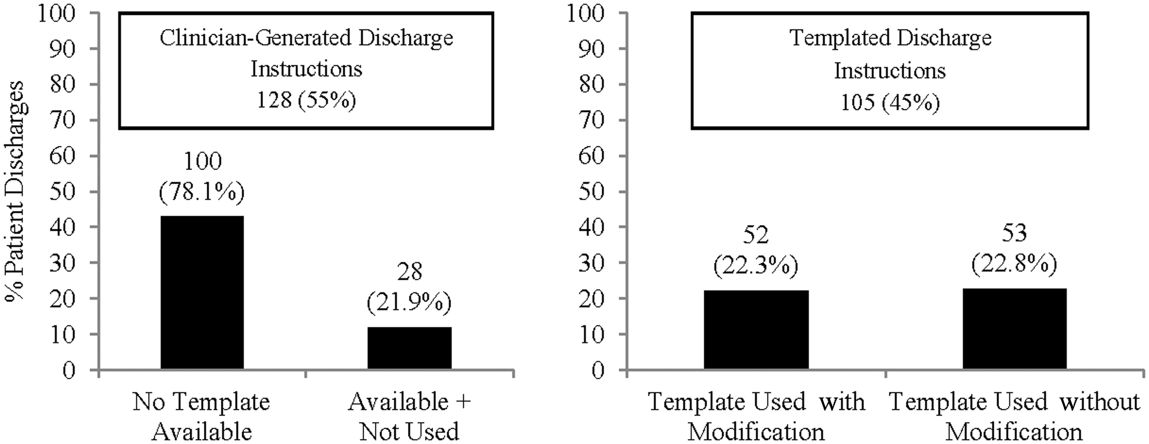
Figure 2: Use of disease-specific templated discharge instructions.
Notes:
Figure 2: Use of disease-specific templated discharge instructions.
Unless provided in the caption above, the following copyright applies to the content of this slide: © The Author 2015. Published by Oxford University Press on behalf of the American Medical Informatics Association. All rights reserved. For Permissions, please email: journals.permissions@oup.com

Slide 3
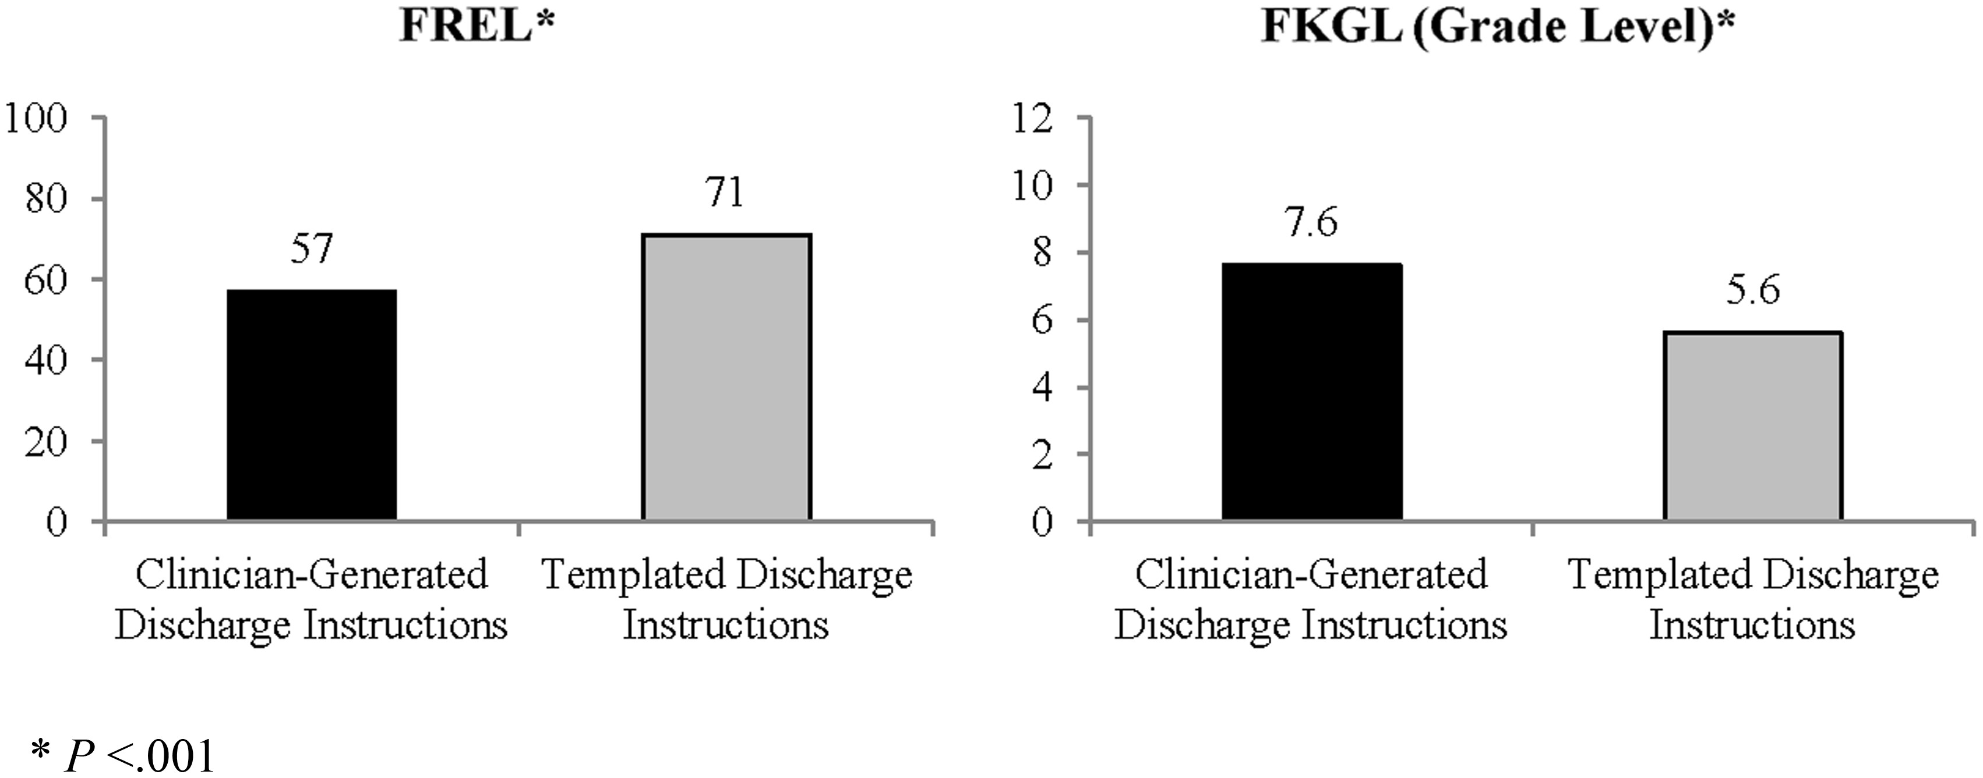
Figure 3: Readability of clinician-generated versus templated discharge instructions.
Notes:
Figure 3: Readability of clinician-generated versus templated discharge instructions.
Unless provided in the caption above, the following copyright applies to the content of this slide: © The Author 2015. Published by Oxford University Press on behalf of the American Medical Informatics Association. All rights reserved. For Permissions, please email: journals.permissions@oup.com

