Slide 1
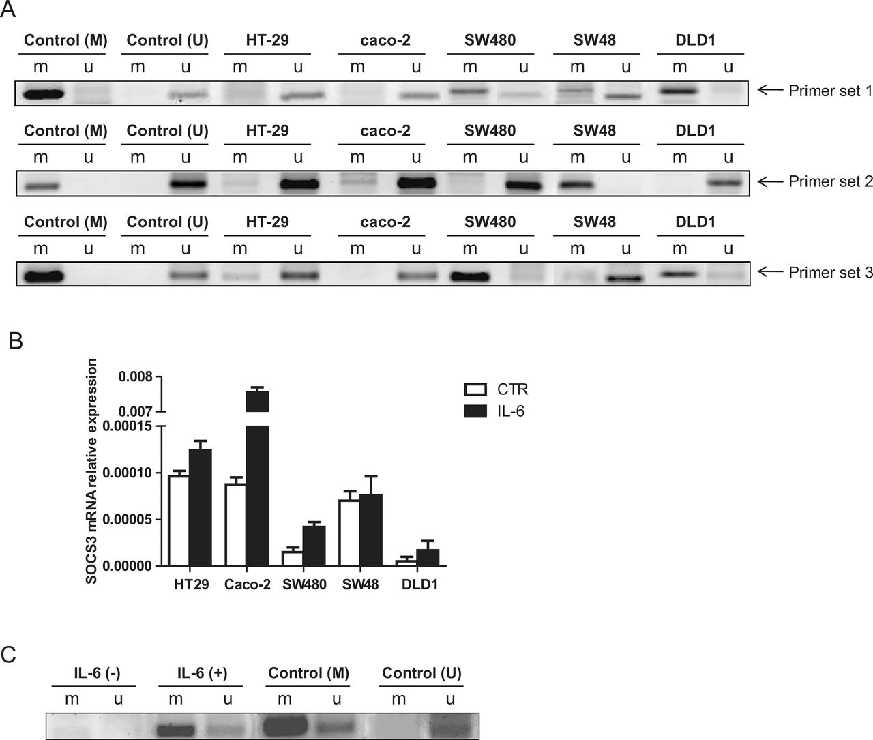
Fig. 2. Different SOCS3 promoter methylation in CRC cell lines. (A) The methylation status was determined in five CRC ...
Notes:
Fig. 2. Different SOCS3 promoter methylation in CRC cell lines. (A) The methylation status was determined in five CRC cell lines using MSP at three different regions of SOCS3 promoter. HT29, SW480, SW48 and DLD1 showed more SOCS3 methylation than caco-2 cells. (B) Induction of SOCS3 expression upon IL-6 stimulation in CRC cell lines. (C) IL-6-induced methylation of SOCS3 gene in caco-2 cells after 48h.
Unless provided in the caption above, the following copyright applies to the content of this slide: © The Author 2012. Published by Oxford University Press. All rights reserved. For Permissions, please email: journals.permissions@oup.com

Slide 2
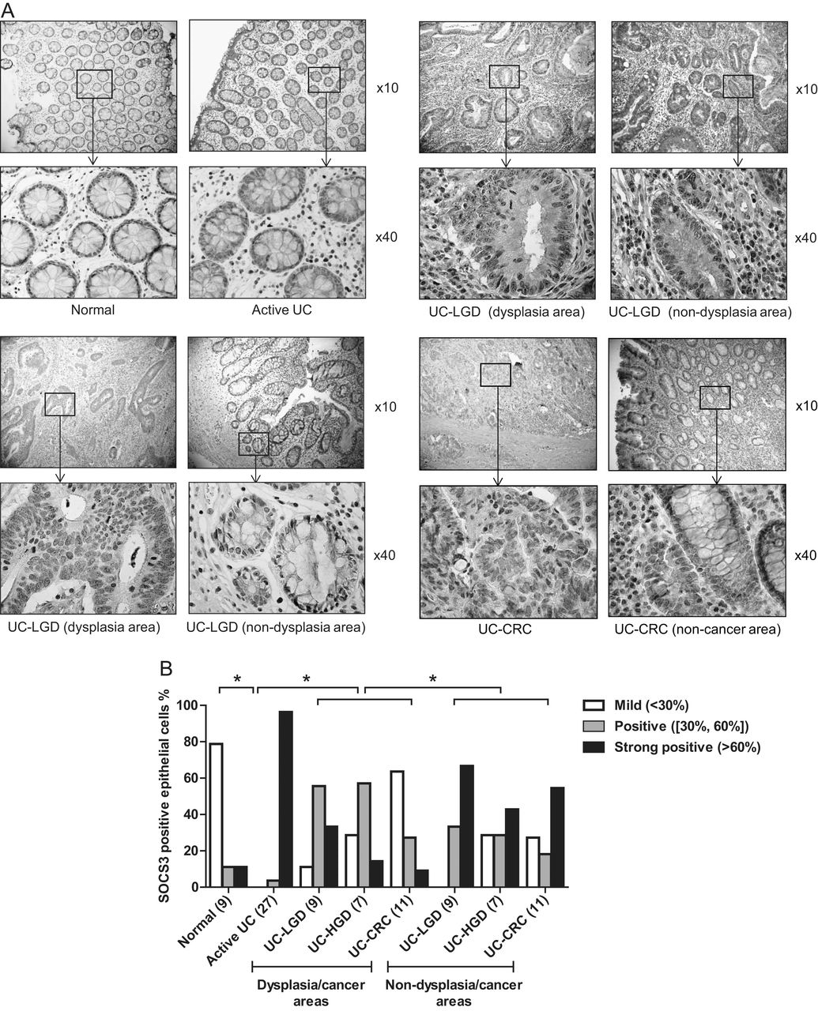
Fig. 1. Specific SOCS3 down regulation in epithelial cells during progression from low-grade dysplasia (LGD) to ...
Notes:
Fig. 1. Specific SOCS3 down regulation in epithelial cells during progression from low-grade dysplasia (LGD) to UC–CRC in the dysplastic and/or cancer region. (A) Immunohistochemistry (IHC) staining shows SOCS3 expression in dysplastic/cancer and adjacent non-dysplastic/cancer area in the same biopsies. (B) Epithelial SOCS3 expression was compared in the same biopsies between dysplastic/cancerous areas and non-dysplastic areas. SOCS3-positive epithelial cells are significantly more numerous in the non-dysplastic/non-cancer area than in the dysplastic/cancer area from the same biopsies ( P < 0.05). To assess SOCS3 expression in different areas of cancer tissues, experienced gastro-pathologist evaluated dysplasia/cancer after hematoxylin and eosin staining and marked dysplastic/cancerous area in every slide. Then two independent trained scientists scored the slides with SOCS3 positive epithelial cells in a blinded manner. The scoring criteria were defined as mild expression 60% of SOCS3 positive epithelial cells.
Unless provided in the caption above, the following copyright applies to the content of this slide: © The Author 2012. Published by Oxford University Press. All rights reserved. For Permissions, please email: journals.permissions@oup.com

Slide 3
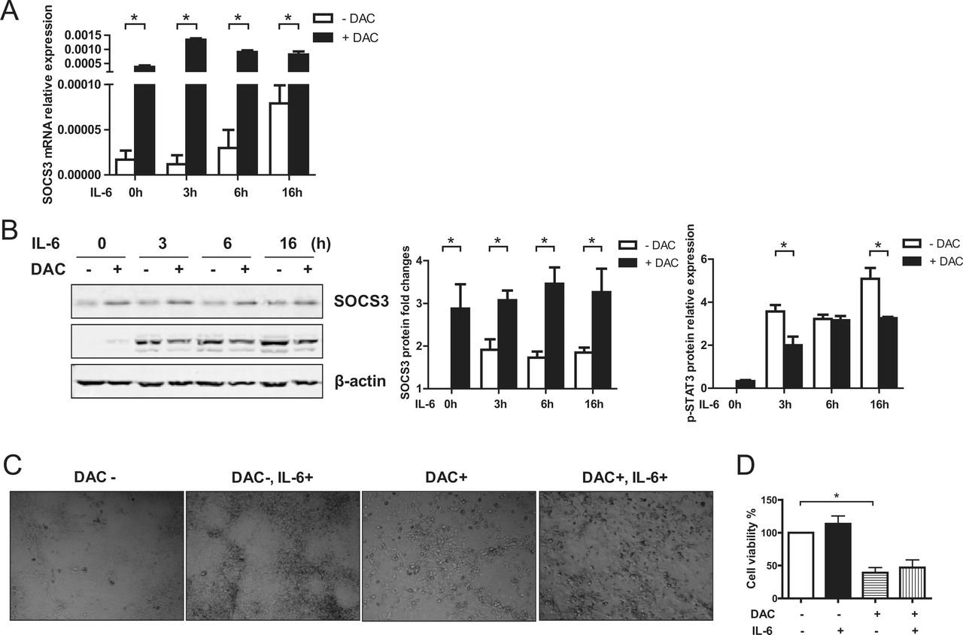
Fig. 3. DAC restores SOCS3 inducibility. (A–B) In DLD1 cells, DAC treatment increases basal levels of SOCS3 ...
Notes:
Fig. 3. DAC restores SOCS3 inducibility. (A–B) In DLD1 cells, DAC treatment increases basal levels of SOCS3 expression both at mRNA ( P < 0.05) (A) and protein level ( P < 0.05) (B), and this expression was further increased after IL-6 stimulation. DAC restoration of SOCS3 expression at basal levels reduced the IL-6-induced STAT3 phosphorylation in DLD1 cells ( P < 0.05) (B). (C–D) The restoration of SOCS3 expression by DNMT1 inhibition affects cell growth. DLD1 cells were cultured in medium with or without DAC for 3 days, then for an additional 3 days, with or without IL-6. Cells treated with DAC for the entire 6 days shown a significant reduction in cell growth compared with those cultured without DAC ( P < 0.05). Whereas IL-6 stimulation further increased the growth of cells in the absence of DAC, DAC treatment prevented enhanced cell growth by IL-6.
Unless provided in the caption above, the following copyright applies to the content of this slide: © The Author 2012. Published by Oxford University Press. All rights reserved. For Permissions, please email: journals.permissions@oup.com

Slide 4
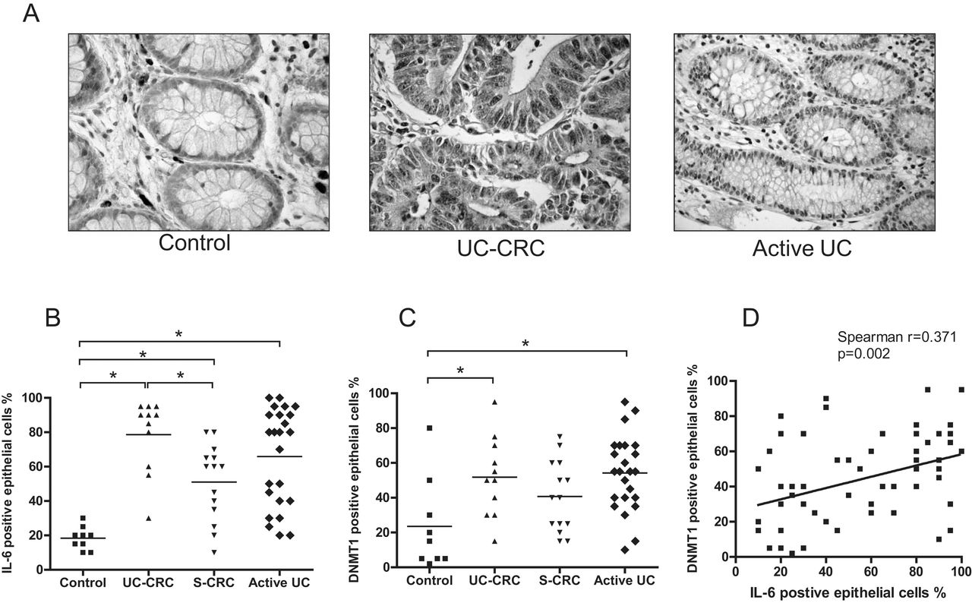
Fig. 4. IL-6 and DNMT1 expression and their correlation in patient biopsies. (A) Immunohistochemistry (IHC) staining ...
Notes:
Fig. 4. IL-6 and DNMT1 expression and their correlation in patient biopsies. (A) Immunohistochemistry (IHC) staining was used to visualize DNMT1 expression in the biopsies from controls, UC–CRC and active UC. (B) Analysis of the number of IL-6 positive epithelial cells. IL-6 expression is significantly higher in UC–CRC ( P = 0.0002), sporadic CRC ( P = 0.0017) and active UC ( P < 0.0001) than in normal controls. Biopsies from UC-CRC had even higher IL-6 expression than sporadic CRC ( P = 0.006). (C) Analysis of DNMT1 positive epithelial cells. DNMT1 expression is significantly higher in UC–CRC ( P = 0.020) and active UC ( P = 0.004) compared with controls. (D) Overall the expression levels of IL-6 and DNMT1 in all the biopsies show positive correlation (Spearman’s correlation coefficient r = 0.371, P = 0.002).
Unless provided in the caption above, the following copyright applies to the content of this slide: © The Author 2012. Published by Oxford University Press. All rights reserved. For Permissions, please email: journals.permissions@oup.com

