Slide 1
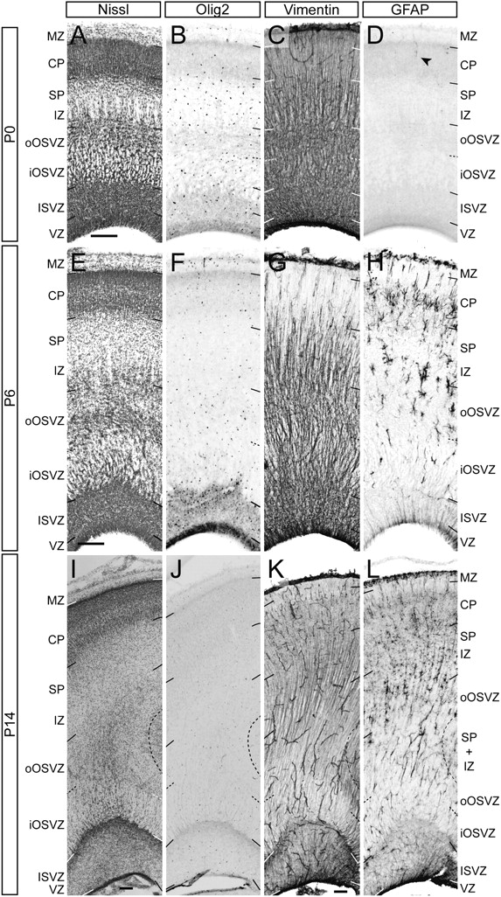
Figure 7. Ontogeny of glial marker expression in the presumptive visual cortex of the postnatal ferret. Details across ...
Notes:
Figure 7. Ontogeny of glial marker expression in the presumptive visual cortex of the postnatal ferret. Details across the cortical depth of representative stains for Nissl (A, E, and I), Olig2 (B, F, and J), Vimentin (C, G, and K), and GFAP (D, H, and L) at P0, P6, and P14. Details in main text. Note the abundance of GFAP+ radial processes in VZ/ISVZ at P6 and P14. Scale bar—200 μm.
Unless provided in the caption above, the following copyright applies to the content of this slide: © The Author 2011. Published by Oxford University Press. All rights reserved. For permissions, please e-mail: journals.permissions@oup.com

Slide 2
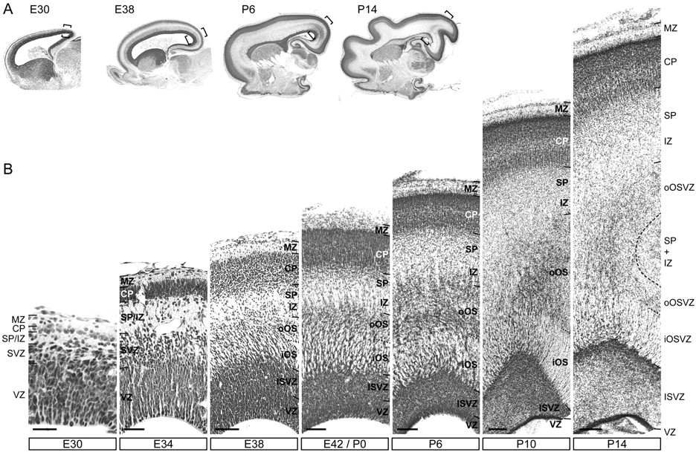
Figure 1. Ontogeny of the germinal layers in the ferret cerebral cortex. (A) Nissl stains of sagittal sections across ...
Notes:
Figure 1. Ontogeny of the germinal layers in the ferret cerebral cortex. (A) Nissl stains of sagittal sections across the brain of developing ferrets at different stages of development. Brackets in (A) indicate regions shown in (B). (B) Details across the cortical depth of representative Nissl stains at different stages of development. At embryonic day (E) 30 and E34, a thin and disorganized SVZ is distinguishable from the columnar VZ. At E38, differences in cell density distinguish the SVZ into ISVZ and OSVZ, which is additionally subdivided in an iOS or iOSVZ and an oOS or oOSVZ. At postnatal stages (P), the thickness of the VZ decreases, while all other layers become thicker, including ISVZ, OSVZ, IZ, SP, and CP. Scale bars—50 μm (E30 and E34), 150 μm (E38 and E42), 200 μm (P6 and P10), and 300 μm (P14).
Unless provided in the caption above, the following copyright applies to the content of this slide: © The Author 2011. Published by Oxford University Press. All rights reserved. For permissions, please e-mail: journals.permissions@oup.com

Slide 3
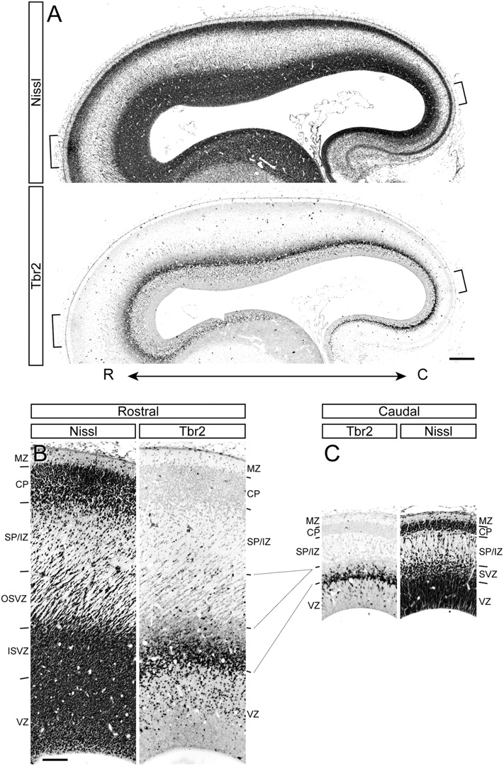
Figure 2. Gradient of SVZ development in the embryonic ferret. (A) Sagittal sections along the rostro-caudal extent of ...
Notes:
Figure 2. Gradient of SVZ development in the embryonic ferret. (A) Sagittal sections along the rostro-caudal extent of the E34 cortex stained for Nissl substance and Tbr2. Brackets indicate regions shown in (B and C). R, rostral; C, caudal. (B and C) Details of the rostral and caudal regions of the cerebral cortex shown in (A), illustrating differences in SVZ size and complexity. The cytoarchitecture and pattern of Tbr2+ cell distribution characteristic of the caudal SVZ extend rostrally to become ISVZ, whereas the rostral OSVZ does not have an equivalent layer at caudal levels. Scale bars—250 μm (A) and 250 μm (B and C).
Unless provided in the caption above, the following copyright applies to the content of this slide: © The Author 2011. Published by Oxford University Press. All rights reserved. For permissions, please e-mail: journals.permissions@oup.com

Slide 4
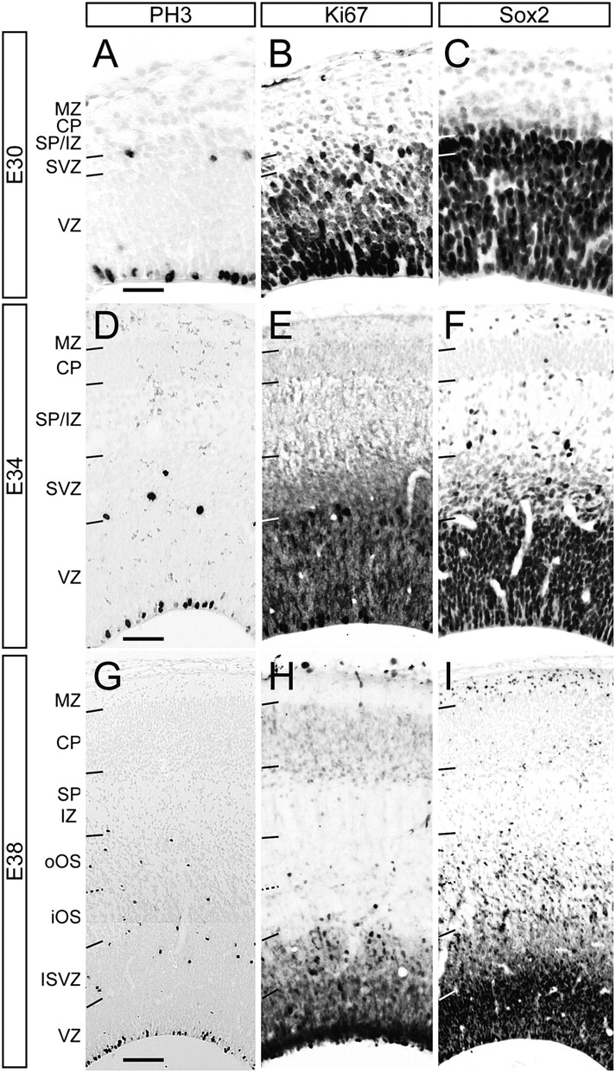
Figure 3. Ontogeny of germinal layers in the presumptive visual cortex of the embryonic ferret. Details across the ...
Notes:
Figure 3. Ontogeny of germinal layers in the presumptive visual cortex of the embryonic ferret. Details across the cortical depth of representative stains for phosphohistone H3 (PH3) (A, D, and G), Ki67 (B, E, and H), and Sox2 (C, F, and I) at E30, E34, and E38. The SVZ and its multiple subdivisions are characterized by containing basal mitoses (PH3+ nuclei) and a low density of Ki67+ and Sox2+ cells. Scale bars—50 μm (E30 and E34) and 150 μm (E38).
Unless provided in the caption above, the following copyright applies to the content of this slide: © The Author 2011. Published by Oxford University Press. All rights reserved. For permissions, please e-mail: journals.permissions@oup.com

Slide 5
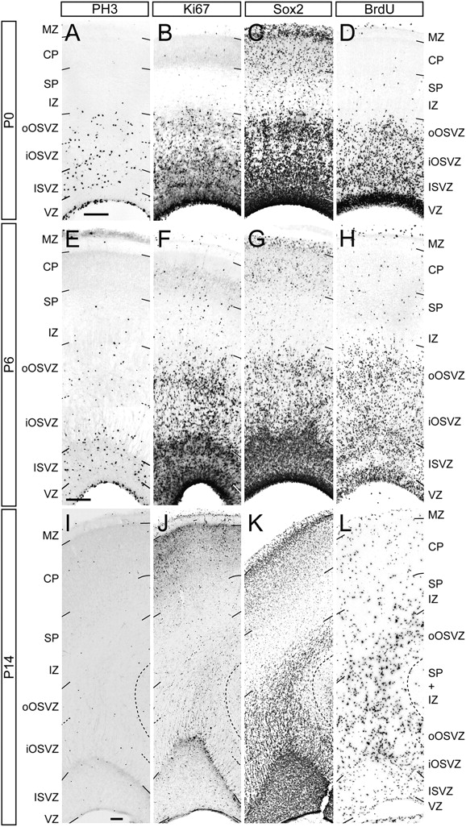
Figure 4. Ontogeny of germinal layers in the presumptive visual cortex of the postnatal ferret. Details across the ...
Notes:
Figure 4. Ontogeny of germinal layers in the presumptive visual cortex of the postnatal ferret. Details across the cortical depth of representative stains for phosphohistone H3 (PH3) (A, E, and I), Ki67 (B, F, and J), Sox2 (C, G, and K), and BrdU (D, H, and L) at P0, P6, and P14. ISVZ and OSVZ are characterized by containing basal PH3+ nuclei. At P0 and P6, the OSVZ is distinguished from the ISVZ by having a lower density of Ki67+, Sox2+, and BrdU+ cells. Within the OSVZ, positive cells are at a higher density in the oOSVZ than in the iOSVZ. At P14, PH3+, Ki67+, and BrdU+ cells accumulate preferentially at the border between ISVZ and OSVZ and along the center of OSVZ. At all ages, Sox2+ cells are abundant in MZ. Scale bar—200 μm.
Unless provided in the caption above, the following copyright applies to the content of this slide: © The Author 2011. Published by Oxford University Press. All rights reserved. For permissions, please e-mail: journals.permissions@oup.com

Slide 6
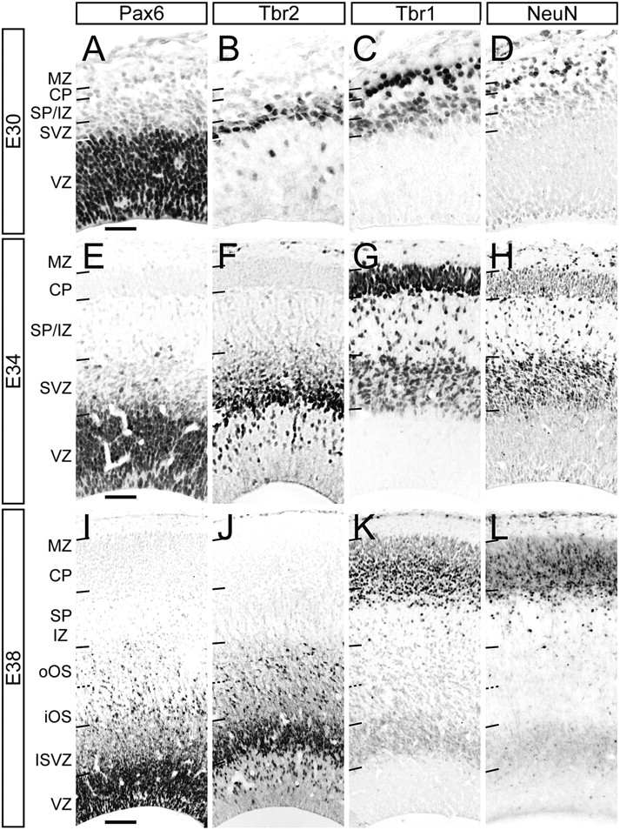
Figure 5. Ontogeny of transcription factor expression in the presumptive visual cortex of the embryonic ferret. Details ...
Notes:
Figure 5. Ontogeny of transcription factor expression in the presumptive visual cortex of the embryonic ferret. Details across the cortical depth of representative stains for Pax6 (A ,E, and I), Tbr2 (B, F, and J), Tbr1 (C, G, and K), and NeuN (D, H, and L) at E30, E34, and E38. The embryonic SVZ and its subdivisions are characterized by containing a high abundance of Tbr2+ and Tbr1+ cells, occasinal Pax6+ cells, and cells weakly labeled for NeuN. Scale bars—50 μm (E30 and E34) and 150 μm (E38).
Unless provided in the caption above, the following copyright applies to the content of this slide: © The Author 2011. Published by Oxford University Press. All rights reserved. For permissions, please e-mail: journals.permissions@oup.com

Slide 7
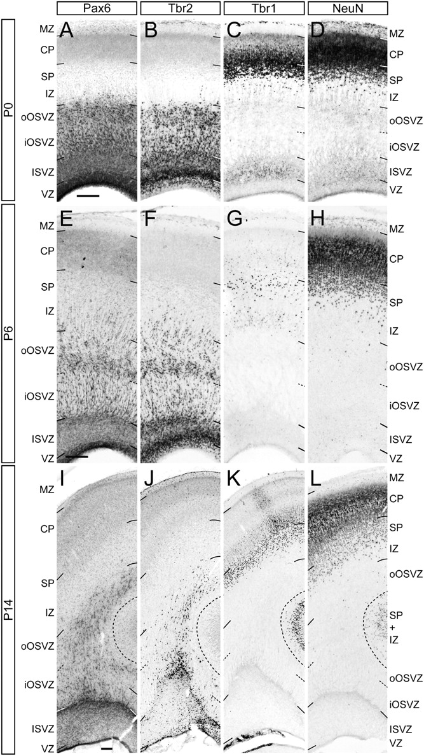
Figure 6. Ontogeny of transcription factor expression in the presumptive visual cortex of the postnatal ferret. Details ...
Notes:
Figure 6. Ontogeny of transcription factor expression in the presumptive visual cortex of the postnatal ferret. Details across the cortical depth of representative stains for Pax6 (A, E, and I), Tbr2 (B, F, and J), Tbr1 (C, G, and K), and NeuN (D, H, and L) at P0, P6, and P14. ISVZ and OSVZ are characterized by containing a high abundance of Pax6+ and Tbr2+ cells. At P14, Pax6+, and Tbr2+ cells accumulate selectively at the border between ISVZ and OSVZ and along the center of the OSVZ. At P0, the ISVZ, but not OSVZ, also contains cells weakly labeled for Tbr1 and NeuN. At P6 and P14, Tbr1+ and NeuN+ cells are only in SP and CP. Scale bar—200 μm.
Unless provided in the caption above, the following copyright applies to the content of this slide: © The Author 2011. Published by Oxford University Press. All rights reserved. For permissions, please e-mail: journals.permissions@oup.com

Slide 8
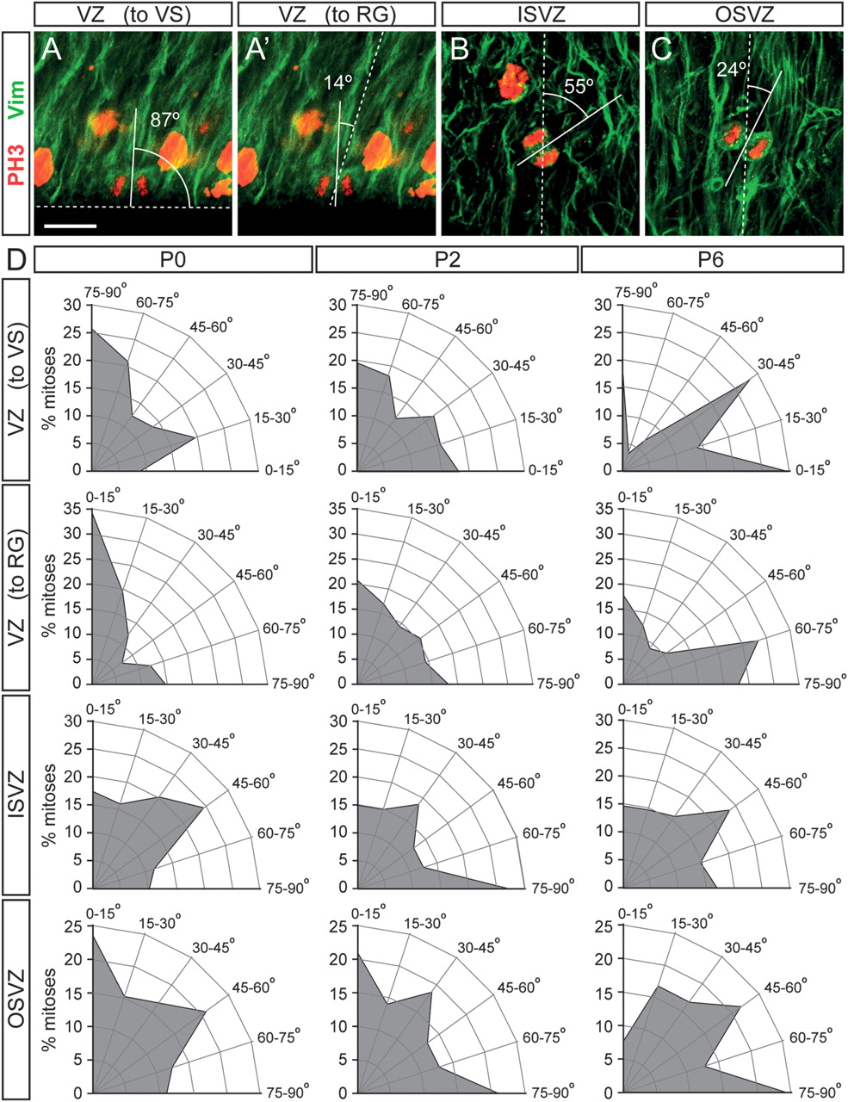
Figure 10. Mitotic cleavage plane orientation varies between germinal layers and during development. (A–C) Double stains ...
Notes:
Figure 10. Mitotic cleavage plane orientation varies between germinal layers and during development. (A–C) Double stains for PH3 (red) and Vimentin (green) of VZ (A and A′), ISVZ (B), and OSVZ (C) at P0, illustrating the relationship between mitotic plane of telophasic cells (solid line), ventricular surface (VS) (dashed line in A), and orientation of radial glia processes (dashed lines in A′, B, and C). (D) Quantifications of the angle of mitotic division of VZ, ISVZ, and OSVZ progenitors at P0, P2, and P6. Each plot represents the percentage of mitoses found within each range of angles (P0, n = 82 mitoses in VZ, 69 in ISVZ, and 75 in OSVZ; P2, n = 77 mitoses in VZ, 81 in ISVZ, and 86 in OSVZ; and P6, n = 57 mitoses in VZ, 89 in ISVZ, and 78 in OSVZ; 3 animals per group). The angle of each VZ mitosis was measured with respect to the VS and to the direction of radial glia fibers (RG), as indicated. The distributions of mitotic plane values for VZ progenitors varied little between the 2 methods of measurement, although the distribution with respect to RG was most coherent. The orientation of mitotic divisions switched gradually between P0 and P6, from mostly parallel to the radial glia to mostly perpendicular. Scale bar—15 μm (A–C).
Unless provided in the caption above, the following copyright applies to the content of this slide: © The Author 2011. Published by Oxford University Press. All rights reserved. For permissions, please e-mail: journals.permissions@oup.com

Slide 9
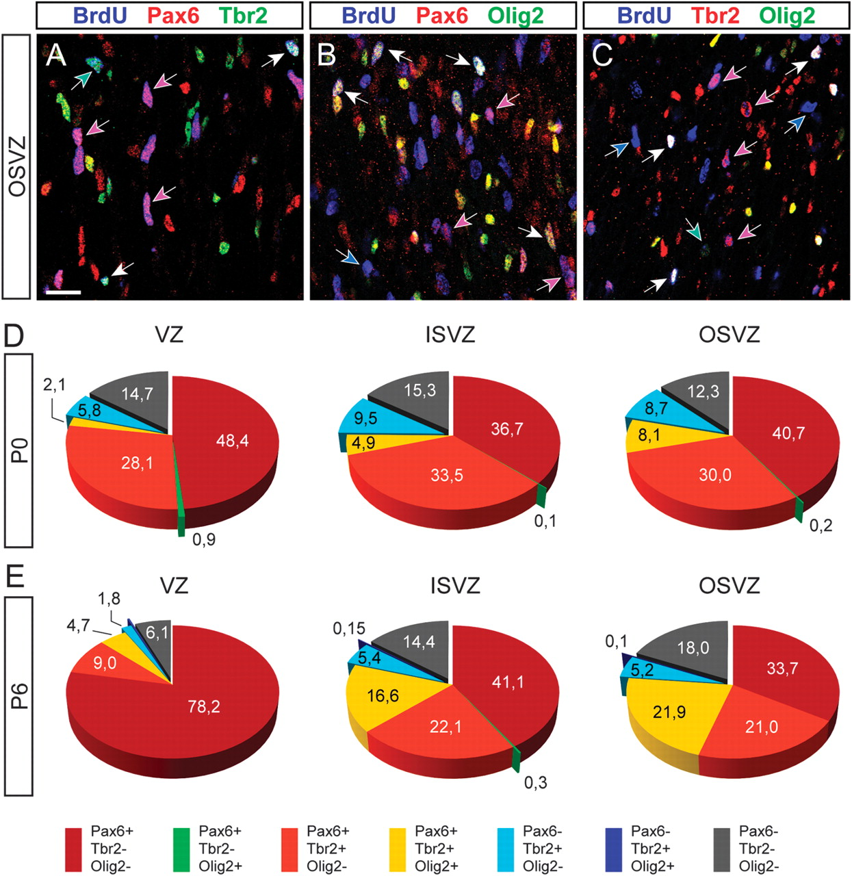
Figure 8. Transcription factor coexpression analysis in cortical progenitors of the prospective primary visual cortex ...
Notes:
Figure 8. Transcription factor coexpression analysis in cortical progenitors of the prospective primary visual cortex at P6. (A–C) Different combinations of triple stains for BrdU, Pax6, Tbr2, and Olig2 in the OSVZ. Cycling progenitors are identified by BrdU stain (blue), and progenitor cells positive for different marker combinations are indicated by arrows color coded as in legend. (D and E) Quantification of the percentage of progenitors in the different proliferative layers at P0 (D) and P6 (E) expressing each of the marker combinations indicated in the color-coded legend. Progenitors in iOSVZ and oOSVZ were pooled. n = 3 animals per group, 3 sections per animal (P0, n = 2957 cells in VZ; 2092 cells in ISVZ; and 2870 cells in OSVZ. P6, n = 2131 cells in VZ; 2011 cells in ISVZ; and 3370 cells in OSVZ). Scale bar—20 μm.
Unless provided in the caption above, the following copyright applies to the content of this slide: © The Author 2011. Published by Oxford University Press. All rights reserved. For permissions, please e-mail: journals.permissions@oup.com

Slide 10
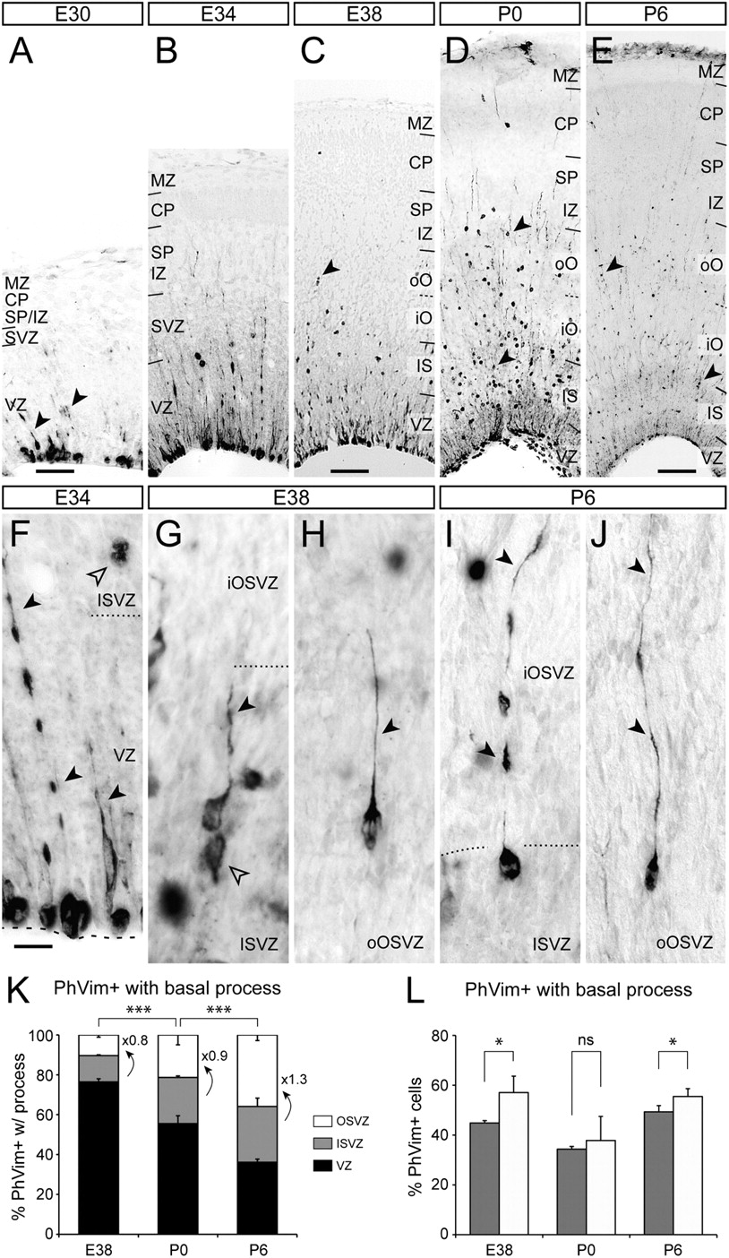
Figure 9. Ontogeny of fosfovimentin expression in the presumptive visual cortex. (A–E) Details across the cortical ...
Notes:
Figure 9. Ontogeny of fosfovimentin expression in the presumptive visual cortex. (A–E) Details across the cortical depth of representative stains for fosfovimentin at embryonic and early postnatal stages. Arrowheads indicate examples of cells with a basal process. iO, inner OSVZ; oO, outer OSVZ; and IZ, ISVZ. (F–J) High magnification of cells with a basal process (solid arrowheads) in the VZ (F), ISVZ (G and I), and OSVZ (H and J) at the ages indicated. Open arrowheads in (F and G) point at examples of cells without a basal process in ISVZ. (K) Quantification of the laminar distribution of fosfovimentin (PhVim) positive cells with a basal process between E38 and P6. Numbers within graph indicate fold difference of OSVZ with respect to ISVZ. E38, n = 775 cells, 2 animals; P0, n = 501 cells, 3 animals; and P6, n = 1481 cells, 3 animals. (L) Proportion of PhVim+ cells in ISVZ and OSVZ that have a basal process. Legend as in (K). At E38 and P6, cells with a basal process were more abundant in OSVZ than in ISVZ. n = 3 animals per age, 3 sections per animal (E38, n = 297 cells in ISVZ, 186 cells in OSVZ; P0, n = 342 cells in ISVZ, 288 cells in OSVZ; and P6, n = 839 cells in ISVZ, 958 cells in OSVZ. *** P < 0.001; * P < 0.05; ns, not significant; chi-square test. Scale bar—50 μm (A and B), 150 μm (C and D), 200 μm (E), and 15 μm (F–J).
Unless provided in the caption above, the following copyright applies to the content of this slide: © The Author 2011. Published by Oxford University Press. All rights reserved. For permissions, please e-mail: journals.permissions@oup.com

Slide 11
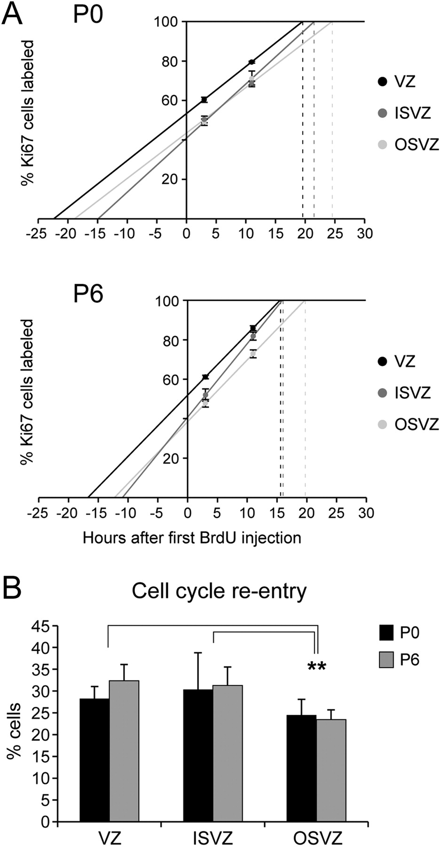
Figure 11. Analysis of cell cycle dynamics of cortical progenitors in the prospective primary visual cortex of ferret. ...
Notes:
Figure 11. Analysis of cell cycle dynamics of cortical progenitors in the prospective primary visual cortex of ferret. (A) Quantifications of cumulative BrdU-labeling experiments in VZ, ISVZ, and OSVZ at P0 and P6 (gray scale dots, as in legend) expressed as percentage of Ki67+ cells positive for BrdU at 3 or 11 h after the first BrdU injection. Statistical significance between layers was tested by a generalized linear model using a binary logistic regression in which the covariates were time and layer. Statistical differences were tested by chi-square test (P < 0.0001 for all comparisons between layers for same age and between ages for same layer). The regression line for each data set allowed determination of Tc-s (time at which 100% of Ki67+ cells would be labeled by BrdU; y = 100, dashed lines) and Ts (time at which 0% of Ki67+ cells would contain BrdU; y = 0). Tc-s + Ts determines the total length of the cell cycle (Tc). (B) Quantification of the percentage of VZ, ISVZ, and OSVZ progenitor cells reentering the cell cycle at P0 and P6. Cell cycle reentry was identical between P0 and P6 in all layers, but in OSVZ, it was lower than in ISVZ and VZ. **P < 0.01; chi-square test.
Unless provided in the caption above, the following copyright applies to the content of this slide: © The Author 2011. Published by Oxford University Press. All rights reserved. For permissions, please e-mail: journals.permissions@oup.com

