Slide 1
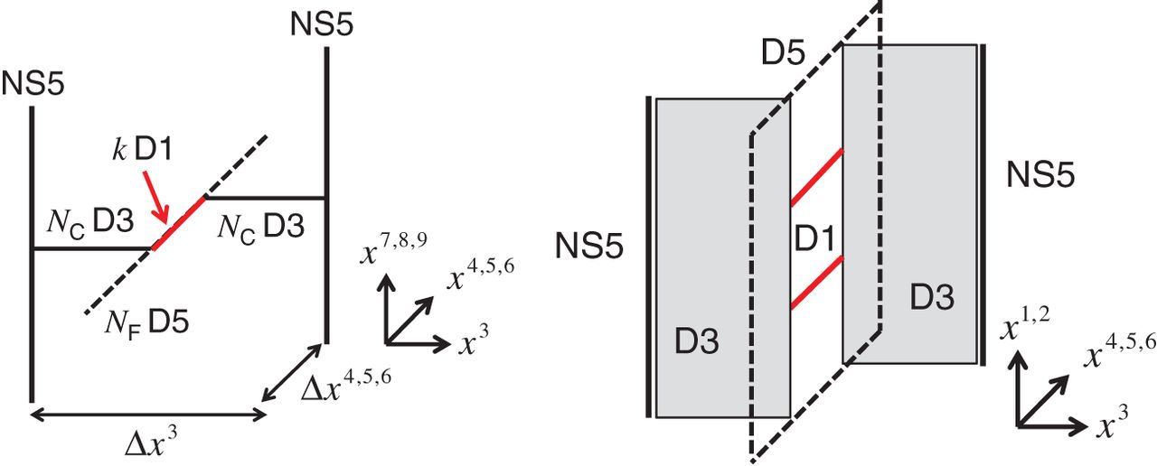
Fig. 1. Brane configuration for $k$ vortices. As for separation of the two NS5-branes, $\Delta x^3$ corresponds to ...
Notes:
Fig. 1. Brane configuration for $k$ vortices. As for separation of the two NS5-branes, $\Delta x^3$ corresponds to $1/g^2$ and $\Big (\Delta x^4,\Delta x^5,\Delta x^6\Big )$ correspond to the triplet of the FI parameters.
Unless provided in the caption above, the following copyright applies to the content of this slide: © The Author(s) 2015. Published by Oxford University Press on behalf of the Physical Society of Japan.This is an Open Access article distributed under the terms of the Creative Commons Attribution License (http://creativecommons.org/licenses/by/4.0/), which permits unrestricted use, distribution, and reproduction in any medium, provided the original work is properly cited.Funded by SCOAP3

Slide 2
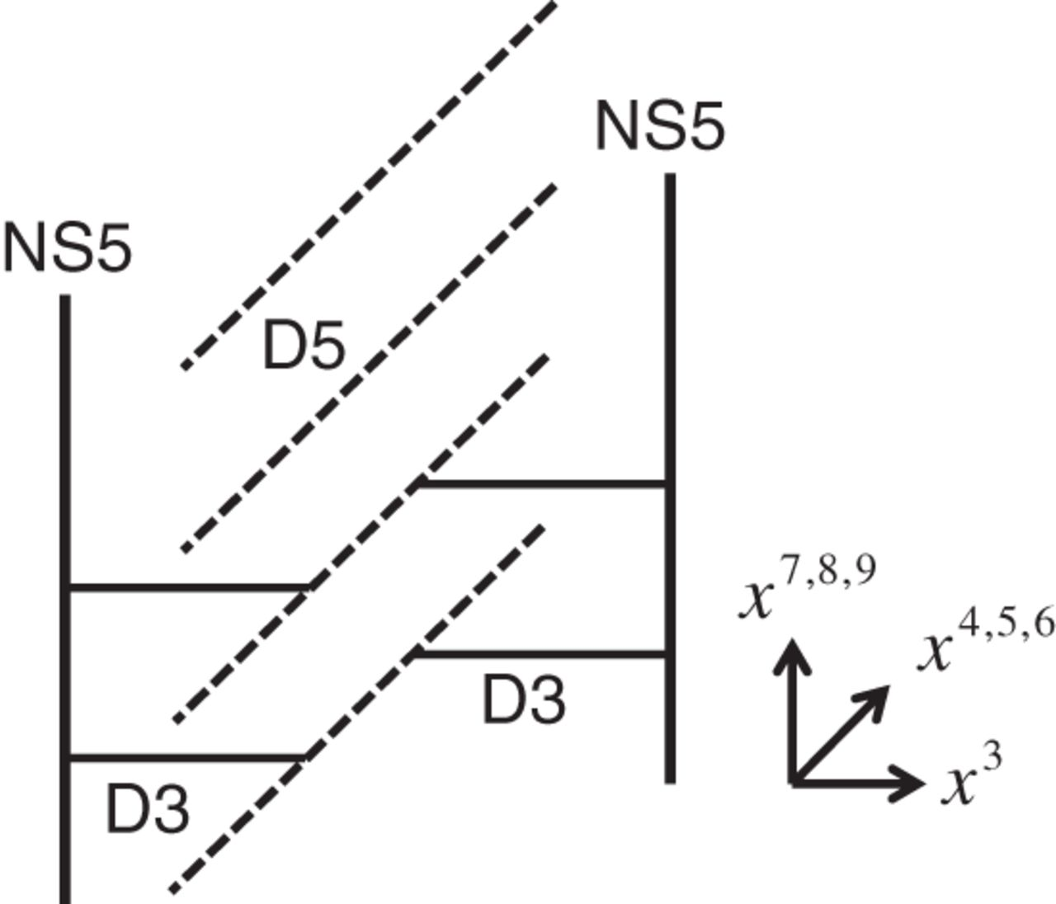
Fig. 2. Vacuum configuration $(k=0)$.
Notes:
Fig. 2. Vacuum configuration $(k=0)$.
Unless provided in the caption above, the following copyright applies to the content of this slide: © The Author(s) 2015. Published by Oxford University Press on behalf of the Physical Society of Japan.This is an Open Access article distributed under the terms of the Creative Commons Attribution License (http://creativecommons.org/licenses/by/4.0/), which permits unrestricted use, distribution, and reproduction in any medium, provided the original work is properly cited.Funded by SCOAP3

Slide 3
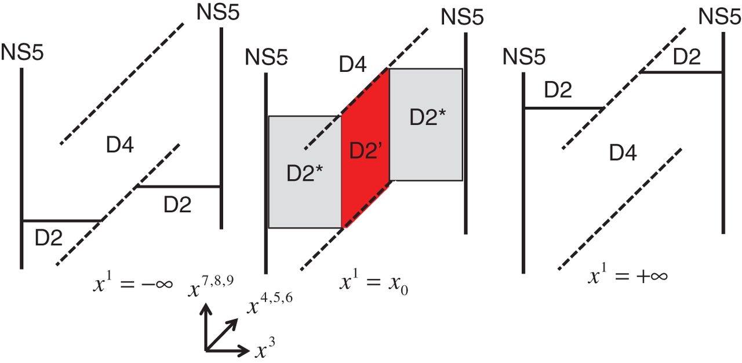
Fig. 3. T-dualized configurations for $k=1$: the $\rm D2'$-brane is assumed to be located at $x^1=x_{0}$.
Notes:
Fig. 3. T-dualized configurations for $k=1$: the $\rm D2'$-brane is assumed to be located at $x^1=x_{0}$.
Unless provided in the caption above, the following copyright applies to the content of this slide: © The Author(s) 2015. Published by Oxford University Press on behalf of the Physical Society of Japan.This is an Open Access article distributed under the terms of the Creative Commons Attribution License (http://creativecommons.org/licenses/by/4.0/), which permits unrestricted use, distribution, and reproduction in any medium, provided the original work is properly cited.Funded by SCOAP3

Slide 4
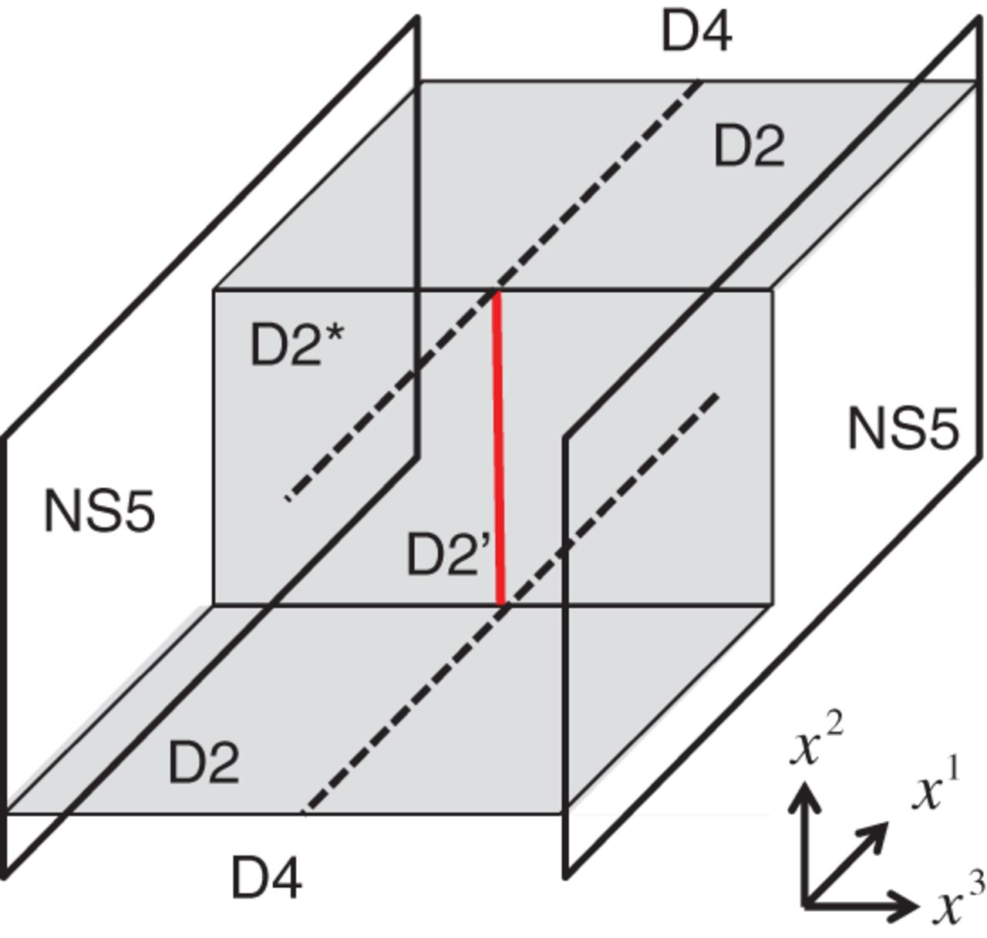
Fig. 4. Brane configuration for a wall.
Notes:
Fig. 4. Brane configuration for a wall.
Unless provided in the caption above, the following copyright applies to the content of this slide: © The Author(s) 2015. Published by Oxford University Press on behalf of the Physical Society of Japan.This is an Open Access article distributed under the terms of the Creative Commons Attribution License (http://creativecommons.org/licenses/by/4.0/), which permits unrestricted use, distribution, and reproduction in any medium, provided the original work is properly cited.Funded by SCOAP3

Slide 5
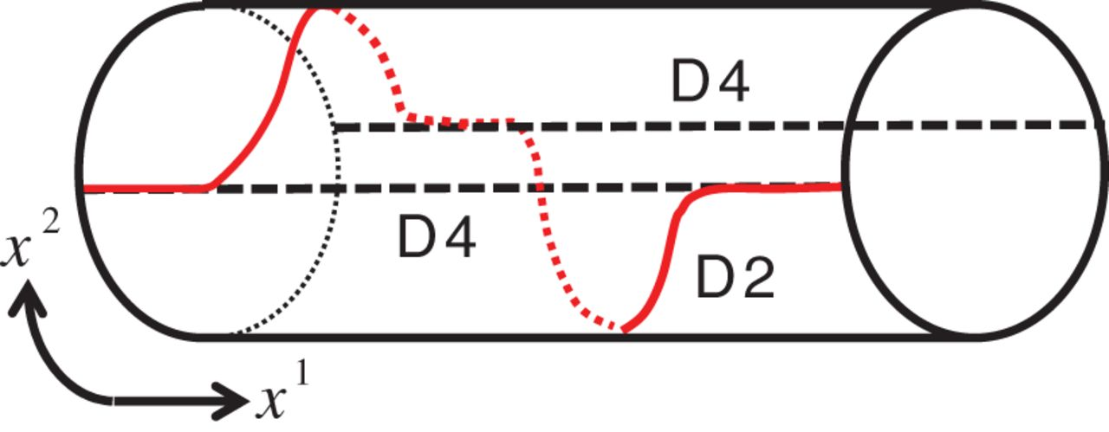
Fig. 5. T-dual picture for $N_{\rm F}=2, N_{\rm C}=1, k=1$.
Notes:
Fig. 5. T-dual picture for $N_{\rm F}=2, N_{\rm C}=1, k=1$.
Unless provided in the caption above, the following copyright applies to the content of this slide: © The Author(s) 2015. Published by Oxford University Press on behalf of the Physical Society of Japan.This is an Open Access article distributed under the terms of the Creative Commons Attribution License (http://creativecommons.org/licenses/by/4.0/), which permits unrestricted use, distribution, and reproduction in any medium, provided the original work is properly cited.Funded by SCOAP3

Slide 6
Fig. 6. Brane picture of the Seiberg dual for kinks, where the presence and absence of color branes is exchanged. ...
Notes:
Fig. 6. Brane picture of the Seiberg dual for kinks, where the presence and absence of color branes is exchanged. Here we give an example of the duality between $Gr_{3,2}$ and $Gr_{3,1} \simeq {\mathbb C}P^2$. The horizontal and vertical directions are $x^1$ and $x^2$, respectively.
Unless provided in the caption above, the following copyright applies to the content of this slide: © The Author(s) 2015. Published by Oxford University Press on behalf of the Physical Society of Japan.This is an Open Access article distributed under the terms of the Creative Commons Attribution License (http://creativecommons.org/licenses/by/4.0/), which permits unrestricted use, distribution, and reproduction in any medium, provided the original work is properly cited.Funded by SCOAP3

Slide 7
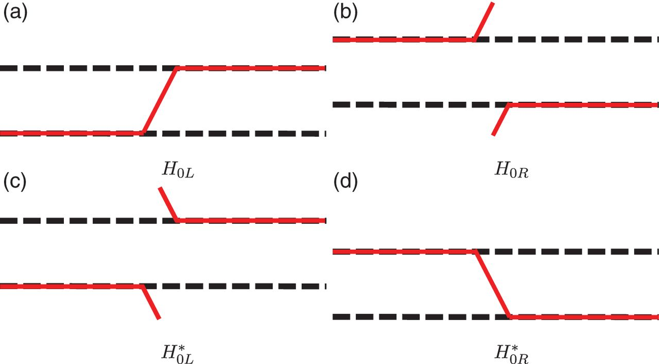
Fig. 7. Brane configurations of fractional instantons in the ${\mathbb C}P^1$ model with the ${\mathbb Z}_2$ twisted ...
Notes:
Fig. 7. Brane configurations of fractional instantons in the ${\mathbb C}P^1$ model with the ${\mathbb Z}_2$ twisted boundary condition, corresponding to (a) $H_{0L}$, (b) $H_{0R}$, (c) $H_{0L}^* $, and (d) $H_{0R}^* $. The horizontal and vertical directions are $x^1$ and $x^2$, respectively. The instanton charges $Q$ are (a) $+1/2$, (b) $+1/2$, (c) $-1/2$, (d) $-1/2$, respectively.
Unless provided in the caption above, the following copyright applies to the content of this slide: © The Author(s) 2015. Published by Oxford University Press on behalf of the Physical Society of Japan.This is an Open Access article distributed under the terms of the Creative Commons Attribution License (http://creativecommons.org/licenses/by/4.0/), which permits unrestricted use, distribution, and reproduction in any medium, provided the original work is properly cited.Funded by SCOAP3

Slide 8
Fig. 8. Composite fractional instantons in the ${\mathbb C}P^2$ model. Keeping the center of mass position $\frac ...
Notes:
Fig. 8. Composite fractional instantons in the ${\mathbb C}P^2$ model. Keeping the center of mass position $\frac {3}{4\pi }\log \lambda _1$ fixed, (a) generic separated fractional instanton solution ($\lambda _1 \approx 1, \lambda _2 \gg 1$), (b) two fractional instantons touching and beginning to merge together ($\lambda _1\approx 1, \lambda _2\approx 1$), (c) compressed fractional instanton solution ($\lambda _1\approx 1, \lambda _2\to 0$).
Unless provided in the caption above, the following copyright applies to the content of this slide: © The Author(s) 2015. Published by Oxford University Press on behalf of the Physical Society of Japan.This is an Open Access article distributed under the terms of the Creative Commons Attribution License (http://creativecommons.org/licenses/by/4.0/), which permits unrestricted use, distribution, and reproduction in any medium, provided the original work is properly cited.Funded by SCOAP3

Slide 9
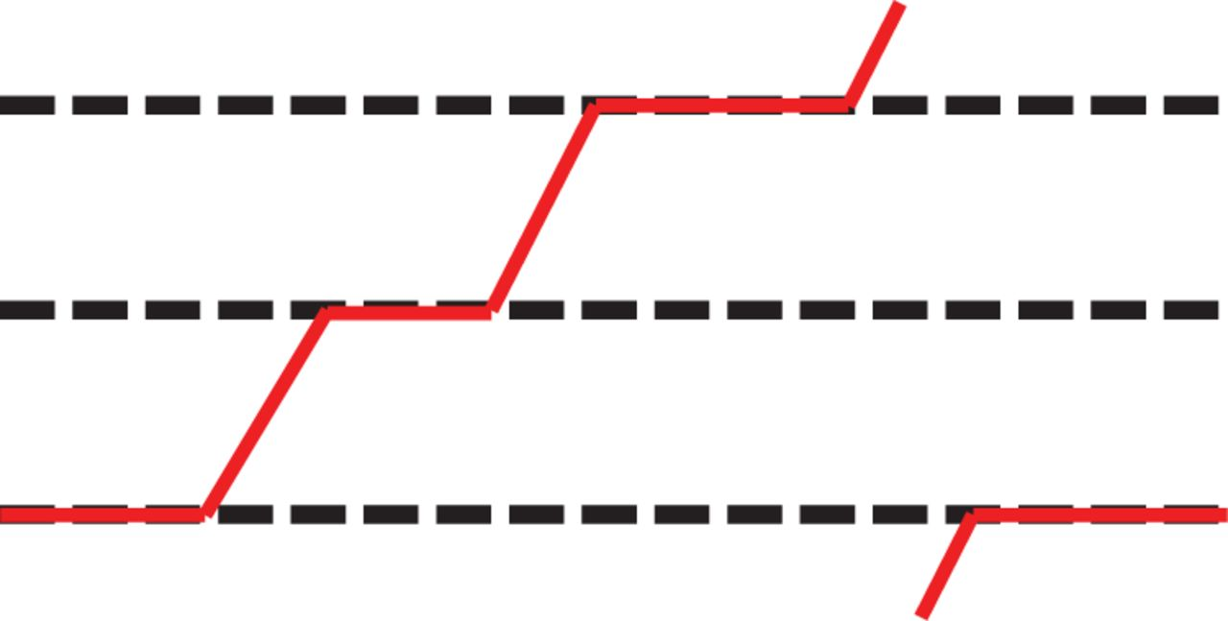
Fig. 9. A ${\mathbb C}P^{2}$ instanton with the unit instanton charge.
Notes:
Fig. 9. A ${\mathbb C}P^{2}$ instanton with the unit instanton charge.
Unless provided in the caption above, the following copyright applies to the content of this slide: © The Author(s) 2015. Published by Oxford University Press on behalf of the Physical Society of Japan.This is an Open Access article distributed under the terms of the Creative Commons Attribution License (http://creativecommons.org/licenses/by/4.0/), which permits unrestricted use, distribution, and reproduction in any medium, provided the original work is properly cited.Funded by SCOAP3

Slide 10
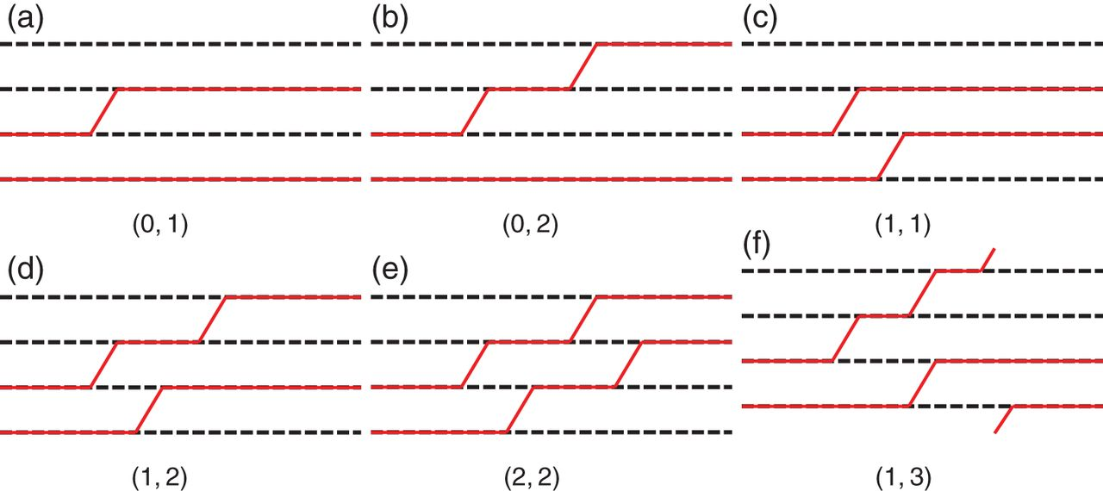
Fig. 10. Fractional instantons for two adjacent flavors occupied by colors at the left vacuum in $Gr_{4,2}$, labeled ...
Notes:
Fig. 10. Fractional instantons for two adjacent flavors occupied by colors at the left vacuum in $Gr_{4,2}$, labeled by indices (a) $(0,1)$, (b) $(0,2)$, (c) $(1,1)$, (d) $(1,2)$, (e) $(2,2)$, and (f) $(1,3)$. Diagram (a) is an elementary fractional instanton, and (b)–(e) are composite fractional instantons. Diagram (f) is an instanton, but not a composite fractional instanton.
Unless provided in the caption above, the following copyright applies to the content of this slide: © The Author(s) 2015. Published by Oxford University Press on behalf of the Physical Society of Japan.This is an Open Access article distributed under the terms of the Creative Commons Attribution License (http://creativecommons.org/licenses/by/4.0/), which permits unrestricted use, distribution, and reproduction in any medium, provided the original work is properly cited.Funded by SCOAP3

Slide 11
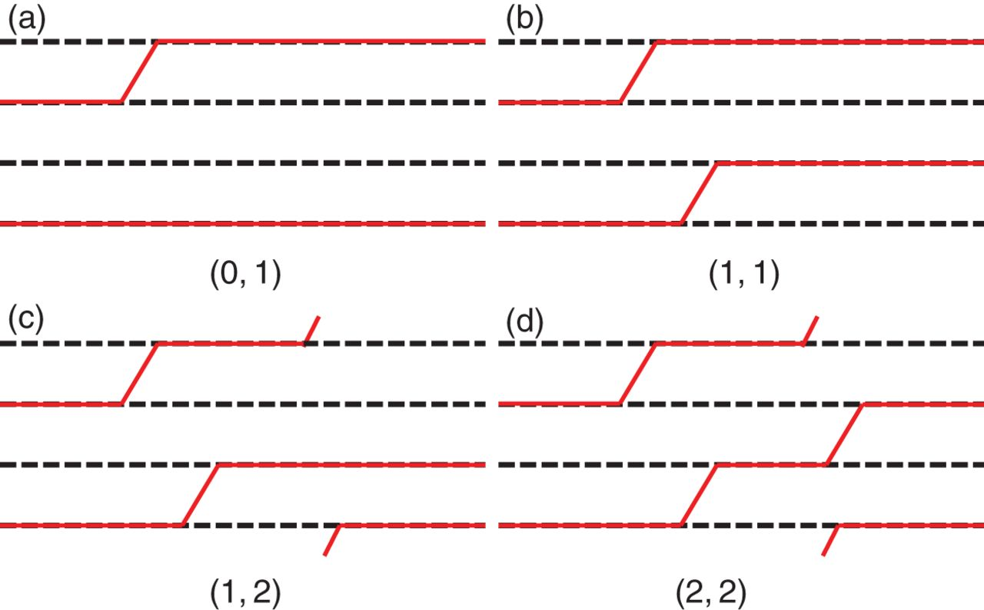
Fig. 11. Fractional instantons for two non-adjacent flavors occupied by colors at the left vacuum in $Gr_{4,2}$, ...
Notes:
Fig. 11. Fractional instantons for two non-adjacent flavors occupied by colors at the left vacuum in $Gr_{4,2}$, labeled by indices (a) $(0,1)$, (b) $(1,1)$, (c) $(1,2)$, and (d) $(2,2)$. Diagram (a) is an elementary fractional instanton, (b) and (c) are composite fractional instantons, (d) is a BPS instanton.
Unless provided in the caption above, the following copyright applies to the content of this slide: © The Author(s) 2015. Published by Oxford University Press on behalf of the Physical Society of Japan.This is an Open Access article distributed under the terms of the Creative Commons Attribution License (http://creativecommons.org/licenses/by/4.0/), which permits unrestricted use, distribution, and reproduction in any medium, provided the original work is properly cited.Funded by SCOAP3

Slide 12
Fig. 12. BPS reconnection. The moduli space of the configuration after BPS reconnection is a boundary of the moduli ...
Notes:
Fig. 12. BPS reconnection. The moduli space of the configuration after BPS reconnection is a boundary of the moduli space of that before BPS reconnection.
Unless provided in the caption above, the following copyright applies to the content of this slide: © The Author(s) 2015. Published by Oxford University Press on behalf of the Physical Society of Japan.This is an Open Access article distributed under the terms of the Creative Commons Attribution License (http://creativecommons.org/licenses/by/4.0/), which permits unrestricted use, distribution, and reproduction in any medium, provided the original work is properly cited.Funded by SCOAP3

Slide 13
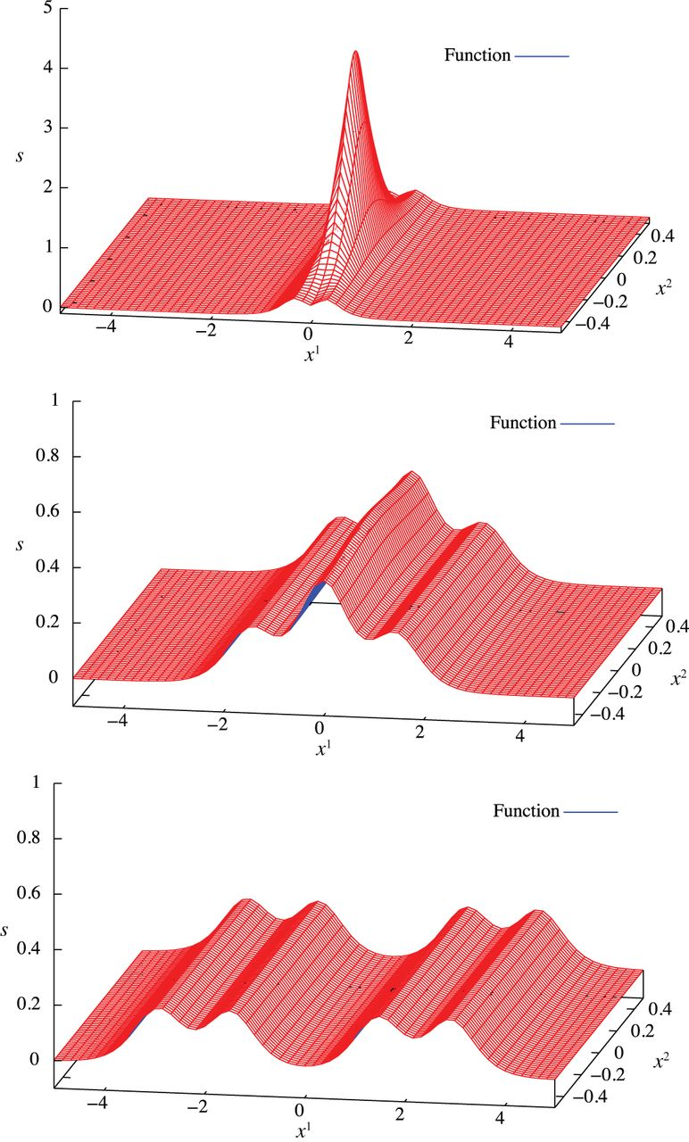
Fig. 13. Energy density $s({\textbf{x}})$ for the BPS instanton configuration of the Grassmann sigma model in Fig. ...
Notes:
Fig. 13. Energy density $s({\textbf{x}})$ for the BPS instanton configuration of the Grassmann sigma model in Fig. 10(f) for $\lambda _{1} =1,\,\lambda _{3}=1,\,\lambda _{4} =1,\, \lambda _{5}=1$ (top); $\lambda _{1} =1,\,\lambda _{3}=1,\, \lambda _{4} =10,\,\lambda _{5}=10$ (middle); and $\lambda _{1} =10,\,\lambda _{3}=0.1,\,\lambda _{4} =10,\, \lambda _{5}=100$ (bottom). Grassmann sigma model coupling is taken as $v^2=1$.
Unless provided in the caption above, the following copyright applies to the content of this slide: © The Author(s) 2015. Published by Oxford University Press on behalf of the Physical Society of Japan.This is an Open Access article distributed under the terms of the Creative Commons Attribution License (http://creativecommons.org/licenses/by/4.0/), which permits unrestricted use, distribution, and reproduction in any medium, provided the original work is properly cited.Funded by SCOAP3

Slide 14
Fig. 14. A neutral bion in the ${\mathbb C}P^1$ model.
Notes:
Fig. 14. A neutral bion in the ${\mathbb C}P^1$ model.
Unless provided in the caption above, the following copyright applies to the content of this slide: © The Author(s) 2015. Published by Oxford University Press on behalf of the Physical Society of Japan.This is an Open Access article distributed under the terms of the Creative Commons Attribution License (http://creativecommons.org/licenses/by/4.0/), which permits unrestricted use, distribution, and reproduction in any medium, provided the original work is properly cited.Funded by SCOAP3

Slide 15
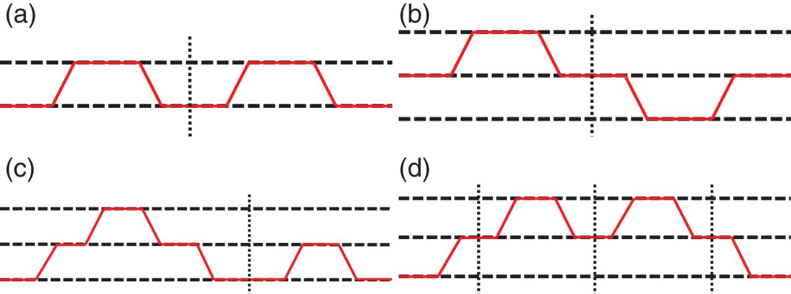
Fig. 15. Reducible neutral bions in the ${\mathbb C}P^{N_{\rm F}-1}$ model.
Notes:
Fig. 15. Reducible neutral bions in the ${\mathbb C}P^{N_{\rm F}-1}$ model.
Unless provided in the caption above, the following copyright applies to the content of this slide: © The Author(s) 2015. Published by Oxford University Press on behalf of the Physical Society of Japan.This is an Open Access article distributed under the terms of the Creative Commons Attribution License (http://creativecommons.org/licenses/by/4.0/), which permits unrestricted use, distribution, and reproduction in any medium, provided the original work is properly cited.Funded by SCOAP3

Slide 16
Fig. 16. Irreducible and composite neutral bions in the ${\mathbb C}P^2$ model. (a) Generic position, (b) compressed.
Notes:
Fig. 16. Irreducible and composite neutral bions in the ${\mathbb C}P^2$ model. (a) Generic position, (b) compressed.
Unless provided in the caption above, the following copyright applies to the content of this slide: © The Author(s) 2015. Published by Oxford University Press on behalf of the Physical Society of Japan.This is an Open Access article distributed under the terms of the Creative Commons Attribution License (http://creativecommons.org/licenses/by/4.0/), which permits unrestricted use, distribution, and reproduction in any medium, provided the original work is properly cited.Funded by SCOAP3

Slide 17
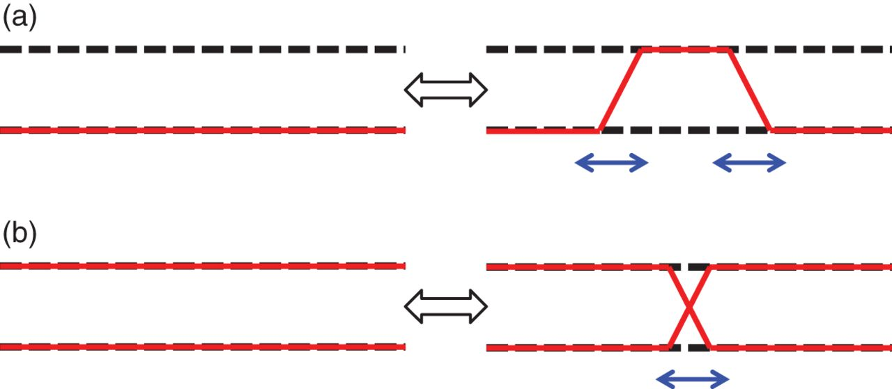
Fig. 17. Fundamental procedures to create neutral bions. (a) Creation of a ...
Notes:
Fig. 17. Fundamental procedures to create neutral bions. (a) Creation of a fractional-instanton–fractional-anti-instanton pair. (b) Crossing/non-BPS reconnection of two color branes. (a) creates neutral bions but (b) does not.
Unless provided in the caption above, the following copyright applies to the content of this slide: © The Author(s) 2015. Published by Oxford University Press on behalf of the Physical Society of Japan.This is an Open Access article distributed under the terms of the Creative Commons Attribution License (http://creativecommons.org/licenses/by/4.0/), which permits unrestricted use, distribution, and reproduction in any medium, provided the original work is properly cited.Funded by SCOAP3

Slide 18
Fig. 18. A reducible neutral bion for the Grassmann sigma models. This is a typical reducible bion in addition to the ...
Notes:
Fig. 18. A reducible neutral bion for the Grassmann sigma models. This is a typical reducible bion in addition to the configurations in Figs. 15(a) and (b), which exist for the ${\mathbb C}P^{N_{\rm F}-1}$ model. This configuration is a dual to that of Fig. 15(b).
Unless provided in the caption above, the following copyright applies to the content of this slide: © The Author(s) 2015. Published by Oxford University Press on behalf of the Physical Society of Japan.This is an Open Access article distributed under the terms of the Creative Commons Attribution License (http://creativecommons.org/licenses/by/4.0/), which permits unrestricted use, distribution, and reproduction in any medium, provided the original work is properly cited.Funded by SCOAP3

Slide 19
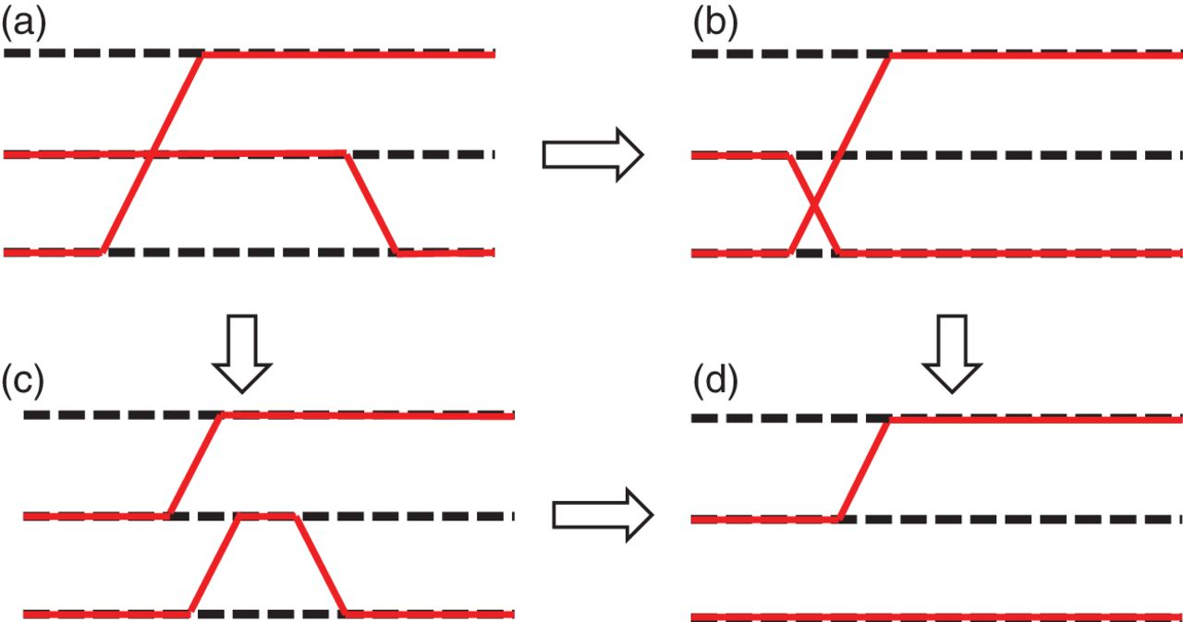
Fig. 19. Annihilation of a compressed kink and a single anti-kink. (a) is the initial configuration of a compressed ...
Notes:
Fig. 19. Annihilation of a compressed kink and a single anti-kink. (a) is the initial configuration of a compressed kink and a single anti-kink, and (d) is the final configuration with one kink. The non-BPS crossing (b) represents a direct collision of an anti-kink with a compressed kink, and can be understood through the BPS reconnection (a) $\to$ (c) to be equivalent to the pair annihilation of a kink and an anti-kink.
Unless provided in the caption above, the following copyright applies to the content of this slide: © The Author(s) 2015. Published by Oxford University Press on behalf of the Physical Society of Japan.This is an Open Access article distributed under the terms of the Creative Commons Attribution License (http://creativecommons.org/licenses/by/4.0/), which permits unrestricted use, distribution, and reproduction in any medium, provided the original work is properly cited.Funded by SCOAP3

Slide 20
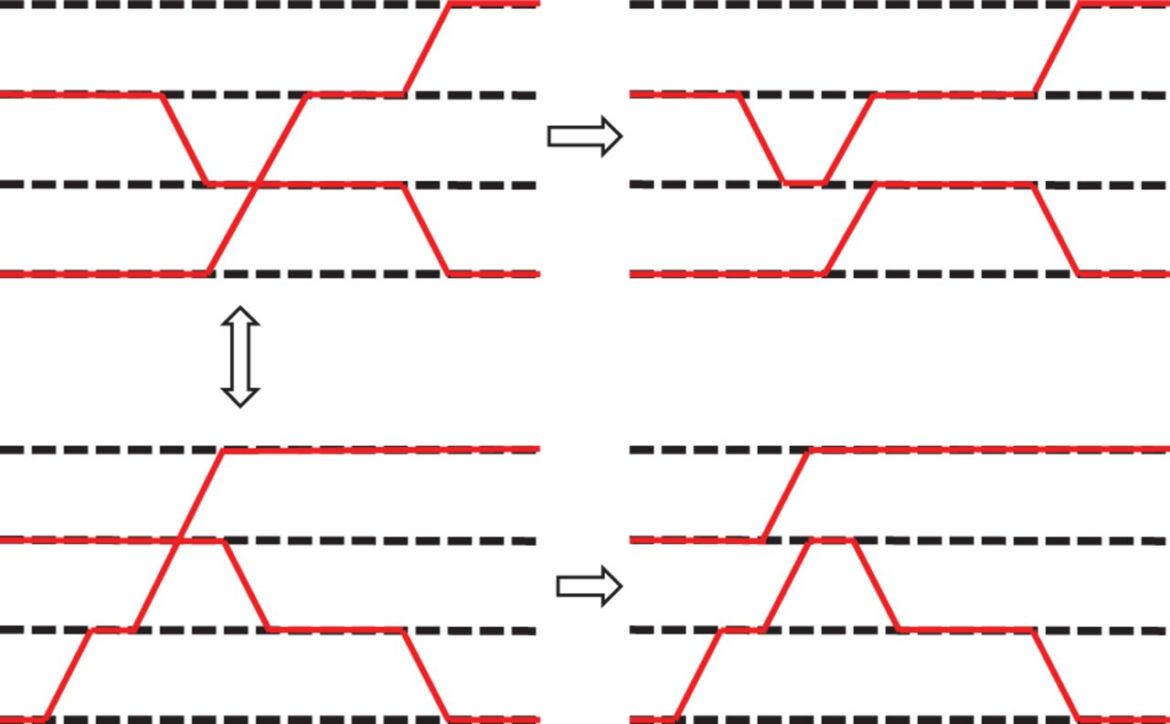
Fig. 20. The upper left and lower left configurations, which are connected to each other by a smooth deformation, ...
Notes:
Fig. 20. The upper left and lower left configurations, which are connected to each other by a smooth deformation, become the upper right and lower right configurations, respectively, after BPS reconnections, which are disconnected from each other.
Unless provided in the caption above, the following copyright applies to the content of this slide: © The Author(s) 2015. Published by Oxford University Press on behalf of the Physical Society of Japan.This is an Open Access article distributed under the terms of the Creative Commons Attribution License (http://creativecommons.org/licenses/by/4.0/), which permits unrestricted use, distribution, and reproduction in any medium, provided the original work is properly cited.Funded by SCOAP3

Slide 21
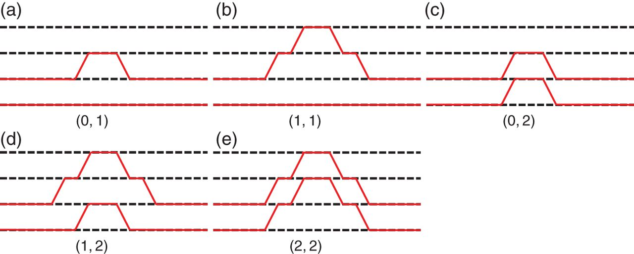
Fig. 21. Neutral bions in $Gr_{4,2}$, labeled by indices (a) $(0,1)$, (b) $(0,2)$, (c) $(1,1)$, (d) $(1,2)$, (e) ...
Notes:
Fig. 21. Neutral bions in $Gr_{4,2}$, labeled by indices (a) $(0,1)$, (b) $(0,2)$, (c) $(1,1)$, (d) $(1,2)$, (e) $(2,2)$. (a)–(e) are elementary neutral bions in $Gr_{4,2}$.
Unless provided in the caption above, the following copyright applies to the content of this slide: © The Author(s) 2015. Published by Oxford University Press on behalf of the Physical Society of Japan.This is an Open Access article distributed under the terms of the Creative Commons Attribution License (http://creativecommons.org/licenses/by/4.0/), which permits unrestricted use, distribution, and reproduction in any medium, provided the original work is properly cited.Funded by SCOAP3

Slide 22
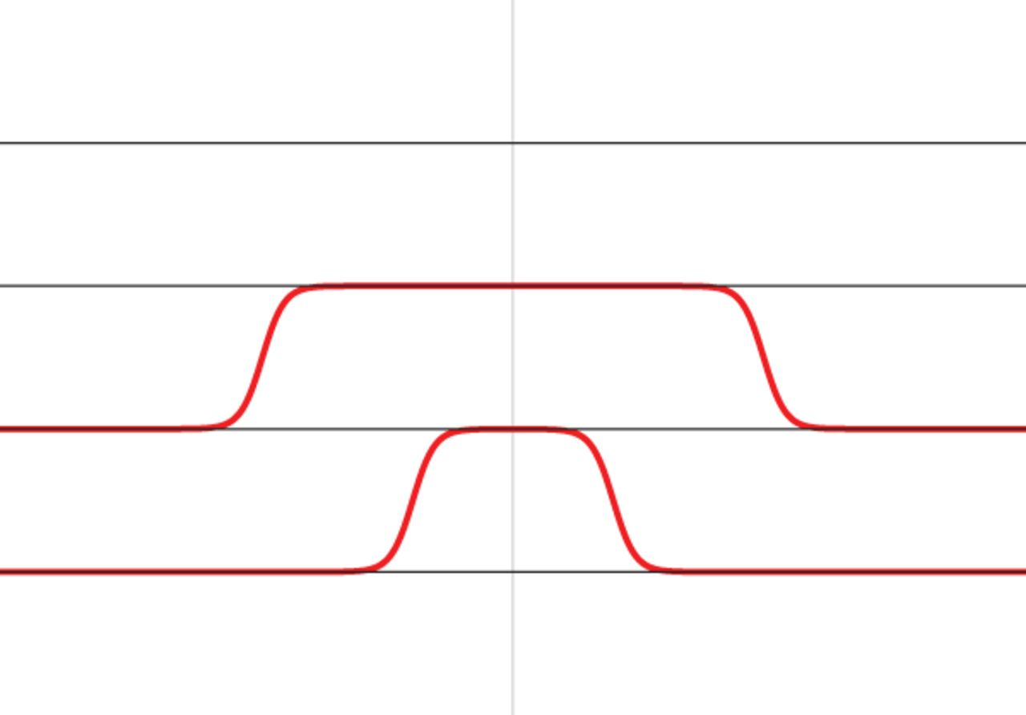
Fig. 22. Brane configuration calculated from the ansatz (5.5) for $\lambda _{1} =10^{-2}, \lambda _{2}=10^{-2}, ...
Notes:
Fig. 22. Brane configuration calculated from the ansatz (5.5) for $\lambda _{1} =10^{-2}, \lambda _{2}=10^{-2}, \lambda _{3}=10^{-5}, \lambda _{4}=10^{-5},N_{\rm F}=4$.
Unless provided in the caption above, the following copyright applies to the content of this slide: © The Author(s) 2015. Published by Oxford University Press on behalf of the Physical Society of Japan.This is an Open Access article distributed under the terms of the Creative Commons Attribution License (http://creativecommons.org/licenses/by/4.0/), which permits unrestricted use, distribution, and reproduction in any medium, provided the original work is properly cited.Funded by SCOAP3

Slide 23
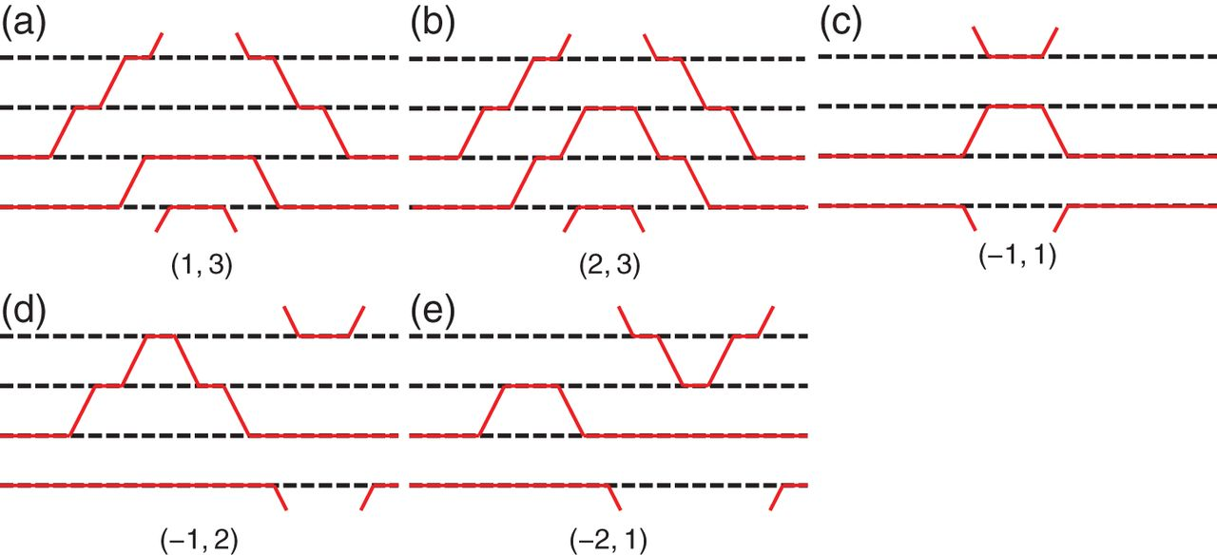
Fig. 23. Solitons in $Gr_{4,2}$ labeled by (a) $(1,3)$, (b) $(2,3)$, (c) $(-1,1)$, (d) $(-1,2)$, and (e) $(-2,1)$, are ...
Notes:
Fig. 23. Solitons in $Gr_{4,2}$ labeled by (a) $(1,3)$, (b) $(2,3)$, (c) $(-1,1)$, (d) $(-1,2)$, and (e) $(-2,1)$, are not elementary neutral bions in $Gr_{4,2}$. (a) $(1,3)$ is an instanton–anti-instanton pair and is not a bion. (b) $(2,3)$ is not an elementary bion anymore because of the decomposition $(2,3) = (1,3) + (1,0)$, where the former is an instanton–anti-instanton pair. (c) is composite. (d) and (e) are not elementary neutral bions that can be understood in dual pictures.
Unless provided in the caption above, the following copyright applies to the content of this slide: © The Author(s) 2015. Published by Oxford University Press on behalf of the Physical Society of Japan.This is an Open Access article distributed under the terms of the Creative Commons Attribution License (http://creativecommons.org/licenses/by/4.0/), which permits unrestricted use, distribution, and reproduction in any medium, provided the original work is properly cited.Funded by SCOAP3

Slide 24
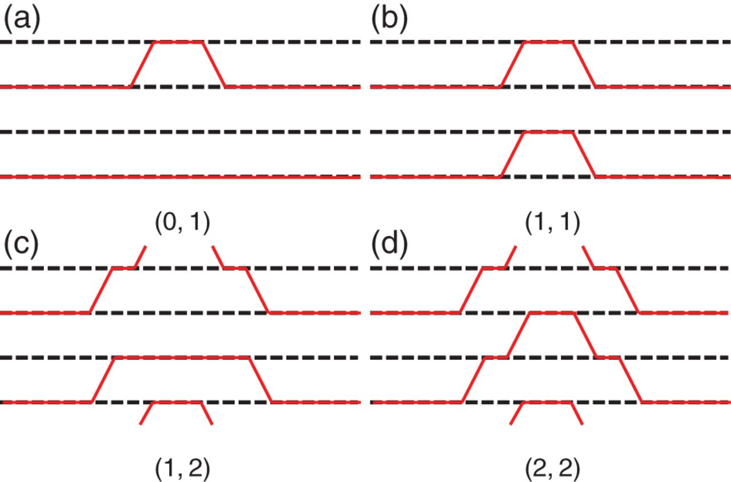
Fig. 24. Neutral bions in $Gr_{4,2}$ for the left vacuum with non-adjacent flavors occupied by colors, labeled by ...
Notes:
Fig. 24. Neutral bions in $Gr_{4,2}$ for the left vacuum with non-adjacent flavors occupied by colors, labeled by indices (a) $(0,1)$, (b) $(1,1)$, (c) $(1,2)$, and (d) $(2,2)$. (a) $(0,1)$ is an elementary neutral bion in $Gr_{4,2}$. (b) $(1,1)$ is a reducible diagram. (c) $(1,2)$ is a neutral bion. (d) $(2,2)$ is a composite of an instanton–anti-instanton pair and is not a neutral bion anymore.
Unless provided in the caption above, the following copyright applies to the content of this slide: © The Author(s) 2015. Published by Oxford University Press on behalf of the Physical Society of Japan.This is an Open Access article distributed under the terms of the Creative Commons Attribution License (http://creativecommons.org/licenses/by/4.0/), which permits unrestricted use, distribution, and reproduction in any medium, provided the original work is properly cited.Funded by SCOAP3

Slide 25
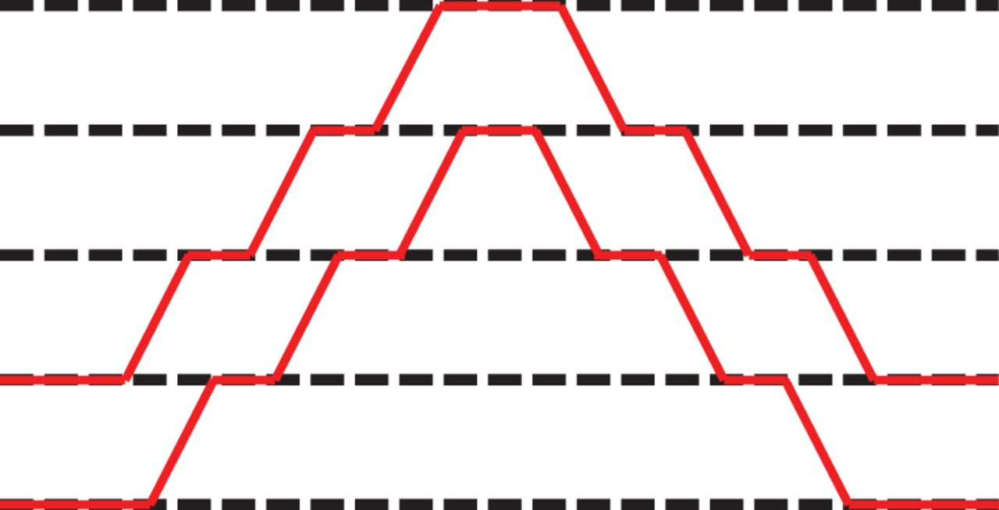
Fig. 25. An irreducible neutral bion with an instanton charge larger than one in $Gr_{5,2}$.
Notes:
Fig. 25. An irreducible neutral bion with an instanton charge larger than one in $Gr_{5,2}$.
Unless provided in the caption above, the following copyright applies to the content of this slide: © The Author(s) 2015. Published by Oxford University Press on behalf of the Physical Society of Japan.This is an Open Access article distributed under the terms of the Creative Commons Attribution License (http://creativecommons.org/licenses/by/4.0/), which permits unrestricted use, distribution, and reproduction in any medium, provided the original work is properly cited.Funded by SCOAP3

Slide 26
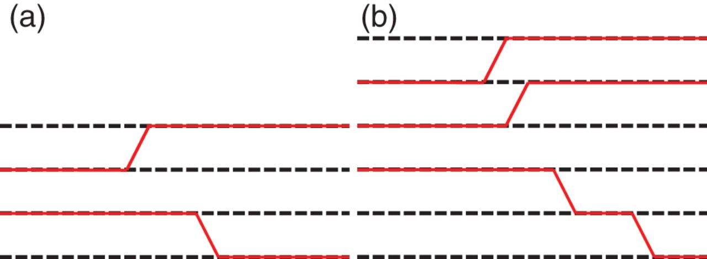
Fig. 26. Non-BPS exact solutions of charged bions in the Grassmann sigma models. (a) Only one possible charged bion in ...
Notes:
Fig. 26. Non-BPS exact solutions of charged bions in the Grassmann sigma models. (a) Only one possible charged bion in $Gr_{4,2}$. (b) An example of a charged bion in $Gr_{6,3}$.
Unless provided in the caption above, the following copyright applies to the content of this slide: © The Author(s) 2015. Published by Oxford University Press on behalf of the Physical Society of Japan.This is an Open Access article distributed under the terms of the Creative Commons Attribution License (http://creativecommons.org/licenses/by/4.0/), which permits unrestricted use, distribution, and reproduction in any medium, provided the original work is properly cited.Funded by SCOAP3

Slide 27
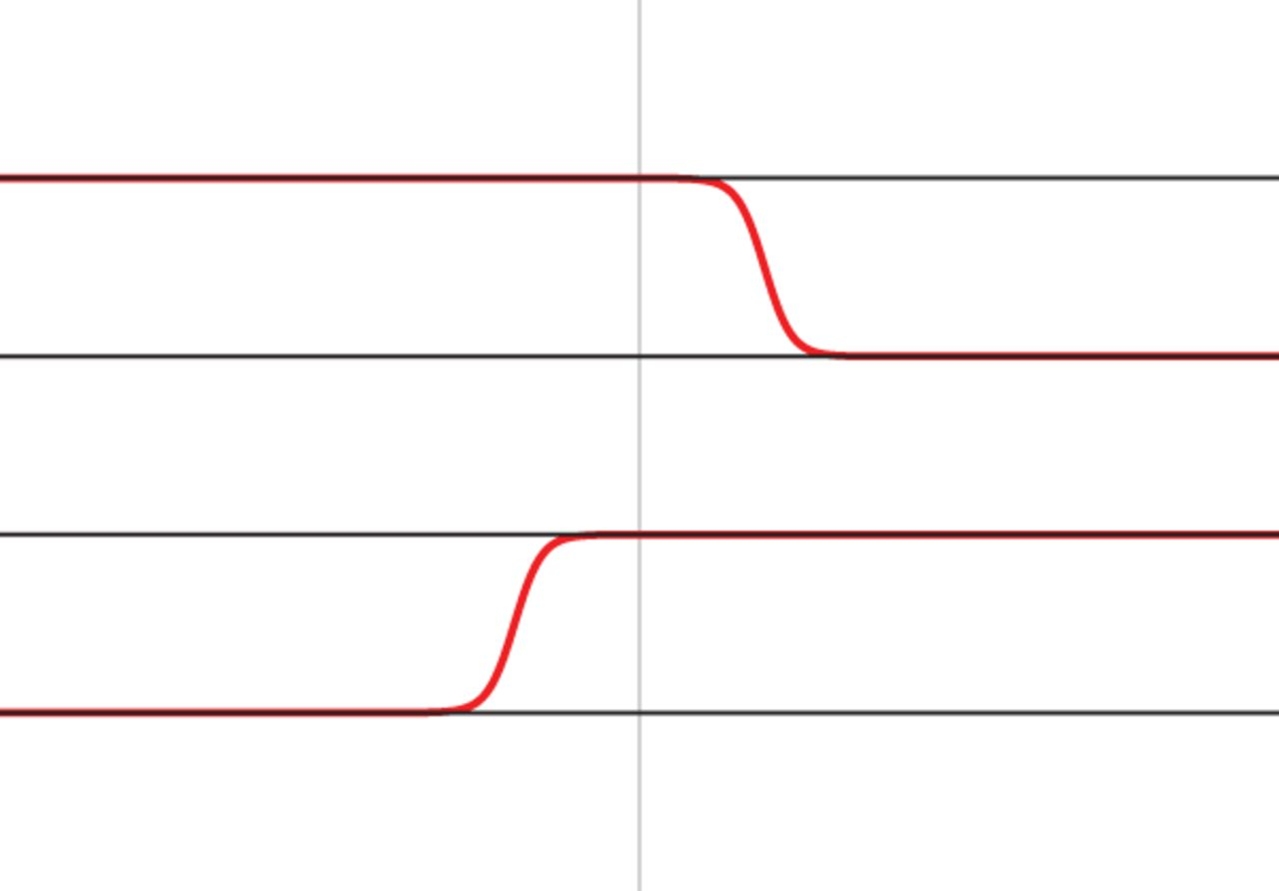
Fig. 27. The brane configuration calculated from the ansatz (5.14) of the exact non-BPS solution of the charged bion ...
Notes:
Fig. 27. The brane configuration calculated from the ansatz (5.14) of the exact non-BPS solution of the charged bion for $\lambda _{1} =10^{2},\lambda _{2}=10^{2},N_{\rm F}=4$.
Unless provided in the caption above, the following copyright applies to the content of this slide: © The Author(s) 2015. Published by Oxford University Press on behalf of the Physical Society of Japan.This is an Open Access article distributed under the terms of the Creative Commons Attribution License (http://creativecommons.org/licenses/by/4.0/), which permits unrestricted use, distribution, and reproduction in any medium, provided the original work is properly cited.Funded by SCOAP3

Slide 28
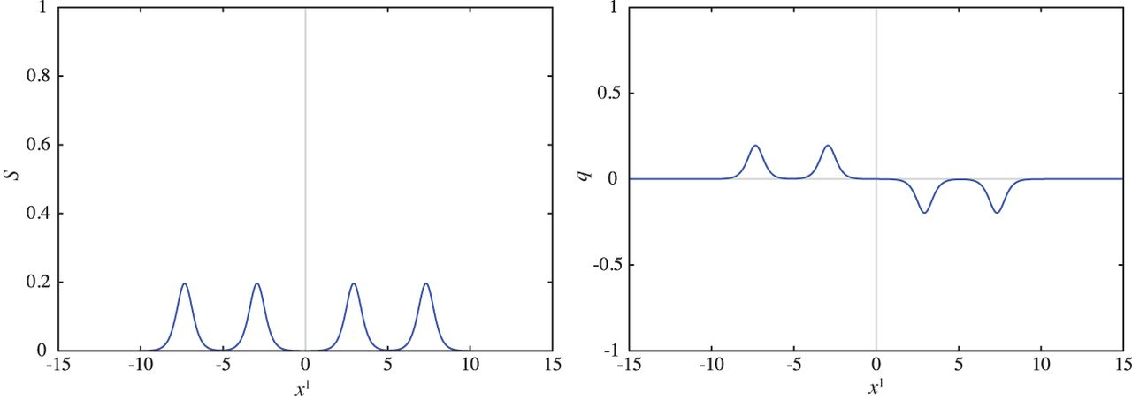
Fig. 28. Energy density $s(x^{1})$ (left) and topological charge density $q(x^{1})$ (right) for the neutral bion ...
Notes:
Fig. 28. Energy density $s(x^{1})$ (left) and topological charge density $q(x^{1})$ (right) for the neutral bion $(1,1)$ in Eq. (5.5) and in Fig. 21(c) for $\lambda _{1} =10^{-2},\,\lambda _{2}=10^{-2},\, \lambda _{3}=10^{-5}, \,\lambda _{4}=10^{-5},\,N_{\rm F}=4$.
Unless provided in the caption above, the following copyright applies to the content of this slide: © The Author(s) 2015. Published by Oxford University Press on behalf of the Physical Society of Japan.This is an Open Access article distributed under the terms of the Creative Commons Attribution License (http://creativecommons.org/licenses/by/4.0/), which permits unrestricted use, distribution, and reproduction in any medium, provided the original work is properly cited.Funded by SCOAP3

Slide 29
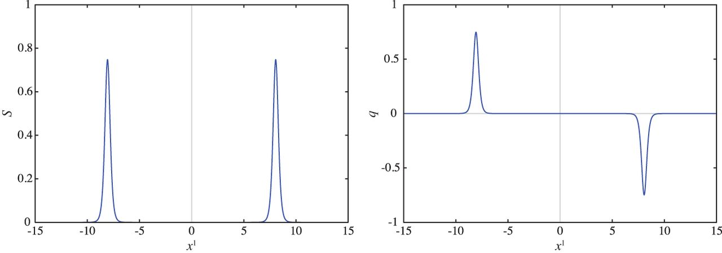
Fig. 29. Energy density $s(x^{1})$ (left) and topological charge density $q(x^{1})$ (right) for the configuration of ...
Notes:
Fig. 29. Energy density $s(x^{1})$ (left) and topological charge density $q(x^{1})$ (right) for the configuration of Eq. (5.5) for $\lambda _{1} =10^{-6},\,\lambda _{2}=10^{-6},\,\lambda _{3}=10^{-5}, \,\lambda _{4}=10^{-5},\,N_{\rm F}=4$.
Unless provided in the caption above, the following copyright applies to the content of this slide: © The Author(s) 2015. Published by Oxford University Press on behalf of the Physical Society of Japan.This is an Open Access article distributed under the terms of the Creative Commons Attribution License (http://creativecommons.org/licenses/by/4.0/), which permits unrestricted use, distribution, and reproduction in any medium, provided the original work is properly cited.Funded by SCOAP3

Slide 30
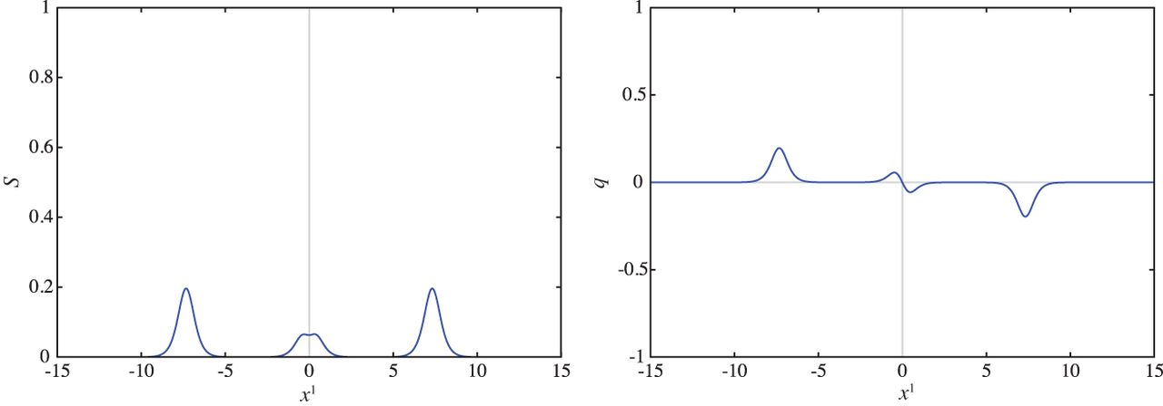
Fig. 30. Energy density $s(x^{1})$ (left) and topological charge density $q(x^{1})$ (right) for the configuration of ...
Notes:
Fig. 30. Energy density $s(x^{1})$ (left) and topological charge density $q(x^{1})$ (right) for the configuration of Eq. (5.5) for $\lambda _{1} =1,\lambda _{2}=1,\lambda _{3}=10^{-5},\lambda _{4}=10^{-5},N_{\rm F}=4$.
Unless provided in the caption above, the following copyright applies to the content of this slide: © The Author(s) 2015. Published by Oxford University Press on behalf of the Physical Society of Japan.This is an Open Access article distributed under the terms of the Creative Commons Attribution License (http://creativecommons.org/licenses/by/4.0/), which permits unrestricted use, distribution, and reproduction in any medium, provided the original work is properly cited.Funded by SCOAP3

Slide 31
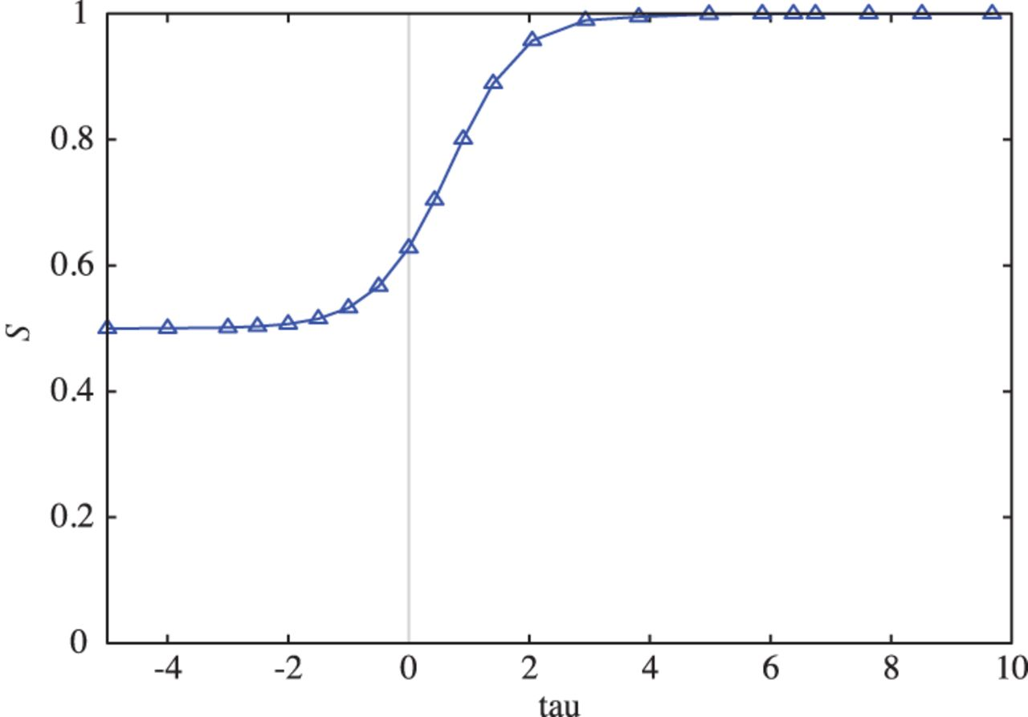
Fig. 31. The total energy as a function of $\tau =-(N_{\rm F}/\pi )\log \lambda$ with $\lambda =\lambda _{1}=\lambda ...
Notes:
Fig. 31. The total energy as a function of $\tau =-(N_{\rm F}/\pi )\log \lambda$ with $\lambda =\lambda _{1}=\lambda _{2}$ for $\lambda _{3}=\lambda _{4}=10^{-5}$ with $N_{\rm F}=4$ fixed.
Unless provided in the caption above, the following copyright applies to the content of this slide: © The Author(s) 2015. Published by Oxford University Press on behalf of the Physical Society of Japan.This is an Open Access article distributed under the terms of the Creative Commons Attribution License (http://creativecommons.org/licenses/by/4.0/), which permits unrestricted use, distribution, and reproduction in any medium, provided the original work is properly cited.Funded by SCOAP3

Slide 32
Fig. 32. Plot of $\log (-S_{\rm int}(N_{\rm F},\tau ))$ as a function of $\tau$ for $N_{\rm F}=3$ (left), $N_{\rm ...
Notes:
Fig. 32. Plot of $\log (-S_{\rm int}(N_{\rm F},\tau ))$ as a function of $\tau$ for $N_{\rm F}=3$ (left), $N_{\rm F}=4$ (center), and $N_{\rm F}=5$ (right) for (5.5) (red curves with triangle points). For the intermediate region of $\tau$, the curve is approximated by $-(2\pi /N_{\rm F})\tau +C(N_{\rm F})$ (blue curves).
Unless provided in the caption above, the following copyright applies to the content of this slide: © The Author(s) 2015. Published by Oxford University Press on behalf of the Physical Society of Japan.This is an Open Access article distributed under the terms of the Creative Commons Attribution License (http://creativecommons.org/licenses/by/4.0/), which permits unrestricted use, distribution, and reproduction in any medium, provided the original work is properly cited.Funded by SCOAP3

Slide 33
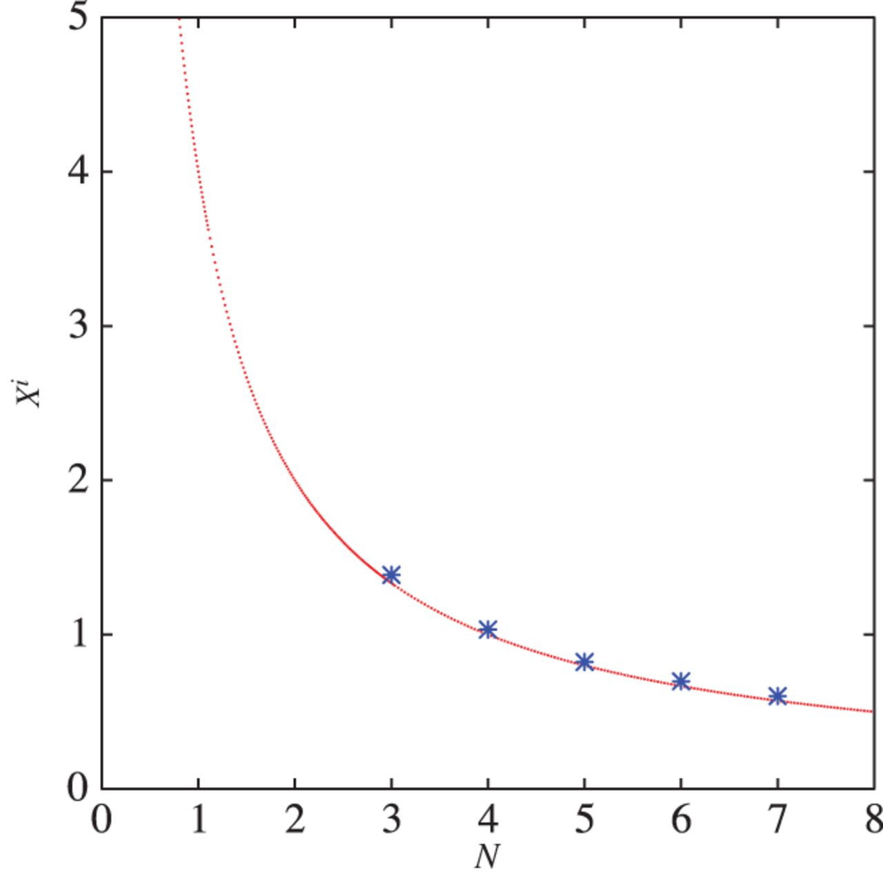
Fig. 33. The constant $\exp [C(N_{\rm F})]$ as a function of $N_{\rm F}$ for $N_{\rm F} = 3,4,5,6,7$ (blue points). It ...
Notes:
Fig. 33. The constant $\exp [C(N_{\rm F})]$ as a function of $N_{\rm F}$ for $N_{\rm F} = 3,4,5,6,7$ (blue points). It is well approximated by $4/N_{\rm F}$ (red curve).
Unless provided in the caption above, the following copyright applies to the content of this slide: © The Author(s) 2015. Published by Oxford University Press on behalf of the Physical Society of Japan.This is an Open Access article distributed under the terms of the Creative Commons Attribution License (http://creativecommons.org/licenses/by/4.0/), which permits unrestricted use, distribution, and reproduction in any medium, provided the original work is properly cited.Funded by SCOAP3

Slide 34
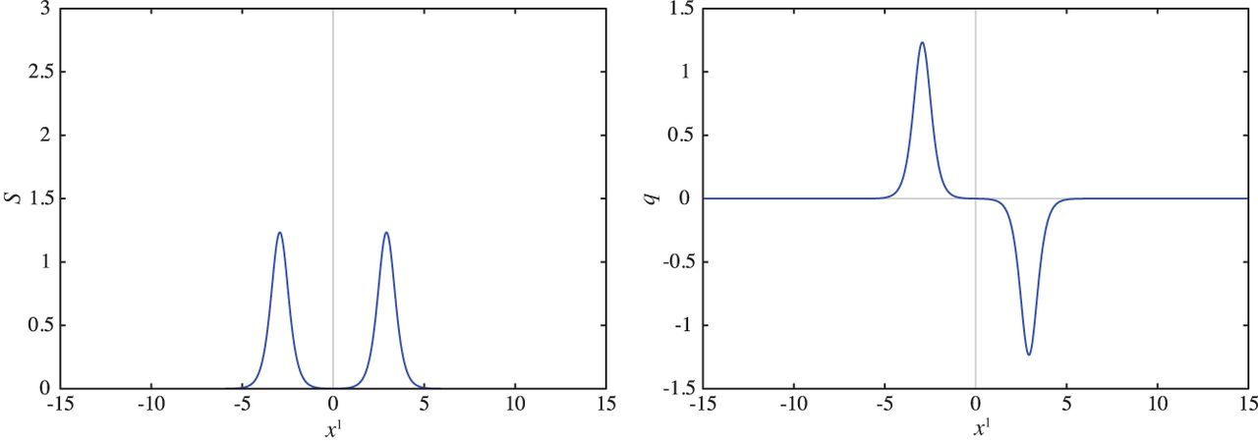
Fig. 34. Energy density $s(x^{1})$ (left) and topological charge density $q(x^{1})$ (right) for the configuration of ...
Notes:
Fig. 34. Energy density $s(x^{1})$ (left) and topological charge density $q(x^{1})$ (right) for the configuration of Eq. (5.14) for $\lambda _{1} =10^{2},\,\lambda _{2}=10^{2},\,N_{\rm F}=4$.
Unless provided in the caption above, the following copyright applies to the content of this slide: © The Author(s) 2015. Published by Oxford University Press on behalf of the Physical Society of Japan.This is an Open Access article distributed under the terms of the Creative Commons Attribution License (http://creativecommons.org/licenses/by/4.0/), which permits unrestricted use, distribution, and reproduction in any medium, provided the original work is properly cited.Funded by SCOAP3

Slide 35
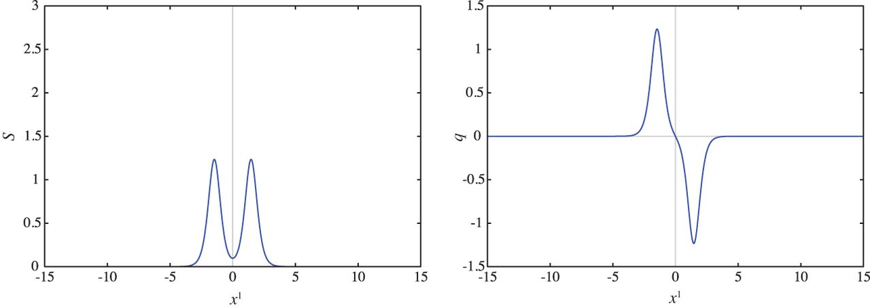
Fig. 35. Energy density $s(x^{1})$ (left) and topological charge density $q(x^{1})$ (right) for the configuration of ...
Notes:
Fig. 35. Energy density $s(x^{1})$ (left) and topological charge density $q(x^{1})$ (right) for the configuration of Eq. (5.14) for $\lambda _{1} =10,\,\lambda _{2}=10,\,N_{\rm F}=4$.
Unless provided in the caption above, the following copyright applies to the content of this slide: © The Author(s) 2015. Published by Oxford University Press on behalf of the Physical Society of Japan.This is an Open Access article distributed under the terms of the Creative Commons Attribution License (http://creativecommons.org/licenses/by/4.0/), which permits unrestricted use, distribution, and reproduction in any medium, provided the original work is properly cited.Funded by SCOAP3

Slide 36
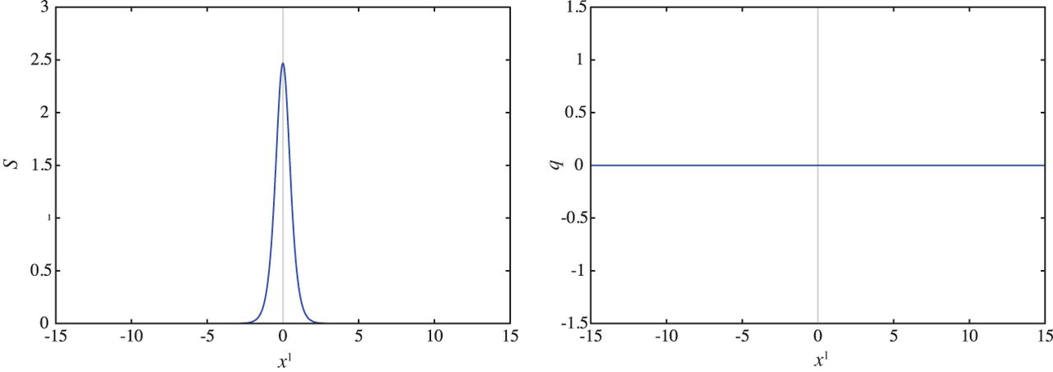
Fig. 36. Energy density $s(x^{1})$ (left) and topological charge density $q(x^{1})$ (right) for the configuration of ...
Notes:
Fig. 36. Energy density $s(x^{1})$ (left) and topological charge density $q(x^{1})$ (right) for the configuration of Eq. (5.14) for $\lambda _{1} =1,\,\lambda _{2}=1,\,N_{\rm F}=4$.
Unless provided in the caption above, the following copyright applies to the content of this slide: © The Author(s) 2015. Published by Oxford University Press on behalf of the Physical Society of Japan.This is an Open Access article distributed under the terms of the Creative Commons Attribution License (http://creativecommons.org/licenses/by/4.0/), which permits unrestricted use, distribution, and reproduction in any medium, provided the original work is properly cited.Funded by SCOAP3

Slide 37
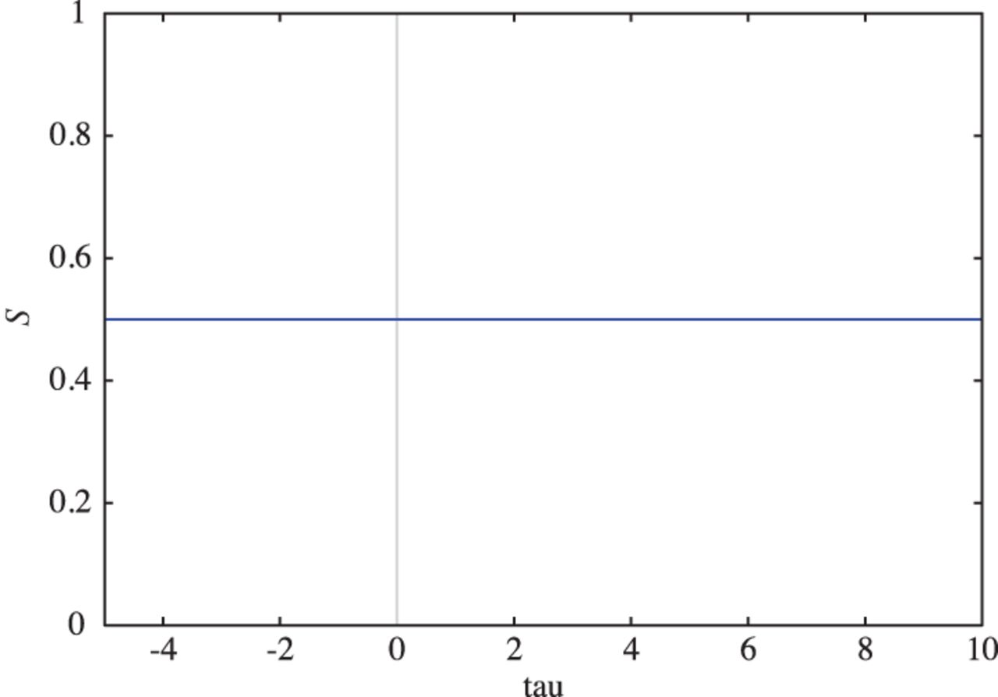
Fig. 37. The total energy of the charged bions as a function of $\tau =(N_{\rm F}/\pi )\log \lambda$ with $\lambda ...
Notes:
Fig. 37. The total energy of the charged bions as a function of $\tau =(N_{\rm F}/\pi )\log \lambda$ with $\lambda =\lambda _{1}=\lambda _{2}$ for $N_{\rm F}=4$ fixed.
Unless provided in the caption above, the following copyright applies to the content of this slide: © The Author(s) 2015. Published by Oxford University Press on behalf of the Physical Society of Japan.This is an Open Access article distributed under the terms of the Creative Commons Attribution License (http://creativecommons.org/licenses/by/4.0/), which permits unrestricted use, distribution, and reproduction in any medium, provided the original work is properly cited.Funded by SCOAP3

