Slide 1
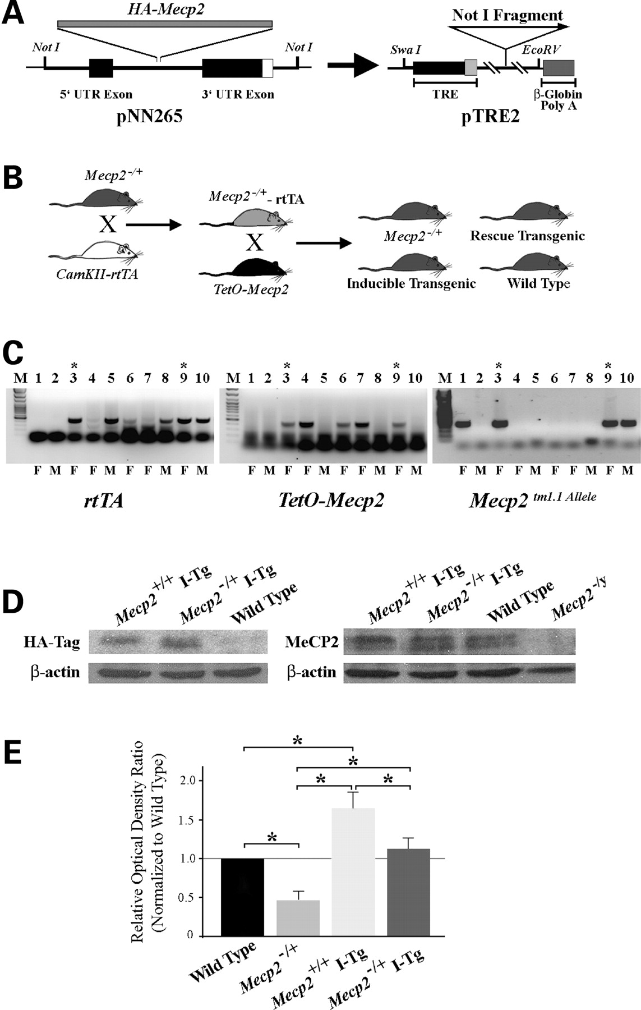
Figure 1. Generation of inducible transgenic mice. (A) Illustration of the transgene cassettes employed. The ...
Notes:
Figure 1. Generation of inducible transgenic mice. (A) Illustration of the transgene cassettes employed. The HA-Mecp2cDNA was initially introduced into the pNN265 shuttle vector that contains a hybrid 5′ exon to facilitate nuclear export of the transcribed mRNA, and a 3′ untranslated exon with an SV40 polyadenylation signal (30). This expression carriage was excised from pNN265 with Not1 and placed downstream of the TRE of the pTRE2 vector. The mini CMV promoter within the TRE is denoted in gray. The transgene for micro-injection was excised from this plasmid by restriction digestion with Swa1 and EcoRV. (B) Schematic illustration of the breeding scheme used to generate the different cohorts of transgenic mice. Female Mecp2−/+ mice were crossed with male CamKII-rtTA mice to introduce the rtTA factor into the Mecp2−/+ background. The female double mutants were then crossed with transgenic line B mice. The mice born from this cross were evaluated for a 1 year period and then genotyped and assigned to groups. (C) Example of PCR-based genotyping. The different panels show the PCR detection of the rtTA factor (left panel), the HA-Mecp2 transgene (middle panel) or the mutant Mecp2 allele (right panel) in mice from two litters. In this group, number 6 is an over-expressing inducible transgenic, whereas numbers 3 and 9 are rescue mice (denoted by asterisks). (D) Detection of expressed transgene in cortical tissue. Shown are representative immunoblots of cortical tissue derived from an inducible transgenic mouse, a transgenic rescue mouse and a wild-type mouse. The left panel shows HA immunoreactivity, whereas the right panel shows total MeCP2 immunoreactivity in samples from the same mice. An MeCP2−/y mouse cortical sample (right panel) illustrates specificity. (E) Histogram depicting the normalized expression level (mean ± standard error, n= 3 for each) of MeCP2 protein in cortical tissue from inducible transgenic line B mice, female rescue mice and female Mecp2−/+ mice. The values represent the MeCP2 densitometric immunoreactive intensity of the inducible transgenic, female Mecp2−/+ and female rescue mice, normalized to the intensity of the wild-type mouse sample on the same blot. Asterisks denote statistically significant differences between the indicated groups (one-way ANOVA, P < 0.05 with Bonferroni post hoc correction for multiple comparisons).
Unless provided in the caption above, the following copyright applies to the content of this slide: © The Author 2008. Published by Oxford University Press. All rights reserved. For Permissions, please email: journals.permissions@oxfordjournals.org

Slide 2
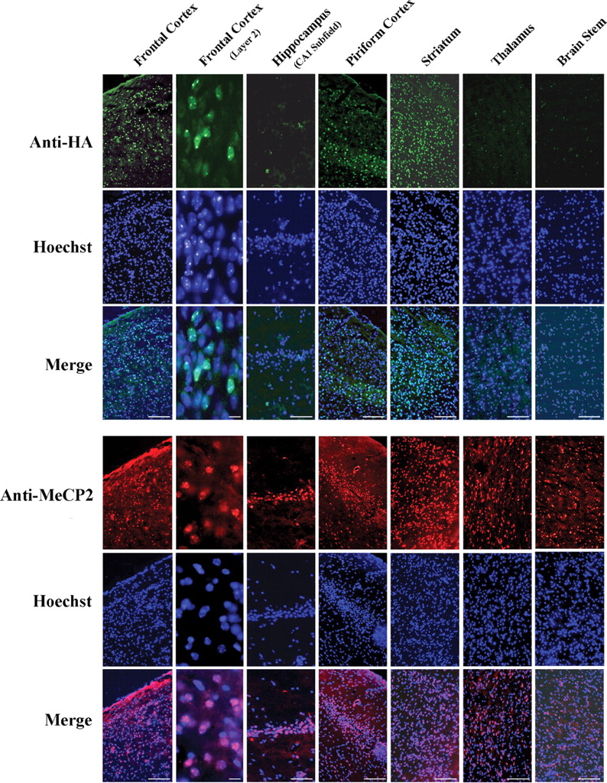
Figure 2. Immunohistochemical localization of the HA-MeCP2 protein in brain regions of adult inducible transgenic mice. ...
Notes:
Figure 2. Immunohistochemical localization of the HA-MeCP2 protein in brain regions of adult inducible transgenic mice. The two sets of panels show individual fluorescence channels and a merged image of the same field to compare the expression profile of the inducible transgene with endogenous MeCP2. In the top panels, transgene immunoreactivity is detected with anti-HA antibodies (green) in specific brain regions of an adult line B inducible transgenic mouse. In the bottom panels, endogenous MeCP2 immunoreactivity (red) is detected in the same brain regions of an adult wild-type mouse. In each set, Hoechst 33215 is included to label all cell nuclei in the field. Strong transgene immunoreactivity is observed in frontal cortex, piriform cortex and striatum, whereas little or no transgene immunoreactivity is detected in hippocampus, thalamus and brain stem. The higher magnification image of frontal cortex shows the expressed transgene to localize within the nucleus, where it displays a staining pattern similar to endogenous MeCP2. Scale bars for low and high magnification panels are 100 and 10 μm, respectively.
Unless provided in the caption above, the following copyright applies to the content of this slide: © The Author 2008. Published by Oxford University Press. All rights reserved. For Permissions, please email: journals.permissions@oxfordjournals.org

Slide 3
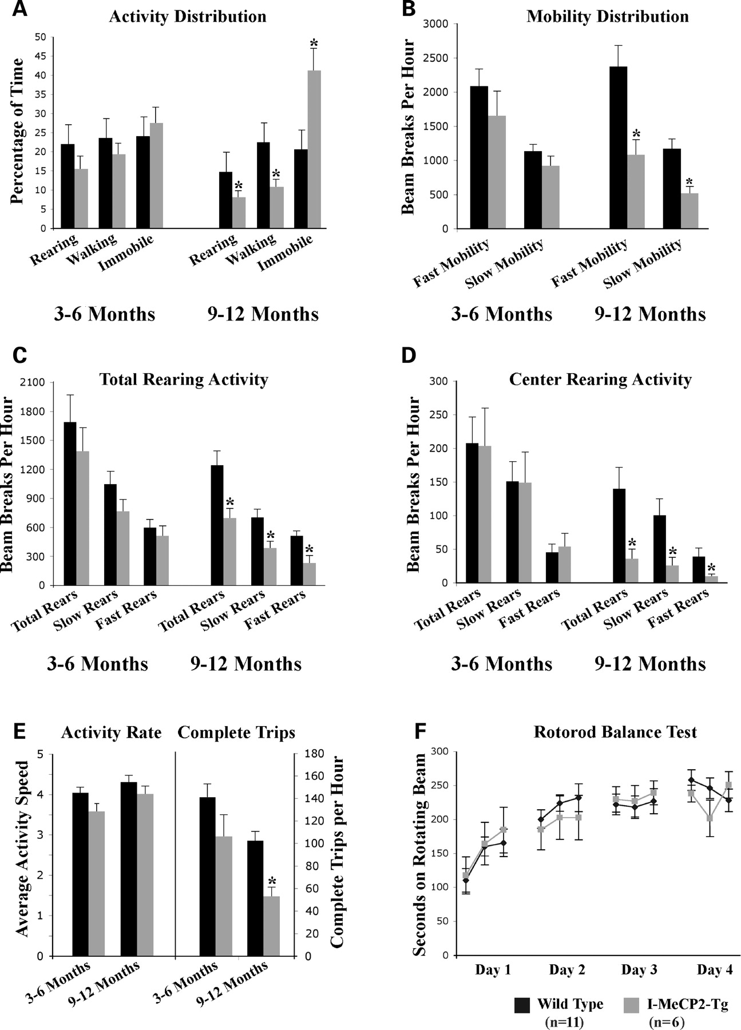
Figure 3. The open-field behavior of the inducible transgenic mice is initially preserved, but impairments develop ...
Notes:
Figure 3. The open-field behavior of the inducible transgenic mice is initially preserved, but impairments develop later in life. (A)–(E) Histograms showing the behavioral performances of 3–6-month-old and 9–12-month-old wild-type mice (black bars) and inducible transgenic mice (gray bars) in different open-field tests. (F) Illustration of the performance of 9–12-month-old wild-type and inducible transgenic mice on the rotorod test. (A) The percentage of time during the 1 h observation window that the mice spent rearing, walking or immobile. (B) The number of beam breaks associated with fast or slow movement for the younger and older mice. Fast movement is defined as consecutive beam breaks occurring 200 ms. (C) The total number of beam breaks corresponding total rearing activity, and the number of fast and slow rears during the observation period. The same fast and slow criteria as mentioned earlier are used. (D) The total number of beam breaks in the center field of the open-field box, and the number of breaks corresponding to fast and slow rearing activities in this region. The center field is defined as beam breaks that do not involve the detection lasers along the periphery of the open-field apparatus. (E) The average rate at which the subject performs an activity is shown in the left panels, whereas the average number of complete front-to-rear exploration trips taken by a subject during the observation period is presented in the right panels. Asterisks denote statistically significant differences between wild-type and inducible transgenics at the specific task and age (one-way ANOVA, P < 0.05). (F) The time subjects balanced themselves on an accelerating rotating rod (presented in seconds). The test was performed three times a day for four successive days. The time spent on the rod was recorded when the subject fell. Mice that held onto the rod and circled during a trial were excluded from analysis. No significant differences were observed in the rotorod performance between the wild-type and inducible transgenic mice, and no differences were observed in the rate at which the different groups improved their performance on the task (one-way ANOVA, P < 0.05).
Unless provided in the caption above, the following copyright applies to the content of this slide: © The Author 2008. Published by Oxford University Press. All rights reserved. For Permissions, please email: journals.permissions@oxfordjournals.org

Slide 4
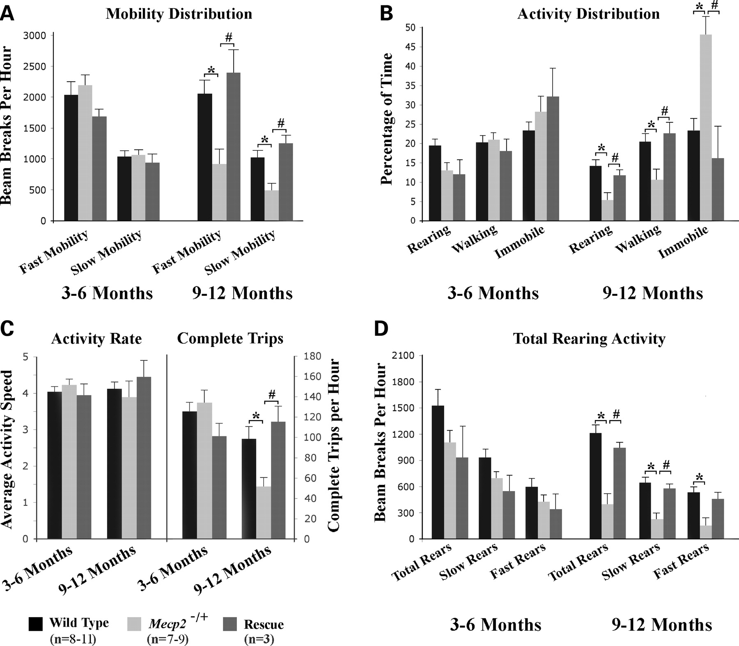
Figure 4. The open-field behavioral impairments of female Mecp2^{−/+} mice are improved by re-introducing ...
Notes:
Figure 4. The open-field behavioral impairments of female Mecp2−/+ mice are improved by re-introducing HA-MeCP2 into forebrain neurons. (A)–(D) Histograms showing the open-field behavioral performance properties (mean and standard error) of female wild-type mice (black, n = 8–11), female Mecp2−/+ mice (lighter gray, n = 7–9) and female Mecp2−/+ mice expressing the HA-MeCP2 transgene in forebrain neurons (darker gray, n = 3) at 3–6 months and 9–12 months of age. Fast and slow movements are as defined in Figure 3. No significant differences in any of these open-field parameters were observed in the cohorts at 3–6 months of age. At 9–12 months of age, however, the cohort of female Mecp2−/+ mice displayed significantly less fast and slow mobility counts (A), spent significantly less time rearing and walking, but more time immobile (B), made significantly fewer complete exploration trips in the test cage (C) and made significantly fewer fast and slow rearing events (D) compared with wild-type controls. Each of these behavioral deficiencies (except fast rearing, where the P-value was 0.078) was significantly improved and restored to wild-type levels in the female rescue mice expressing the HA-MeCP2 transgene in forebrain neurons. *P < 0.05 compared with wild-type mice; #P < 0.05 compared with Mecp2−/+ mice (one-way ANOVA with Tukey’s post hoc correction for multiple comparisons).
Unless provided in the caption above, the following copyright applies to the content of this slide: © The Author 2008. Published by Oxford University Press. All rights reserved. For Permissions, please email: journals.permissions@oxfordjournals.org

Slide 5
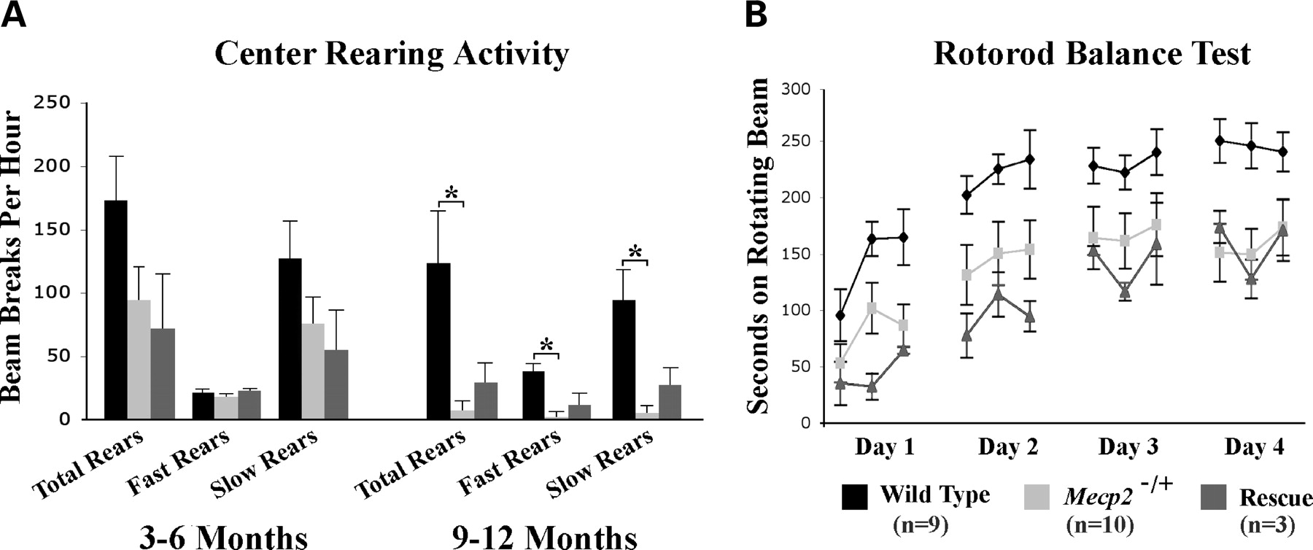
Figure 5. The ectopic re-introduction of the MeCP2 transgene protein in forebrain neurons does not improve the impaired ...
Notes:
Figure 5. The ectopic re-introduction of the MeCP2 transgene protein in forebrain neurons does not improve the impaired center field rearing behavior or the rotorod performance of female Mecp2−/+ mice. (A) The cumulative data (mean and standard error) of the center field rearing activity of the three cohorts of mice. At 9–12 months of age, the female Mecp2−/+ mice showed significantly fewer total rears in the center field, and both their fast and slow rearing activities in the center field were diminished from wild-type levels. The behavior of the rescue cohort of mice (n = 3) in center field rearing was not improved from the female Mecp2−/+ mice (n = 7–9). *P < 0.05 compared with wild-type mice; #P < 0.05 compared with Mecp2−/+ mice (one-way ANOVA with Tukey’s post hoc correction for multiple comparisons). (B) The cumulative data (mean and standard error) of the rotorod performance of the three cohorts of mice at 9–12 months of age. Both the female Mecp2−/+ mice (n = 10) and the rescue mice (n = 3) performed significantly below wild-type levels (n = 9) for each trial day excluding the first. No differences were observed between the balance performance of the female Mecp2−/+ mice and the rescue mice. *P < 0.05 compared with wild-type, two-way ANOVA (genotype and trial) with Tukey’s post hoc correction.
Unless provided in the caption above, the following copyright applies to the content of this slide: © The Author 2008. Published by Oxford University Press. All rights reserved. For Permissions, please email: journals.permissions@oxfordjournals.org

