Slide 1
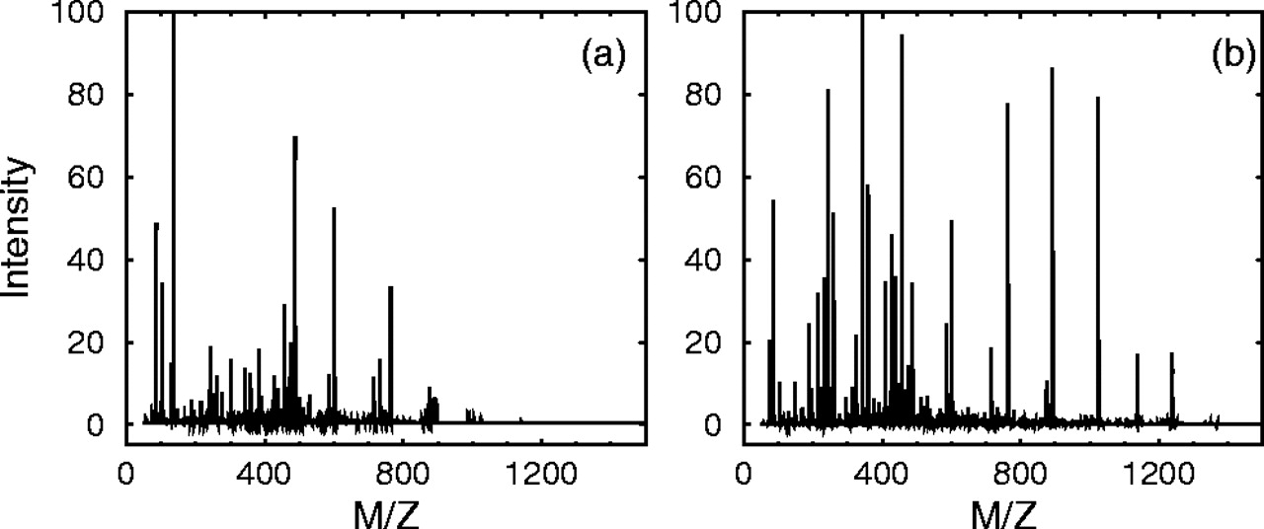
Fig. 1 The two spectra associated with the same peptide EETLMEYLENPK. Both parts (a) and (b) (respectively spectrum ...
Notes:
Fig. 1 The two spectra associated with the same peptide EETLMEYLENPK. Both parts (a) and (b) (respectively spectrum 43 and 49 in Table 3 of Supplementary information) are Q-TOF data; the parent ion in (a) is triply charged, whereas the parent ion in (b) is doubly charged. When using the default parameters, both Mascot and Tandem find no significant hit for spectrum (a) and find the correct peptide for spectrum (b).
Unless provided in the caption above, the following copyright applies to the content of this slide: Published by Oxford University Press 2005 The online version of this article has been published under an open access model. Users are entitled to use, reproduce, disseminate, or display the open access version of this article for non-commercial purposes provided that: the original authorship is properly and fully attributed; the Journal and Oxford University Press are attributed as the original place of publication with the correct citation details given; if an article is subsequently reproduced or disseminated not in its entirety but only in part or as a derivative work this must be clearly indicated. For commercial re-use, please contact journals.permissions@oxfordjournals.org

Slide 2
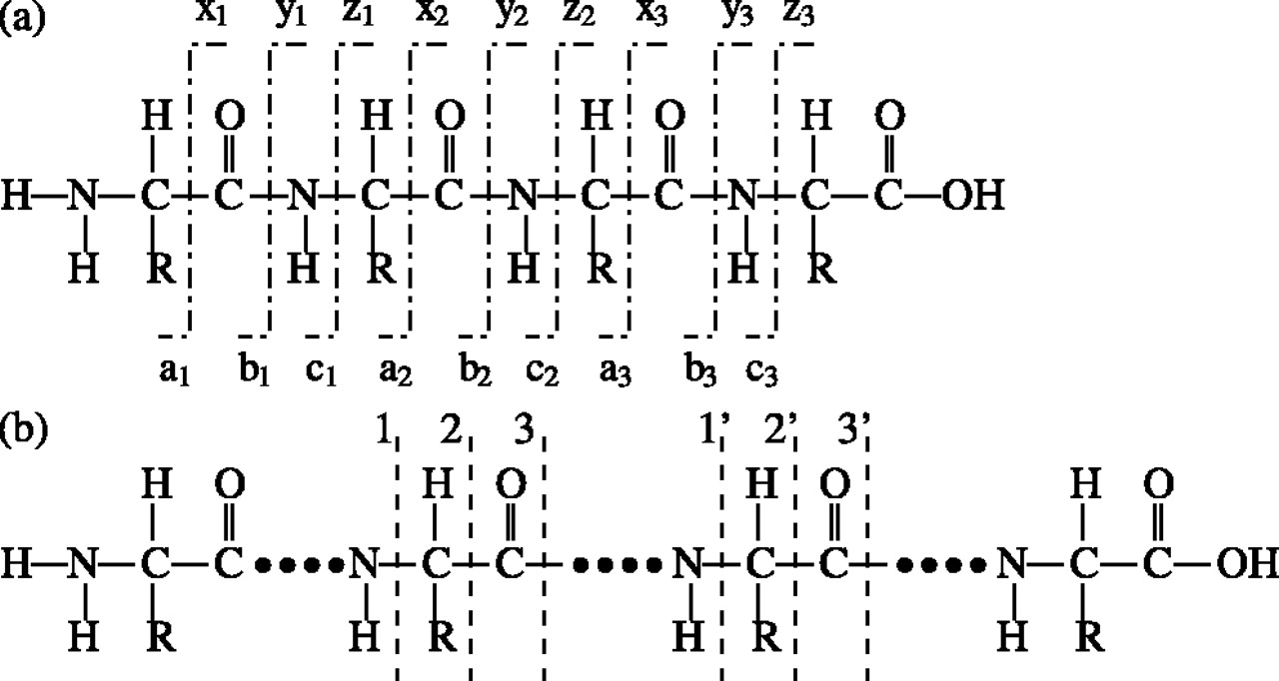
Fig. 2 Bond breaking points along a peptide chain. (a) In the example peptide (of four amino acids), a break can ...
Notes:
Fig. 2 Bond breaking points along a peptide chain. (a) In the example peptide (of four amino acids), a break can occur at any of the sites labeled by the dashed vertical lines. The resulting fragment ions with the N-terminus are the a-, b- and c-ions, and the ions with the C-terminus are the x-, y- and z-ions (Biemann, 1990); (b) The segment(s) with its(their) left cut at 1 or 2 or 3 and right cut at 1′ or 2′ or 3′ correspond to internal fragments. The most common pair of cutting points is (3, 3′). Note that two other pairs of cutting points, (1, 1′) and (2, 2′), also yield the same internal fragment masses, i.e.\batchmode \documentclass[fleqn,10pt,legalpaper]{article} \usepackage{amssymb} \usepackage{amsfonts} \usepackage{amsmath} \pagestyle{empty} \begin{document} \({\mathcal{M}}_{1,{1}^{\prime }}={\mathcal{M}}_{2,{2}^{\prime }}={\mathcal{M}}_{3,{3}^{\prime }}\) \end{document}. The other frequent pair of cutting points, (3, 2′), yields a molecular mass \batchmode \documentclass[fleqn,10pt,legalpaper]{article} \usepackage{amssymb} \usepackage{amsfonts} \usepackage{amsmath} \pagestyle{empty} \begin{document} \({\mathcal{M}}_{3,{2}^{\prime }}={\mathcal{M}}_{3,{3}^{\prime }}-28\) \end{document}.
Unless provided in the caption above, the following copyright applies to the content of this slide: Published by Oxford University Press 2005 The online version of this article has been published under an open access model. Users are entitled to use, reproduce, disseminate, or display the open access version of this article for non-commercial purposes provided that: the original authorship is properly and fully attributed; the Journal and Oxford University Press are attributed as the original place of publication with the correct citation details given; if an article is subsequently reproduced or disseminated not in its entirety but only in part or as a derivative work this must be clearly indicated. For commercial re-use, please contact journals.permissions@oxfordjournals.org

Slide 3
Fig. 3 Demonstration of miscleavage and incorrect cleavage. (a) Depicts a segment of a protein sequence, with all ...
Notes:
Fig. 3 Demonstration of miscleavage and incorrect cleavage. (a) Depicts a segment of a protein sequence, with all theoretical trypsin cleavage points marked by ‘V’. The peptide in (b) corresponds to the case of two miscleavages. In addition to one miscleavage, the peptide in (c) has an incorrect N-terminal cleavage because the peptide bond between \batchmode \documentclass[fleqn,10pt,legalpaper]{article} \usepackage{amssymb} \usepackage{amsfonts} \usepackage{amsmath} \pagestyle{empty} \begin{document} \(\mathsf{\hbox{ H }}\) \end{document} and \batchmode \documentclass[fleqn,10pt,legalpaper]{article} \usepackage{amssymb} \usepackage{amsfonts} \usepackage{amsmath} \pagestyle{empty} \begin{document} \(\mathsf{\hbox{ T }}\) \end{document} is not one of the theoretical cleavage points.
Unless provided in the caption above, the following copyright applies to the content of this slide: Published by Oxford University Press 2005 The online version of this article has been published under an open access model. Users are entitled to use, reproduce, disseminate, or display the open access version of this article for non-commercial purposes provided that: the original authorship is properly and fully attributed; the Journal and Oxford University Press are attributed as the original place of publication with the correct citation details given; if an article is subsequently reproduced or disseminated not in its entirety but only in part or as a derivative work this must be clearly indicated. For commercial re-use, please contact journals.permissions@oxfordjournals.org

