Slide 1
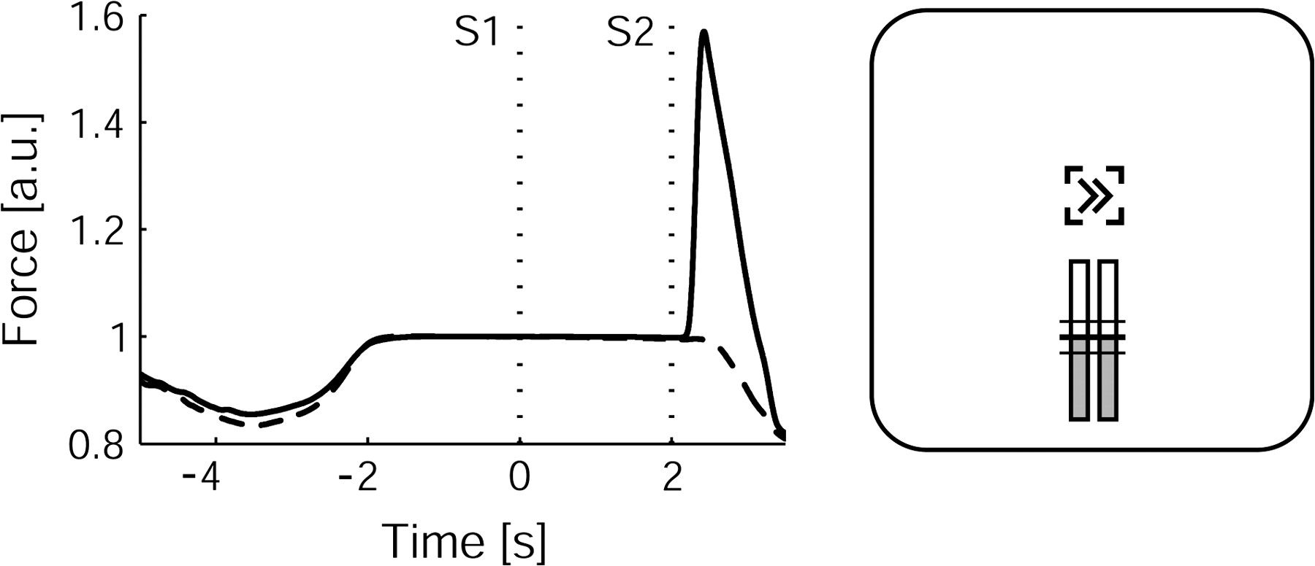
Figure 1. Experimental set-up of a trial. Left panel shows example force profiles of the response hand (solid line) and ...
Notes:
Figure 1. Experimental set-up of a trial. Left panel shows example force profiles of the response hand (solid line) and nonresponse hand (dashed line) during a trial. Right panel resembles a screen shot during a trial. Note that in the experiment, stimuli were presented in white against a gray background and force feedback was displayed by color-changing bars.
Unless provided in the caption above, the following copyright applies to the content of this slide: © The Author 2008. Published by Oxford University Press. All rights reserved. For permissions, please e-mail: journals.permissions@oxfordjournals.org

Slide 2
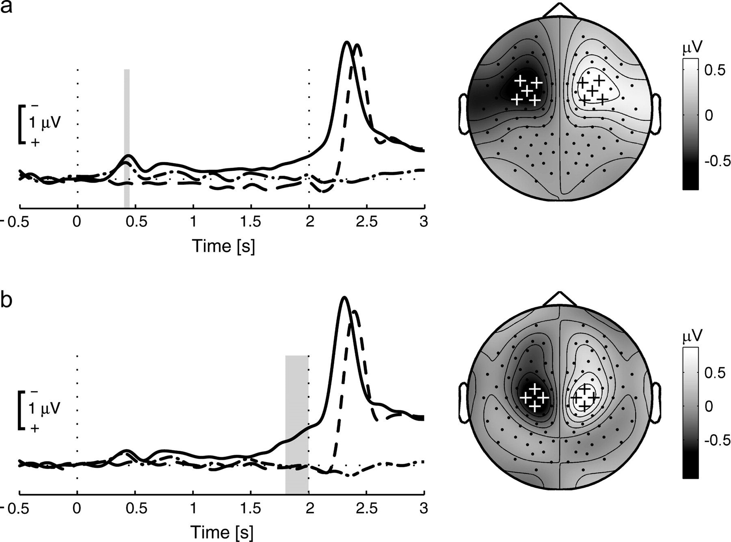
Figure 2. Time course and scalp distribution of the ADAN (a) and LRP (b) component. Amplitudes are averaged over the ...
Notes:
Figure 2. Time course and scalp distribution of the ADAN (a) and LRP (b) component. Amplitudes are averaged over the selected channels marked with a +. Solid line: predictive cue condition, dashed–dotted line: nonpredictive cue condition, dashed line: nonpredictive cue condition with respect to response side. The gray bars indicate the time intervals used for statistical evaluation and for display of the scalp distributions. The scalp distribution of the ADAN is averaged across the predictive and nonpredictive cue condition. The LRP scalp distribution represents the predictive cue condition only.
Unless provided in the caption above, the following copyright applies to the content of this slide: © The Author 2008. Published by Oxford University Press. All rights reserved. For permissions, please e-mail: journals.permissions@oxfordjournals.org

Slide 3
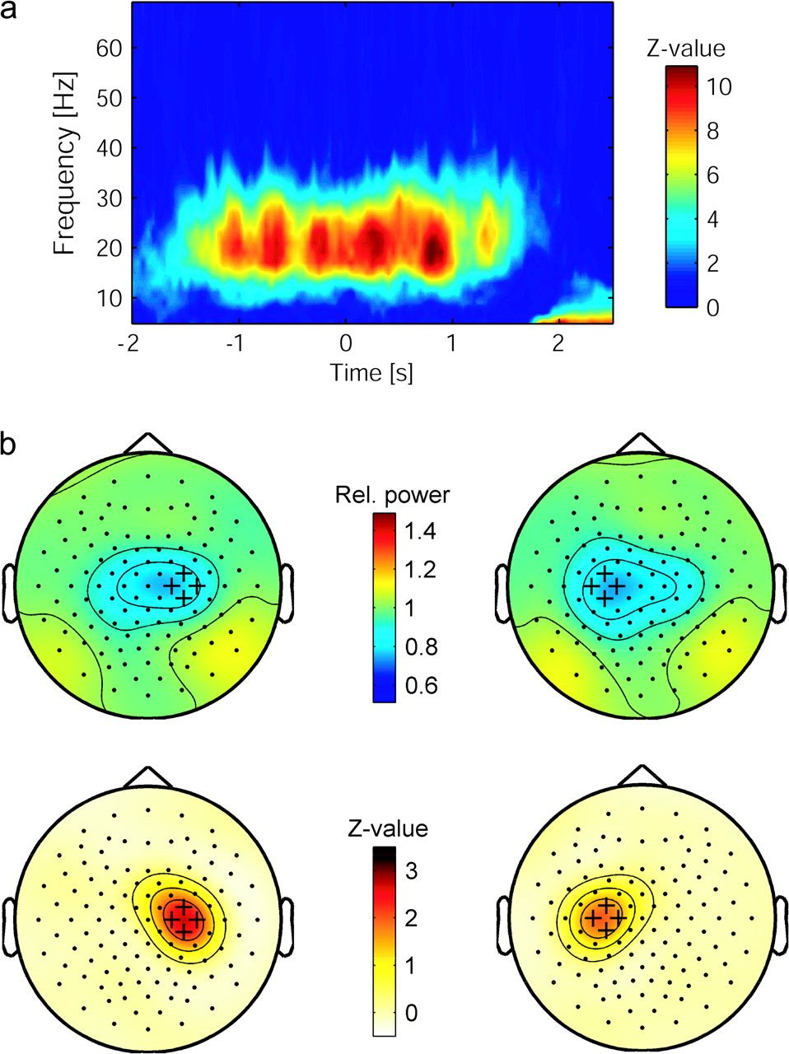
Figure 3. (a) Time–frequency representation of corticospinal coherence between the left first dorsal interosseous ...
Notes:
Figure 3. (a) Time–frequency representation of corticospinal coherence between the left first dorsal interosseous muscle and selected EEG channels (see b) overlying the contralateral motor cortex. The frequency band selected for analysis (15–30 Hz) stands out as the frequency band with strongest coherence. Shown here are grand-averaged data for the predictive cue condition with left hand responses. Corticospinal coherence for the left flexor pollicis brevis muscle and the 2 muscles of the right hand, as well as corticospinal phase synchronization, were confined to the same frequency range in all conditions. (b) Scalp distribution of EEG beta power and corticospinal coherence. Top row shows the lateralized distribution of EEG power (15–30 Hz) during the preparation for a left (left) and right hand response (right) in the predictive cue condition (time window 1500–2000 ms). Power values were divided by the average power in the baseline interval and averaged over participants. Channels marked with a + were selected for analysis. Bottom row shows the scalp distribution of corticospinal coherence (15–30 Hz) for the first dorsal interosseous muscle of the left and right hand (left and right panel, respectively) in the predictive cue condition with left hand responses. Coherence was localized over the motor cortex with an expansion over fronto-medial channels. Scalp distributions for corticospinal phase synchronization were similar.
Unless provided in the caption above, the following copyright applies to the content of this slide: © The Author 2008. Published by Oxford University Press. All rights reserved. For permissions, please e-mail: journals.permissions@oxfordjournals.org

Slide 4
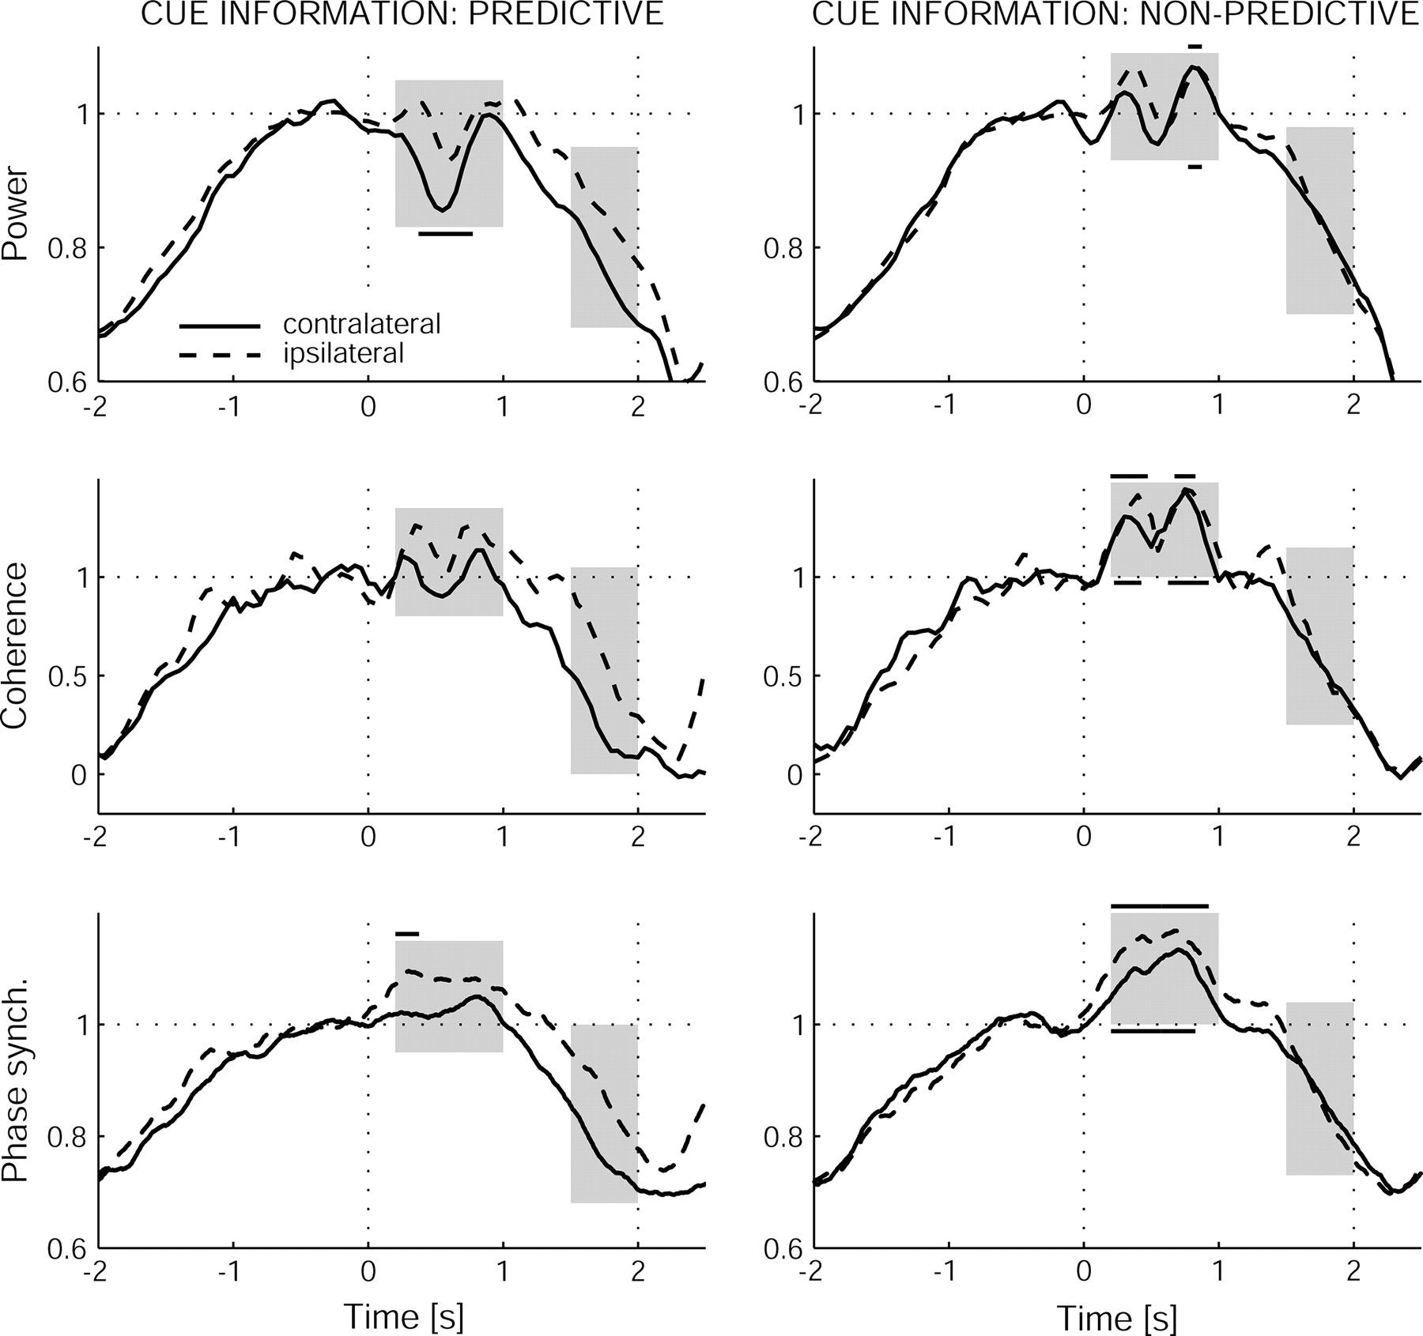
Figure 4. Time course of EEG power, corticospinal coherence and corticospinal phase synchronization. The time series ...
Notes:
Figure 4. Time course of EEG power, corticospinal coherence and corticospinal phase synchronization. The time series represent values averaged over left and right hand trials, selected channels, beta frequency band (15–30 Hz) and participants and are divided by the mean of the baseline line interval. Analyzed time windows are indicated with gray bars. Note the similar time course for the different measures as well as the absence of the short-lasting amplitude drop around 500 ms for phase synchronization. Data points in the 200- to 1000-ms interval that differed significantly from baseline are indicated with black lines above (for the ipsilateral hemisphere) and below (for the contralateral hemisphere) the gray bars.
Unless provided in the caption above, the following copyright applies to the content of this slide: © The Author 2008. Published by Oxford University Press. All rights reserved. For permissions, please e-mail: journals.permissions@oxfordjournals.org

