Slide 1
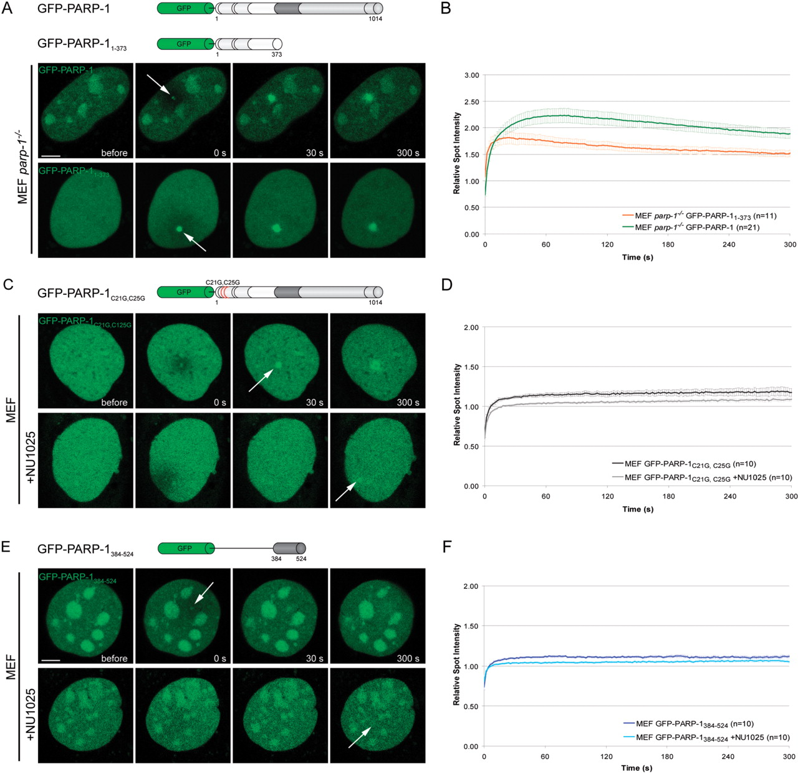
Figure 2. Mechanism of PARP-1 recruitment to DNA damage sites. ( A ) Live cell imaging of microirradiated PARP-1 knock ...
Notes:
Figure 2. Mechanism of PARP-1 recruitment to DNA damage sites. ( A ) Live cell imaging of microirradiated PARP-1 knock out MEFs (MEF parp-1 −/− ) expressing either GFP-PARP-1 or the GFP-tagged DNA binding domain of PARP-1 (GFP-PARP-1 1–373 ). Accumulation of both, GFP-PARP-1 and GFP-PARP-1 1–373 can be observed immediately after microirradiation. ( B ) Quantitative evaluation of GFP-PARP-1 1–373 recruitment kinetics. For comparision, the recruitment kinetics of GFP-PARP-1 from Figure 1 F are displayed. Time-matched controls are shown in Supplementary Figure 3. ( C ) Live cell imaging of microirradiated MEFs expressing a PARP-1 fusion protein containing two point mutations affecting the DNA binding capacities of PARP-1 (GFP-PARP-1 C21G,C25G ) in the absence or presence of the PARP inhibitor NU1025. ( D ) Quantitative evaluation of recruitment kinetics. ( E ) Live cell imaging of microirradiated MEFs expressing the GFP-tagged BRCT domain of PARP-1 (GFP-PARP-1 384–524 ) in the absence or presence of the PARP inhibitor NU1025. ( F ) Quantitative evaluation of recruitment kinetics. Error bars represent the SEM. Scale bar, 5 μm.
Unless provided in the caption above, the following copyright applies to the content of this slide: © 2007 The Author(s)This is an Open Access article distributed under the terms of the Creative Commons Attribution Non-Commercial License (http://creativecommons.org/licenses/by-nc/2.0/uk/) which permits unrestricted non-commercial use, distribution, and reproduction in any medium, provided the original work is properly cited.

Slide 2
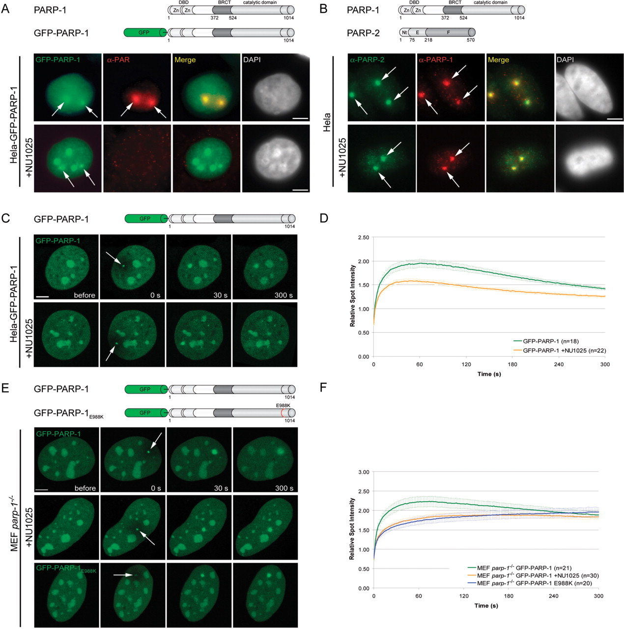
Figure 1. Recruitment of PARP-1 to DNA damage sites. ( A ) Immunostaining of PAR after microirradiation of Hela cells ...
Notes:
Figure 1. Recruitment of PARP-1 to DNA damage sites. ( A ) Immunostaining of PAR after microirradiation of Hela cells stably transfected with GFP-PARP-1. GFP-PARP-1 clearly colocalizes with PAR at microirradiated sites. Treatment of Hela GFP-PARP-1 cells with the PARP-1 inhibitor NU1025 results in loss of PAR signals at microirradiated sites, while GFP-PARP-1 accumulation is still present. ( B ) Immunostaining of PARP-1 and PARP-2 after microirradiation of Hela cells in the absence or presence of NU1025. ( C ) Live cell imaging of microirradiated Hela cells stably expressing GFP-PARP-1. Accumulation of GFP-PARP-1 can be observed immediately after microirradiation in untreated cells as well as in cells treated with the PARP inhibitor NU1025. ( D ) Quantitative evaluation of PARP-1 recruitment kinetics in the absence and presence of the PARP inhibitor NU1025. Inhibition of PARP activity does not prevent recruitment of PARP-1 but leads to a reduced accumulation at microirradiated sites. ( E and F ) Live cell imaging and quantitative evaluation of PARP-1 recruitment kinetics in the absence and presence of the PARP inhibitor NU1025 compared with the recruitment kinetics of the fluorescence tagged catalytic mutant PARP-1 after microirradiation of PARP-1 knock out cells. Error bars represent the SEM. Scale bar, 5 μm.
Unless provided in the caption above, the following copyright applies to the content of this slide: © 2007 The Author(s)This is an Open Access article distributed under the terms of the Creative Commons Attribution Non-Commercial License (http://creativecommons.org/licenses/by-nc/2.0/uk/) which permits unrestricted non-commercial use, distribution, and reproduction in any medium, provided the original work is properly cited.

Slide 3
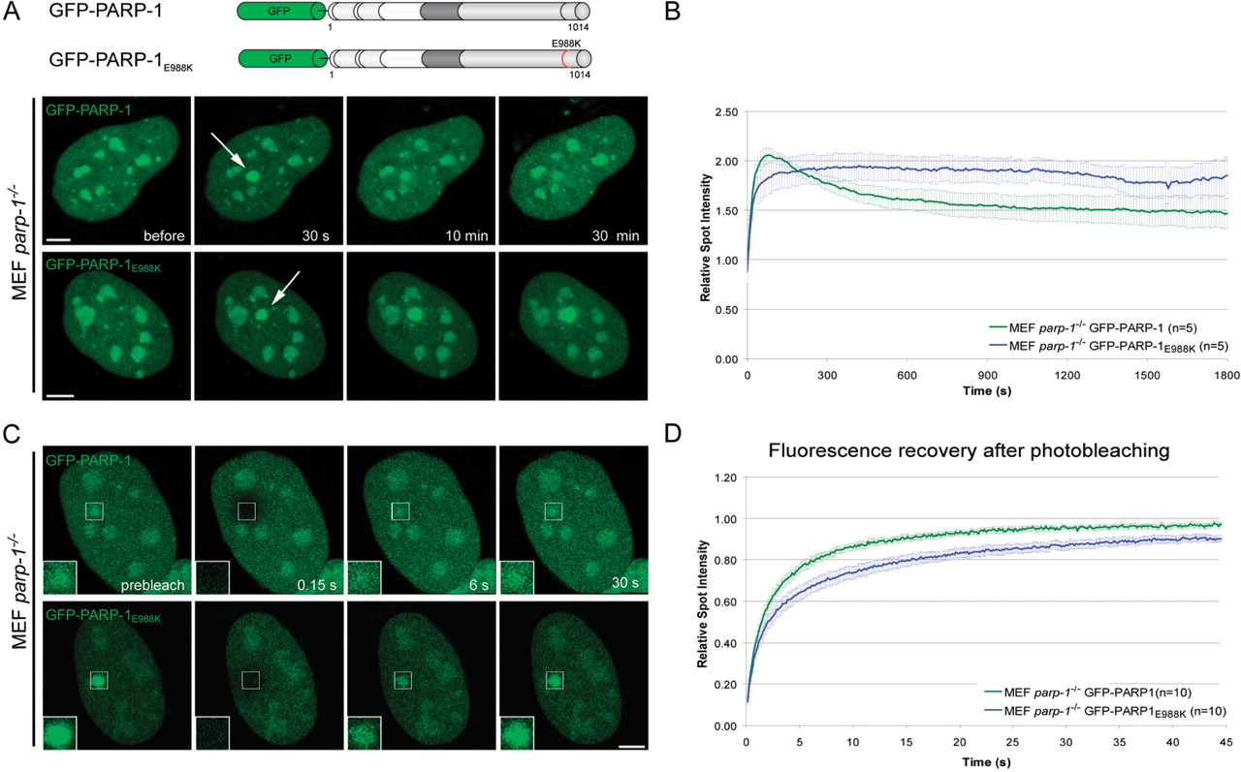
Figure 3. The catalytic activity of PARP-1 is needed for dissociation from DNA damage sites. ( A ) Long-term ...
Notes:
Figure 3. The catalytic activity of PARP-1 is needed for dissociation from DNA damage sites. ( A ) Long-term observations of microirradiated PARP-1 knock out MEFs (MEF parp-1 −/− ) expressing either GFP-PARP-1 or a GFP-tagged catalytic mutant (GFP-PARP-1 E988K ). The catalytic mutant shows a prolonged association at DNA damage sites. ( B ) Quantitative evaluation of recruitment kinetics. ( C ) Mobility of GFP-PARP-1 and GFP-PARP-1 E988K at DNA damage sites. The mobility of accumulated fluorescent fusion proteins was determined by bleaching the microirradiated site 5 min after microirradiation and subsequent recovery measurements. Inset shows the bleached microirradiated site. ( D ) FRAP data from 10 individual experiments are shown as mean curves. Error bars represent the SEM. Scale bar, 5 μm.
Unless provided in the caption above, the following copyright applies to the content of this slide: © 2007 The Author(s)This is an Open Access article distributed under the terms of the Creative Commons Attribution Non-Commercial License (http://creativecommons.org/licenses/by-nc/2.0/uk/) which permits unrestricted non-commercial use, distribution, and reproduction in any medium, provided the original work is properly cited.

Slide 4
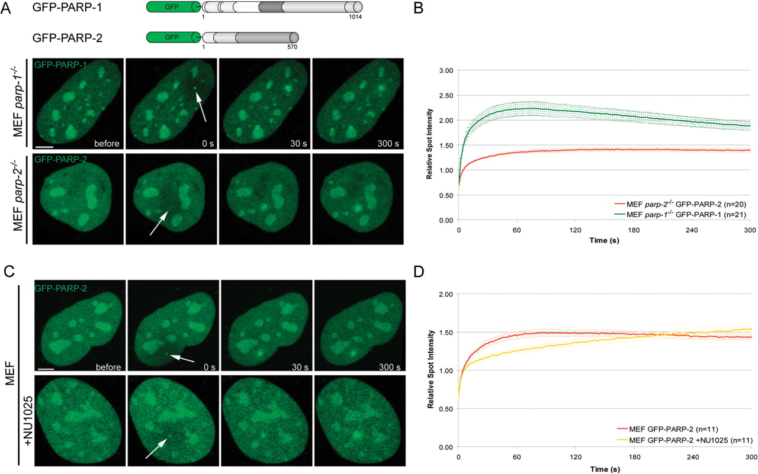
Figure 4. Recruitment of PARP-2 to DNA damage sites in living cells. ( A ) Live cell imaging of microirradiated MEFs ...
Notes:
Figure 4. Recruitment of PARP-2 to DNA damage sites in living cells. ( A ) Live cell imaging of microirradiated MEFs either expressing GFP-PARP-1 or GFP-PARP-2. Accumulation of GFP-PARP-1 and GFP-PARP-2 can be observed immediately after microirradiation. ( B ) Quantitative evaluation of GFP-PARP-2 recruitment kinetics. For comparision, the recruitment kinetics of GFP-PARP-1 from Figure 1 F are displayed. Time-matched controls are shown in Supplementary Figure 3. ( C and D ) Live cell imaging of microirradiated MEFs reveals a slower accumulation of GFP-PARP-2 in the presence of NU1025. Error bars represent the SEM. Scale bar, 5 μm.
Unless provided in the caption above, the following copyright applies to the content of this slide: © 2007 The Author(s)This is an Open Access article distributed under the terms of the Creative Commons Attribution Non-Commercial License (http://creativecommons.org/licenses/by-nc/2.0/uk/) which permits unrestricted non-commercial use, distribution, and reproduction in any medium, provided the original work is properly cited.

Slide 5
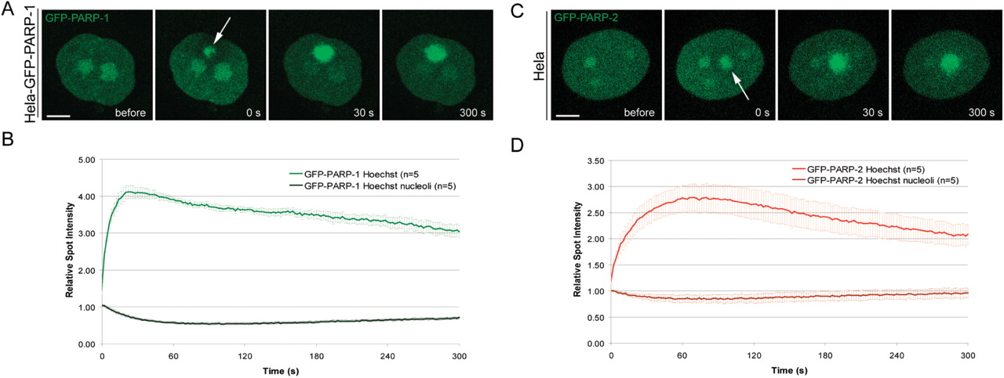
Figure 5. The Nucleolus serves as a storage of PARP-1 and PARP-2 to cope with heavy DNA damage. ( A and C ) Live cell ...
Notes:
Figure 5. The Nucleolus serves as a storage of PARP-1 and PARP-2 to cope with heavy DNA damage. ( A and C ) Live cell imaging of microirradiated Hela cells sensitized with Hoechst 33285. Microirradiation of Hoechst sensitized cells leads to massive recruitment and temporary depletion of PARP-1 and PARP-2 from the nucleolus. ( B and D ) Quantitative evaluation of recruitment and nucleolar depletion kinetics. Error bars represent the SEM. Scale bar, 5 μm.
Unless provided in the caption above, the following copyright applies to the content of this slide: © 2007 The Author(s)This is an Open Access article distributed under the terms of the Creative Commons Attribution Non-Commercial License (http://creativecommons.org/licenses/by-nc/2.0/uk/) which permits unrestricted non-commercial use, distribution, and reproduction in any medium, provided the original work is properly cited.

Slide 6
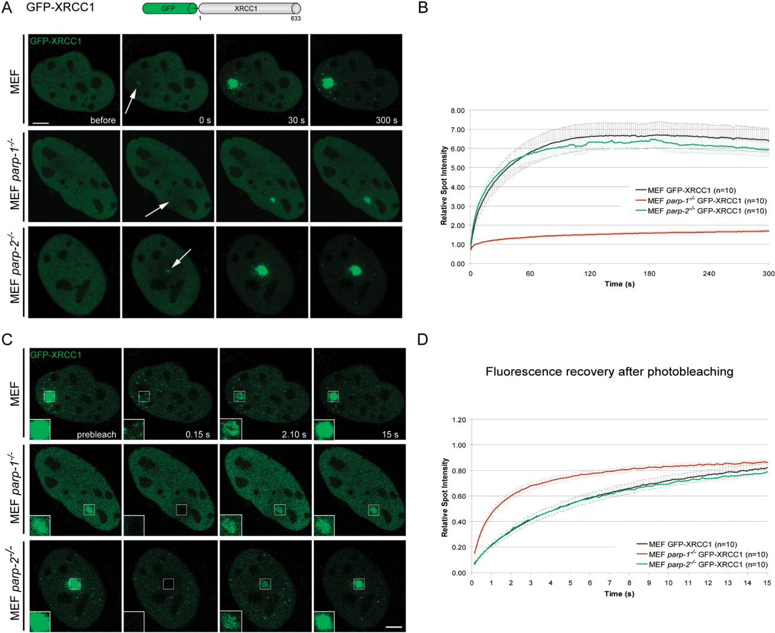
Figure 6. Efficient recruitment of XRCC1 to DNA repair sites depends on the presence of PARP-1. ( A ) Live cell ...
Notes:
Figure 6. Efficient recruitment of XRCC1 to DNA repair sites depends on the presence of PARP-1. ( A ) Live cell imaging of microirradiated wild-type, PARP-1 and PARP-2 knock out MEFs (MEF parp-1 −/− , MEF parp-2 −/− ) expressing GFP-XRCC1. Accumulation of GFP-XRCC1 at DNA damage sites is dramatically reduced in the absence of PARP-1. ( B ) Quantitative evaluation of recruitment kinetics. ( C and D ) Mobility of GFP-XRCC1 at DNA damage sites. The mobility of accumulated fluorescent fusion proteins was determined by bleaching the microirradiated site 5 min after microirradiation and subsequent recovery measurements. Inset shows the bleached microirradiated site. FRAP data from 10 individual experiments are shown as mean curves. Error bars represent the SEM. Scale bar, 5 μm.
Unless provided in the caption above, the following copyright applies to the content of this slide: © 2007 The Author(s)This is an Open Access article distributed under the terms of the Creative Commons Attribution Non-Commercial License (http://creativecommons.org/licenses/by-nc/2.0/uk/) which permits unrestricted non-commercial use, distribution, and reproduction in any medium, provided the original work is properly cited.

Slide 7
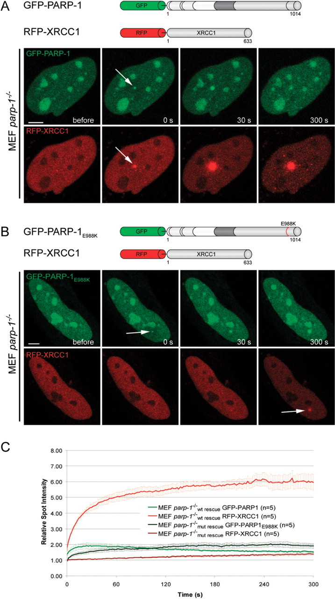
Figure 7. The catalytic activity of PARP-1 is needed for efficient recruitment of XRCC1 to laser-induced DNA damage ...
Notes:
Figure 7. The catalytic activity of PARP-1 is needed for efficient recruitment of XRCC1 to laser-induced DNA damage sites. ( A ) Live cell imaging of microirradiated PARP-1 knock out MEFs (MEF parp-1 −/− ) coexpressing GFP-PARP-1 and RFP-XRCC1. Expression of GFP-tagged wild-type PARP-1 results in efficient recruitment of RFP-XRCC1. ( B ) Live cell imaging of microirradiated PARP-1 knock out MEFs (MEF parp-1 −/− ) coexpressing GFP-PARP-1 E988K and RFP-XRCC1. Accumulation of RFP-XRCC1 at DNA damage sites is dramatically reduced in PARP-1 knock out MEFs expressing catalytically inactive GFP-PARP-1 E988K . ( C ) Quantitative evaluation of recruitment kinetics. Error bars represent the SEM. Scale bar, 5 μm.
Unless provided in the caption above, the following copyright applies to the content of this slide: © 2007 The Author(s)This is an Open Access article distributed under the terms of the Creative Commons Attribution Non-Commercial License (http://creativecommons.org/licenses/by-nc/2.0/uk/) which permits unrestricted non-commercial use, distribution, and reproduction in any medium, provided the original work is properly cited.

Slide 8
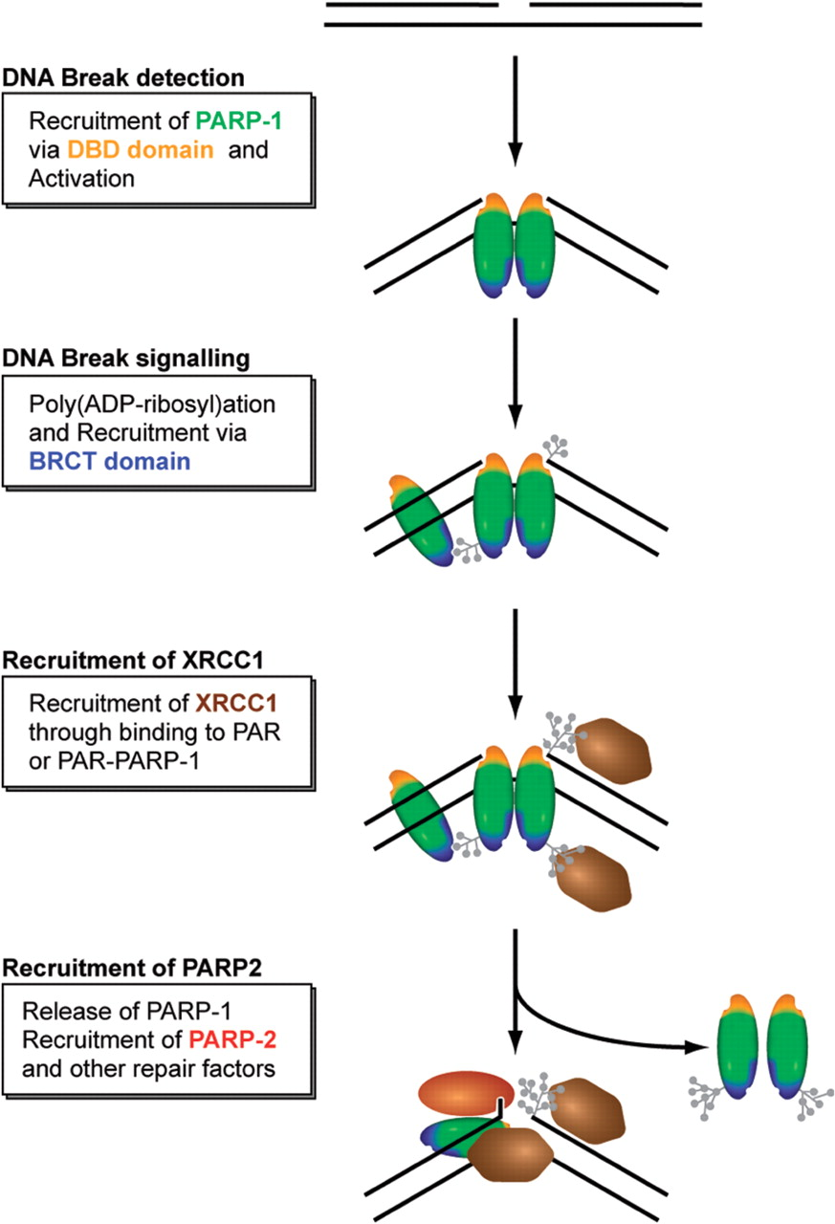
Figure 8. Simplified model for the recruitment of repair factors to SSB. See text for a detailed discussion of the role ...
Notes:
Figure 8. Simplified model for the recruitment of repair factors to SSB. See text for a detailed discussion of the role and regulation of PARPs.
Unless provided in the caption above, the following copyright applies to the content of this slide: © 2007 The Author(s)This is an Open Access article distributed under the terms of the Creative Commons Attribution Non-Commercial License (http://creativecommons.org/licenses/by-nc/2.0/uk/) which permits unrestricted non-commercial use, distribution, and reproduction in any medium, provided the original work is properly cited.

