Slide 1
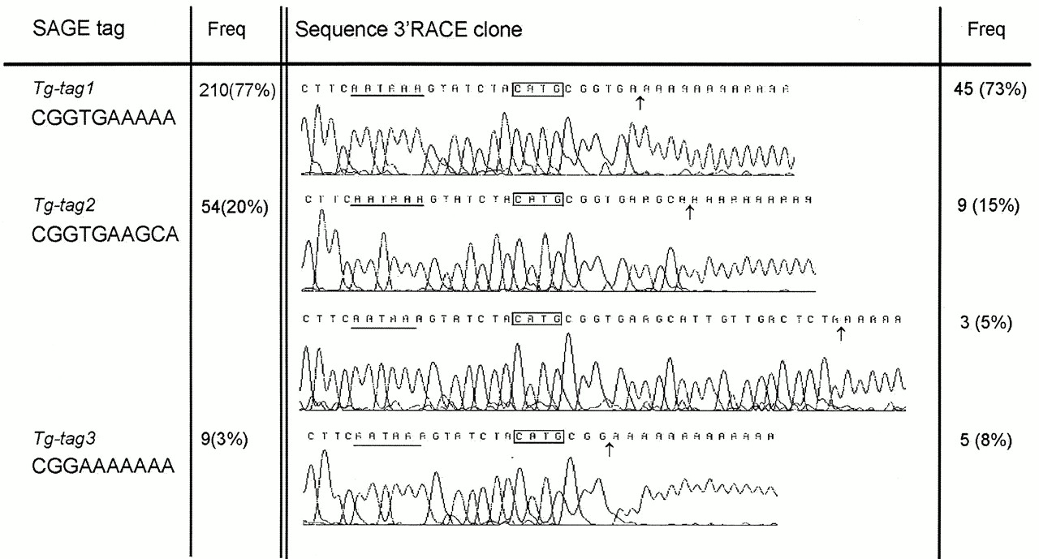
Figure 1. Alternative cleavage sites in TG mRNA. Results are summarized from SAGE and 3′-RACE. Sequence for ...
Notes:
Figure 1. Alternative cleavage sites in TG mRNA. Results are summarized from SAGE and 3′-RACE. Sequence for each variant is shown together with their relative abundance. SAGE-tag frequency is out of a total of 10 994 tags, 3′-RACE-clone frequency is out of a total of 62 clones.
Unless provided in the caption above, the following copyright applies to the content of this slide:

Slide 2
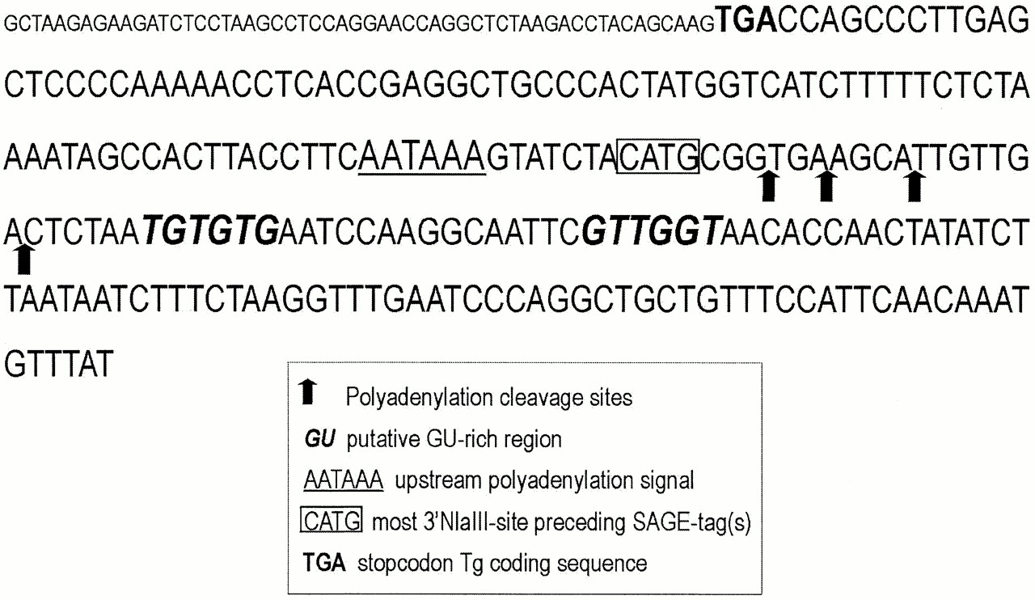
Figure 2. Genomic sequence (accession no. AF080484) of the last coding exon (48) of the human TG gene. ...
Notes:
Figure 2. Genomic sequence (accession no. AF080484) of the last coding exon (48) of the human TG gene. Consensus regulating elements are indicated as well as the four described cleavage sites. Small font is coding sequence, large font represents pre-RNA containing regulating polyadenylation signals.
Unless provided in the caption above, the following copyright applies to the content of this slide:

Slide 3
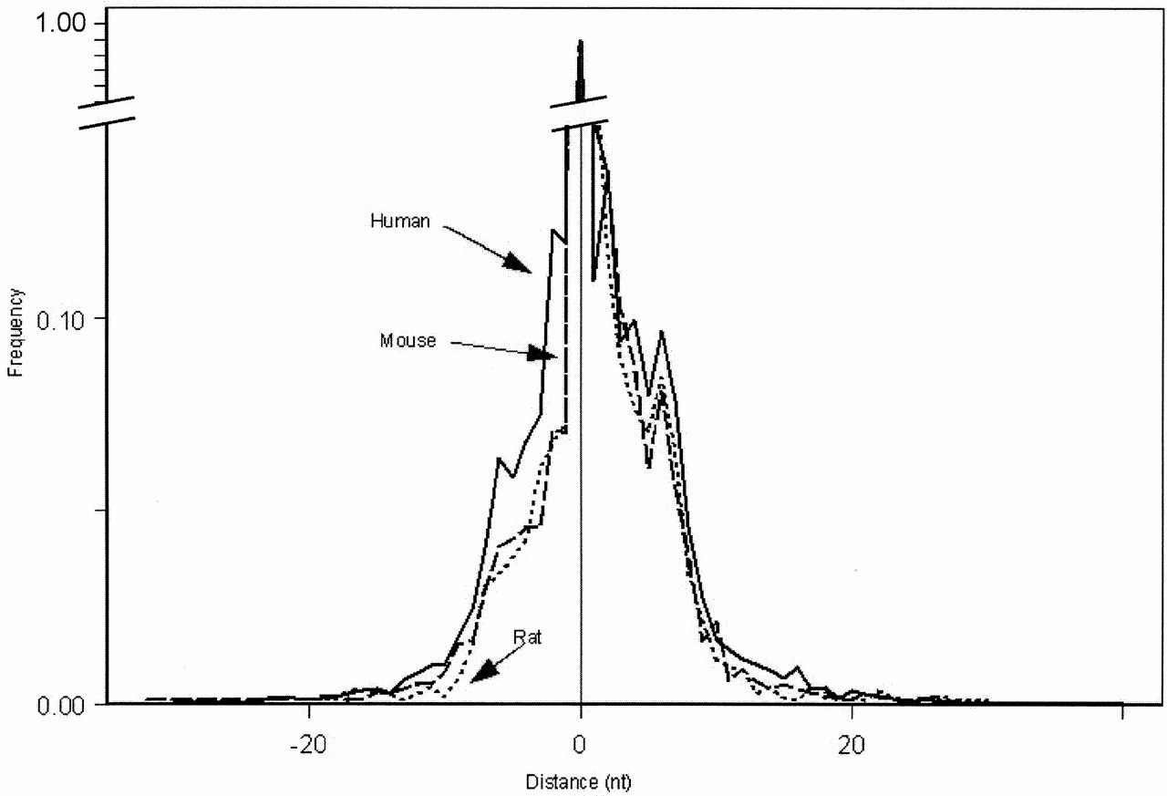
Figure 3. Distance of alternative cleavage sites relative to wild-type cleavage site in Unigene clusters with ...
Notes:
Figure 3. Distance of alternative cleavage sites relative to wild-type cleavage site in Unigene clusters with alternative polyadenylation. The distance is divided into the number of upstream (–) and downstream (+) nucleotides (x-axis). The most abundant cleavage site is used as a reference and is depicted as 0. Frequency is given on the y-axis. Arrows indicate human, mouse and rat data.
Unless provided in the caption above, the following copyright applies to the content of this slide:

