Slide 1
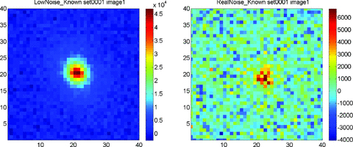
Figure 1 Left-hand panel: the first galaxy of the first LowNoise_Known fits image. Right-hand panel: the first galaxy ...
Notes:
Figure 1 Left-hand panel: the first galaxy of the first LowNoise_Known fits image. Right-hand panel: the first galaxy of the first RealNoise_Known fits image. The signal is a factor of 10 smaller for the RealNoise images than the LowNoise images, making the problem much more challenging.
Unless provided in the caption above, the following copyright applies to the content of this slide: © 2010 The Authors. Journal compilation © 2010 RAS. Re-use of this article is permitted in accordance with the Terms and Conditions set out at http://www3.interscience.wiley.com/authorresources/onlineopen.htmlThis is an Open Access article distributed under the terms of the Creative Commons Attribution Non-Commercial License (http://creativecommons.org/licenses/by-nc/3.0/), which permits non-commercial re-use, distribution, and reproduction in any medium, provided the original work is properly cited. For commercial re-use, please contact journals.permissions@oup.com

Slide 2
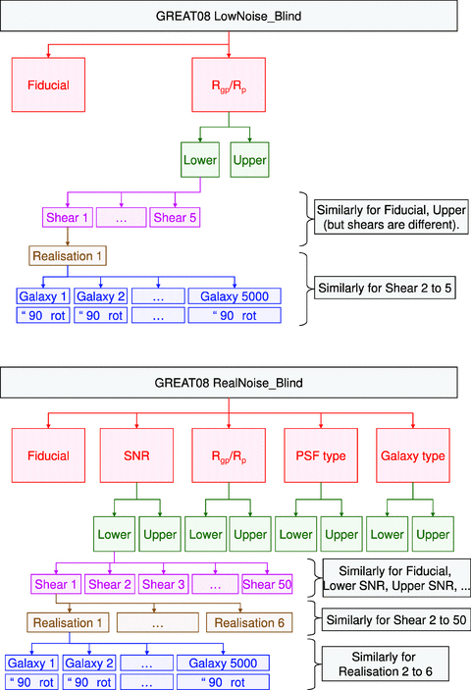
Figure 2 Upper panel: schematic of the galaxy parameters used in LowNoise_Blind. Each realization corresponds to a ...
Notes:
Figure 2 Upper panel: schematic of the galaxy parameters used in LowNoise_Blind. Each realization corresponds to a different set or fits image file containing 10 000 galaxies. The schematic looks identical for LowNoise_Known. For RealNoise_Known, there are 100 shears per branch in place of 5. The bottom row of boxes represents galaxies with the same properties as the penultimate row of boxes, but rotated by 90°. Lower panel: schematic of the galaxy parameters used in RealNoise_Blind.
Unless provided in the caption above, the following copyright applies to the content of this slide: © 2010 The Authors. Journal compilation © 2010 RAS. Re-use of this article is permitted in accordance with the Terms and Conditions set out at http://www3.interscience.wiley.com/authorresources/onlineopen.htmlThis is an Open Access article distributed under the terms of the Creative Commons Attribution Non-Commercial License (http://creativecommons.org/licenses/by-nc/3.0/), which permits non-commercial re-use, distribution, and reproduction in any medium, provided the original work is properly cited. For commercial re-use, please contact journals.permissions@oup.com

Slide 3
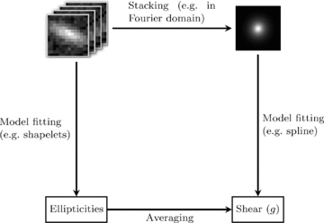
Figure 3 Illustration of the different routes to a combined shear statistic from multiple galaxies. The lower left ...
Notes:
Figure 3 Illustration of the different routes to a combined shear statistic from multiple galaxies. The lower left route is the traditional approach in which each galaxy image is analysed separately to produce a shear estimate. The upper right route illustrates the ‘stacking’ methods which average some statistic of each image and perform shear estimation on the averaged statistic.
Unless provided in the caption above, the following copyright applies to the content of this slide: © 2010 The Authors. Journal compilation © 2010 RAS. Re-use of this article is permitted in accordance with the Terms and Conditions set out at http://www3.interscience.wiley.com/authorresources/onlineopen.htmlThis is an Open Access article distributed under the terms of the Creative Commons Attribution Non-Commercial License (http://creativecommons.org/licenses/by-nc/3.0/), which permits non-commercial re-use, distribution, and reproduction in any medium, provided the original work is properly cited. For commercial re-use, please contact journals.permissions@oup.com

Slide 4
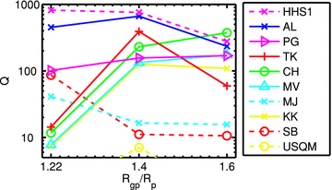
Figure 4 Our figure of merit Q as a function of galaxy size for LowNoise_Blind.
Notes:
Figure 4 Our figure of merit Q as a function of galaxy size for LowNoise_Blind.
Unless provided in the caption above, the following copyright applies to the content of this slide: © 2010 The Authors. Journal compilation © 2010 RAS. Re-use of this article is permitted in accordance with the Terms and Conditions set out at http://www3.interscience.wiley.com/authorresources/onlineopen.htmlThis is an Open Access article distributed under the terms of the Creative Commons Attribution Non-Commercial License (http://creativecommons.org/licenses/by-nc/3.0/), which permits non-commercial re-use, distribution, and reproduction in any medium, provided the original work is properly cited. For commercial re-use, please contact journals.permissions@oup.com

Slide 5
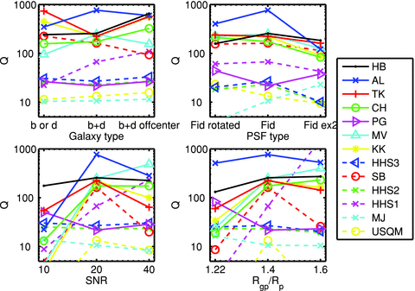
Figure 5 Shear measurement figure of merit Q as a function of simulation properties for RealNoise_Blind.
Notes:
Figure 5 Shear measurement figure of merit Q as a function of simulation properties for RealNoise_Blind.
Unless provided in the caption above, the following copyright applies to the content of this slide: © 2010 The Authors. Journal compilation © 2010 RAS. Re-use of this article is permitted in accordance with the Terms and Conditions set out at http://www3.interscience.wiley.com/authorresources/onlineopen.htmlThis is an Open Access article distributed under the terms of the Creative Commons Attribution Non-Commercial License (http://creativecommons.org/licenses/by-nc/3.0/), which permits non-commercial re-use, distribution, and reproduction in any medium, provided the original work is properly cited. For commercial re-use, please contact journals.permissions@oup.com

Slide 6
Figure A1 True shears for LowNoise_Blind and RealNoise_Blind, colour coded for the different branches of the ...
Notes:
Figure A1 True shears for LowNoise_Blind and RealNoise_Blind, colour coded for the different branches of the simulations.
Unless provided in the caption above, the following copyright applies to the content of this slide: © 2010 The Authors. Journal compilation © 2010 RAS. Re-use of this article is permitted in accordance with the Terms and Conditions set out at http://www3.interscience.wiley.com/authorresources/onlineopen.htmlThis is an Open Access article distributed under the terms of the Creative Commons Attribution Non-Commercial License (http://creativecommons.org/licenses/by-nc/3.0/), which permits non-commercial re-use, distribution, and reproduction in any medium, provided the original work is properly cited. For commercial re-use, please contact journals.permissions@oup.com

Slide 7
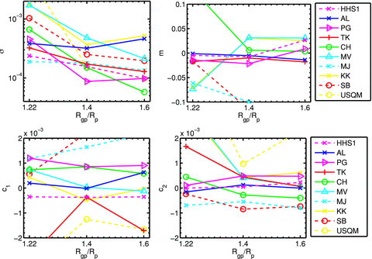
Figure C1 Scatter, multiplicative and additive shear measurement bias as a function of galaxy size for LowNoise_Blind.
Notes:
Figure C1 Scatter, multiplicative and additive shear measurement bias as a function of galaxy size for LowNoise_Blind.
Unless provided in the caption above, the following copyright applies to the content of this slide: © 2010 The Authors. Journal compilation © 2010 RAS. Re-use of this article is permitted in accordance with the Terms and Conditions set out at http://www3.interscience.wiley.com/authorresources/onlineopen.htmlThis is an Open Access article distributed under the terms of the Creative Commons Attribution Non-Commercial License (http://creativecommons.org/licenses/by-nc/3.0/), which permits non-commercial re-use, distribution, and reproduction in any medium, provided the original work is properly cited. For commercial re-use, please contact journals.permissions@oup.com

Slide 8
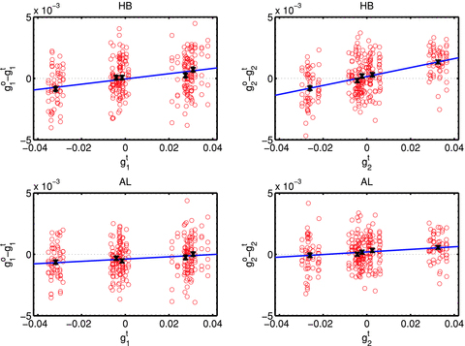
Figure C2 Residual shear versus true shear for shear component 1 (left-hand panels) and shear component 2 (right-hand ...
Notes:
Figure C2 Residual shear versus true shear for shear component 1 (left-hand panels) and shear component 2 (right-hand panels) for the top two methods HB (upper panels) and AL (lower panels). The circles show results for each set in the fiducial simulation branch and the crosses and error bars show the average residual for each root shear value for the fiducial branch.
Unless provided in the caption above, the following copyright applies to the content of this slide: © 2010 The Authors. Journal compilation © 2010 RAS. Re-use of this article is permitted in accordance with the Terms and Conditions set out at http://www3.interscience.wiley.com/authorresources/onlineopen.htmlThis is an Open Access article distributed under the terms of the Creative Commons Attribution Non-Commercial License (http://creativecommons.org/licenses/by-nc/3.0/), which permits non-commercial re-use, distribution, and reproduction in any medium, provided the original work is properly cited. For commercial re-use, please contact journals.permissions@oup.com

Slide 9
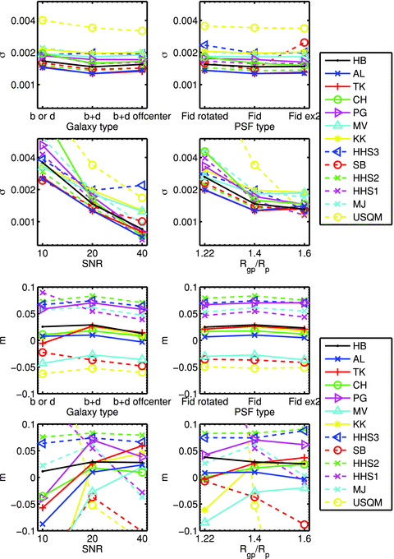
Figure C3 Upper panel: scatter about a linear fit to output versus input shear. Lower panel: multiplicative shear ...
Notes:
Figure C3 Upper panel: scatter about a linear fit to output versus input shear. Lower panel: multiplicative shear measurement bias as a function of galaxy size for RealNoise_Blind.
Unless provided in the caption above, the following copyright applies to the content of this slide: © 2010 The Authors. Journal compilation © 2010 RAS. Re-use of this article is permitted in accordance with the Terms and Conditions set out at http://www3.interscience.wiley.com/authorresources/onlineopen.htmlThis is an Open Access article distributed under the terms of the Creative Commons Attribution Non-Commercial License (http://creativecommons.org/licenses/by-nc/3.0/), which permits non-commercial re-use, distribution, and reproduction in any medium, provided the original work is properly cited. For commercial re-use, please contact journals.permissions@oup.com

Slide 10
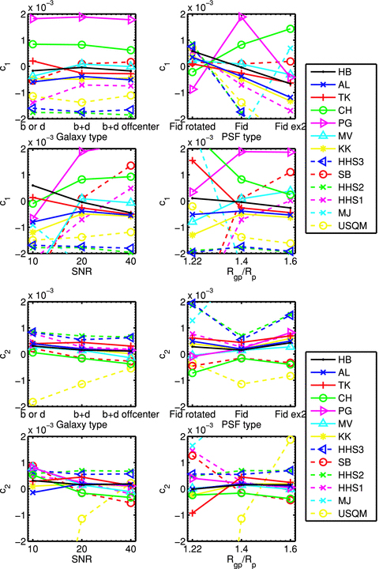
Figure C4 Additive shear measurement bias as a function of galaxy size for RealNoise_Blind.
Notes:
Figure C4 Additive shear measurement bias as a function of galaxy size for RealNoise_Blind.
Unless provided in the caption above, the following copyright applies to the content of this slide: © 2010 The Authors. Journal compilation © 2010 RAS. Re-use of this article is permitted in accordance with the Terms and Conditions set out at http://www3.interscience.wiley.com/authorresources/onlineopen.htmlThis is an Open Access article distributed under the terms of the Creative Commons Attribution Non-Commercial License (http://creativecommons.org/licenses/by-nc/3.0/), which permits non-commercial re-use, distribution, and reproduction in any medium, provided the original work is properly cited. For commercial re-use, please contact journals.permissions@oup.com

