Slide 1
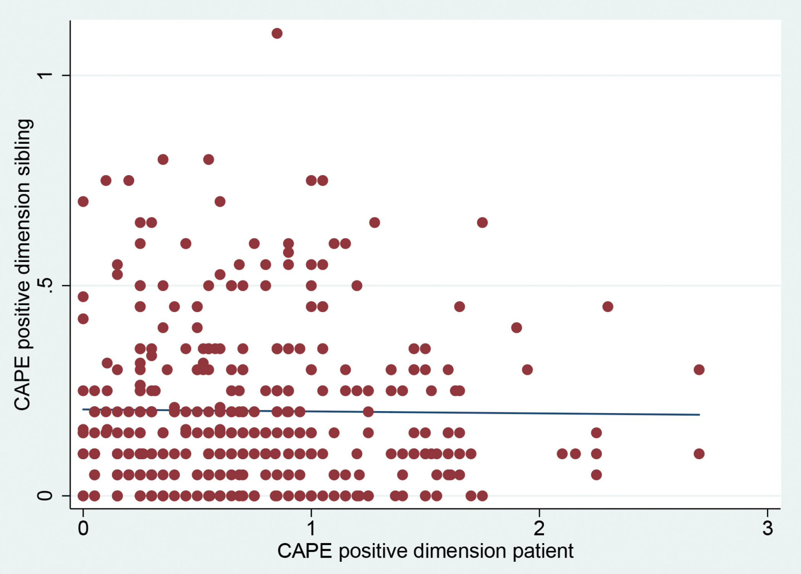
Fig. 1. Correlation between patient positive psychotic symptoms and sibling positive psychotic symptoms (left panel ...
Notes:
Fig. 1. Correlation between patient positive psychotic symptoms and sibling positive psychotic symptoms (left panel in rural environment and right panel in urban environment). CAPE, Community Assessment of Psychic Experiences.
Unless provided in the caption above, the following copyright applies to the content of this slide: © The Author 2017. Published by Oxford University Press on behalf of the Maryland Psychiatric Research Center. All rights reserved. For permissions, please email: journals.permissions@oup.com

Slide 2
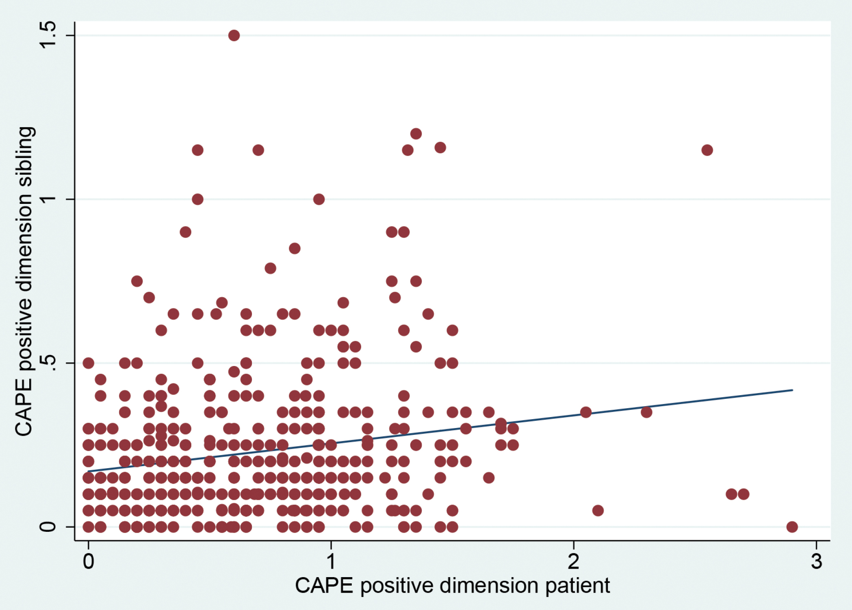
Fig. 1. Correlation between patient positive psychotic symptoms and sibling positive psychotic symptoms (left panel ...
Notes:
Fig. 1. Correlation between patient positive psychotic symptoms and sibling positive psychotic symptoms (left panel in rural environment and right panel in urban environment). CAPE, Community Assessment of Psychic Experiences.
Unless provided in the caption above, the following copyright applies to the content of this slide: © The Author 2017. Published by Oxford University Press on behalf of the Maryland Psychiatric Research Center. All rights reserved. For permissions, please email: journals.permissions@oup.com

Slide 3
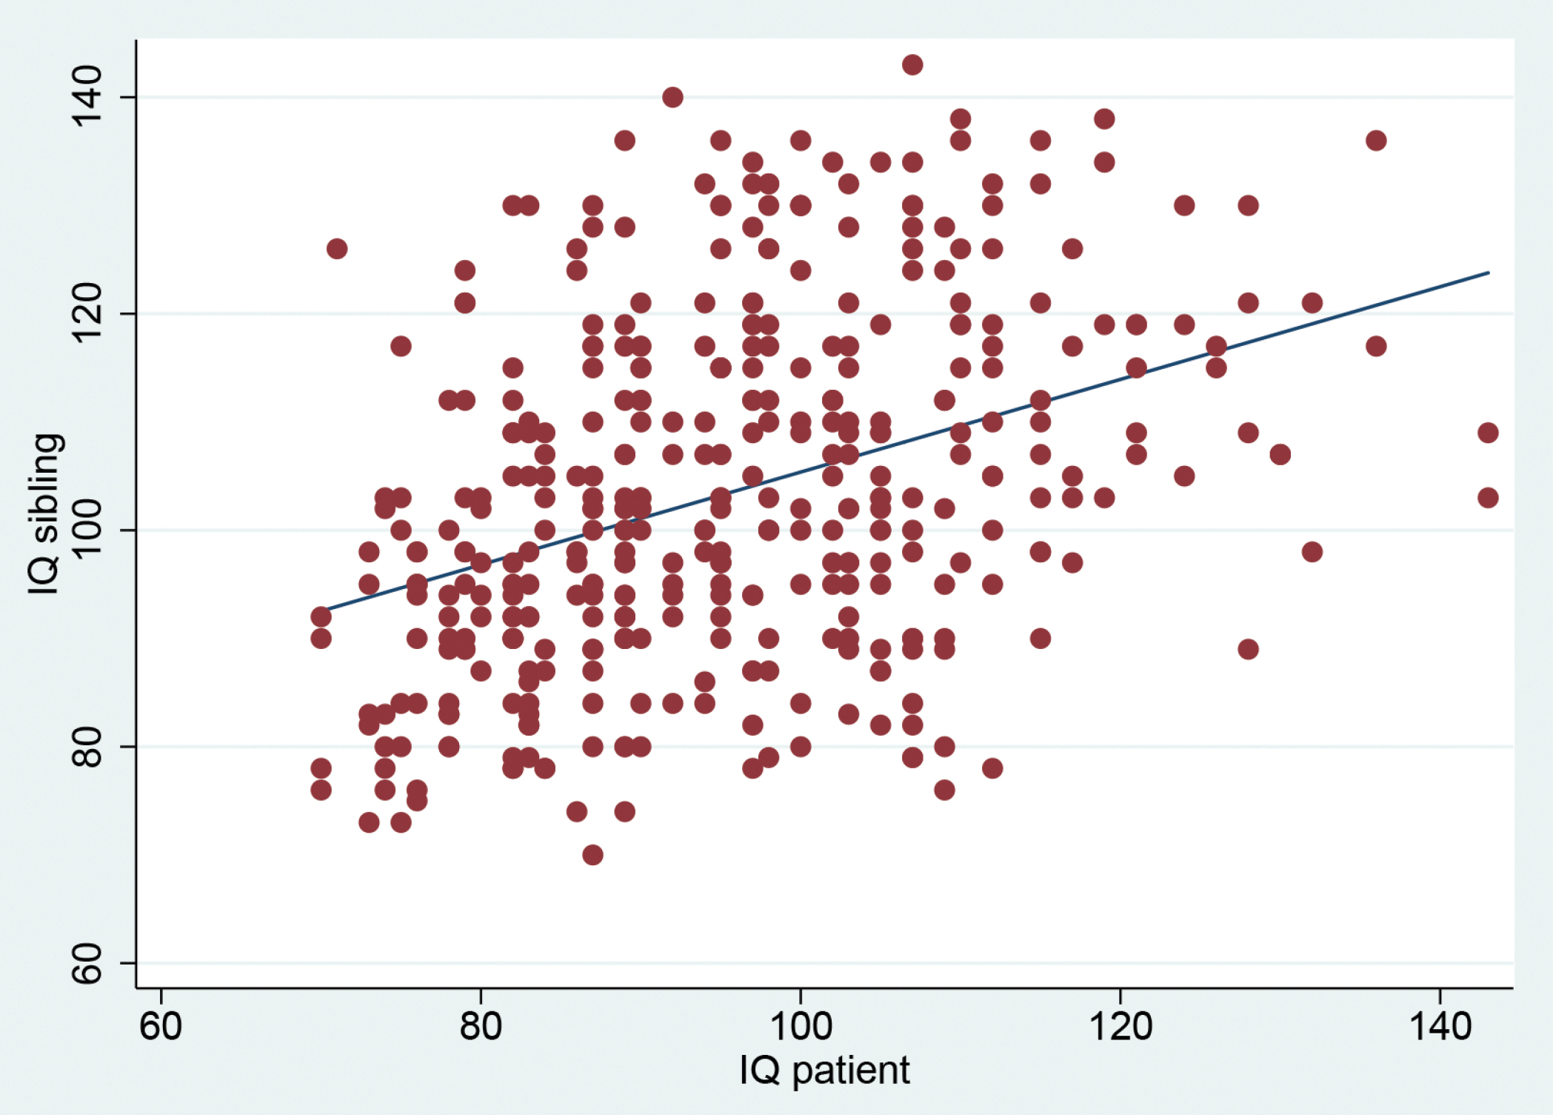
Fig. 2. Correlation between patient and siblings IQ (left panel in rural environment and right panel in urban ...
Notes:
Fig. 2. Correlation between patient and siblings IQ (left panel in rural environment and right panel in urban environment).
Unless provided in the caption above, the following copyright applies to the content of this slide: © The Author 2017. Published by Oxford University Press on behalf of the Maryland Psychiatric Research Center. All rights reserved. For permissions, please email: journals.permissions@oup.com

Slide 4
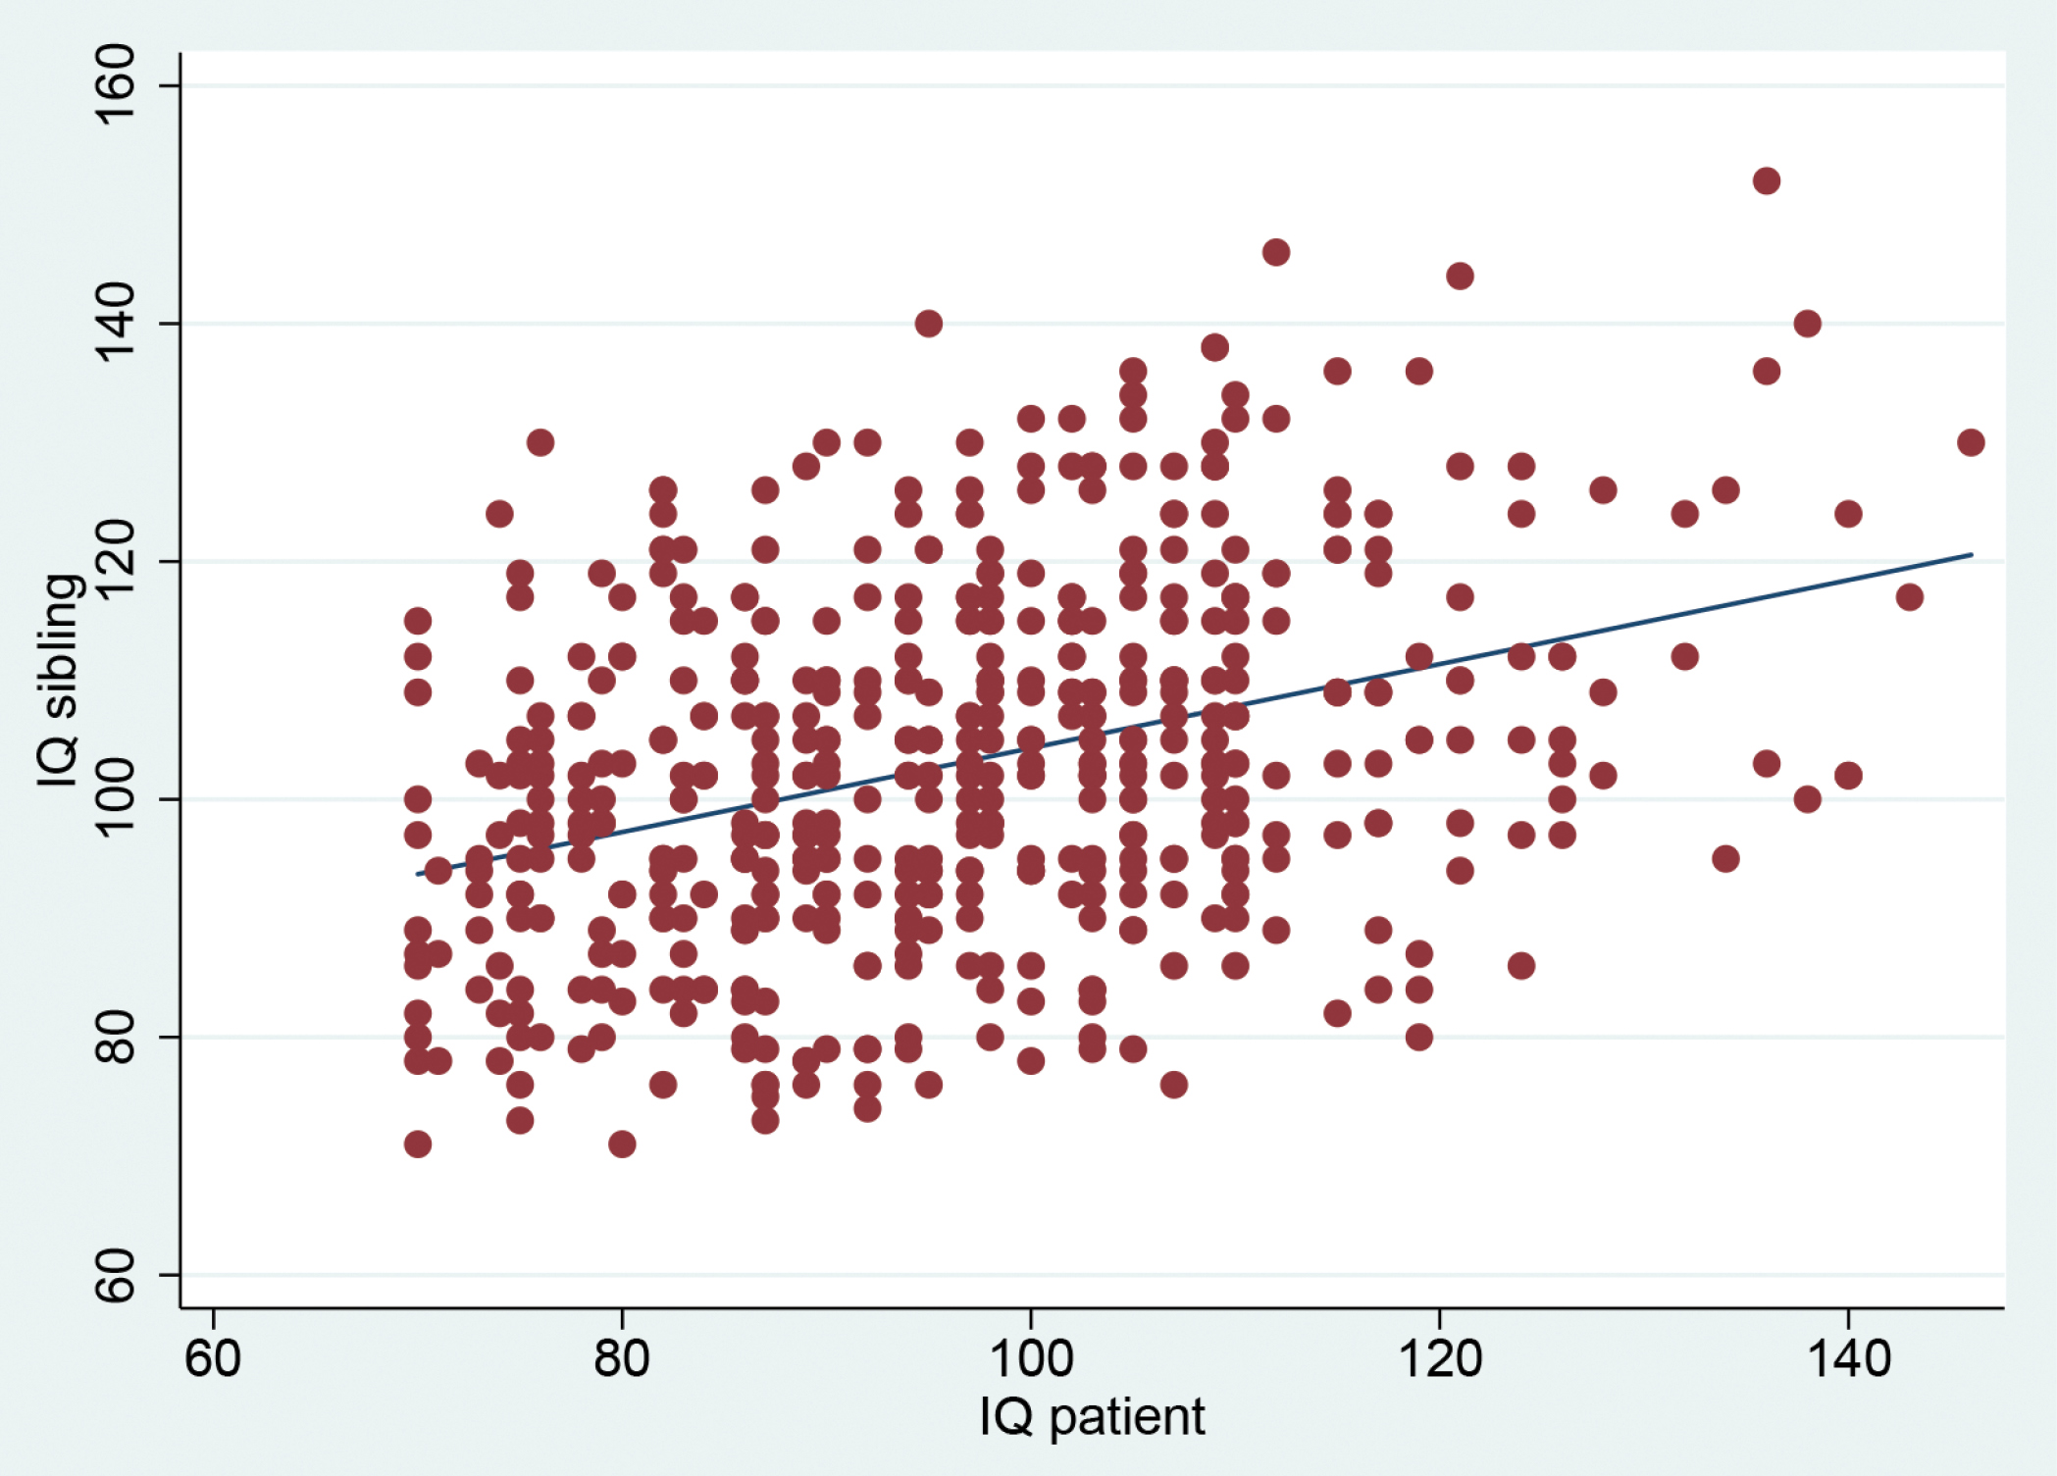
Fig. 2. Correlation between patient and siblings IQ (left panel in rural environment and right panel in urban ...
Notes:
Fig. 2. Correlation between patient and siblings IQ (left panel in rural environment and right panel in urban environment).
Unless provided in the caption above, the following copyright applies to the content of this slide: © The Author 2017. Published by Oxford University Press on behalf of the Maryland Psychiatric Research Center. All rights reserved. For permissions, please email: journals.permissions@oup.com

Slide 5
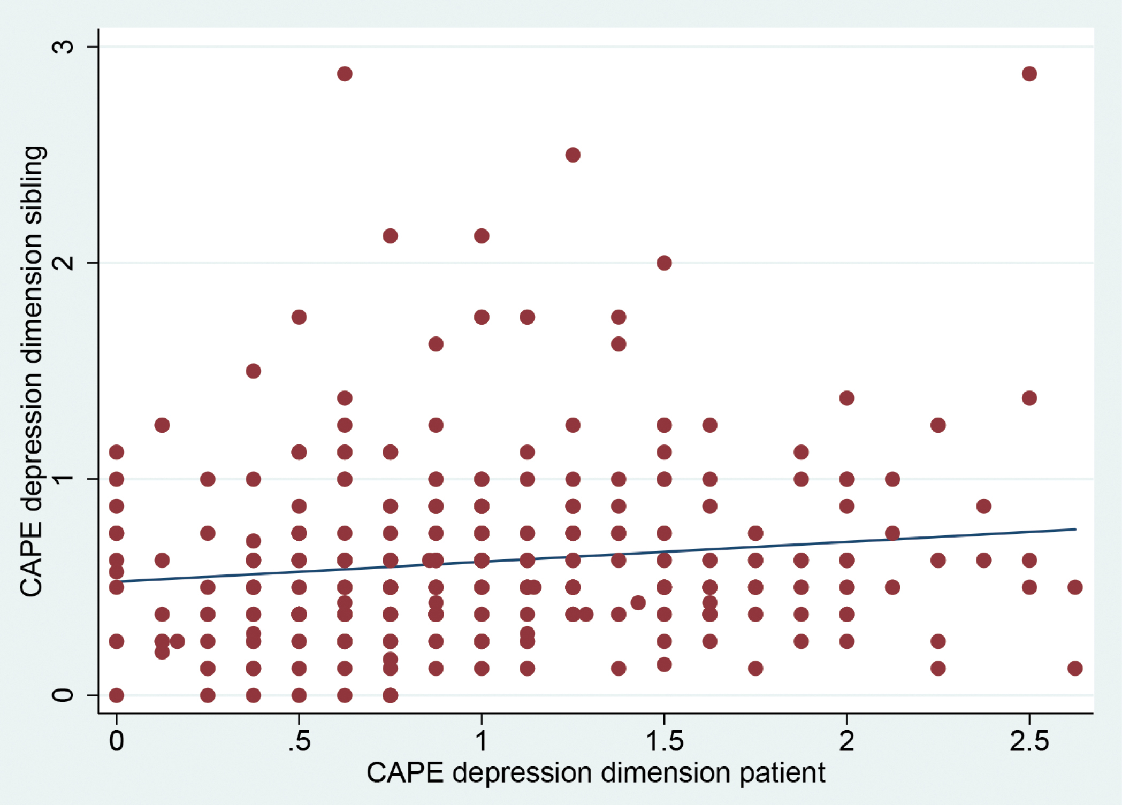
Fig. 3. Correlation between patient and sibling symptoms of depression (left panel in rural environment and right ...
Notes:
Fig. 3. Correlation between patient and sibling symptoms of depression (left panel in rural environment and right panel in urban environment). CAPE, Community Assessment of Psychic Experiences.
Unless provided in the caption above, the following copyright applies to the content of this slide: © The Author 2017. Published by Oxford University Press on behalf of the Maryland Psychiatric Research Center. All rights reserved. For permissions, please email: journals.permissions@oup.com

Slide 6
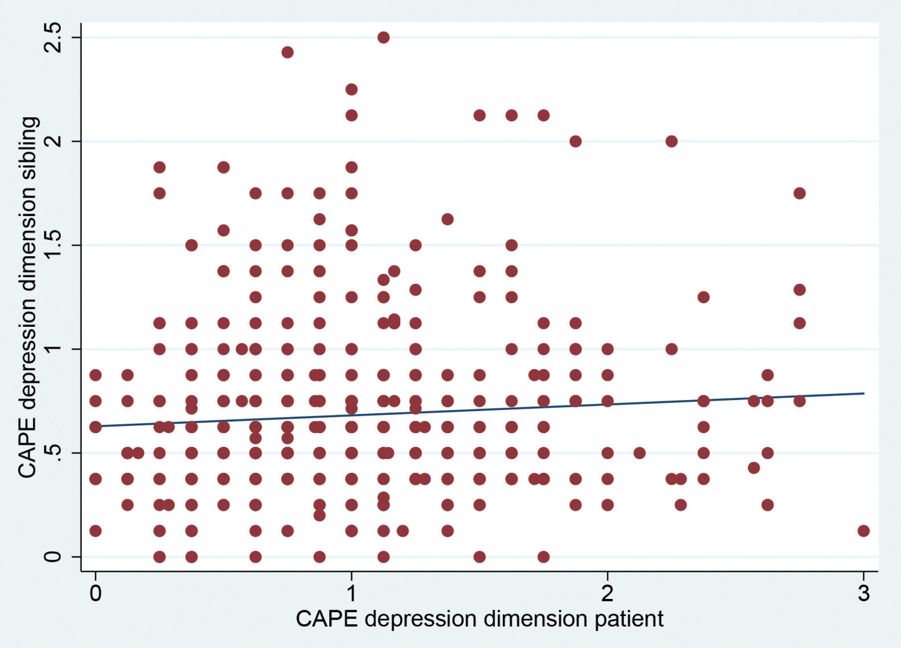
Fig. 3. Correlation between patient and sibling symptoms of depression (left panel in rural environment and right ...
Notes:
Fig. 3. Correlation between patient and sibling symptoms of depression (left panel in rural environment and right panel in urban environment). CAPE, Community Assessment of Psychic Experiences.
Unless provided in the caption above, the following copyright applies to the content of this slide: © The Author 2017. Published by Oxford University Press on behalf of the Maryland Psychiatric Research Center. All rights reserved. For permissions, please email: journals.permissions@oup.com

Slide 7
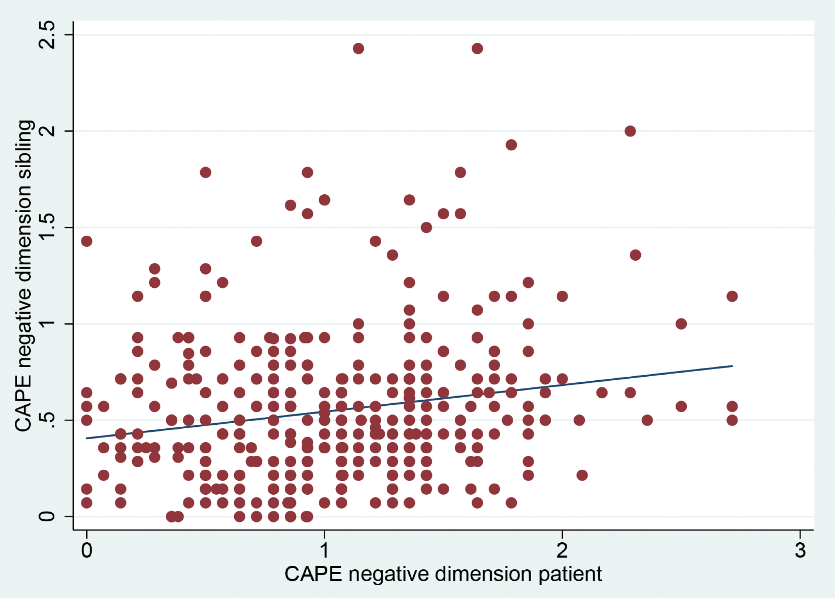
Fig. 4. Correlation between patient and sibling CAPE negative symptoms (left panel in rural environment and right ...
Notes:
Fig. 4. Correlation between patient and sibling CAPE negative symptoms (left panel in rural environment and right panel in urban environment). CAPE, Community Assessment of Psychic Experiences.
Unless provided in the caption above, the following copyright applies to the content of this slide: © The Author 2017. Published by Oxford University Press on behalf of the Maryland Psychiatric Research Center. All rights reserved. For permissions, please email: journals.permissions@oup.com

Slide 8
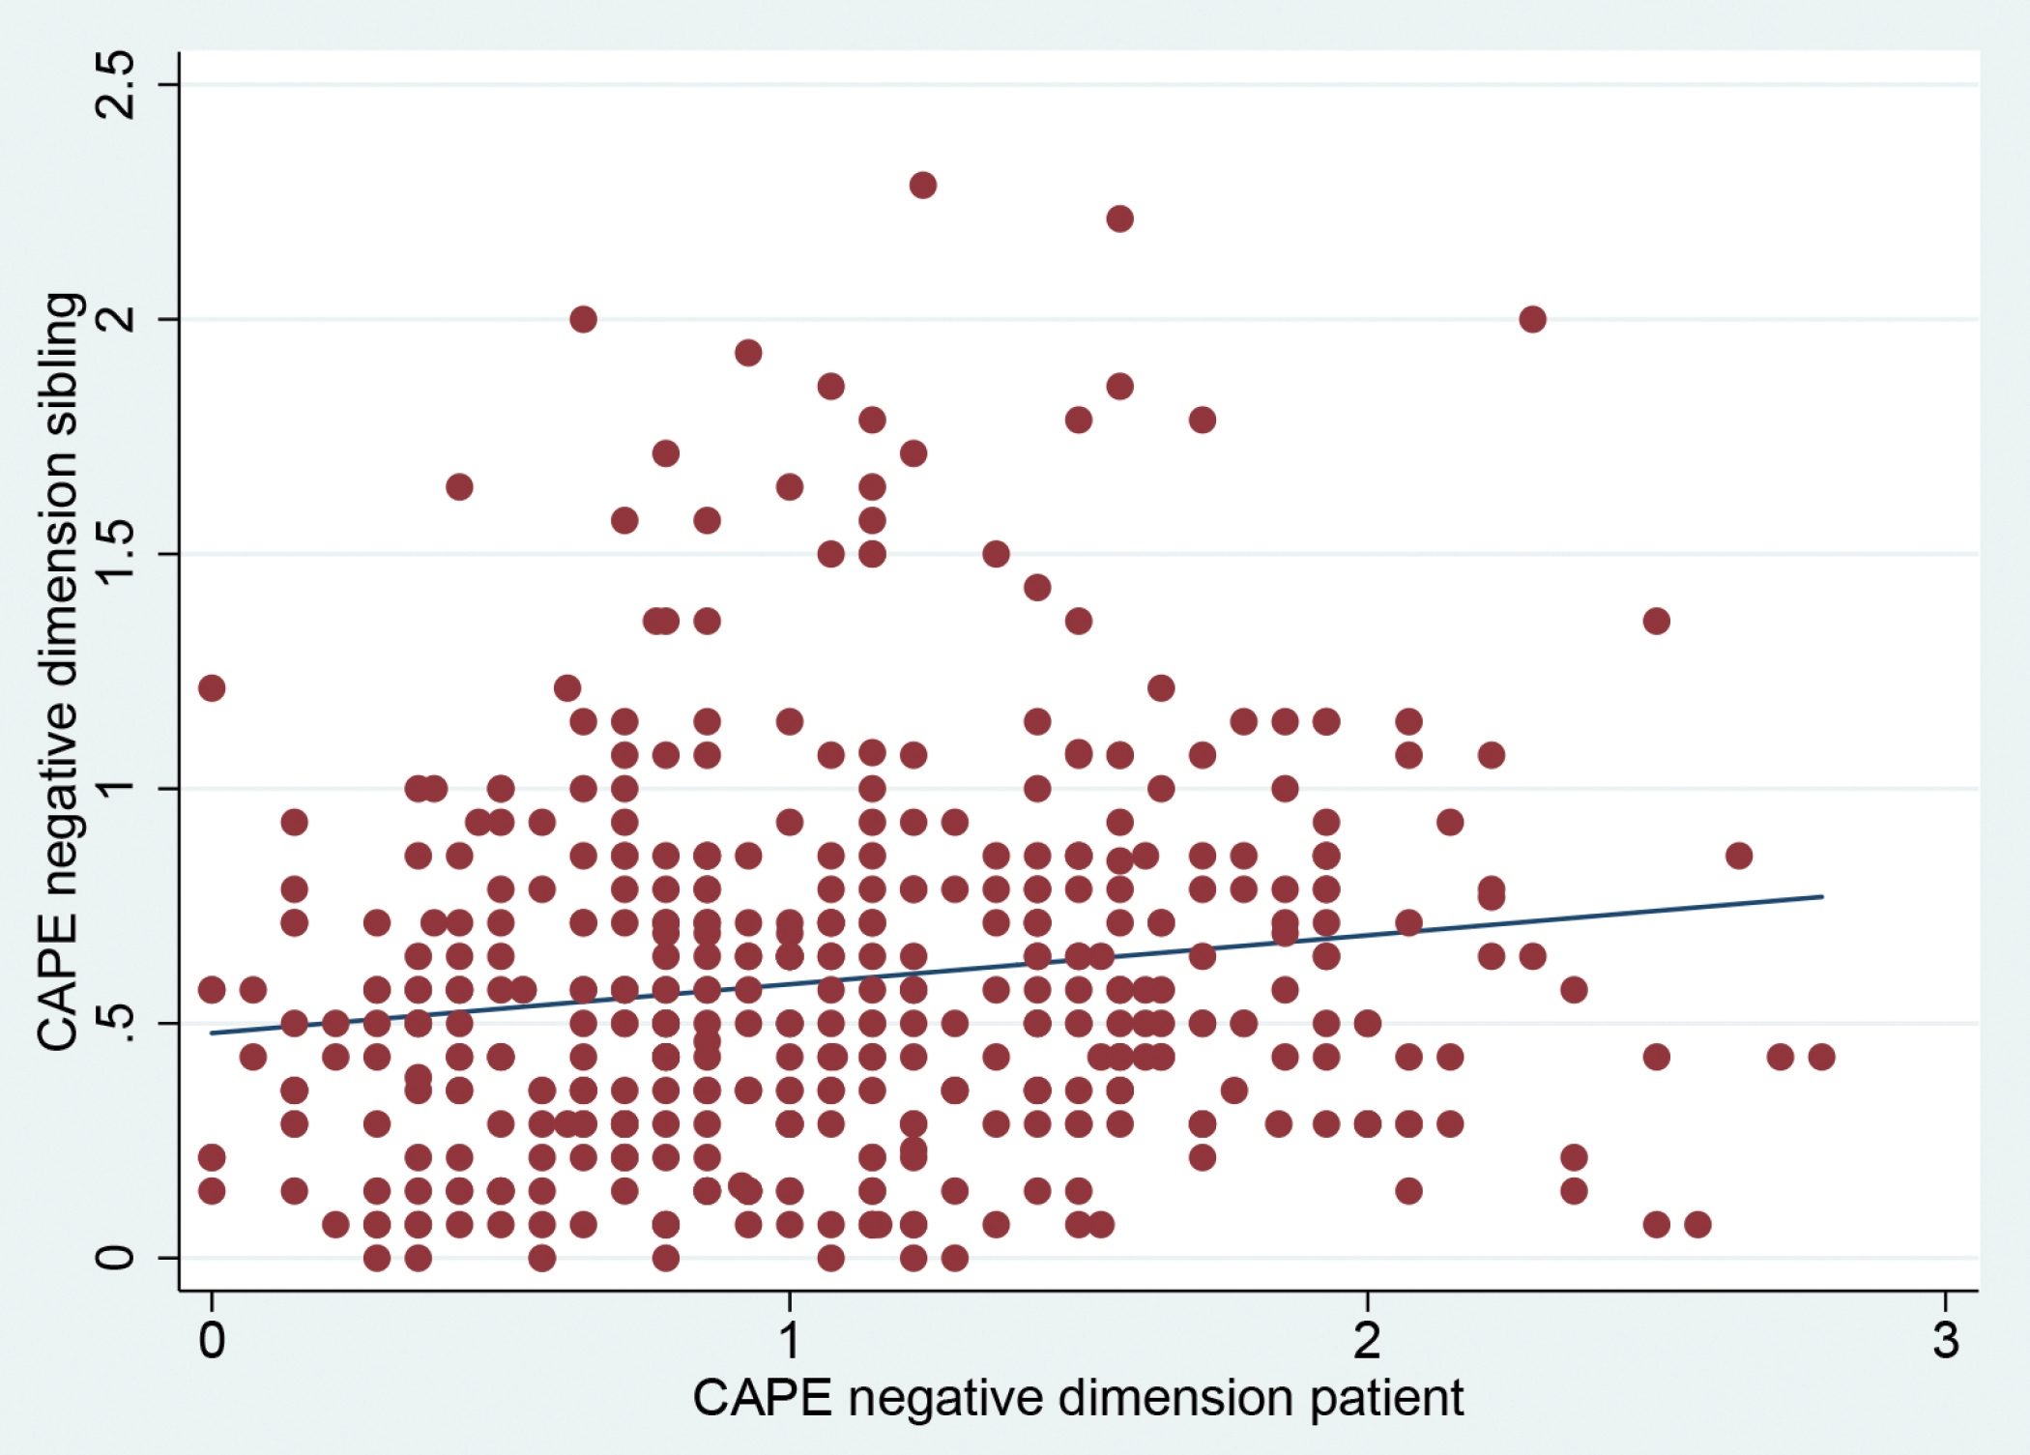
Fig. 4. Correlation between patient and sibling CAPE negative symptoms (left panel in rural environment and right ...
Notes:
Fig. 4. Correlation between patient and sibling CAPE negative symptoms (left panel in rural environment and right panel in urban environment). CAPE, Community Assessment of Psychic Experiences.
Unless provided in the caption above, the following copyright applies to the content of this slide: © The Author 2017. Published by Oxford University Press on behalf of the Maryland Psychiatric Research Center. All rights reserved. For permissions, please email: journals.permissions@oup.com

