Slide 1
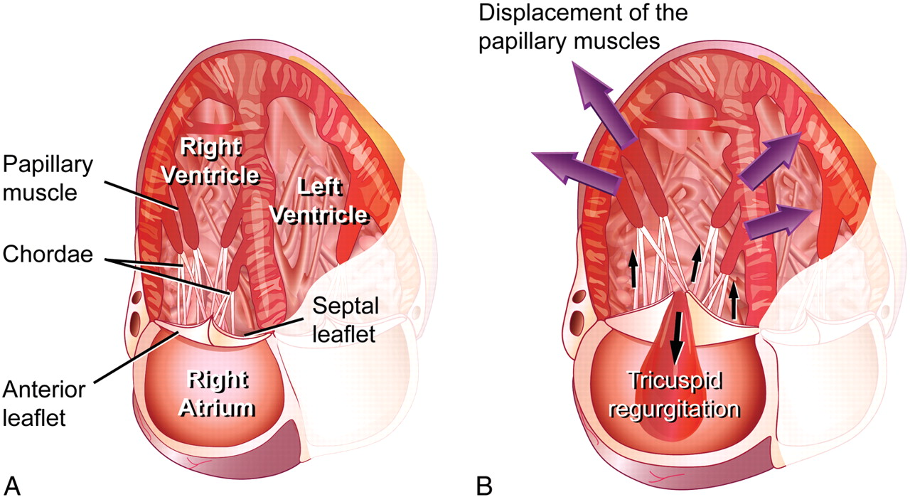
Figure 1 (A) Normal tricuspid valve. (B) Functional tricuspid regurgitation: enlargement of the right ventricle ...
Notes:
Figure 1 (A) Normal tricuspid valve. (B) Functional tricuspid regurgitation: enlargement of the right ventricle results in displacement of the papillary muscles and tethering of the tricuspid leaflets. In addition there is dilatation of the tricuspid annulus.
Unless provided in the caption above, the following copyright applies to the content of this slide: Published on behalf of the European Society of Cardiology. All rights reserved. © The Author 2010. For permissions please email: journals.permissions@oxfordjournals.org

