Slide 1
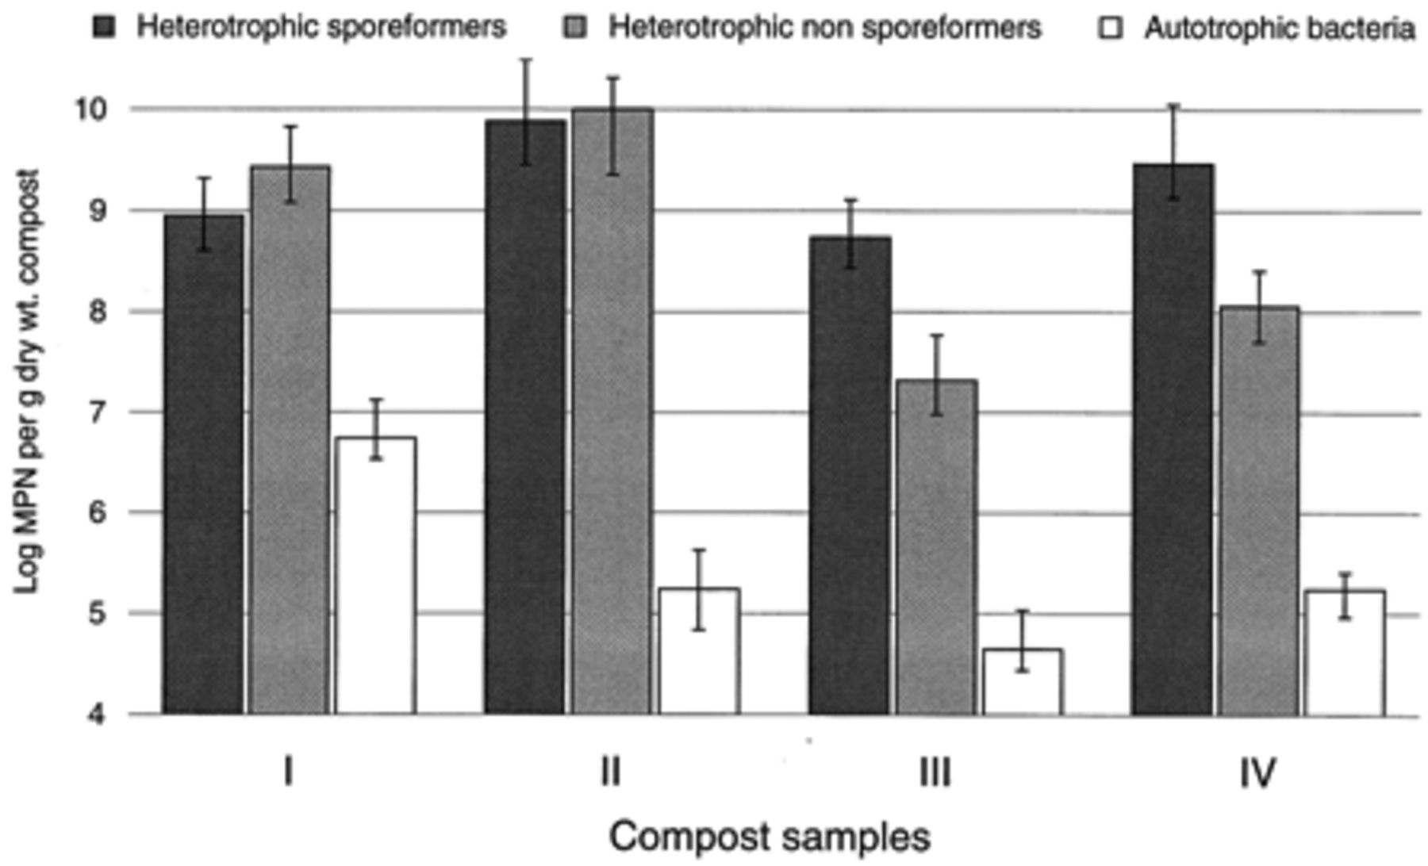
1 Most probable numbers (MPN, single values) of three thermophilic bacterial populations in four hot compost ...
Notes:
1 Most probable numbers (MPN, single values) of three thermophilic bacterial populations in four hot compost samples. The sample features are listed in Table 1. Error bars are confidence intervals (0.05) with 10 000 bootstraps [22].
Unless provided in the caption above, the following copyright applies to the content of this slide: © 1999 Federation of European Microbiological Societies. Published by Elsevier Science B.V. All rights reserved.

Slide 2
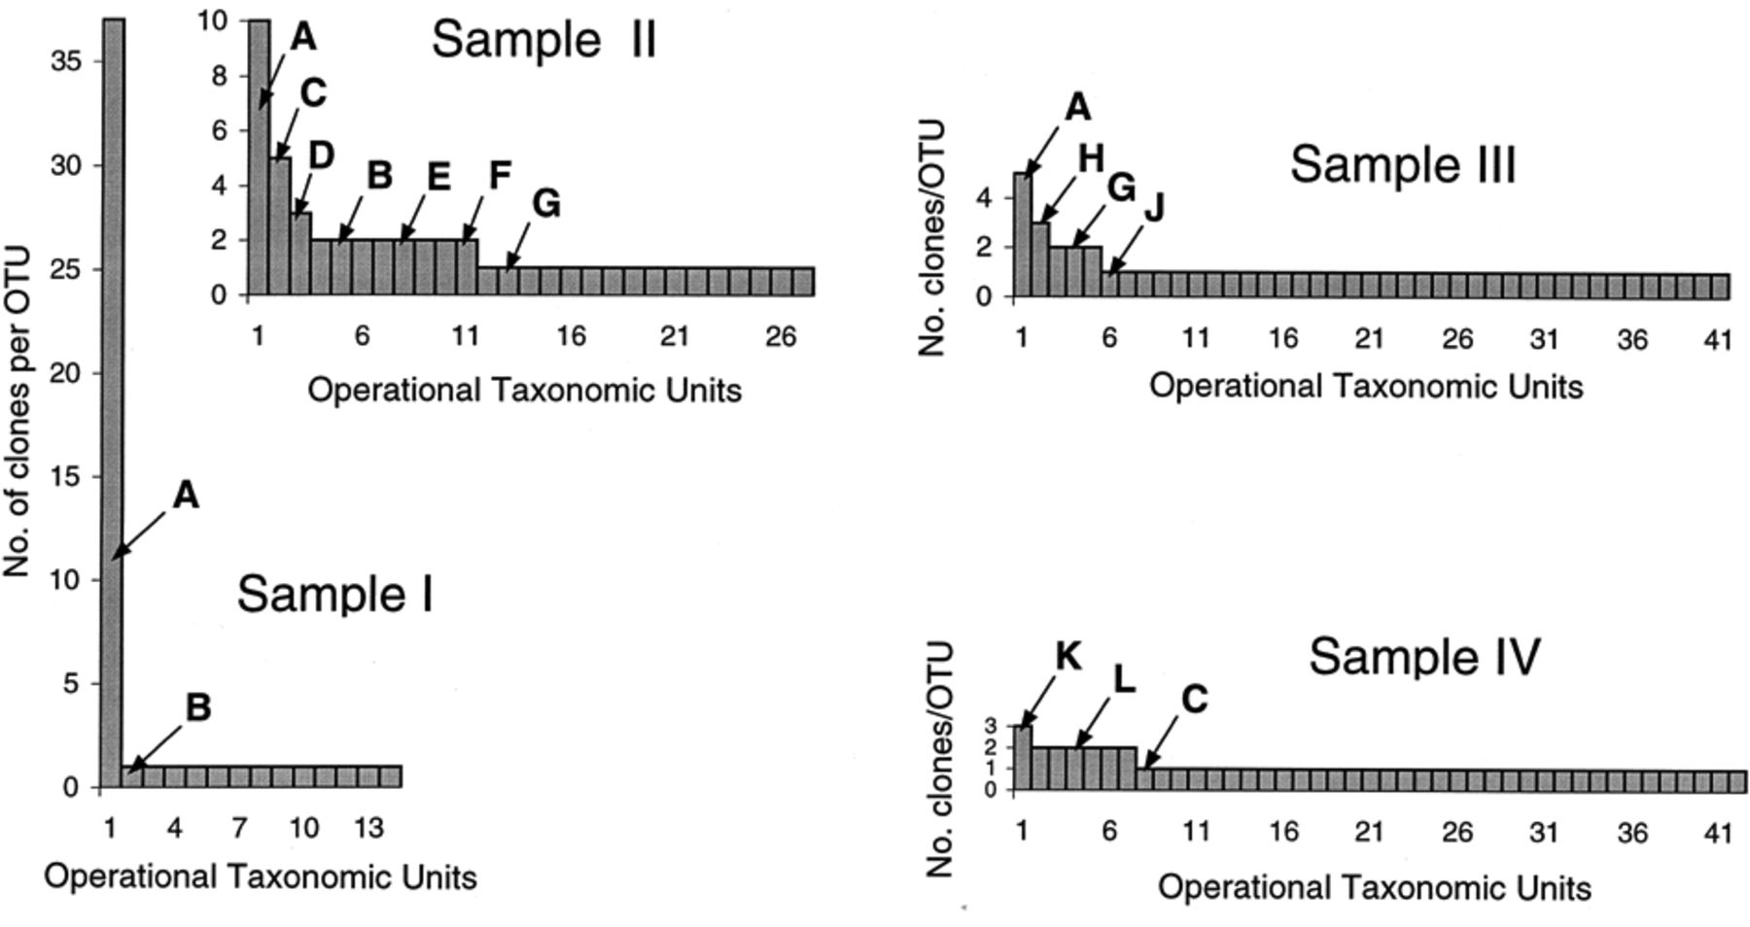
2 Distribution among operational taxonomic units (OTUs) of bacterial 16S rDNA clones from four hot compost ...
Notes:
2 Distribution among operational taxonomic units (OTUs) of bacterial 16S rDNA clones from four hot compost samples. Letters identify OTUs referred to in the text.
Unless provided in the caption above, the following copyright applies to the content of this slide: © 1999 Federation of European Microbiological Societies. Published by Elsevier Science B.V. All rights reserved.

