Slide 1
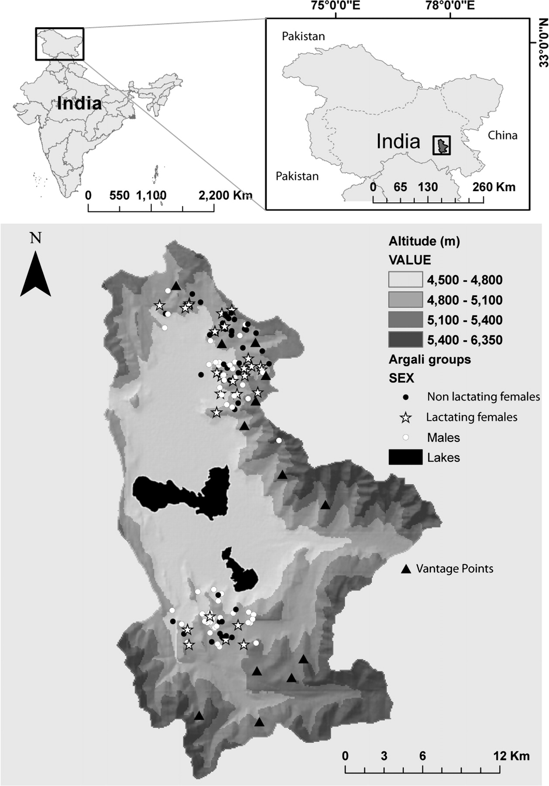
Figure 1 Study area showing the spatial distribution of male, lactating female, and nonlactating female groups of ...
Notes:
Figure 1 Study area showing the spatial distribution of male, lactating female, and nonlactating female groups of argali. Black solid circles are females, empty white circles are males, stars indicate females with lambs, and triangles represent the vantage points.
Unless provided in the caption above, the following copyright applies to the content of this slide: © The Author 2010. Published by Oxford University Press on behalf of the International Society for Behavioral Ecology. All rights reserved. For permissions, please e-mail: journals.permissions@oxfordjournals.org

Slide 2
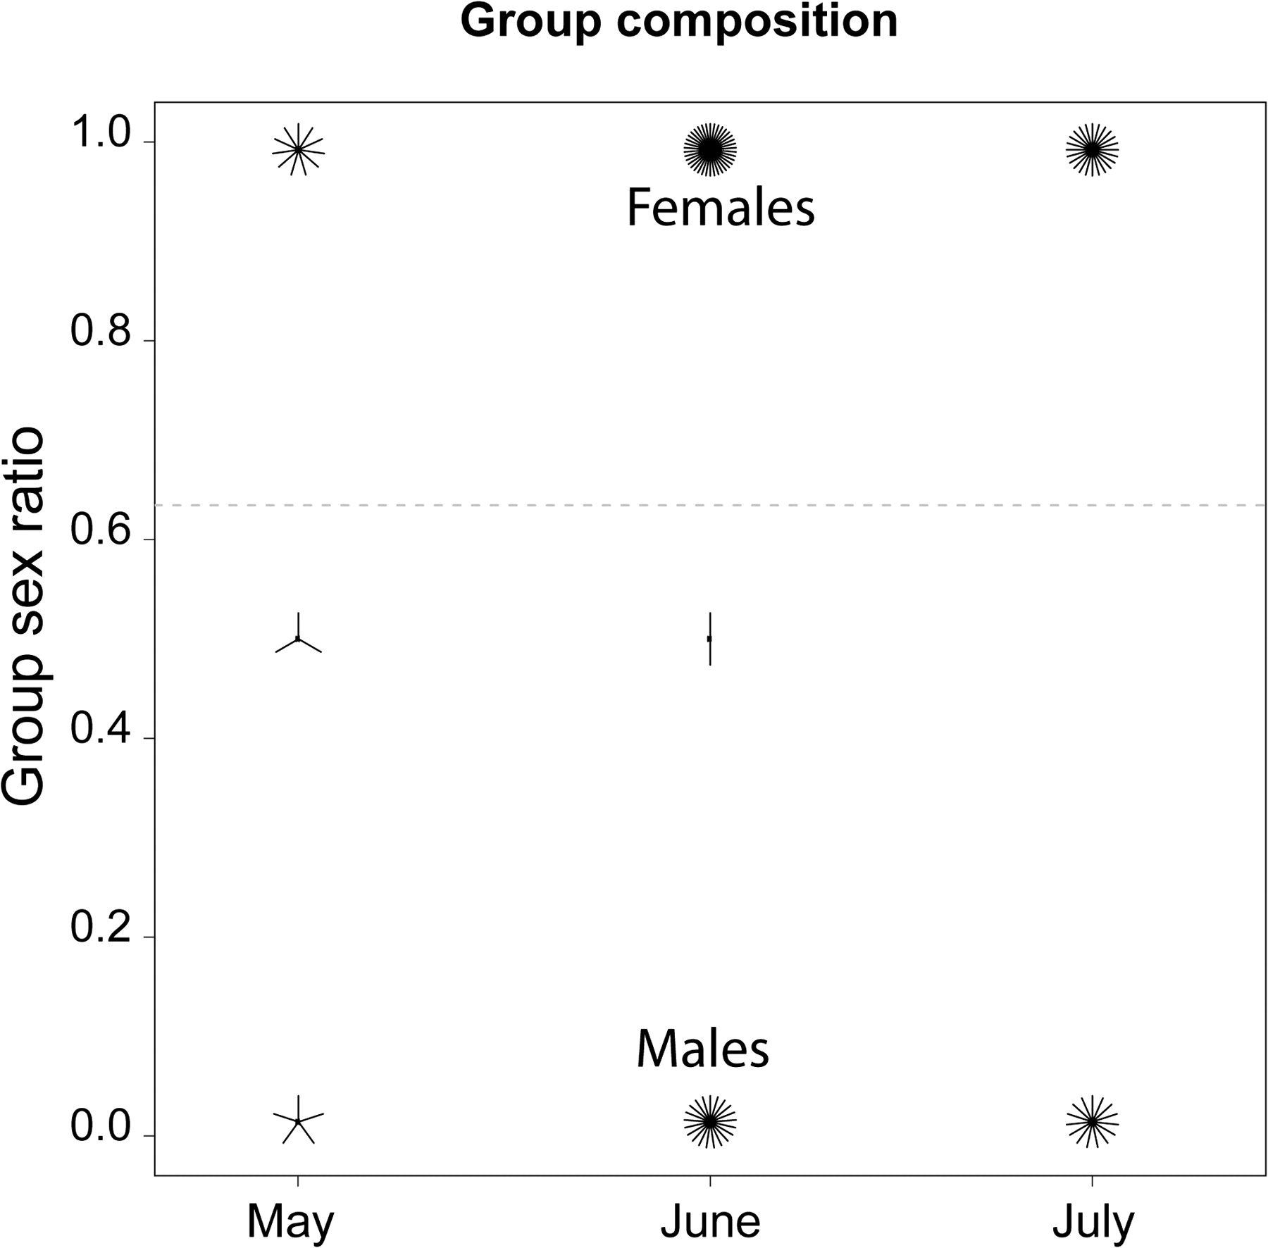
Figure 2 Observed sex ratio of argali groups plotted as the proportion of males in the group, according to the month ...
Notes:
Figure 2 Observed sex ratio of argali groups plotted as the proportion of males in the group, according to the month of observation. The number of spikes represents the number of groups observed: a black dot means that 1 group was recorded and following multiple points are plotted as petals of “sunflowers.” The gray dashed line is the average sex ratio observed in groups of argali. The Y-axis denotes the sex ratio as the proportion of males in a given group. Values of 1.0 represent female-only groups and values of 0.0 males.
Unless provided in the caption above, the following copyright applies to the content of this slide: © The Author 2010. Published by Oxford University Press on behalf of the International Society for Behavioral Ecology. All rights reserved. For permissions, please e-mail: journals.permissions@oxfordjournals.org

Slide 3
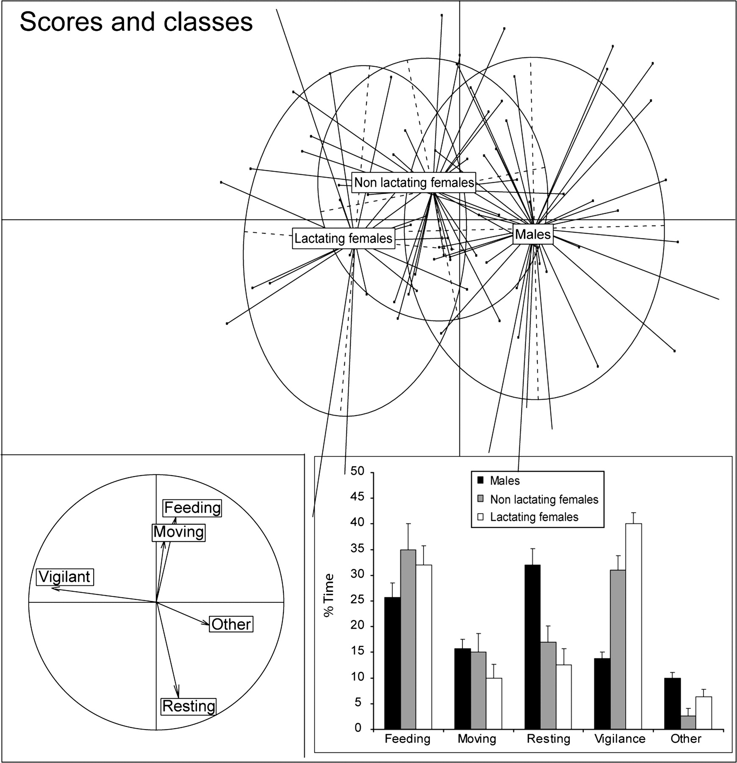
Figure 3 Discriminant analysis of activity budgets of male, lactating, and nonlactating female groups of argali. Group ...
Notes:
Figure 3 Discriminant analysis of activity budgets of male, lactating, and nonlactating female groups of argali. Group is a categorical variable, and each dot represents a single group (total: males = 37, nonlactating females = 25, and lactating females = 20). The first factor axis is represented by “Vigilance” (factor loading: −0.864, eigenvalue: 0.453) and the second axis by “Resting” (factor loading: −0.552, eigenvalue: 0.035). The top panel shows the segregation and distribution of individual groups (represented by each point connected by a line to the center of the group ellipse). Histograms represent percent time spent in each behavioral category (means ± standard error [SE]).
Unless provided in the caption above, the following copyright applies to the content of this slide: © The Author 2010. Published by Oxford University Press on behalf of the International Society for Behavioral Ecology. All rights reserved. For permissions, please e-mail: journals.permissions@oxfordjournals.org

