Slide 1
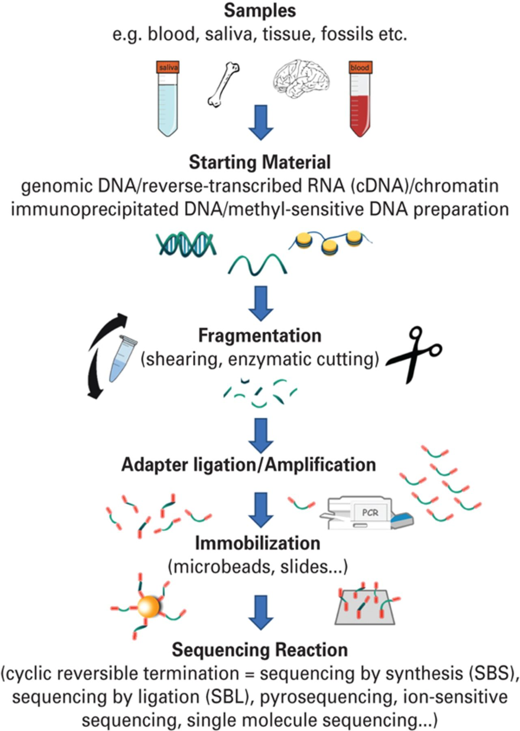
Fig. 1 Schematic workflow of deep sequencing. RNA or genomic DNA is extracted from various sources including blood, ...
Notes:
Fig. 1 Schematic workflow of deep sequencing. RNA or genomic DNA is extracted from various sources including blood, saliva, tissue and forensic specimens. DNA or RNA reverse-transcribed to complementary DNA (cDNA) is physically fragmented at random locations or enzymatically cut at specific sites. Small synthetic DNAs are added to the ends of the fragments (‘adapter ligation’), which are subsequently clonally amplified by polymerase chain reaction (PCR), if not sequenced directly by single-molecule sequencing. Individual DNA fragments are spatially separated, including by use of oil–water emulsions, and in several procedures the fragments are immobilized by attachment to microbeads or slides. Finally, the fragments are sequenced in massively parallel fashion.
Unless provided in the caption above, the following copyright applies to the content of this slide: © CINP 2014

