Slide 1
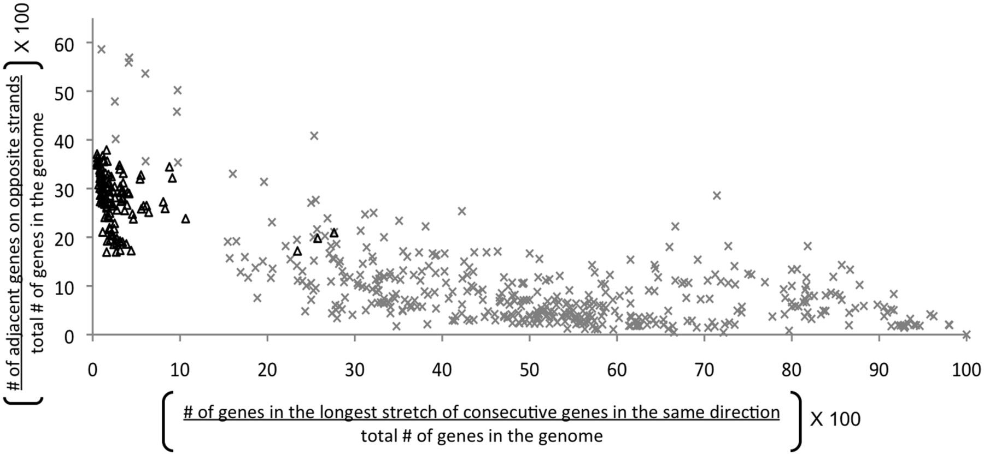
Figure 1. Orientation of proteins in 110 bacterial genomes (triangles) and 600 phages (x). Most of the phages have a ...
Notes:
Figure 1. Orientation of proteins in 110 bacterial genomes (triangles) and 600 phages (x). Most of the phages have a large group of proteins facing in same direction and fewer proteins change their transcriptional directions. Bacteria, in contrast, cluster fewer proteins in the same direction and have high number of transcriptional direction changes.
Unless provided in the caption above, the following copyright applies to the content of this slide: © The Author(s) 2012. Published by Oxford University Press.This is an Open Access article distributed under the terms of the Creative Commons Attribution Non-Commercial License (http://creativecommons.org/licenses/by-nc/3.0), which permits unrestricted non-commercial use, distribution, and reproduction in any medium, provided the original work is properly cited.

Slide 2
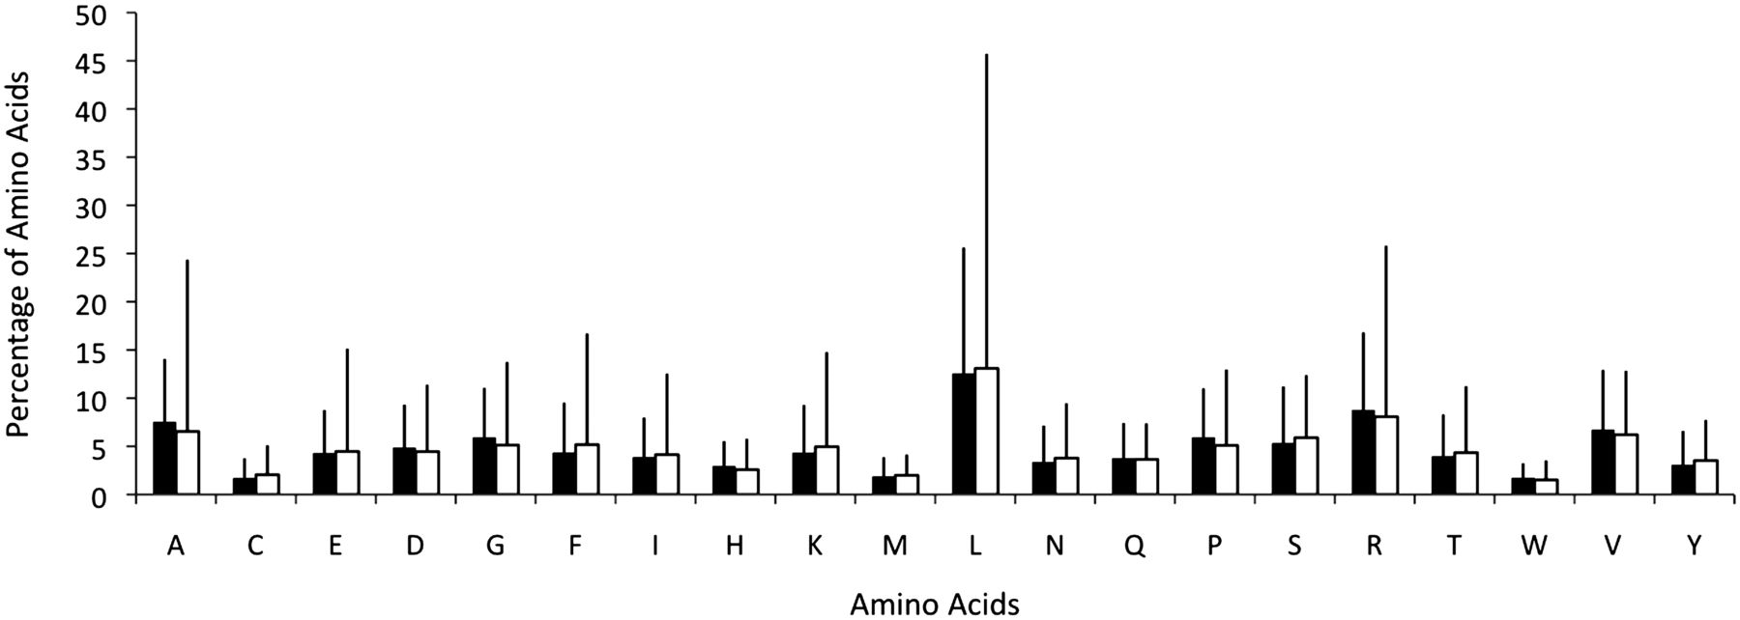
Figure 2. Amino acid distribution in the predicted proteins encoded in 41 bacterial genomes (filled square) and their ...
Notes:
Figure 2. Amino acid distribution in the predicted proteins encoded in 41 bacterial genomes (filled square) and their 190 prophages (open square). The amino acid utilization is similar for both but the standard deviation (vertical bars) is higher for prophages than for bacteria.
Unless provided in the caption above, the following copyright applies to the content of this slide: © The Author(s) 2012. Published by Oxford University Press.This is an Open Access article distributed under the terms of the Creative Commons Attribution Non-Commercial License (http://creativecommons.org/licenses/by-nc/3.0), which permits unrestricted non-commercial use, distribution, and reproduction in any medium, provided the original work is properly cited.

Slide 3
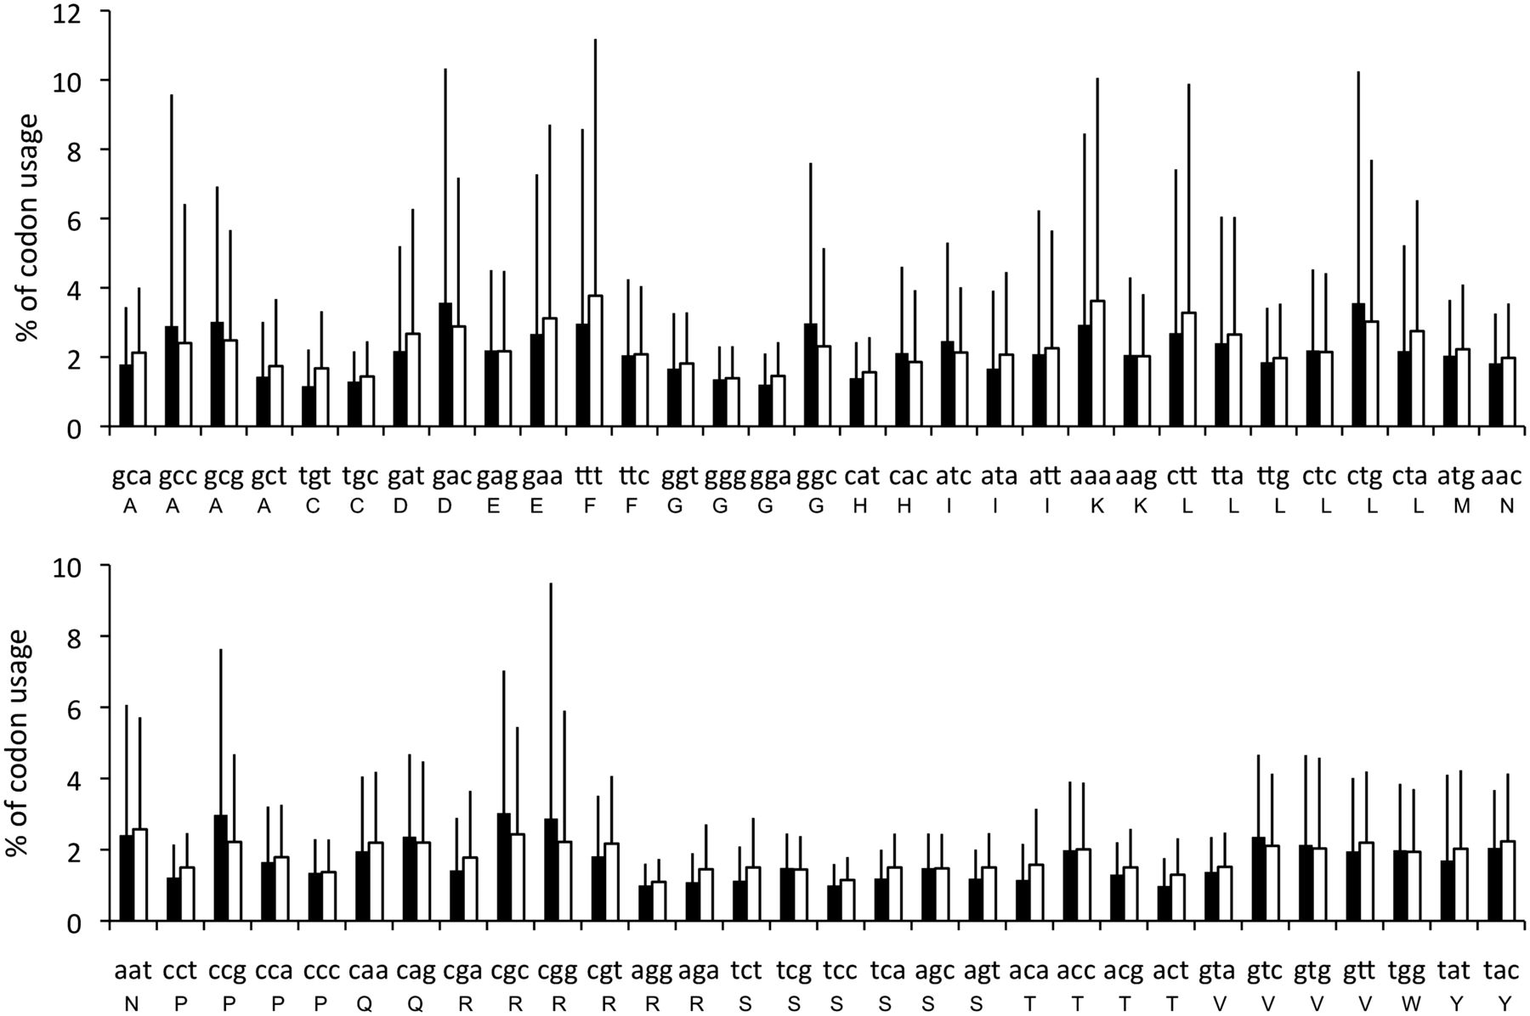
Figure 3. Frequency of codon usage in 41 bacterial genomes (filled square) with 190 prophages (open square). For some ...
Notes:
Figure 3. Frequency of codon usage in 41 bacterial genomes (filled square) with 190 prophages (open square). For some amino acids (notably, Asp, Glu, Phe, Gly, Lys, Pro, Arg), codon usage differs between prophages and their hosts’ genomes.
Unless provided in the caption above, the following copyright applies to the content of this slide: © The Author(s) 2012. Published by Oxford University Press.This is an Open Access article distributed under the terms of the Creative Commons Attribution Non-Commercial License (http://creativecommons.org/licenses/by-nc/3.0), which permits unrestricted non-commercial use, distribution, and reproduction in any medium, provided the original work is properly cited.

Slide 4
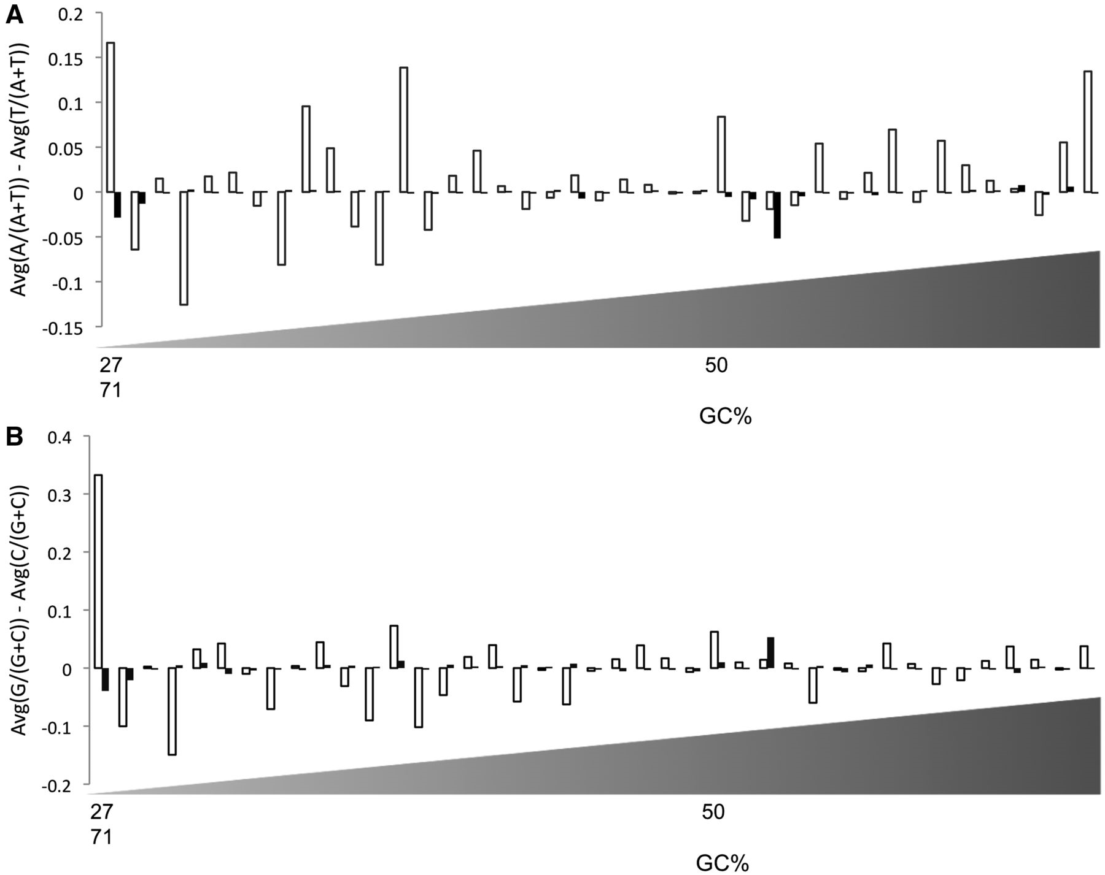
Figure 4. (A) Customized AT skew for 41 complete bacterial genomes (filled square) and their prophages (open square). ...
Notes:
Figure 4. (A) Customized AT skew for 41 complete bacterial genomes (filled square) and their prophages (open square). The x-axis is sorted (ascending order) based on the genomes’ GC content as shown below the figure. (B) Customized GC skew for 41 complete bacterial genomes (filled square) and their prophages (open square). The x-axis is sorted (ascending order) based on the genomes’ GC content.
Unless provided in the caption above, the following copyright applies to the content of this slide: © The Author(s) 2012. Published by Oxford University Press.This is an Open Access article distributed under the terms of the Creative Commons Attribution Non-Commercial License (http://creativecommons.org/licenses/by-nc/3.0), which permits unrestricted non-commercial use, distribution, and reproduction in any medium, provided the original work is properly cited.

Slide 5
Figure 5. Average length of bacterial proteins (filled square) and phage proteins (open square) for 41 bacterial ...
Notes:
Figure 5. Average length of bacterial proteins (filled square) and phage proteins (open square) for 41 bacterial genomes and their prophages. Phage proteins are smaller than bacterial proteins. The x-axis is not sorted.
Unless provided in the caption above, the following copyright applies to the content of this slide: © The Author(s) 2012. Published by Oxford University Press.This is an Open Access article distributed under the terms of the Creative Commons Attribution Non-Commercial License (http://creativecommons.org/licenses/by-nc/3.0), which permits unrestricted non-commercial use, distribution, and reproduction in any medium, provided the original work is properly cited.

Slide 6
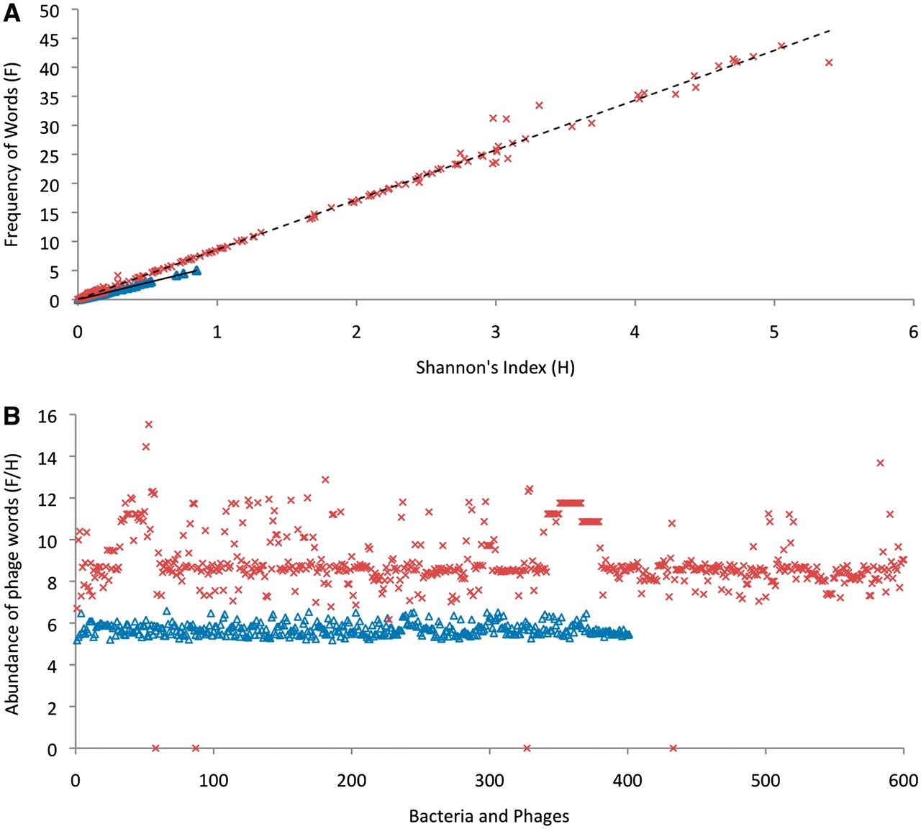
Figure 6. Comparison of the abundance of phage words in bacteria (triangles) and phage genomes (x). (A) The Shannon’s ...
Notes:
Figure 6. Comparison of the abundance of phage words in bacteria (triangles) and phage genomes (x). (A) The Shannon’s index (H) versus the frequency (F) of the presence of phage words for 600 complete phage genomes and 400 randomly chosen complete bacterial genomes. Both H and F are very small for bacterial genomes compared to phage genomes. The relationship between H and F for phages is F = 8.57 H + 0.047 with a regression coefficient R2 = 0.995 and for bacterial genome the relation is F = 5.85 H + 0.014 with a regression coefficient R2 = 0.993. (B) The ratio of the frequency and Shannon’s index, i.e. F/H for 600 complete phage genomes and 400 randomly chosen complete bacterial genomes. There is a statistically significant difference in F/H (abundance of phage words) between phages and bacteria.
Unless provided in the caption above, the following copyright applies to the content of this slide: © The Author(s) 2012. Published by Oxford University Press.This is an Open Access article distributed under the terms of the Creative Commons Attribution Non-Commercial License (http://creativecommons.org/licenses/by-nc/3.0), which permits unrestricted non-commercial use, distribution, and reproduction in any medium, provided the original work is properly cited.

Slide 7
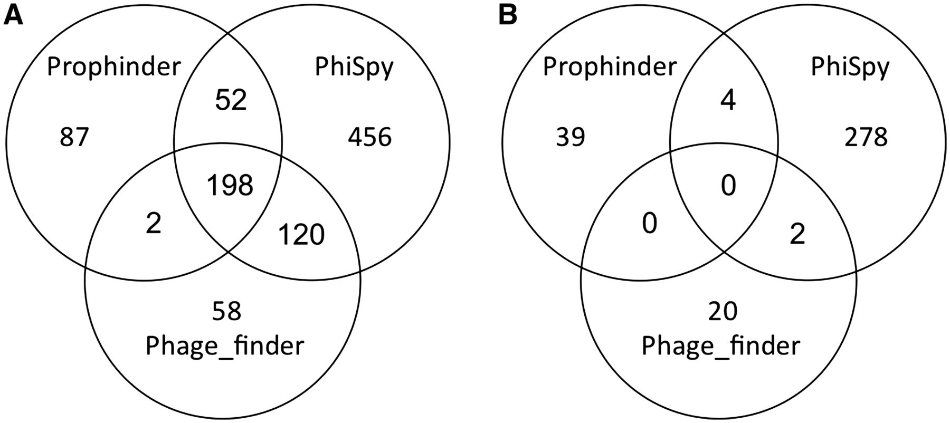
Figure 7. (A) Comparative analysis of all prophages identified in 412 complete bacterial genomes by phiSpy, ...
Notes:
Figure 7. (A) Comparative analysis of all prophages identified in 412 complete bacterial genomes by phiSpy, phage_finder and prophinder. (B) Comparative analysis of undefined prophages (no phage-like proteins) identified from 412 complete bacterial genomes.
Unless provided in the caption above, the following copyright applies to the content of this slide: © The Author(s) 2012. Published by Oxford University Press.This is an Open Access article distributed under the terms of the Creative Commons Attribution Non-Commercial License (http://creativecommons.org/licenses/by-nc/3.0), which permits unrestricted non-commercial use, distribution, and reproduction in any medium, provided the original work is properly cited.

