Slide 1
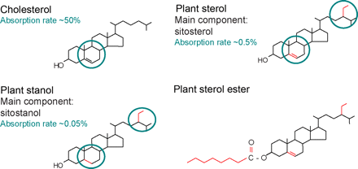
Figure 1 Chemical structure of cholesterol, sitosterol (plant sterol), and sitostanol (plant stanol). Both plant ...
Notes:
Figure 1 Chemical structure of cholesterol, sitosterol (plant sterol), and sitostanol (plant stanol). Both plant sterols and plant stanols differ from cholesterol only in the side chain attached to the sterol ring. Plant stanols are saturated plant sterols without a double bond in the sterol ring. Due to their saturation status, plant stanols are less effectively absorbed. Esterified plant sterols and plant stanols are supplemented in ‘nutraceuticals’ to reduce serum cholesterol levels (modified from ref. 14).
Unless provided in the caption above, the following copyright applies to the content of this slide: Published on behalf of the European Society of Cardiology. All rights reserved. © The Author 2009. For permissions please email: journals.permissions@oxfordjournals.orgThe online version of this article has been published under an open access model. Users are entitled to use, reproduce, disseminate, or display the open access version of this article for non-commercial purposes provided that the original authorship is properly and fully attributed; the Journal, Learned Society and Oxford University Press are attributed as the original place of publication with correct citation details given; if an article is subsequently reproduced or disseminated not in its entirety but only in part or as a derivative work this must be clearly indicated. For commercial re-use, please contact journals.permissions@oxfordjournals.org

Slide 2
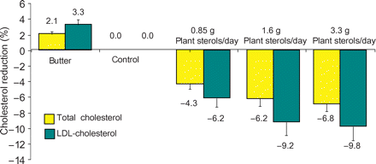
Figure 2 Plant sterols reduce serum cholesterol levels. Total cholesterol and LDL-cholesterol dependent on diet ...
Notes:
Figure 2 Plant sterols reduce serum cholesterol levels. Total cholesterol and LDL-cholesterol dependent on diet (modified from ref. 23).
Unless provided in the caption above, the following copyright applies to the content of this slide: Published on behalf of the European Society of Cardiology. All rights reserved. © The Author 2009. For permissions please email: journals.permissions@oxfordjournals.orgThe online version of this article has been published under an open access model. Users are entitled to use, reproduce, disseminate, or display the open access version of this article for non-commercial purposes provided that the original authorship is properly and fully attributed; the Journal, Learned Society and Oxford University Press are attributed as the original place of publication with correct citation details given; if an article is subsequently reproduced or disseminated not in its entirety but only in part or as a derivative work this must be clearly indicated. For commercial re-use, please contact journals.permissions@oxfordjournals.org

Slide 3
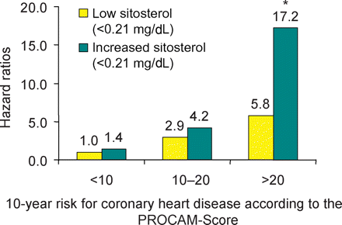
Figure 3 Plant sterols increase cardiac risk. PROCAM-score for the 10 year risk to develop coronary heart disease (n = ...
Notes:
Figure 3 Plant sterols increase cardiac risk. PROCAM-score for the 10 year risk to develop coronary heart disease (n = 477) according to subgroups with increasing risk (PROCAM-score 20). Slightly elevated sitosterol levels are associated with increased cardiac risk. *P < 0.05 low sitosterol (0.21 mg/dL) (modified from ref. 39).
Unless provided in the caption above, the following copyright applies to the content of this slide: Published on behalf of the European Society of Cardiology. All rights reserved. © The Author 2009. For permissions please email: journals.permissions@oxfordjournals.orgThe online version of this article has been published under an open access model. Users are entitled to use, reproduce, disseminate, or display the open access version of this article for non-commercial purposes provided that the original authorship is properly and fully attributed; the Journal, Learned Society and Oxford University Press are attributed as the original place of publication with correct citation details given; if an article is subsequently reproduced or disseminated not in its entirety but only in part or as a derivative work this must be clearly indicated. For commercial re-use, please contact journals.permissions@oxfordjournals.org

