Slide 1
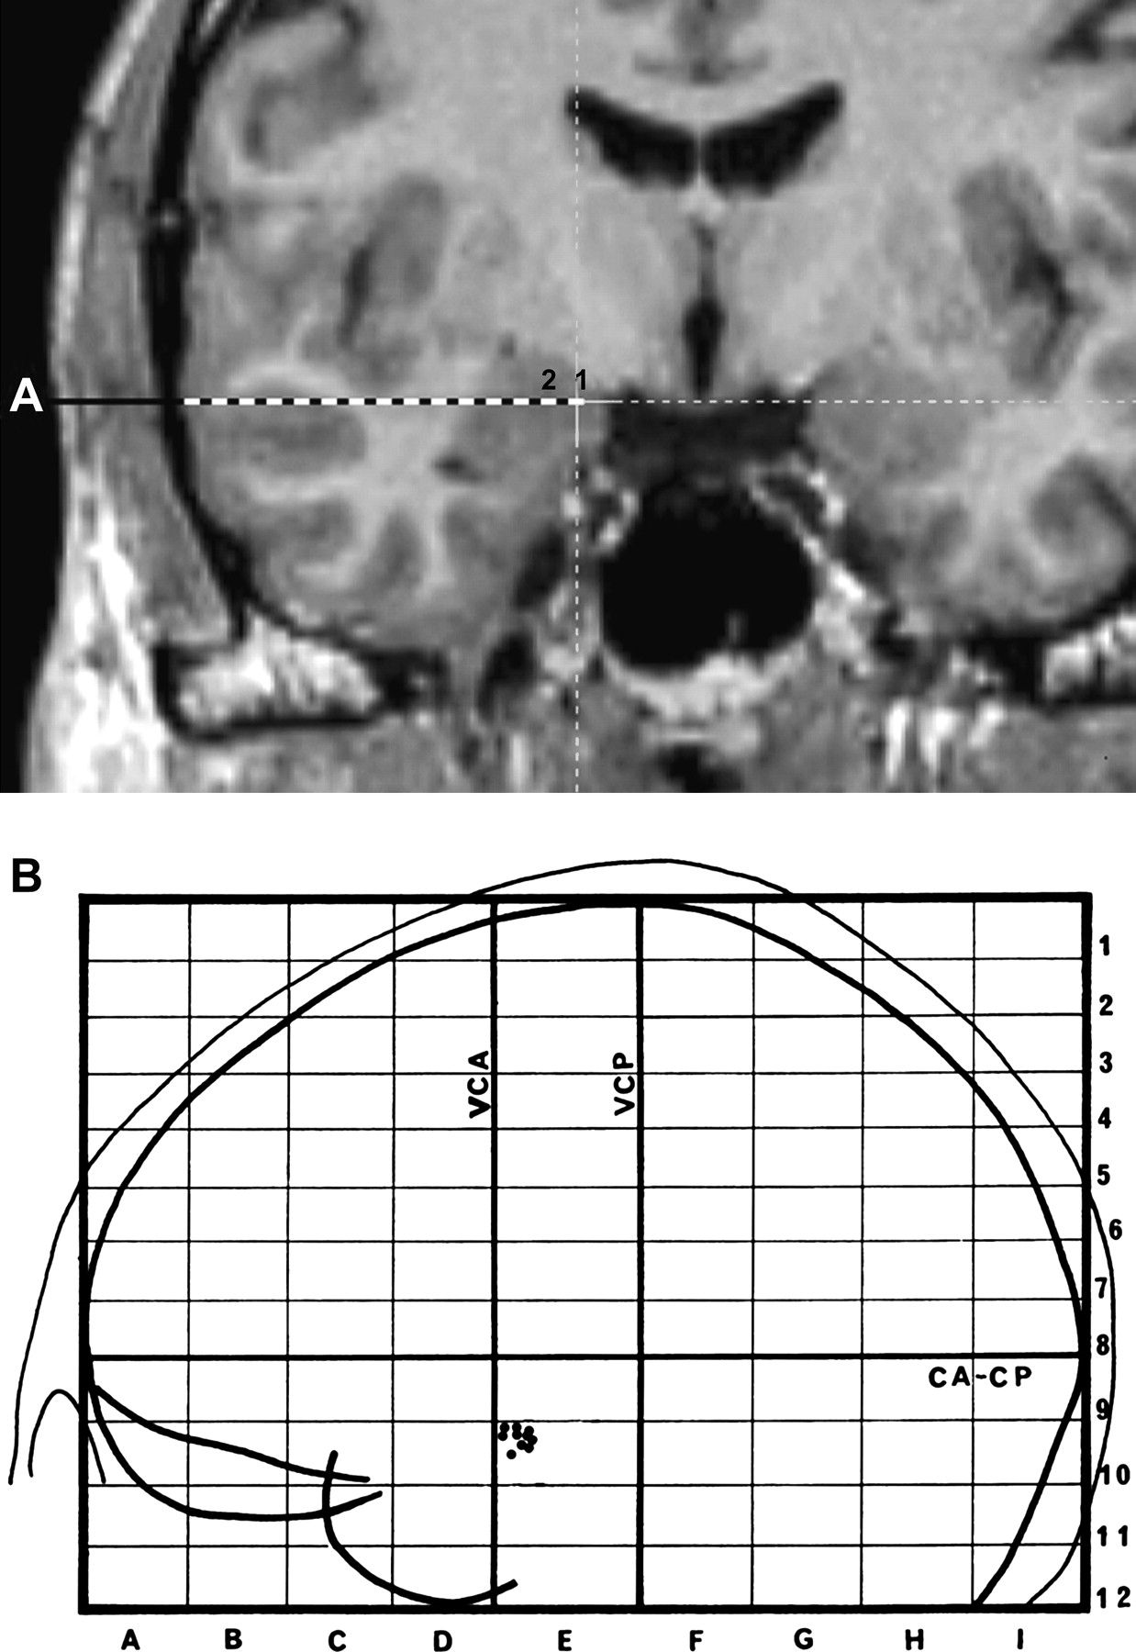
Figure 1. (a) Reconstruction of the amygdala electrode route in the MRI (patient TF). The stimulations were applied in ...
Notes:
Figure 1. (a) Reconstruction of the amygdala electrode route in the MRI (patient TF). The stimulations were applied in the 2 most internal contacts (within the amygdalae) of the electrode (labeled 1 and 2). (b) Representation of the placement of the electrodes from the 8 patients exploring the amygdala. Right and left electrode positions are projected on a lateral view of the left hemisphere normalized in the proportional stereotactic grid system of Talairach and Tournoux. CA–CP, anterior commissure–posterior commissure plane; VCA, vertical plane through CA; VCP, vertical plane through CP.
Unless provided in the caption above, the following copyright applies to the content of this slide: © The Author 2006. Published by Oxford University Press. All rights reserved. For permissions, please e-mail: journals.permissions@oxfordjournals.org

Slide 2
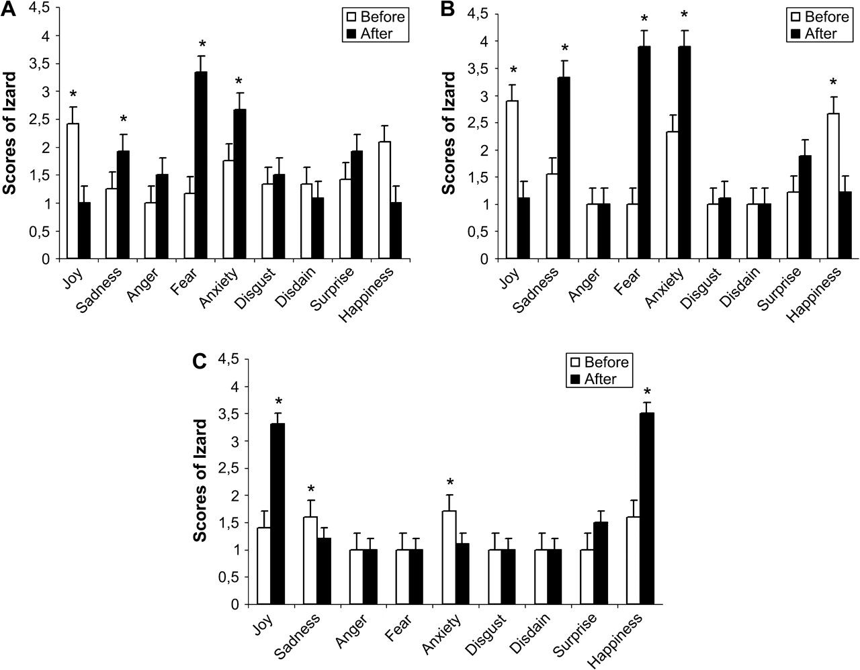
Figure 2. (a) Graphic summarizing the effect of the stimulation on Izard scores (means and standard deviations) for ...
Notes:
Figure 2. (a) Graphic summarizing the effect of the stimulation on Izard scores (means and standard deviations) for each type of emotion, after right amygdala stimulation. (b) Graphic summarizing the effect of the stimulation on Izard scores (means and standard deviations) for each type of emotion when participants reported to have unpleasant states after left amygdala stimulation. (c) Graphic summarizing the effect of the stimulation on Izard scores (means and standard deviations) for each type of emotion when participants reported to have pleasant states, after left amygdala stimulation.
Unless provided in the caption above, the following copyright applies to the content of this slide: © The Author 2006. Published by Oxford University Press. All rights reserved. For permissions, please e-mail: journals.permissions@oxfordjournals.org

Slide 3
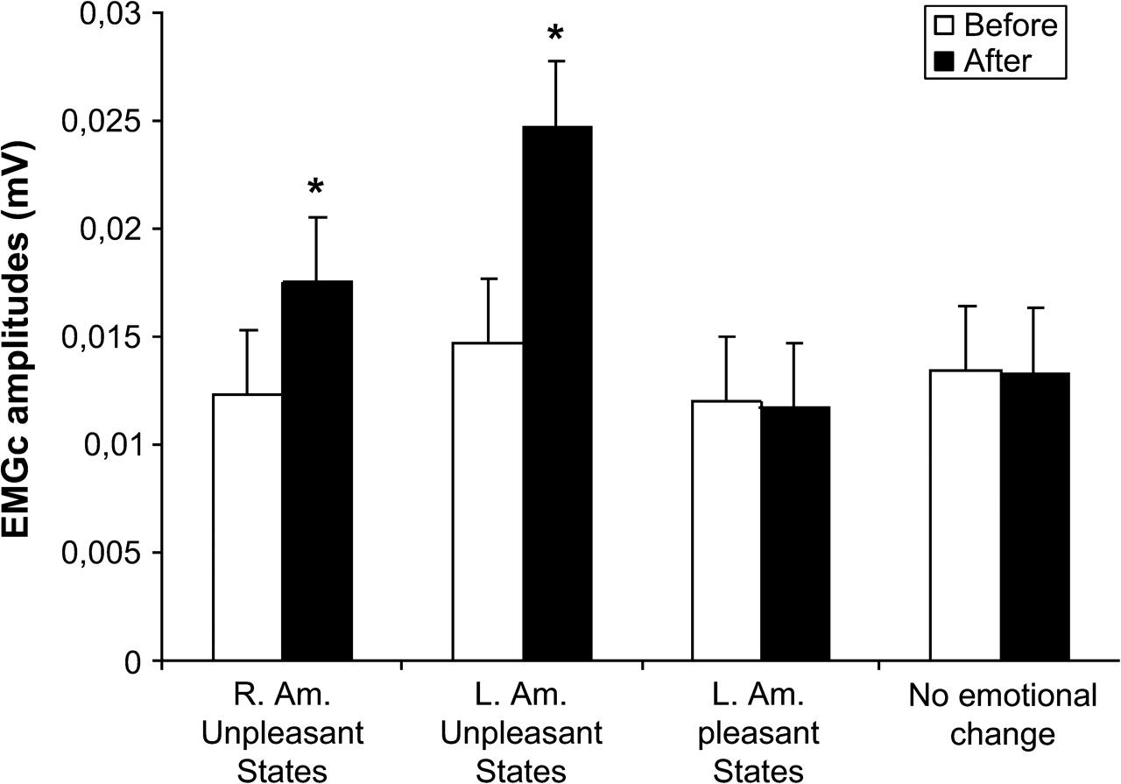
Figure 3. Mean changes and standard deviations for EMGc (mV) when participants reported pleasant, unpleasant, or no ...
Notes:
Figure 3. Mean changes and standard deviations for EMGc (mV) when participants reported pleasant, unpleasant, or no emotions.
Unless provided in the caption above, the following copyright applies to the content of this slide: © The Author 2006. Published by Oxford University Press. All rights reserved. For permissions, please e-mail: journals.permissions@oxfordjournals.org

Slide 4
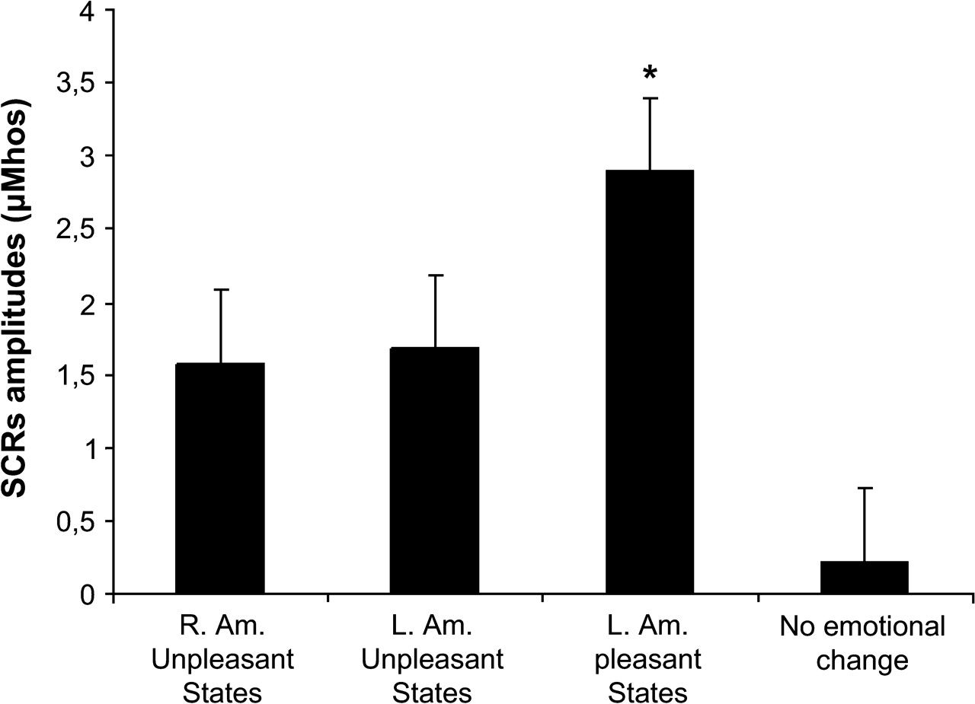
Figure 4. Mean changes and standard deviations for SCR (μmho) magnitude when participants reported pleasant, ...
Notes:
Figure 4. Mean changes and standard deviations for SCR (μmho) magnitude when participants reported pleasant, unpleasant, or no emotions.
Unless provided in the caption above, the following copyright applies to the content of this slide: © The Author 2006. Published by Oxford University Press. All rights reserved. For permissions, please e-mail: journals.permissions@oxfordjournals.org

