Slide 1
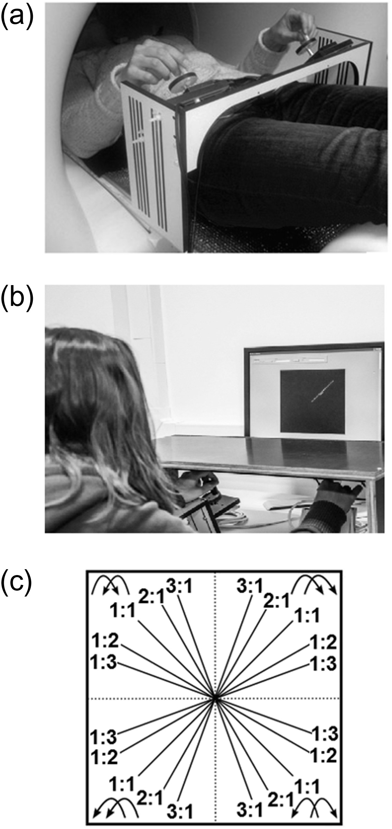
Figure 1. Experimental setup (a) in the scanner at Pre- and Post-test and (b) on the training days. (c) All possible ...
Notes:
Figure 1. Experimental setup (a) in the scanner at Pre- and Post-test and (b) on the training days. (c) All possible bimanual directional combinations (n = 4) and frequency ratios (n = 5).
Unless provided in the caption above, the following copyright applies to the content of this slide: © The Author 2016. Published by Oxford University Press. All rights reserved. For Permissions, please e-mail: journals.permissions@oup.com

Slide 2
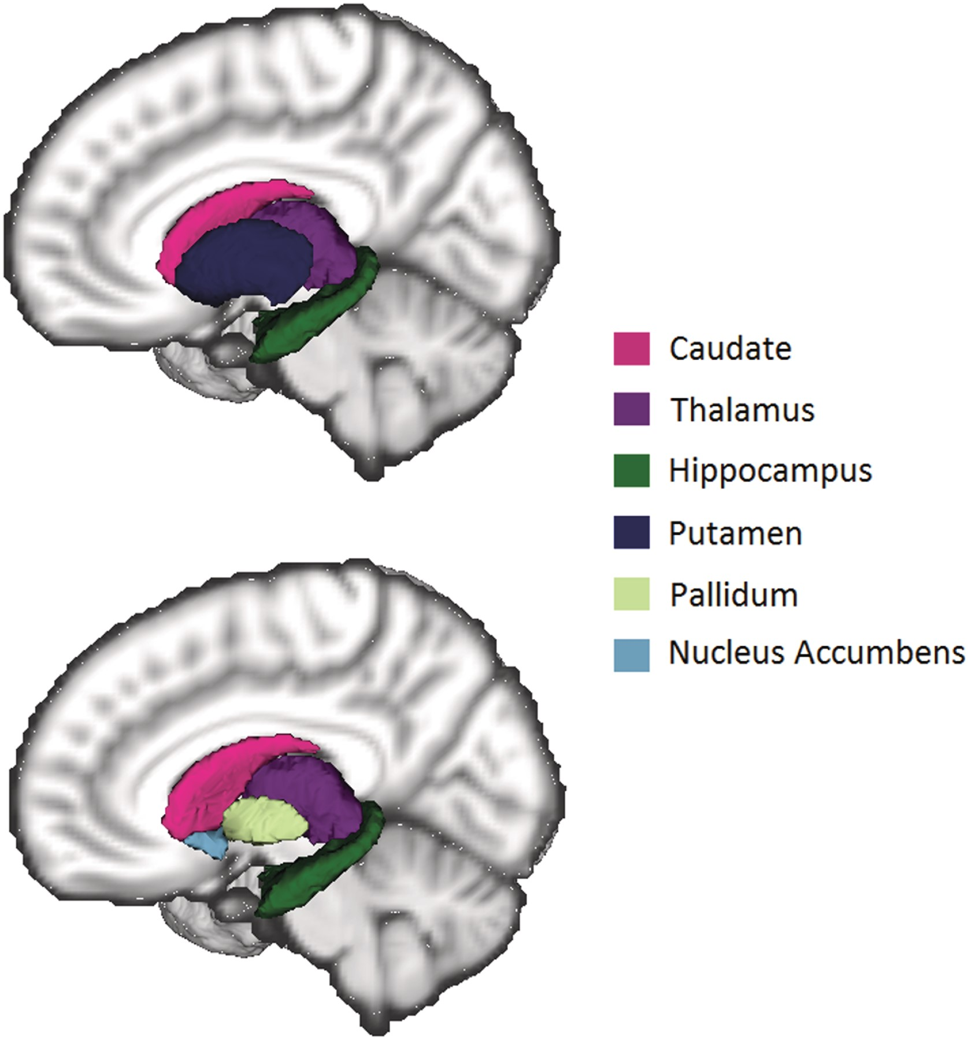
Figure 2. Subcortical structures segmented using FIRST. In the bottom figure, the putamen has been removed to better ...
Notes:
Figure 2. Subcortical structures segmented using FIRST. In the bottom figure, the putamen has been removed to better illustrate the pallidum and nucleus accumbens.
Unless provided in the caption above, the following copyright applies to the content of this slide: © The Author 2016. Published by Oxford University Press. All rights reserved. For Permissions, please e-mail: journals.permissions@oup.com

Slide 3
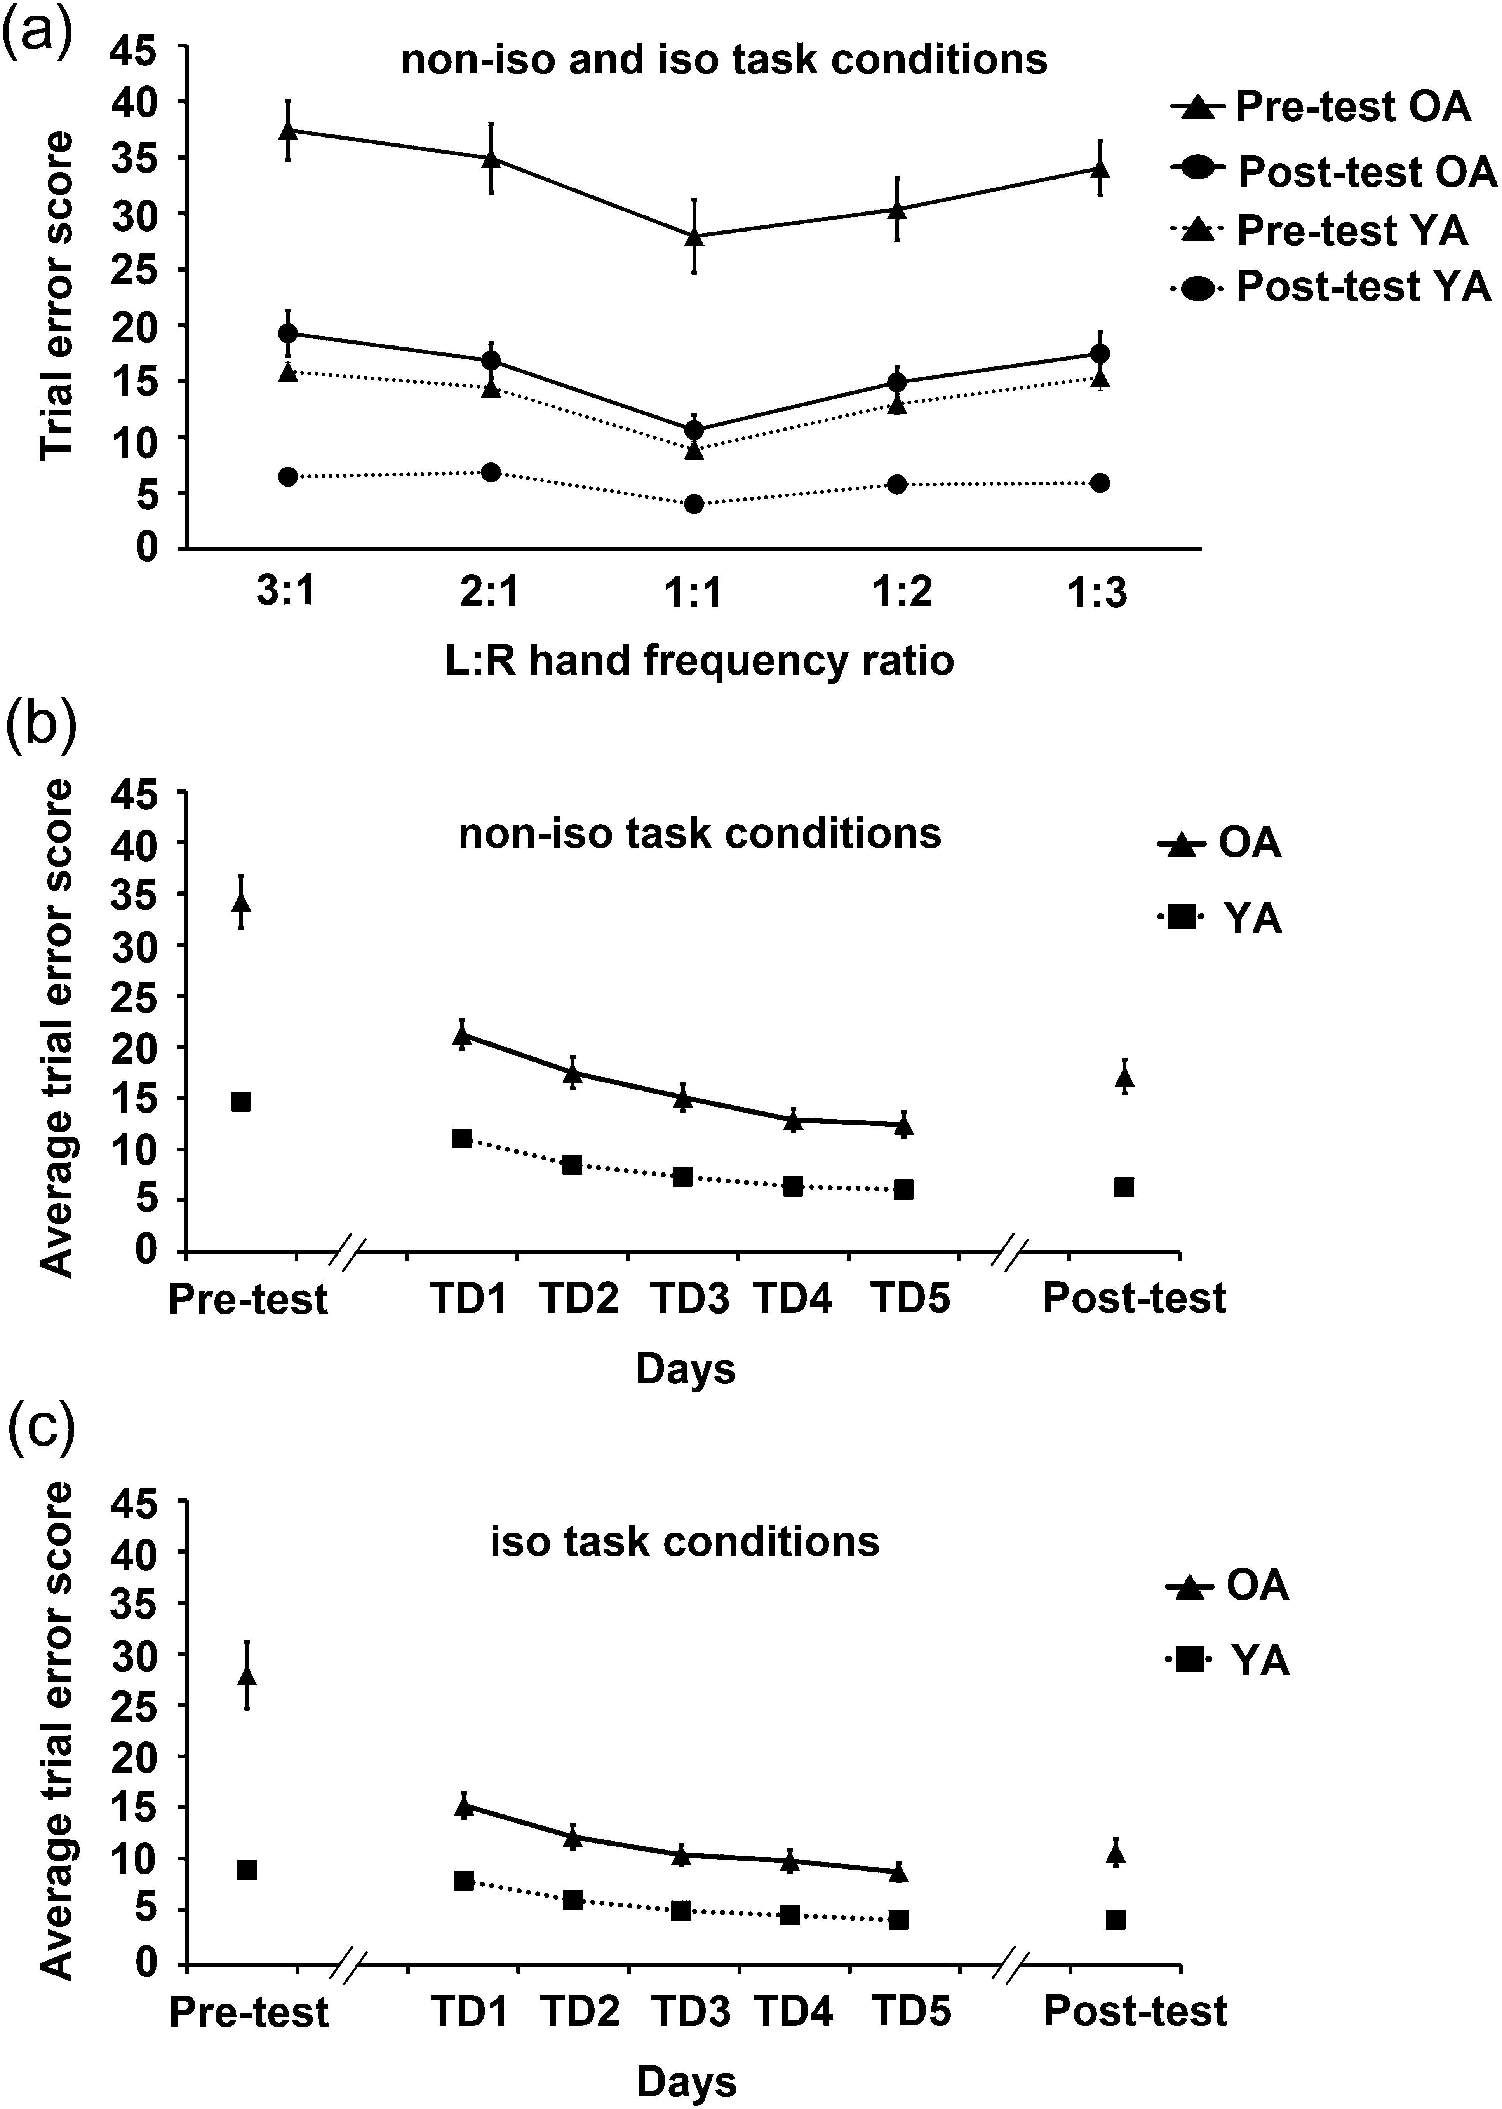
Figure 3. Error scores across testing days. (a) In both YA and OA, trial errors were higher in the non-iso task ...
Notes:
Figure 3. Error scores across testing days. (a) In both YA and OA, trial errors were higher in the non-iso task conditions than in the iso task conditions. Furthermore, OA consistently showed higher errors than YA. Panels (b) and (c) represent average trial error scores in the non-iso and iso task conditions, respectively. For both task conditions, performance of both YA and OA improved throughout the training days. Moreover, although OA consistently showed higher error scores, their performance improvement was greater than YA. L:R, left:right; TD, training day; iso, trials with similar inter-hand frequency ratio (i.e., 1:1); non-iso, trials with different inter-hand frequency ratio (i.e., 1:2, 2:1, 1:3, and 3:1).
Unless provided in the caption above, the following copyright applies to the content of this slide: © The Author 2016. Published by Oxford University Press. All rights reserved. For Permissions, please e-mail: journals.permissions@oup.com

Slide 4
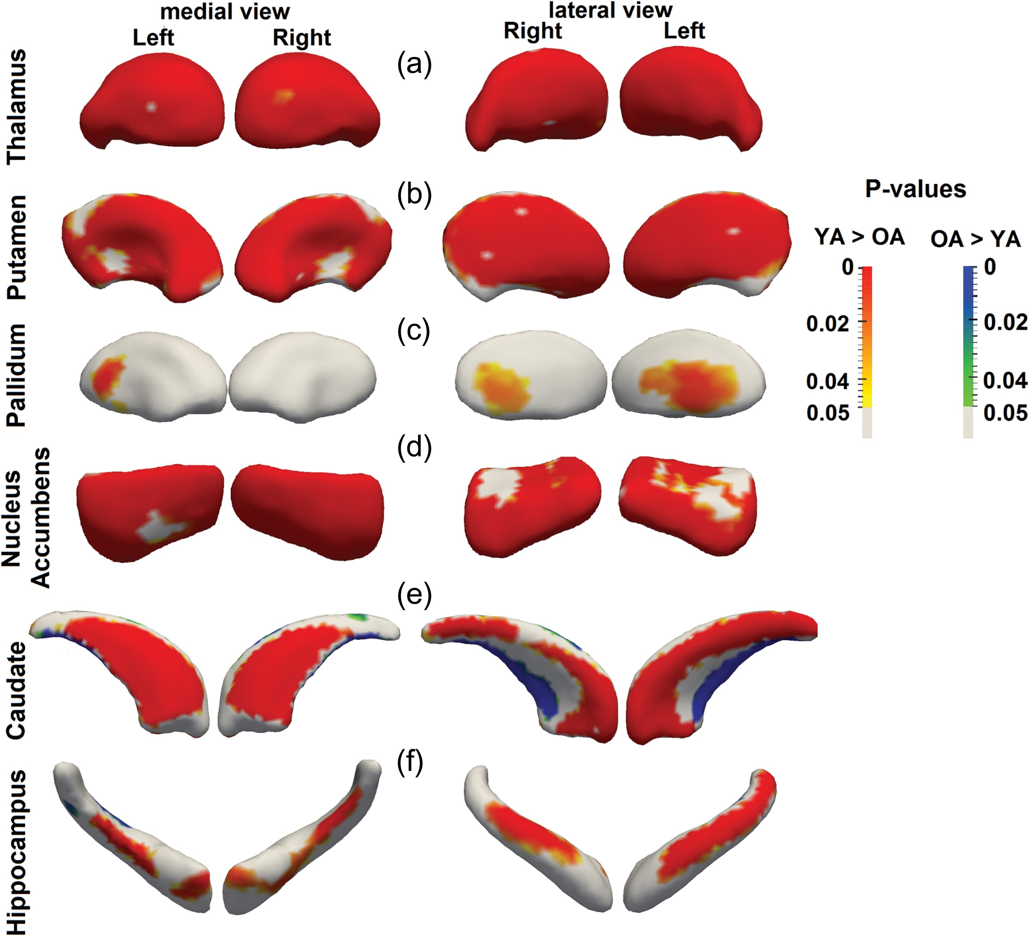
Figure 4. Vertex-wise comparison of (a) thalamus, (b) putamen, (c) pallidum, (d) nucleus accumbens, (e) caudate, and ...
Notes:
Figure 4. Vertex-wise comparison of (a) thalamus, (b) putamen, (c) pallidum, (d) nucleus accumbens, (e) caudate, and (f) hippocampus across YA and OA. Compared with YA, OA showed compressions in all the subcortical structures. Furthermore, OA, as compared with YA, showed subregional expansion in the caudate and hippocampus.
Unless provided in the caption above, the following copyright applies to the content of this slide: © The Author 2016. Published by Oxford University Press. All rights reserved. For Permissions, please e-mail: journals.permissions@oup.com

Slide 5
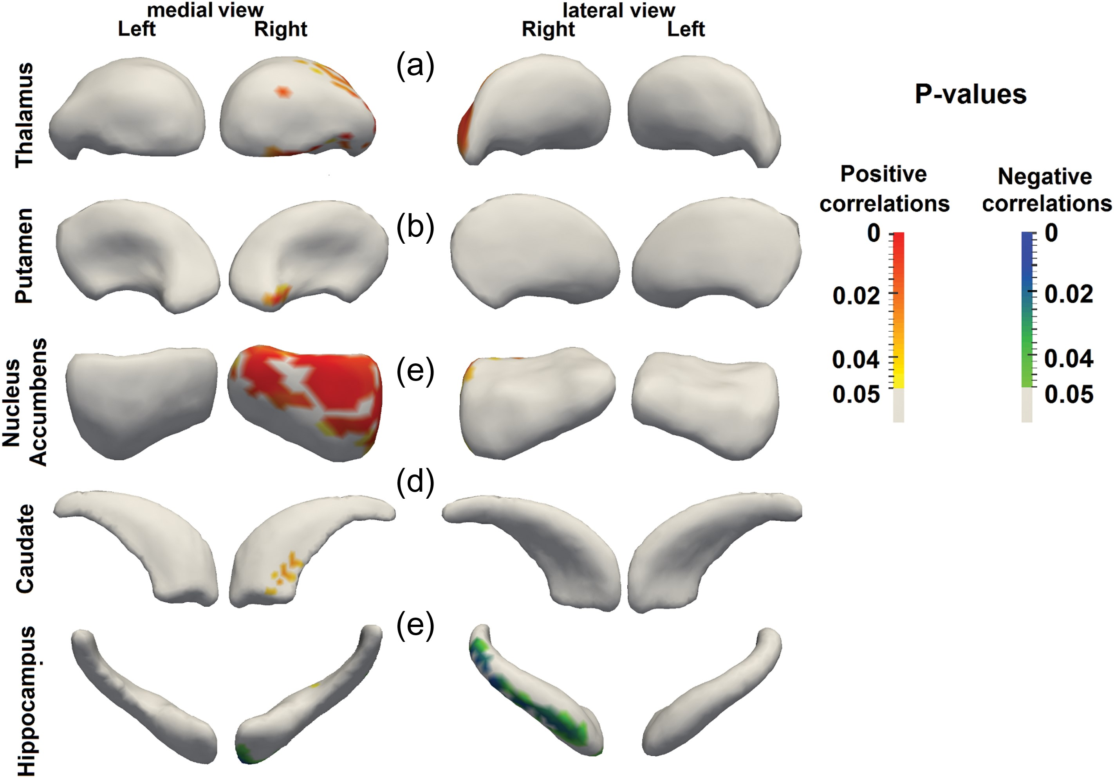
Figure 5. Vertex-wise correlations with Pre-to-Post performance improvement in the non-iso task conditions in different ...
Notes:
Figure 5. Vertex-wise correlations with Pre-to-Post performance improvement in the non-iso task conditions in different age groups. In OA, subregions within the (a) right thalamus, (b) right putamen, (c) right nucleus accumbens, and (d) right caudate showed significant positive correlations with Pre-to-Post performance improvement in the non-iso task conditions. However, in YA, subregions within the (e) right hippocampus were negatively correlated with Pre-to-Post performance improvement in the non-iso task condition. Iso, trials with similar inter-hand frequency ratio (i.e., 1:1); non-iso, trials with different inter-hand frequency ratio (i.e., 1:2, 2:1, 1:3, and 3:1).
Unless provided in the caption above, the following copyright applies to the content of this slide: © The Author 2016. Published by Oxford University Press. All rights reserved. For Permissions, please e-mail: journals.permissions@oup.com

Slide 6
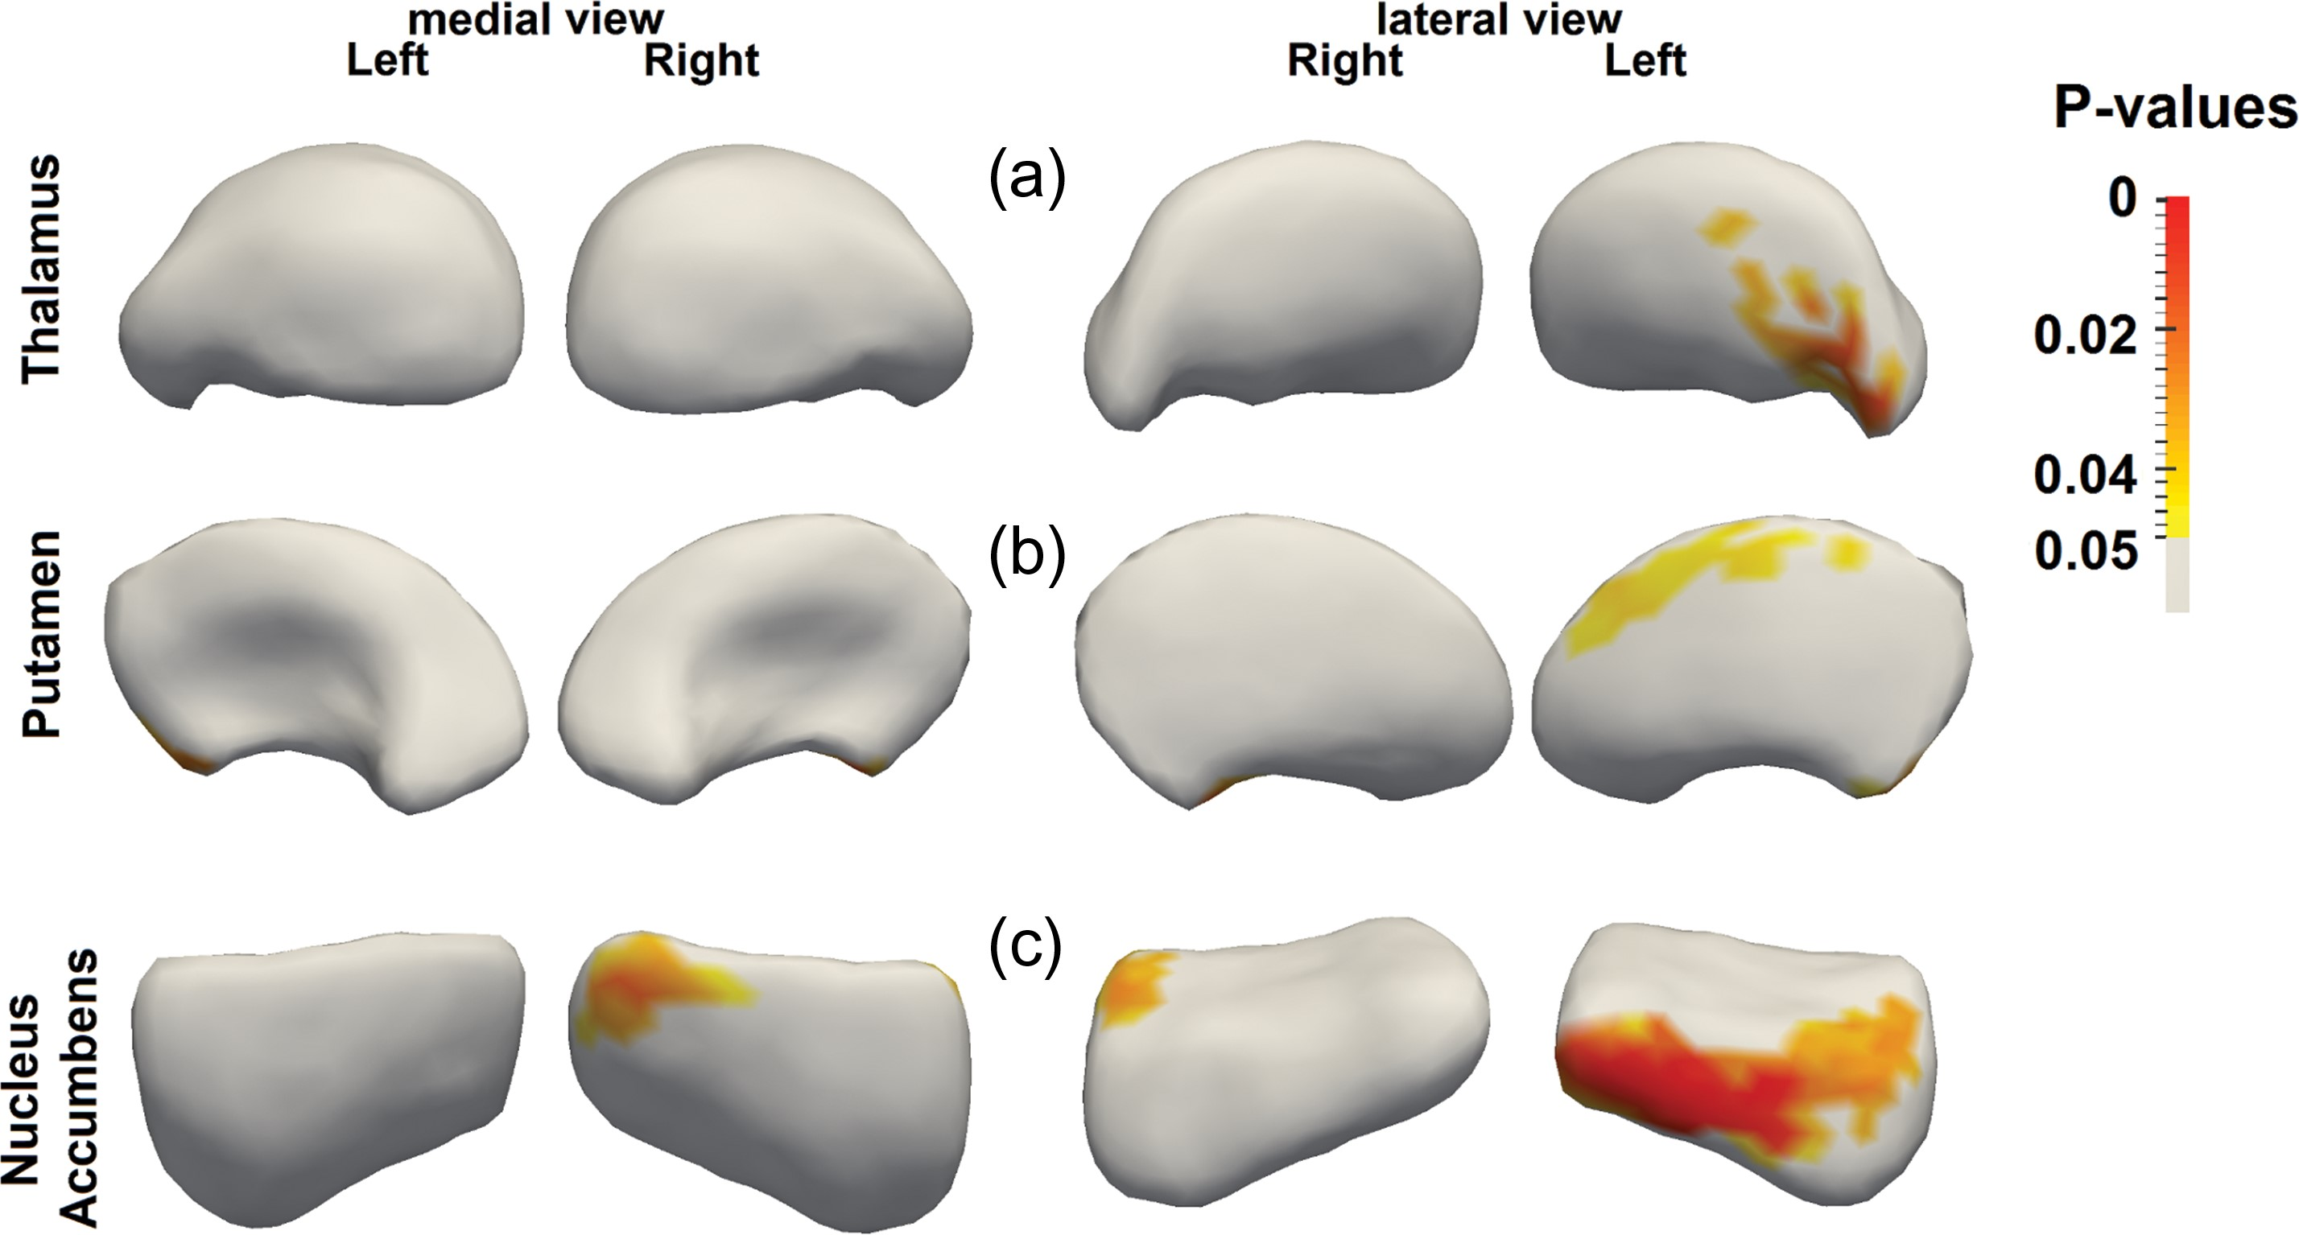
Figure 6. Vertex-wise interaction analyses between age group and Pre-to-Post performance improvement in the non-iso ...
Notes:
Figure 6. Vertex-wise interaction analyses between age group and Pre-to-Post performance improvement in the non-iso task conditions. OA showed greater associations than YA between Pre-to-Post performance improvement in the non-iso task conditions and subregional shape of the (a) left thalamus, (b) bilateral putamen, and (c) bilateral nucleus accumbens. Non-iso, trials with different inter-hand frequency ratio (i.e., 1:2, 2:1, 1:3, and 3:1).
Unless provided in the caption above, the following copyright applies to the content of this slide: © The Author 2016. Published by Oxford University Press. All rights reserved. For Permissions, please e-mail: journals.permissions@oup.com

Slide 7
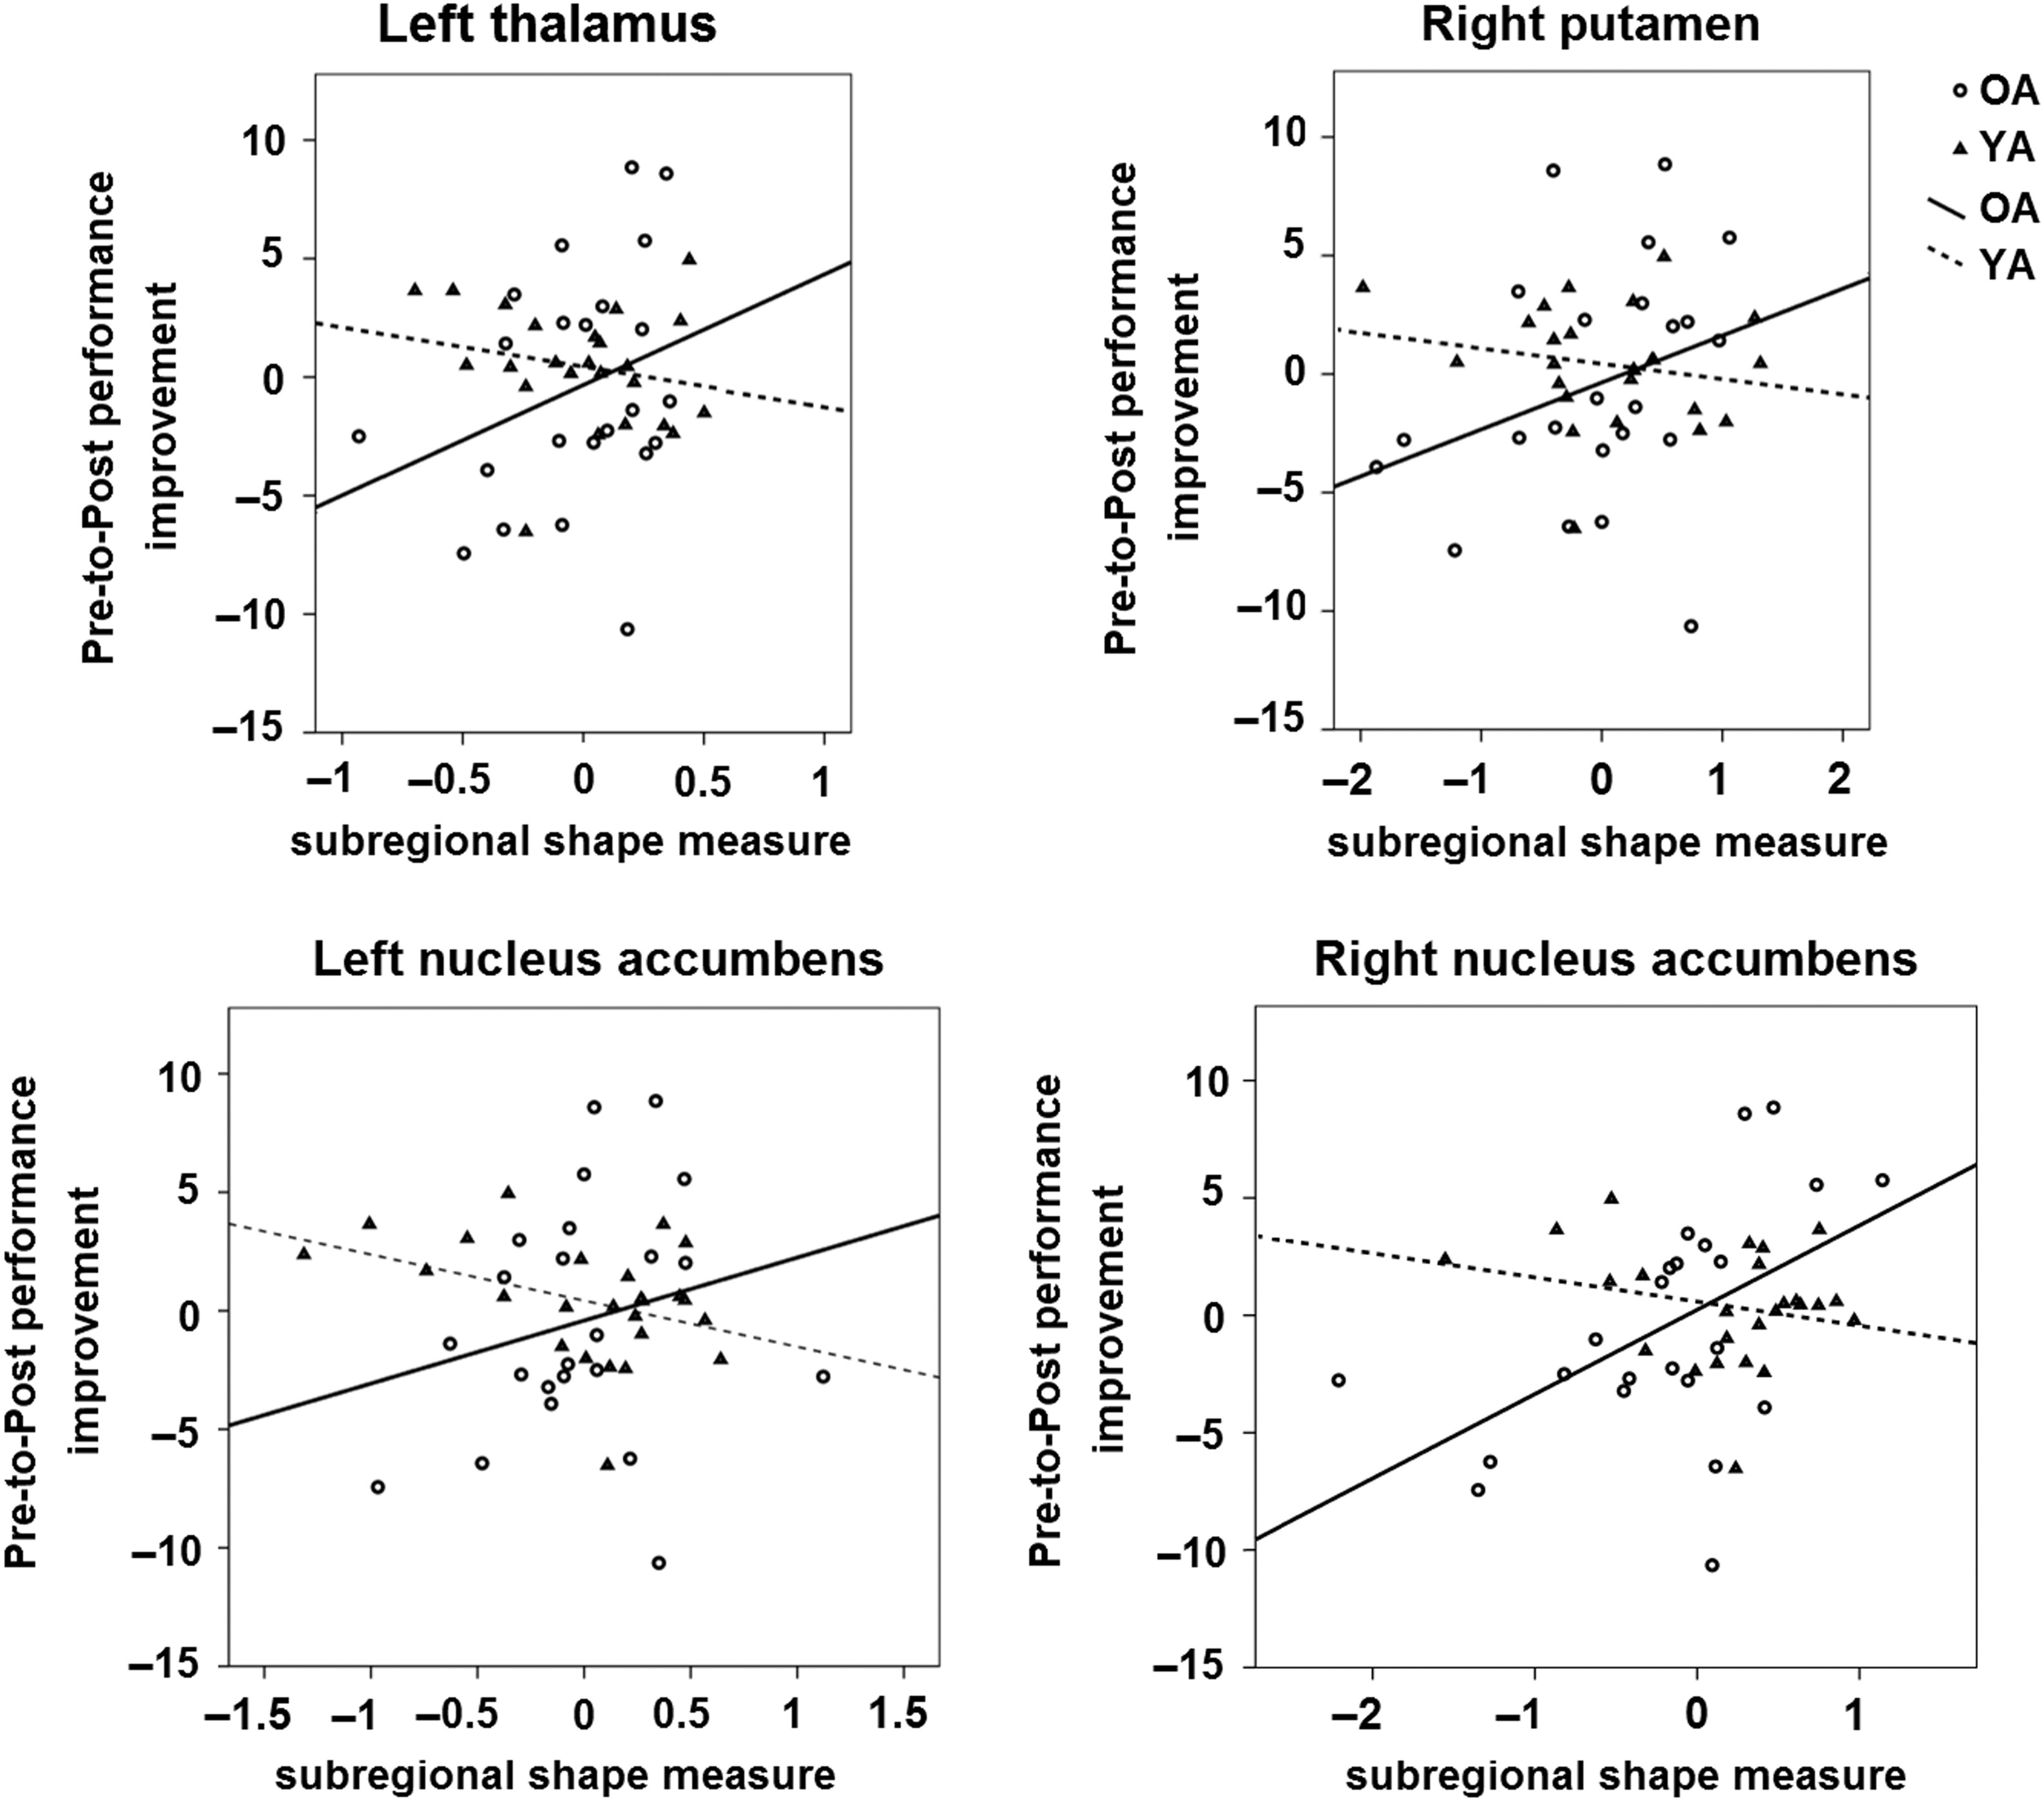
Figure 7. Scatter plots showing that Pre-to-Post performance improvement in the non-iso task conditions (controlled for ...
Notes:
Figure 7. Scatter plots showing that Pre-to-Post performance improvement in the non-iso task conditions (controlled for performance at Pre-test) was differentially correlated with subregional shape measures of the voxels within the left thalamus, right putamen, and bilateral nucleus accumbens (controlled for the TIV) across YA and OA. Non-iso, trials with different inter-hand frequency ratio (i.e., 1:2, 2:1, 1:3, and 3:1).
Unless provided in the caption above, the following copyright applies to the content of this slide: © The Author 2016. Published by Oxford University Press. All rights reserved. For Permissions, please e-mail: journals.permissions@oup.com

Slide 8
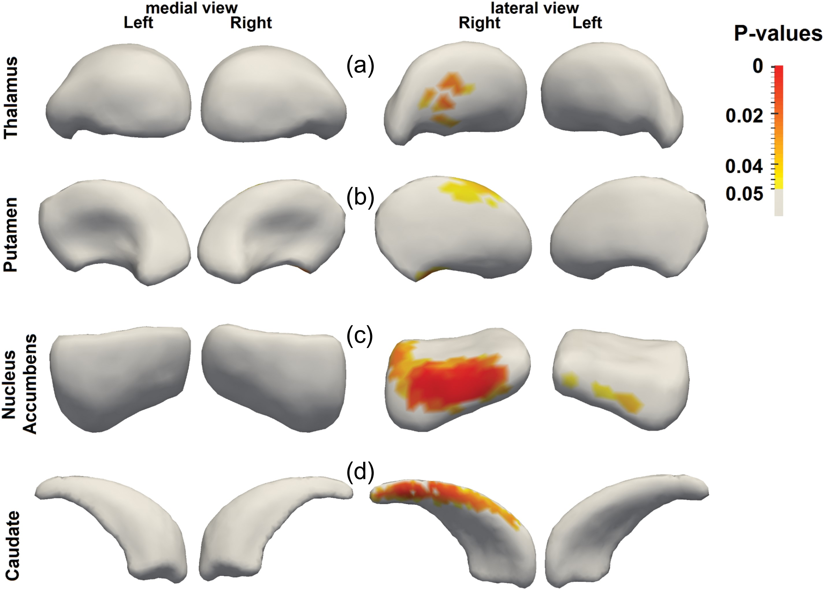
Figure 8. Vertex-wise interaction analyses between age group and Pre-to-Post performance improvement in the iso task ...
Notes:
Figure 8. Vertex-wise interaction analyses between age group and Pre-to-Post performance improvement in the iso task conditions. OA showed greater associations than YA between Pre-to-Post performance improvement in the iso task conditions and subregional shape of the (a) left thalamus, (b) bilateral putamen, and (c) bilateral nucleus accumbens. Iso, trials with similar inter-hand frequency ratio (i.e., 1:1).
Unless provided in the caption above, the following copyright applies to the content of this slide: © The Author 2016. Published by Oxford University Press. All rights reserved. For Permissions, please e-mail: journals.permissions@oup.com

