Slide 1
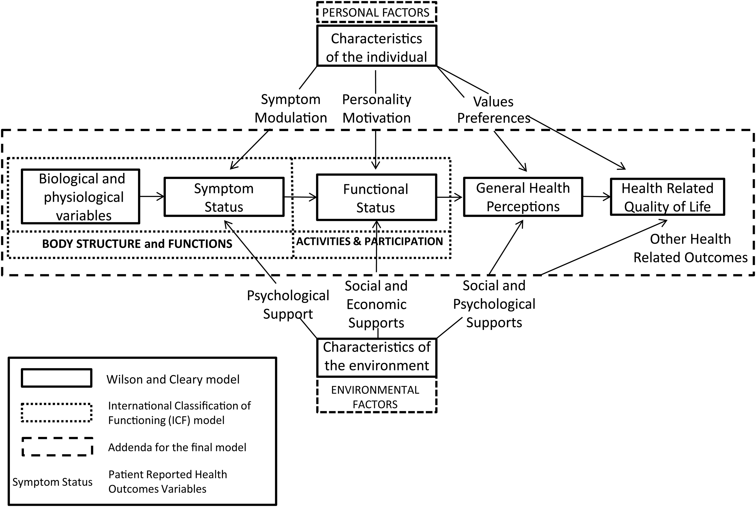
Figure 1 An integrated model for health outcomes. Reprinted with kind permission from Springer Science and Business ...
Notes:
Figure 1 An integrated model for health outcomes. Reprinted with kind permission from Springer Science and Business Media, Valderas and Alonso.7
Unless provided in the caption above, the following copyright applies to the content of this slide: Published on behalf of the European Society of Cardiology. All rights reserved. © The Author 2014. For permissions please email: journals.permissions@oup.com.

Slide 2
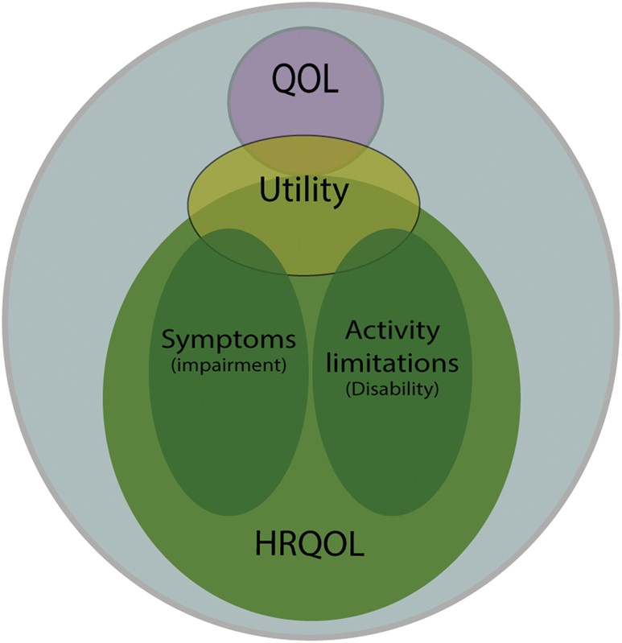
Figure 2 Types of patient-reported outcome measures currently used in medical research. The range of different types ...
Notes:
Figure 2 Types of patient-reported outcome measures currently used in medical research. The range of different types of patient-reported outcomes is shown. The most commonly used patient-reported outcomes measures assess symptoms and/or functional limitations. These are commonly referred to as health-related quality-of-life measures. The commonly used measures which generate utility values also ask about symptoms and/or functional limitations. Patient satisfaction is generally concerned with issues such as the process of treatment and relationships with clinical staff. Quality-of-life measures address need-fulfilment rather than symptoms and/or functional limitations. Reprinted with permission under the terms of the Creative Commons Attribution License http://creativecommons.org/licenses/by/3.0/, which permits unrestricted use, distribution, and reproduction in any medium, provided the original work is properly cited. McKenna SP. BMC Medicine 2011;9:86.
Unless provided in the caption above, the following copyright applies to the content of this slide: Published on behalf of the European Society of Cardiology. All rights reserved. © The Author 2014. For permissions please email: journals.permissions@oup.com.

Slide 3
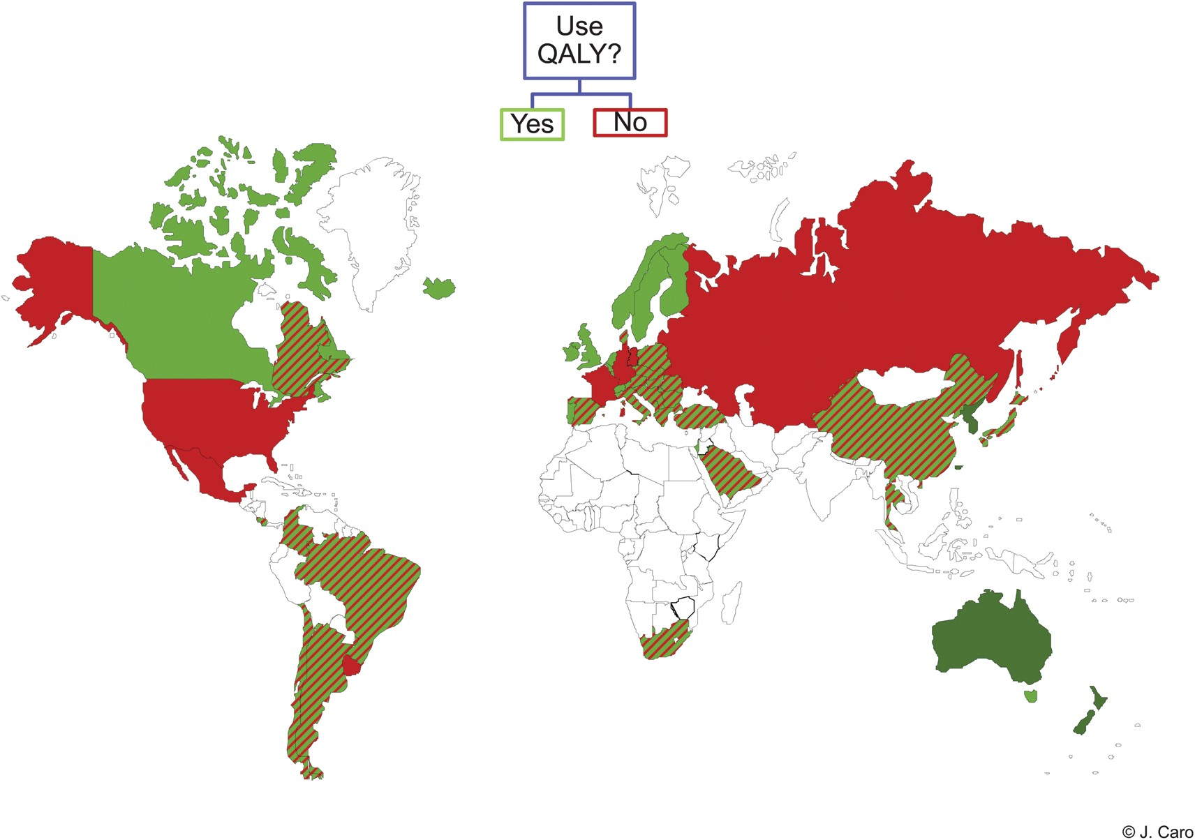
Figure 3 Global use of quality-adjusted life years to inform reimbursement decisions. Courtesy: Jaime Caro.
Notes:
Figure 3 Global use of quality-adjusted life years to inform reimbursement decisions. Courtesy: Jaime Caro.
Unless provided in the caption above, the following copyright applies to the content of this slide: Published on behalf of the European Society of Cardiology. All rights reserved. © The Author 2014. For permissions please email: journals.permissions@oup.com.

Slide 4
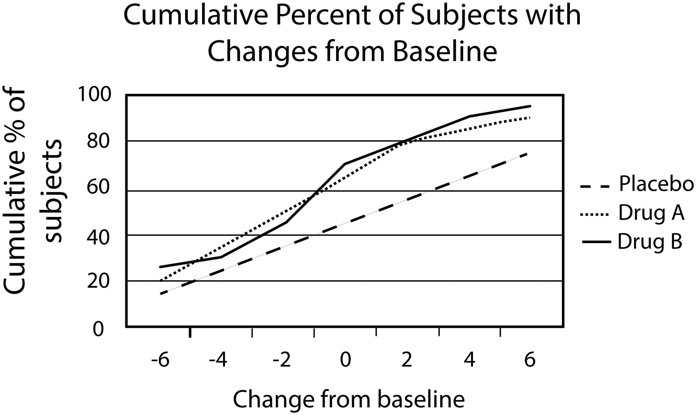
Figure 4 Example of a cumulative distribution curve. Reprinted with permission from Patrick et al.²¹ ...
Notes:
Figure 4 Example of a cumulative distribution curve. Reprinted with permission from Patrick et al.21 (Elsevier, copyright 2007).
Unless provided in the caption above, the following copyright applies to the content of this slide: Published on behalf of the European Society of Cardiology. All rights reserved. © The Author 2014. For permissions please email: journals.permissions@oup.com.

