Slide 1
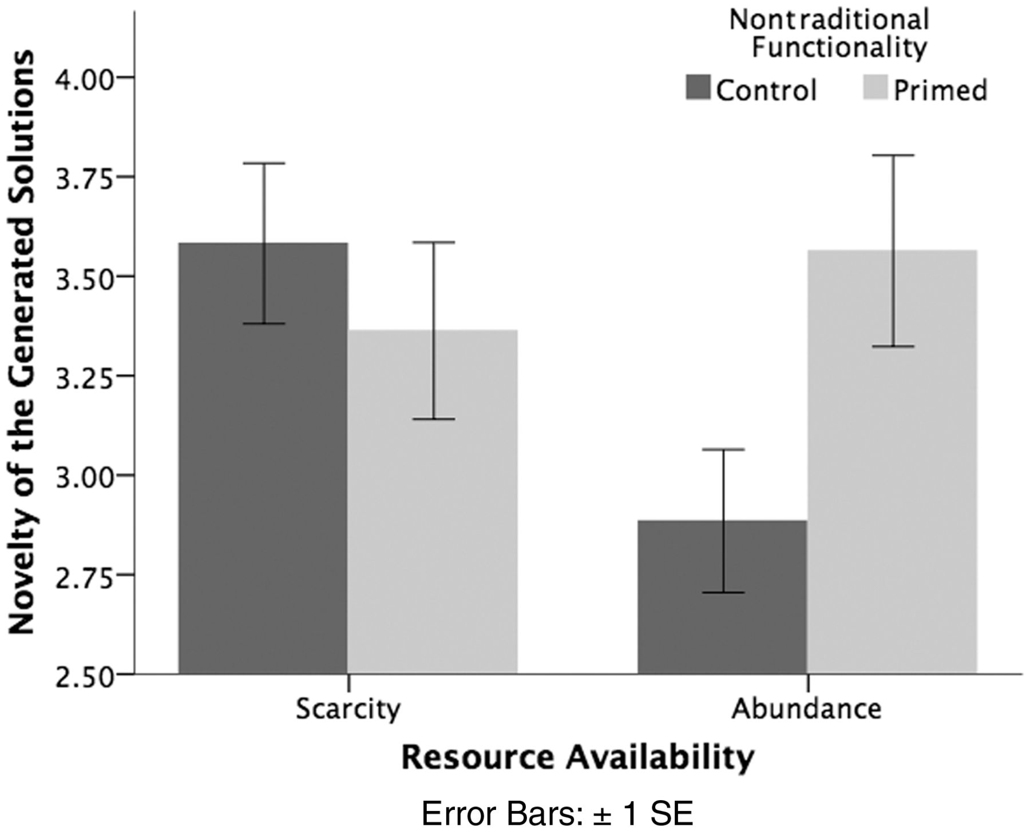
FIGURE 1 NOVELTY OF THE GENERATED PRODUCT USE SOLUTIONS FOR BUBBLE WRAP (EXPERIMENT 5)
Notes:
FIGURE 1 NOVELTY OF THE GENERATED PRODUCT USE SOLUTIONS FOR BUBBLE WRAP (EXPERIMENT 5)
Unless provided in the caption above, the following copyright applies to the content of this slide: © The Author 2015. Published by Oxford University Press on behalf of Journal of Consumer Research, Inc. All rights reserved. For permissions, please e-mail: journals.permissions@oup.com

Slide 2
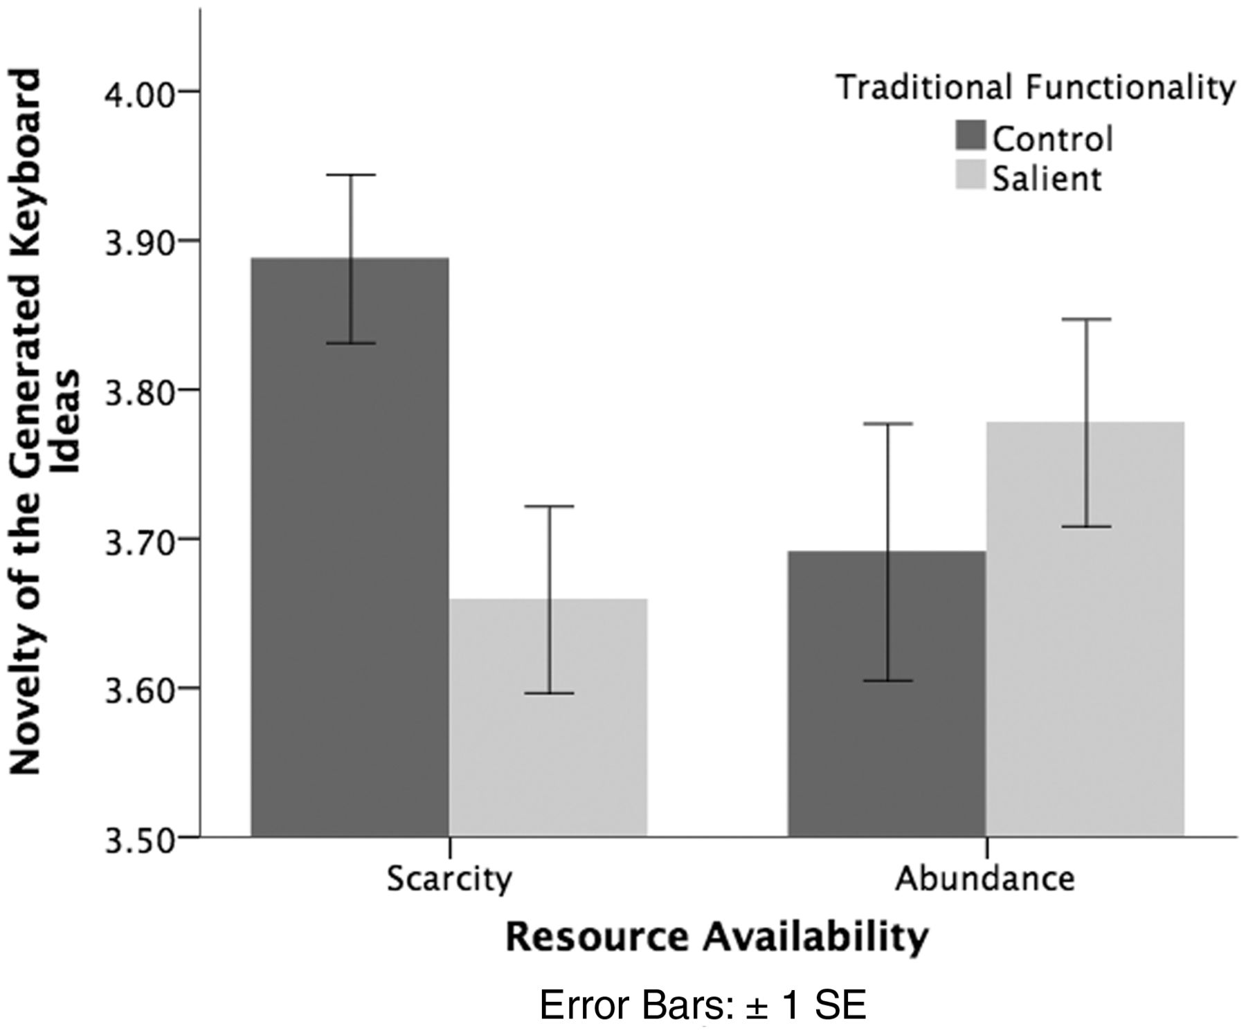
FIGURE 2 NOVELTY OF THE GENERATED KEYBOARD IDEAS (EXPERIMENT 6)
Notes:
FIGURE 2 NOVELTY OF THE GENERATED KEYBOARD IDEAS (EXPERIMENT 6)
Unless provided in the caption above, the following copyright applies to the content of this slide: © The Author 2015. Published by Oxford University Press on behalf of Journal of Consumer Research, Inc. All rights reserved. For permissions, please e-mail: journals.permissions@oup.com

