Slide 1
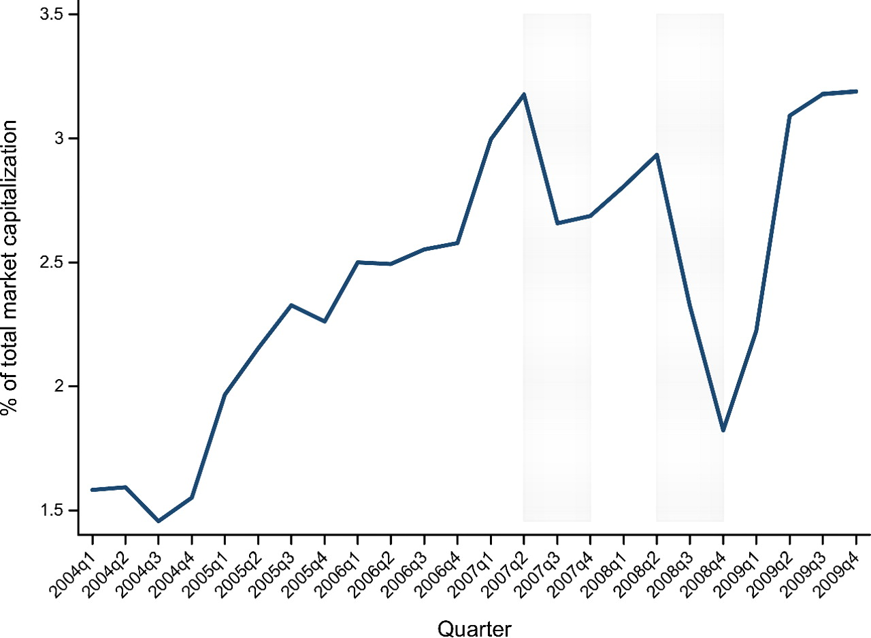
Figure 1 Time series of hedge funds' equity holdings (% of total market capitalization) The figure plots the fraction ...
Notes:
Figure 1 Time series of hedge funds' equity holdings (% of total market capitalization) The figure plots the fraction of U.S. stock market capitalization held by the hedge funds in our sample. The shaded areas denote the quarters around the Quant Meltdown (2007:Q3) and Lehman Brothers' bankruptcy (2008:Q3). The series ranges from 2004Q1 to 2009Q4.
Unless provided in the caption above, the following copyright applies to the content of this slide: © The Author 2011. Published by Oxford University Press on behalf of The Society for Financial Studies. All rights reserved. For Permissions, please e-mail: journals.permissions@oup.com.

Slide 2
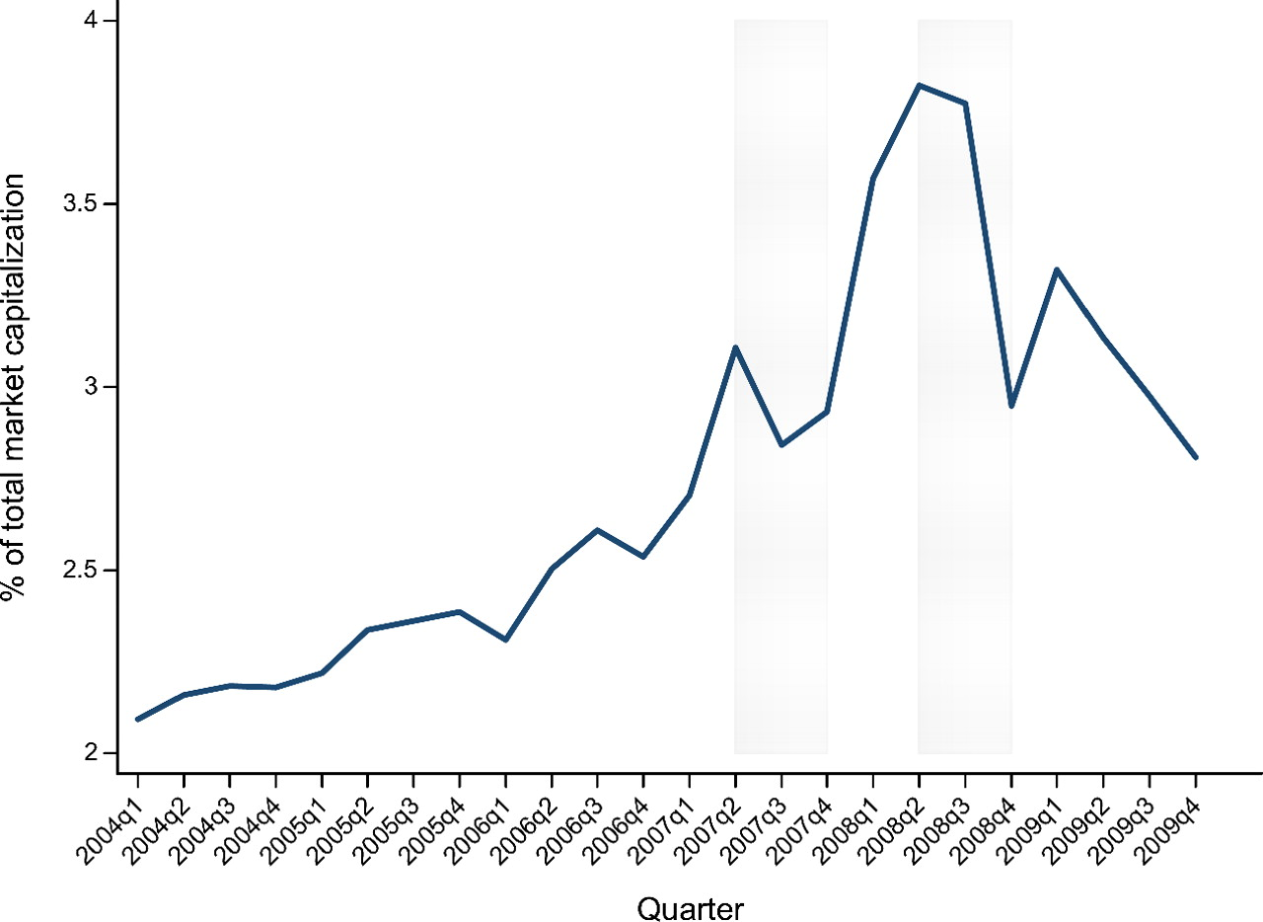
Figure 2 Time series of aggregate short interest (% of total market capitalization) The figure plots the fraction of ...
Notes:
Figure 2 Time series of aggregate short interest (% of total market capitalization) The figure plots the fraction of U.S. stock market capitalization corresponding to the total open short interest as provided by the exchanges. The shaded areas denote the quarters around the Quant Meltdown (2007:Q3-Q4) and the Lehman Brothers' Bankruptcy (2008:Q3-Q4). The series ranges from 2004:Q1 to 2009:Q4.
Unless provided in the caption above, the following copyright applies to the content of this slide: © The Author 2011. Published by Oxford University Press on behalf of The Society for Financial Studies. All rights reserved. For Permissions, please e-mail: journals.permissions@oup.com.

Slide 3
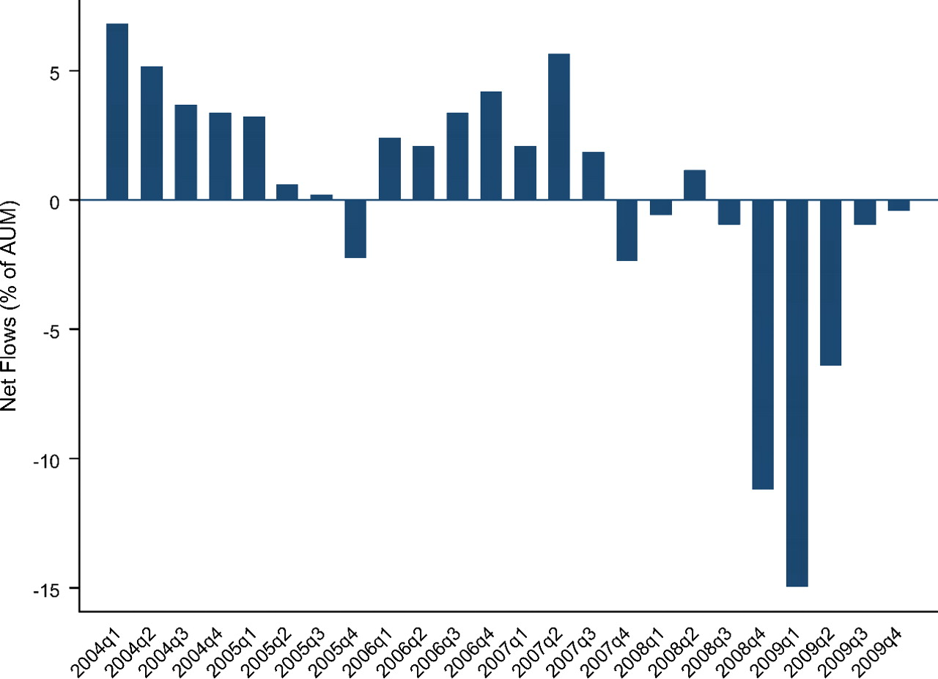
Figure 3 Time series of aggregate net flows (% of assets under management) The figure plots the aggregate net flows ...
Notes:
Figure 3 Time series of aggregate net flows (% of assets under management) The figure plots the aggregate net flows for hedge funds in the intersection between 13F and TASS as a fraction of their aggregate assets under management in the previous quarter (in percent). Fund flows are computed as the quarterly change in AUM minus the dollar return on prior-quarter AUM. The series ranges from 2004:Q1 to 2009:Q4.
Unless provided in the caption above, the following copyright applies to the content of this slide: © The Author 2011. Published by Oxford University Press on behalf of The Society for Financial Studies. All rights reserved. For Permissions, please e-mail: journals.permissions@oup.com.

