Slide 1
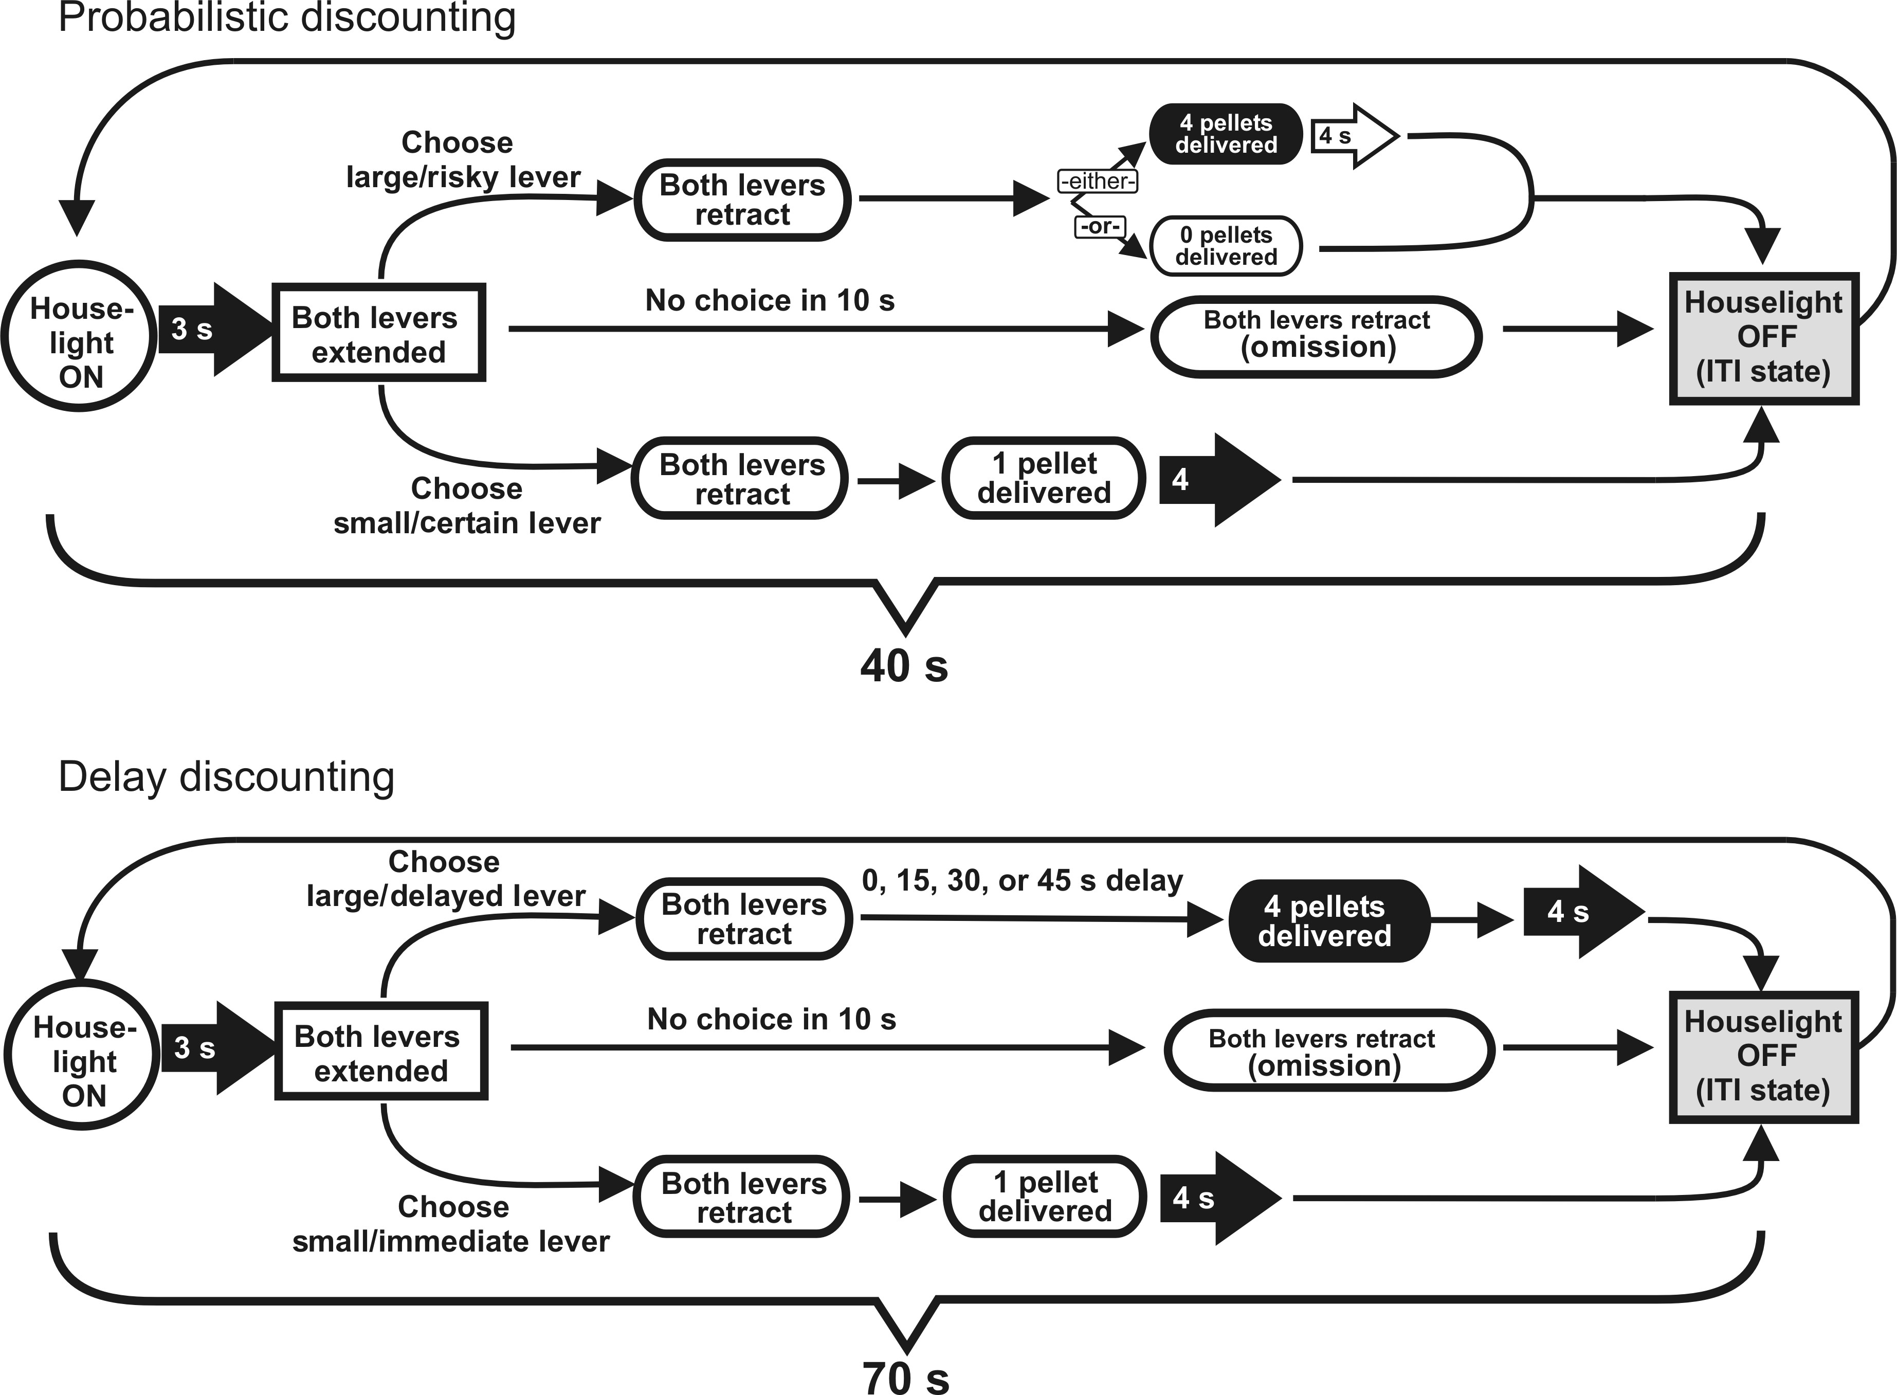
Figure 1. Probabilistic and delay-discounting task design. Format of a single free-choice trial for the probabilistic ...
Notes:
Figure 1. Probabilistic and delay-discounting task design. Format of a single free-choice trial for the probabilistic (top) and delay- (bottom) discounting tasks used in the present study.
Unless provided in the caption above, the following copyright applies to the content of this slide: © The Author 2012. Published by Oxford University Press. All rights reserved. For Permissions, please e-mail: journals.permissions@oup.com

Slide 2
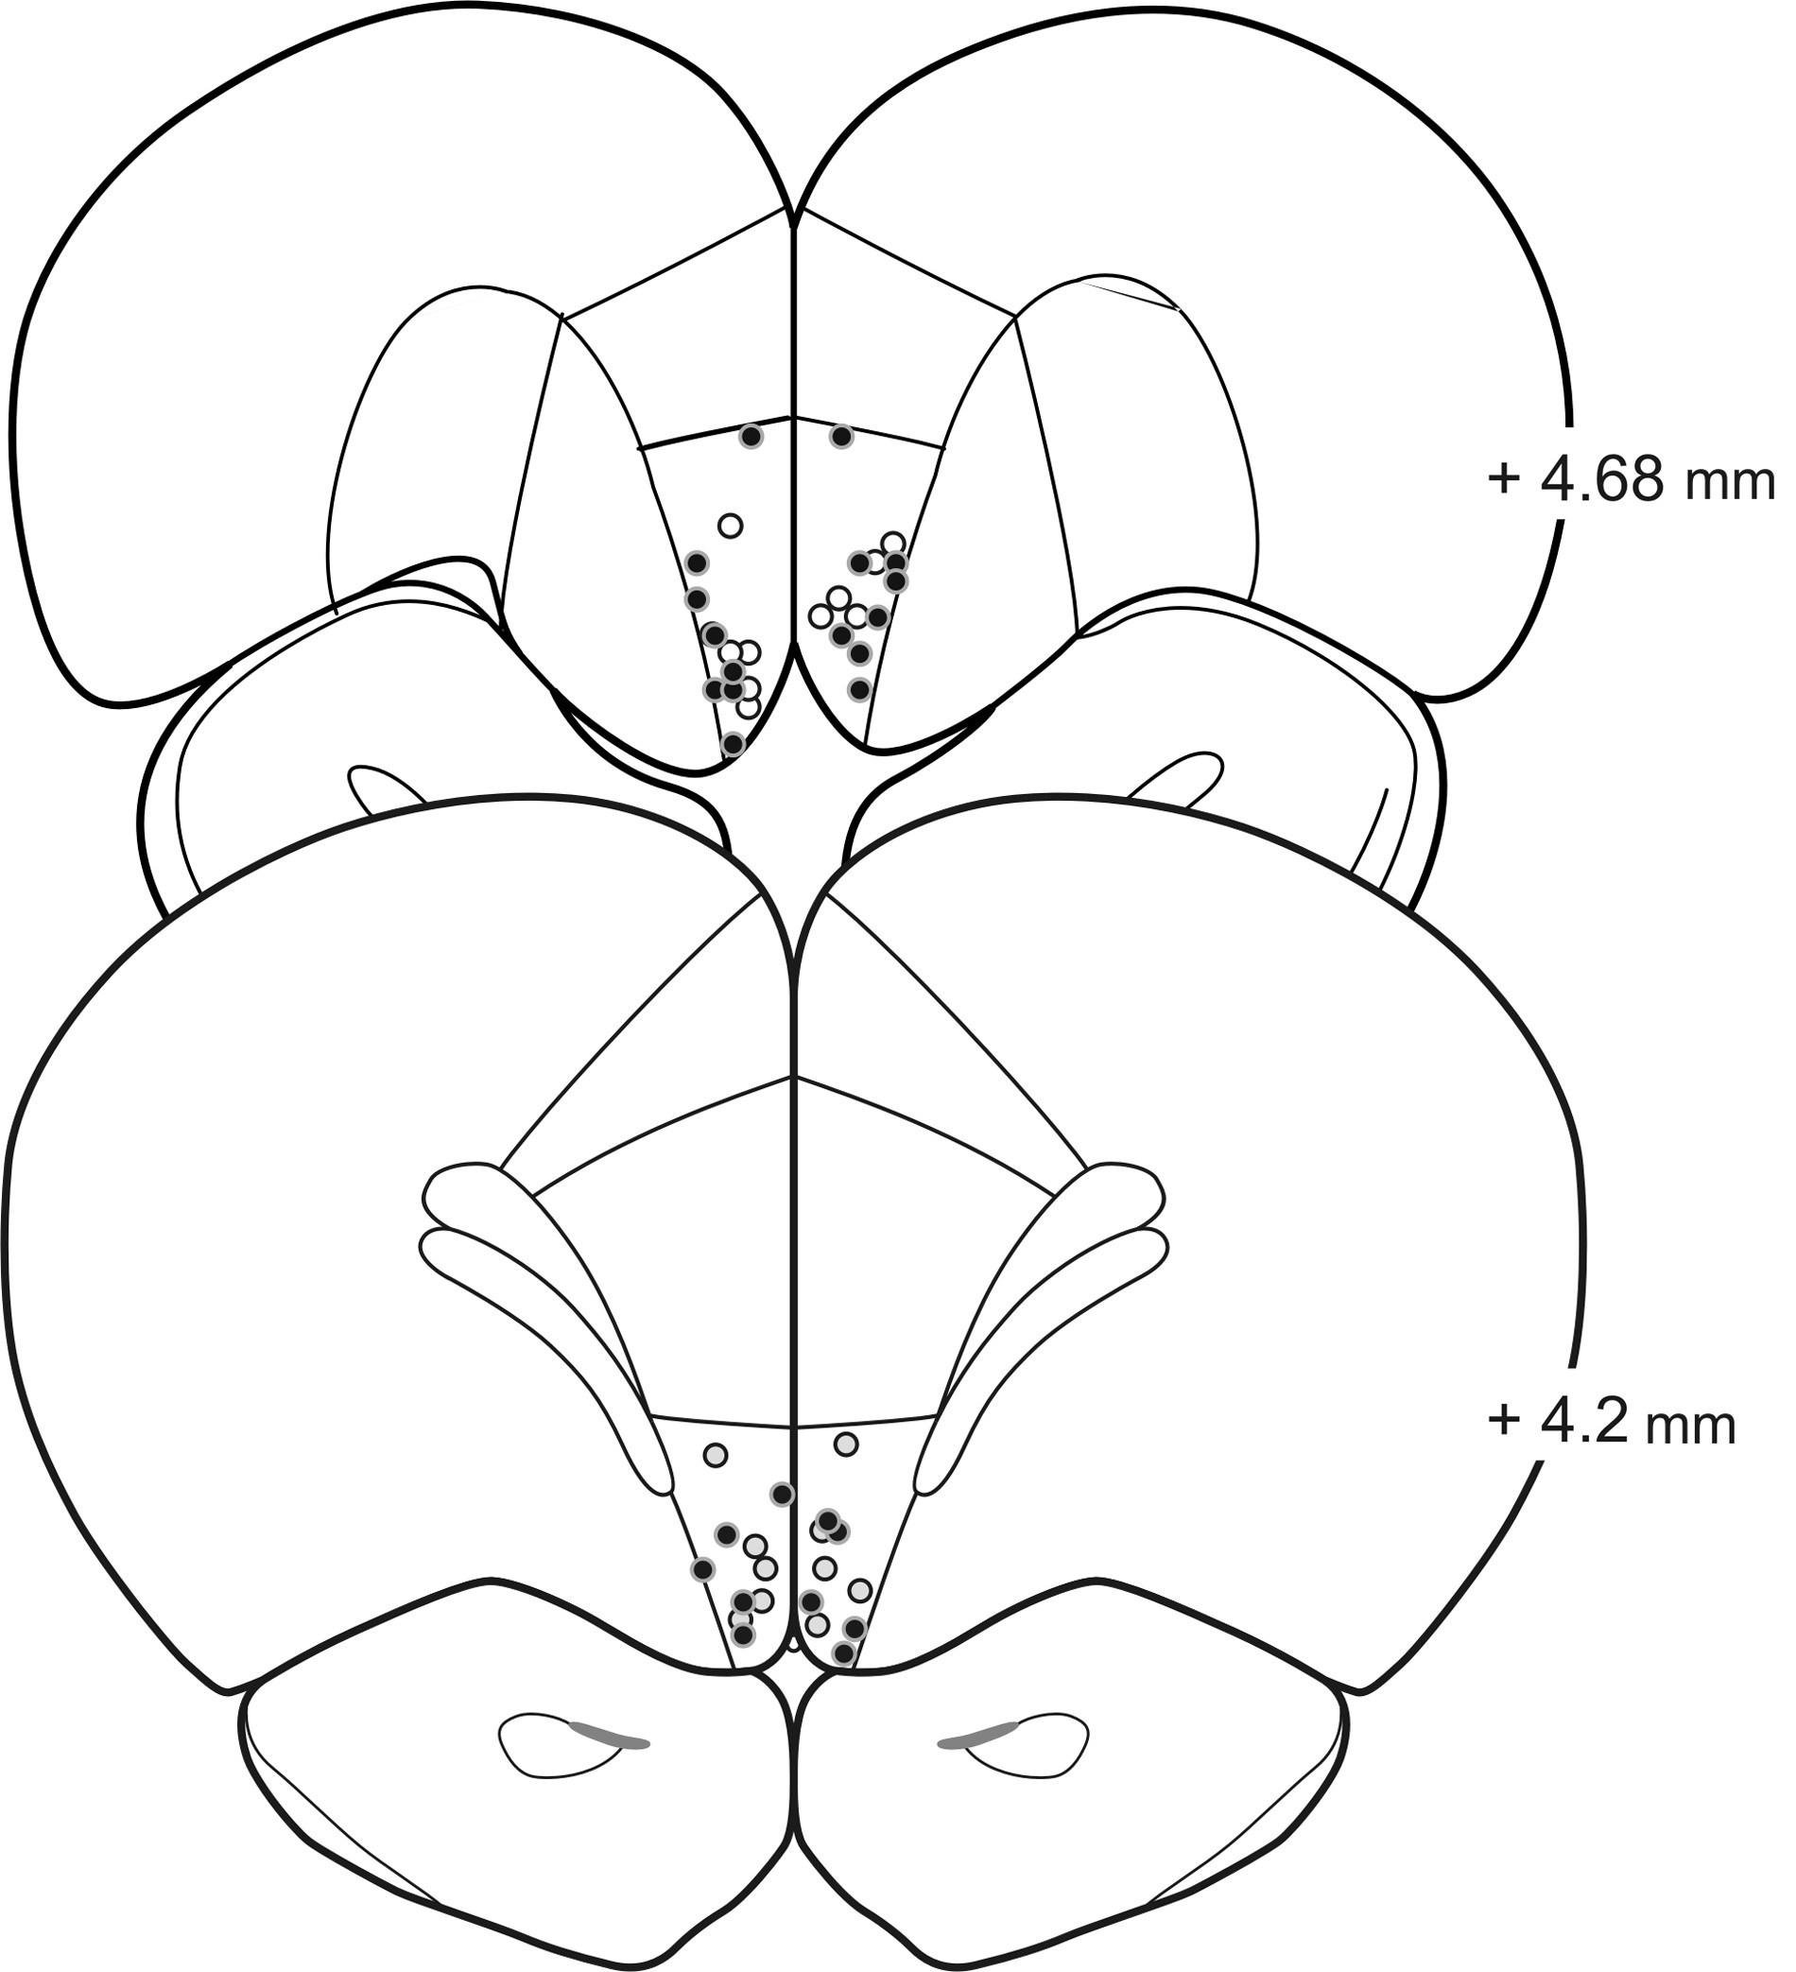
Figure 2. Schematic of sections of the rat brain showing location of acceptable infusions in the mOFC for rats in ...
Notes:
Figure 2. Schematic of sections of the rat brain showing location of acceptable infusions in the mOFC for rats in probabilistic (filled circles) and delay-discounting (open circles) experiments. Numbers correspond to mm from the bregma.
Unless provided in the caption above, the following copyright applies to the content of this slide: © The Author 2012. Published by Oxford University Press. All rights reserved. For Permissions, please e-mail: journals.permissions@oup.com

Slide 3
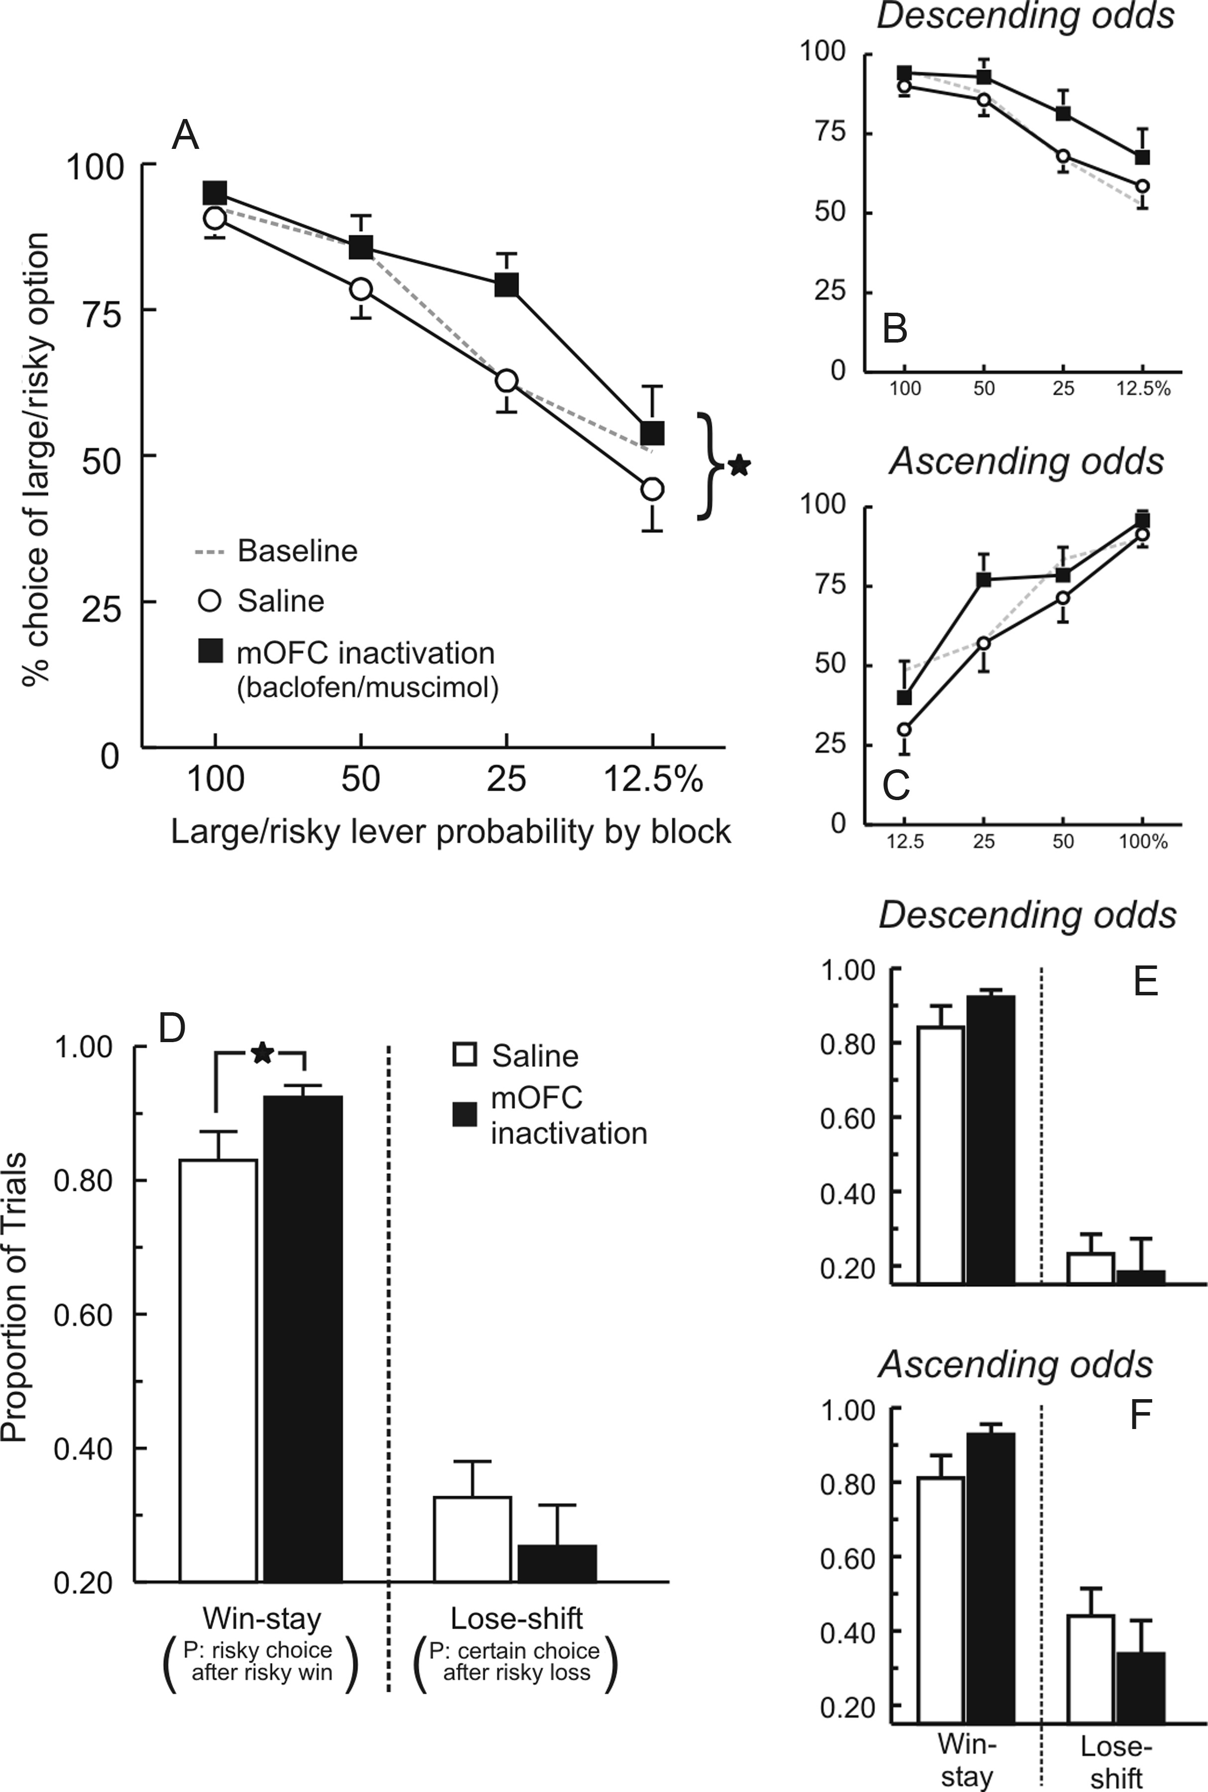
Figure 3. Inactivation of the mOFC increases the risky choice on a probabilistic discounting task. (A) Percentage ...
Notes:
Figure 3. Inactivation of the mOFC increases the risky choice on a probabilistic discounting task. (A) Percentage choice of the large/risky option on baseline training days, and following infusions of baclofen–muscimol or saline into mOFC across 4 blocks of free-choice trials for all animals included in this experiment. Choice data are plotted as a function of probability block, irrespective of the order in which reward probabilities changed over a session. Symbols represent mean ± standard error of the mean (SEM). Black star denotes P < 0.05 for the average choice versus saline. (B) Choice data from the subset of rats tested on the task variant in which reward probabilities decreased from 100% to 12.5% (descending odds) across the 4 blocks of trials. (C) Choice data from the group that were tested on the variant in which reward probabilities increase from 12.5–100% (ascending odds) across the trial blocks. In both instances, mOFC inactivation increased risky choice. (D) Win-stay/lose-shift ratios following inactivation and saline treatments. Win-stay values are displayed as the proportion of choices on the large/risky lever following a rewarded risky choice on the preceding trial. Lose-shift values are displayed as the proportion of choices on the small/certain lever following an unrewarded risky choice on the preceding trial. mOFC inactivation selectively increased the tendency to select the large/risky option after obtaining the larger reward on the preceding trial, as indexed by an increase in win-stay tendencies. (E and F) Win-stay and lose shift ratios obtained from the subset of rats tested on the task variant in which reward probabilities descended or ascended across blocks.
Unless provided in the caption above, the following copyright applies to the content of this slide: © The Author 2012. Published by Oxford University Press. All rights reserved. For Permissions, please e-mail: journals.permissions@oup.com

Slide 4
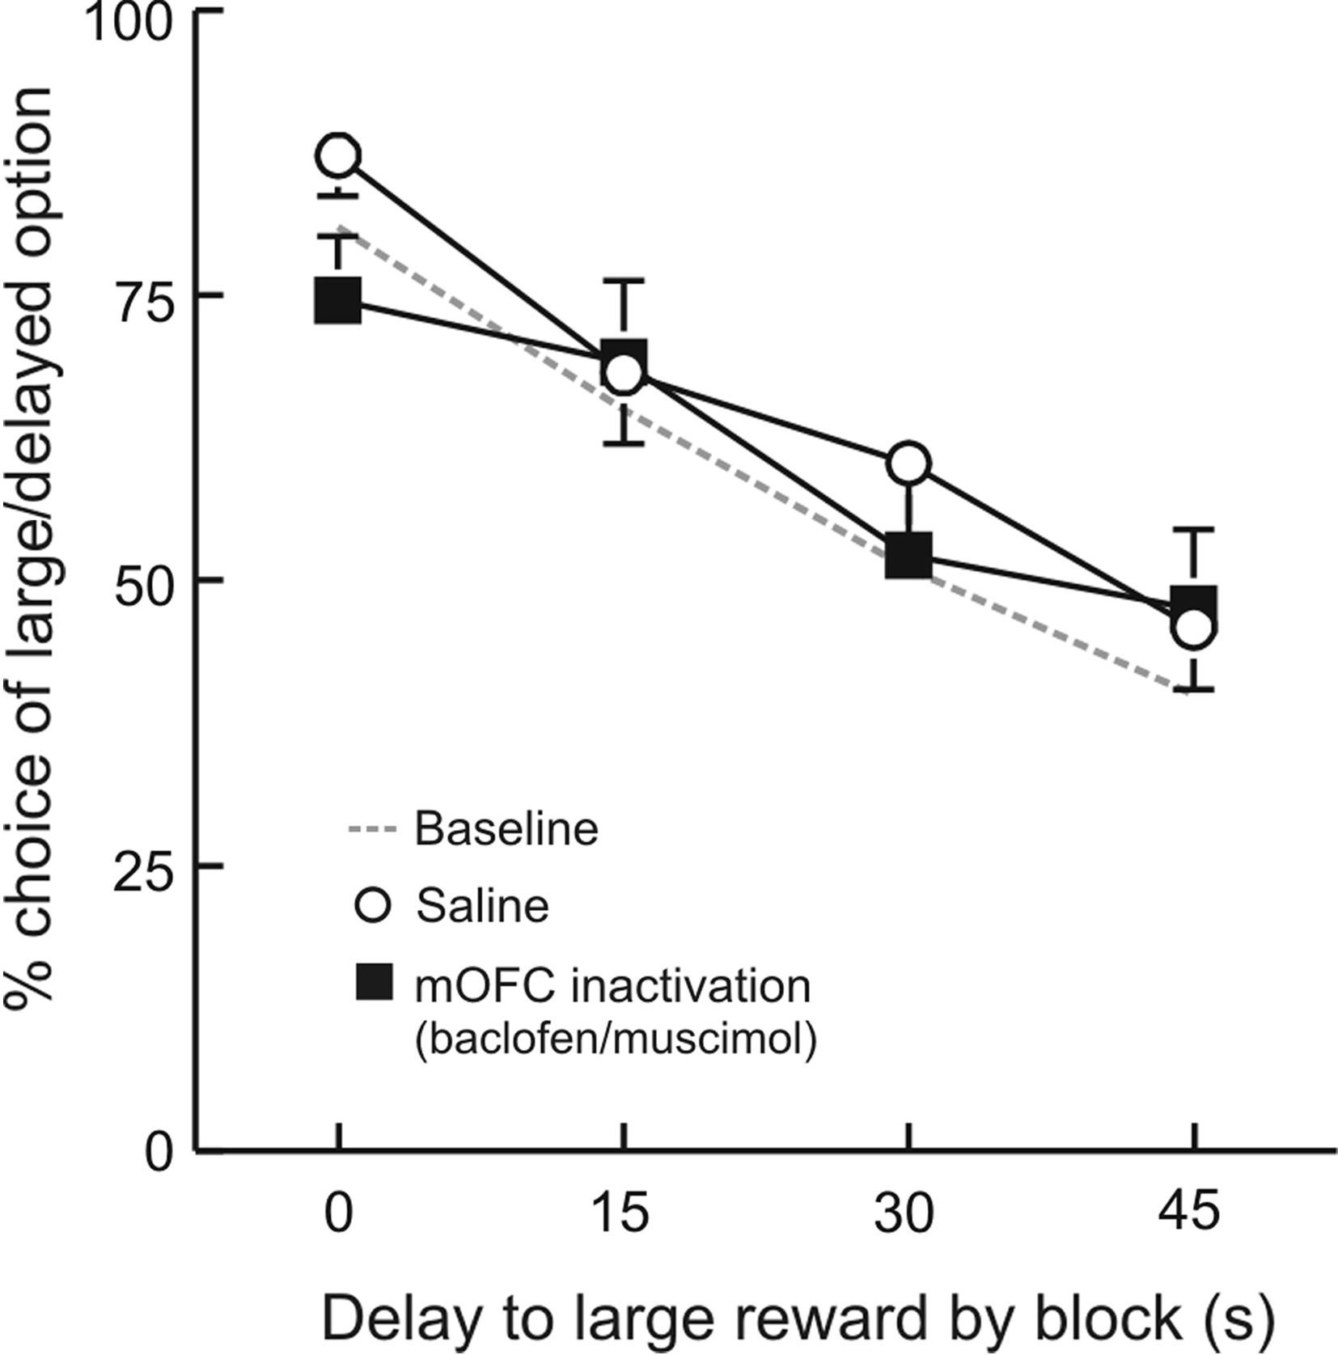
Figure 4. Inactivation of the mOFC does not affect delay discounting. Percentage choice of the large/delayed option on ...
Notes:
Figure 4. Inactivation of the mOFC does not affect delay discounting. Percentage choice of the large/delayed option on baseline training days, and following infusions of baclofen–muscimol or saline into the mOFC across 4 blocks of free-choice trials. Symbols represent mean + SEM.
Unless provided in the caption above, the following copyright applies to the content of this slide: © The Author 2012. Published by Oxford University Press. All rights reserved. For Permissions, please e-mail: journals.permissions@oup.com

