Slide 1
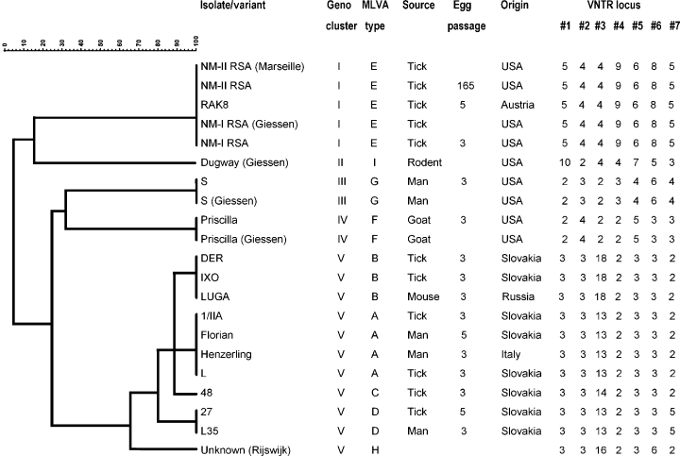
1 Multiple locus variable number tandem repeats analysis clustering of the Coxiella burnetii isolates and their ...
Notes:
1 Multiple locus variable number tandem repeats analysis clustering of the Coxiella burnetii isolates and their variants by the unweighted pair-group method with arithmetic mean categorical coefficient. For abbreviations, see Tables 1 and 2 or text.
Unless provided in the caption above, the following copyright applies to the content of this slide: © 2005 Federation of European Microbiological Societies

Slide 2
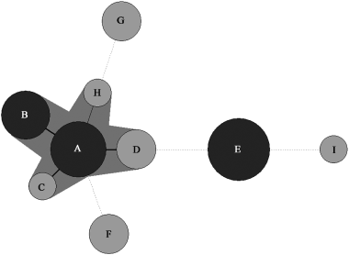
2 Multiple locus variable number tandem repeats analysis (MLVA) genotypes of the Coxiella burnetii isolates and ...
Notes:
2 Multiple locus variable number tandem repeats analysis (MLVA) genotypes of the Coxiella burnetii isolates and their variants using the minimal spanning tree graphing method. The gray circles represent one or two isolates/variants while the black ones represent three or more isolates/variants. The characters refer to the MLVA type. For abbreviations, see text.
Unless provided in the caption above, the following copyright applies to the content of this slide: © 2005 Federation of European Microbiological Societies

